Slide 1
This slide deck contains content created, reviewed, and approved by the American Diabetes Association® (ADA). You are free to use the slides in presentations without further permission as long as the slide content is not altered in any way and appropriate attribution is made to the ADA (the ADA's name and logo on the slides constitute appropriate attribution). Permission is required from the ADA for any commercial use or for reproduction in any print materials (contact permissions@diabetes.org).

Slide 2


Abridged for Primary Care Professionals
Published annually in Clinical Diabetes
Contains evidence-based recommendations most pertinent to primary care
Recommendations are substantively the same as in the complete Standards of Care
Access:
  Abridged Standards of Care —
  https://diabetesjournals.org/collection/2720/2025-Abridged-Standards-of-Care
  Complete Standards of Care and all supporting references —
  https://diabetesjournals.org/care/issue/48/Supplement_1

Slide 3
Improving Care and
Promoting Health in Populations
Section 1

Slide 4
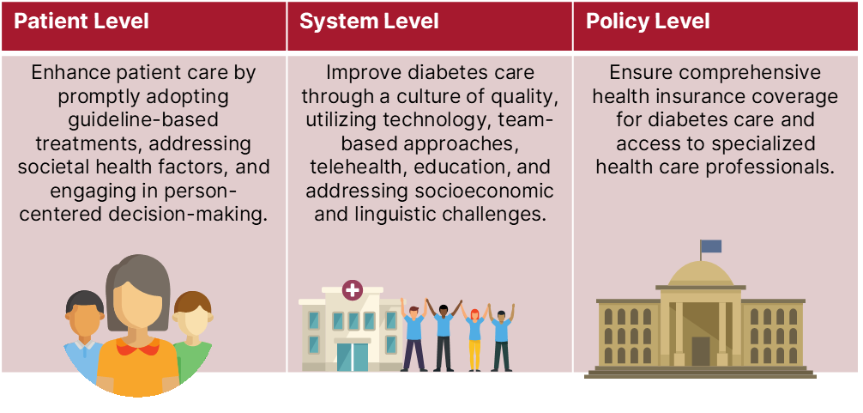
Section 1 | Abridged Standards of Care
Improving Care and Promoting Health in Populations
Population health is defined as “the health outcomes of a group of individuals, including the distribution of health outcomes within the group.” A multifaceted approach encompassing patient-level, system-level, and policy-level interventions is crucial for enhancing population health in the context of diabetes. This approach may include the following key elements.
American Diabetes Association Primary Care Advisory Group. 1. Improving care and promoting health in populations: Standards of Care in Diabetes—2025 Abridged for Primary Care. Clin Diabetes 2025;43:183 (doi: 10.2337/cd25-a001). ©2025 by the American Diabetes Association.

Slide 5
Diagnosis and Classification of Diabetes
Section 2

Slide 6
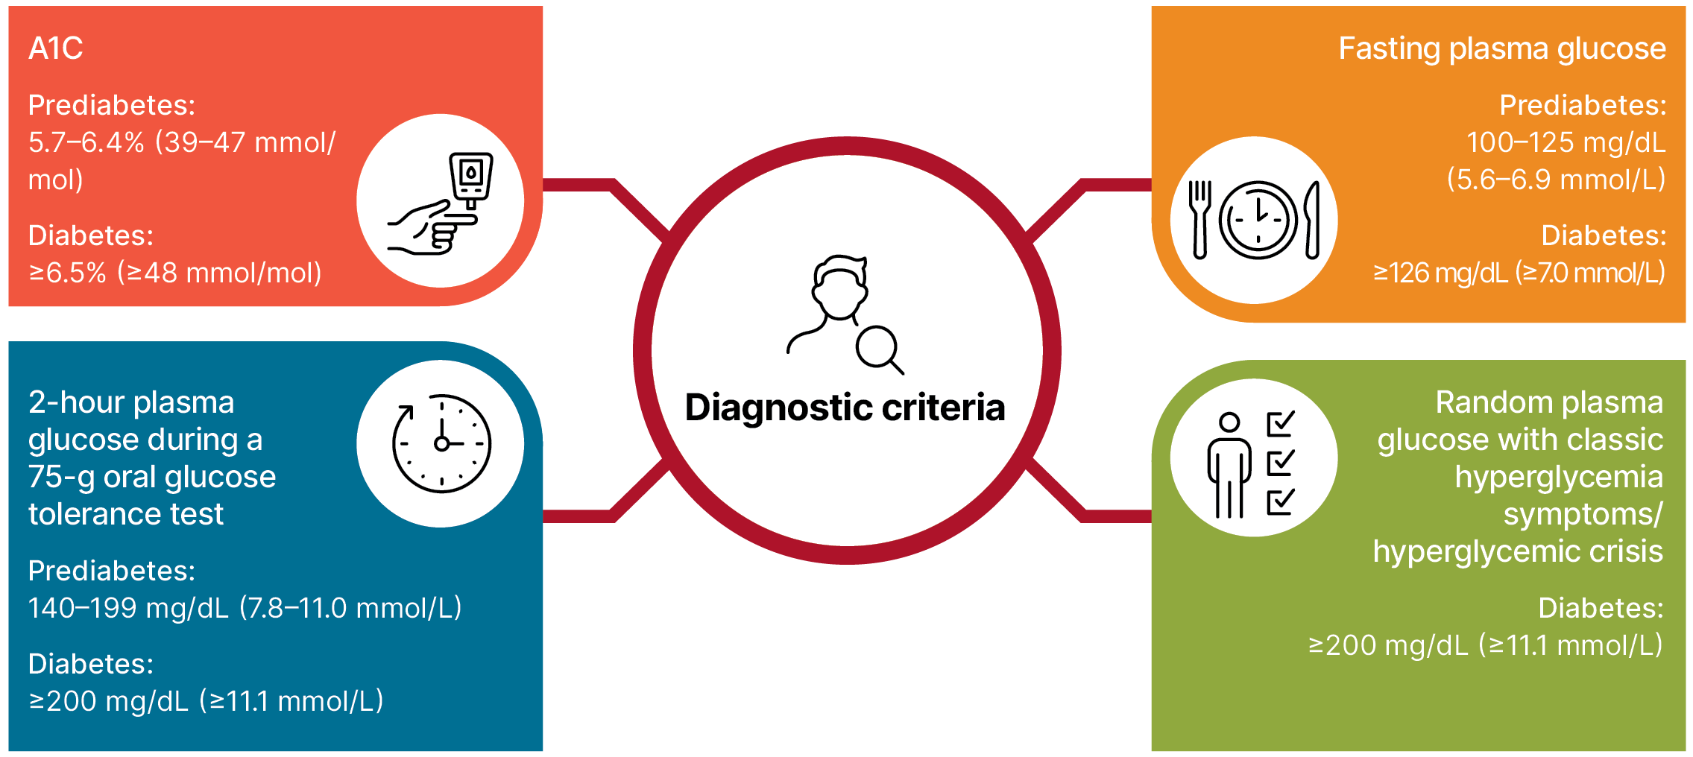
Section 2 | Abridged Standards of Care
Diagnostic Tests for Diabetes
American Diabetes Association Primary Care Advisory Group. 2. Diagnosis and classification of diabetes: Standards of Care in Diabetes—2025 Abridged for Primary Care. Clin Diabetes 2025;43:184–186 (doi: 10.2337/cd25-a002). ©2025 by the American Diabetes Association.

Slide 7
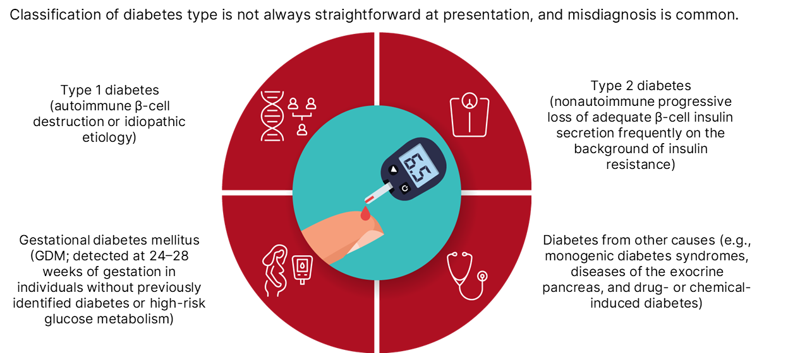
Section 2 | Abridged Standards of Care
Classification
American Diabetes Association Primary Care Advisory Group. 2. Diagnosis and classification of diabetes: Standards of Care in Diabetes—2025 Abridged for Primary Care. Clin Diabetes 2025;43:184–186 (doi: 10.2337/cd25-a002). ©2025 by the American Diabetes Association.

Slide 8
Section 2 | Abridged Standards of Care
Screening Criteria for Prediabetes and Type 2 Diabetes
Informal assessment of risk factors
Validated risk calculator
CLINICAL NOTES
If results are normal, repeat screening at least every 3 years (annually for those with prediabetes), or sooner with symptoms or changes in risk factors for diabetes.
American Diabetes Association Primary Care Advisory Group. 2. Diagnosis and classification of diabetes: Standards of Care in Diabetes—2025 Abridged for Primary Care. Clin Diabetes 2025;43:184–186 (doi: 10.2337/cd25-a002). ©2025 by the American Diabetes Association.

Slide 9
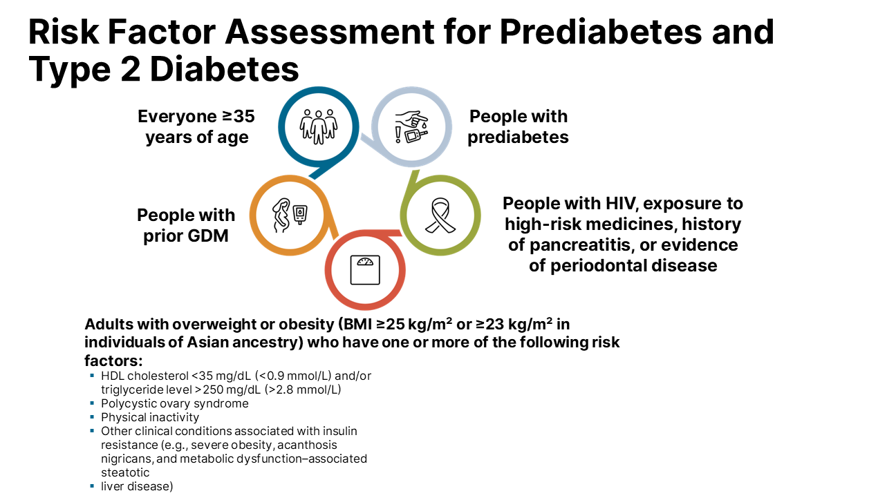
Section 2 | Abridged Standards of Care
American Diabetes Association Primary Care Advisory Group. 2. Diagnosis and classification of diabetes: Standards of Care in Diabetes—2025 Abridged for Primary Care. Clin Diabetes 2025;43:184–186 (doi: 10.2337/cd25-a002). ©2025 by the American Diabetes Association.

Slide 10
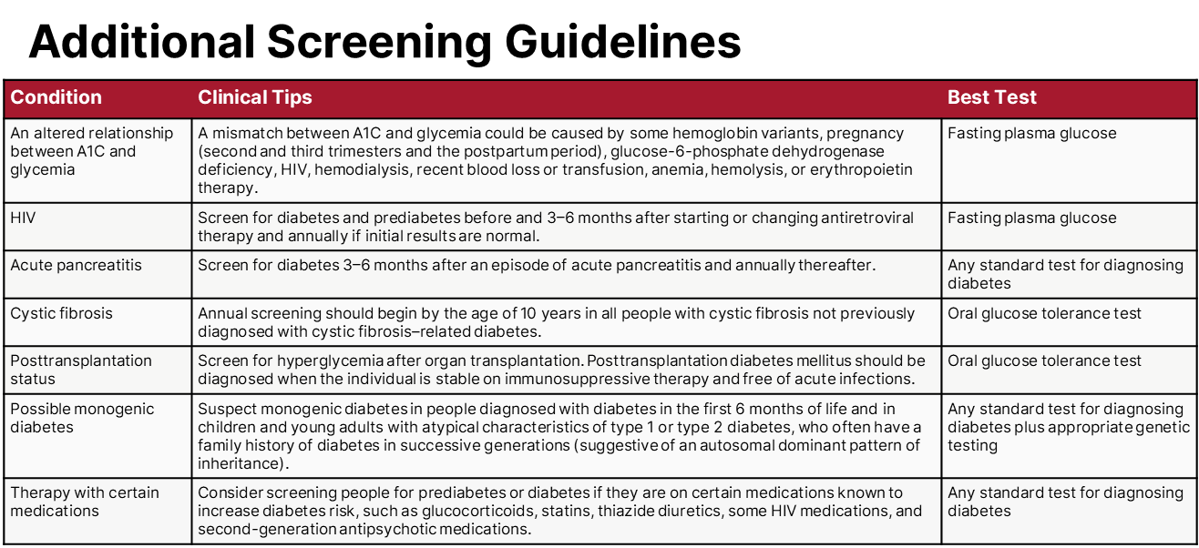
Section 2 | Abridged Standards of Care
American Diabetes Association Primary Care Advisory Group. 2. Diagnosis and classification of diabetes: Standards of Care in Diabetes—2025 Abridged for Primary Care. Clin Diabetes 2025;43:184–186 (doi: 10.2337/cd25-a002). ©2025 by the American Diabetes Association.

Slide 11
Prevention or Delay of Diabetes and
Associated Comorbidities
Section 3

Slide 12
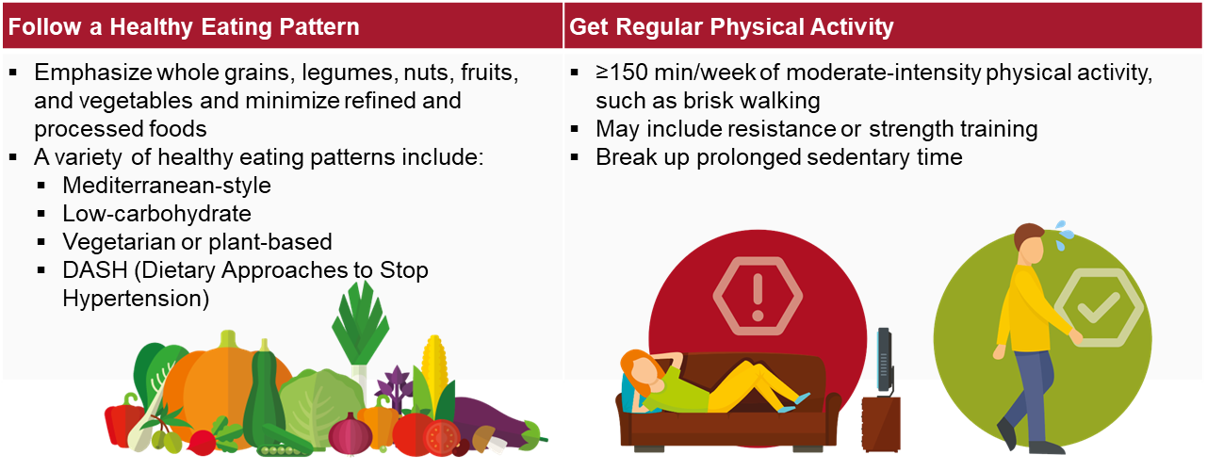
Section 3 | Abridged Standards of Care
Nutrition and Physical Activity Recommendations for Adults at Risk for Type 2 Diabetes
American Diabetes Association Primary Care Advisory Group. 3. Prevention or delay of diabetes and associated comorbidities: Standards of Care in Diabetes—2025 Abridged for Primary Care. Clin Diabetes 2025;43:187–189 (doi: 10.2337/cd25-a003). ©2025 by the American Diabetes Association.

Slide 13
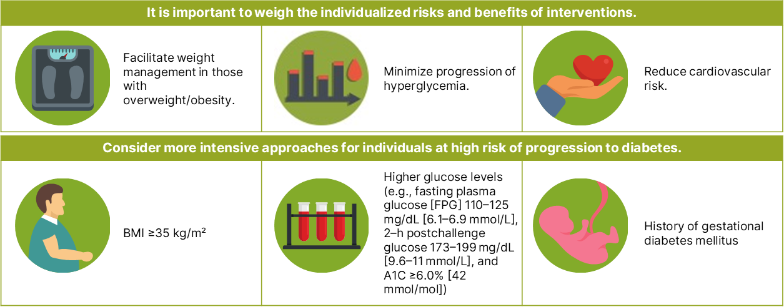
Section 3 | Abridged Standards of Care
Person-Centered Care Goals for
Individuals at Risk of Type 2 Diabetes
American Diabetes Association Primary Care Advisory Group. 3. Prevention or delay of diabetes and associated comorbidities: Standards of Care in Diabetes—2025 Abridged for Primary Care. Clin Diabetes 2025;43:187–189 (doi: 10.2337/cd25-a003). ©2025 by the American Diabetes Association.

Slide 14

Section 3 | Abridged Standards of Care
What medications can be prescribed to adults to prevent type 2 diabetes?
The U.S. Food and Drug Administration has not approved any drugs for diabetes prevention.
Metformin has the strongest evidence base for diabetes prevention.
Who should be considered for metformin therapy to prevent type 2 diabetes?
Adults aged 25–59 years with a BMI ≥35 kg/m²
Individuals with higher fasting plasma glucose (e.g., ≥110 mg/dL [≥ 6 mmol/L])
Those with higher A1C (e.g., ≥6.0% [≥42 mmol/mol])
Individuals with a history of gestational diabetes mellitus
What parameters should be monitoring in people on metformin therapy?
Vitamin B12 should be measured periodically, especially in those with anemia or peripheral neuropathy.
American Diabetes Association Primary Care Advisory Group. 3. Prevention or delay of diabetes and associated comorbidities: Standards of Care in Diabetes—2025 Abridged for Primary Care. Clin Diabetes 2025;43:187–189 (doi: 10.2337/cd25-a003). ©2025 by the American Diabetes Association.

Slide 15
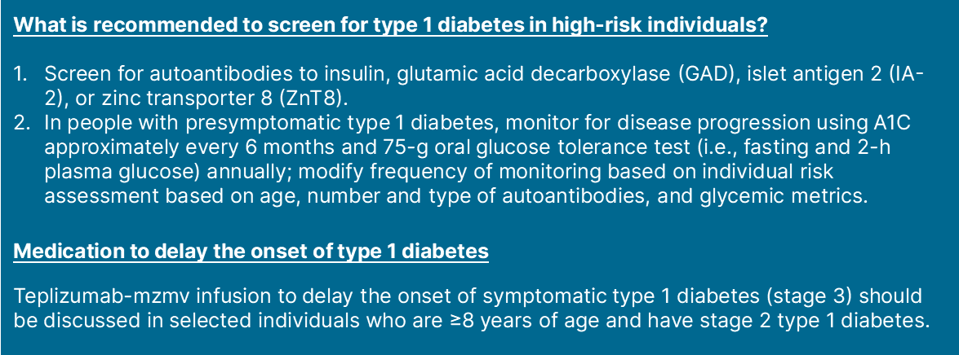
Section 3 | Abridged Standards of Care
Prevention of Type 1 Diabetes
American Diabetes Association Primary Care Advisory Group. 3. Prevention or delay of diabetes and associated comorbidities: Standards of Care in Diabetes—2025 Abridged for Primary Care. Clin Diabetes 2025;43:187–189 (doi: 10.2337/cd25-a003). ©2025 by the American Diabetes Association.

Slide 16
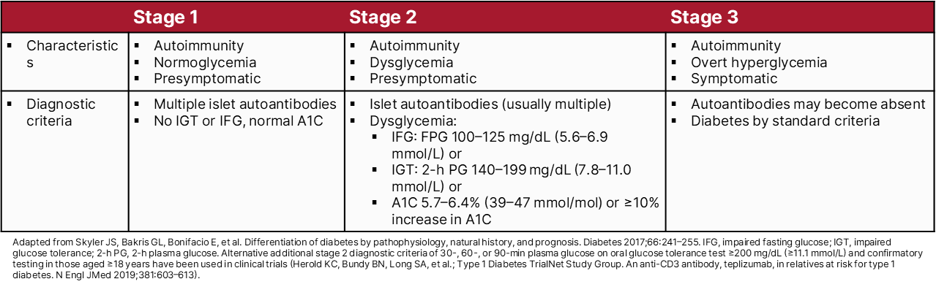
Section 3 | Abridged Standards of Care
Staging of Type 1 Diabetes
American Diabetes Association Primary Care Advisory Group. 3. Prevention or delay of diabetes and associated comorbidities: Standards of Care in Diabetes—2025 Abridged for Primary Care. Clin Diabetes 2025;43:187–189 (doi: 10.2337/cd25-a003). ©2025 by the American Diabetes Association.

Slide 17
Comprehensive Medical Evaluation and Assessment of Comorbidities
Section 4

Slide 18
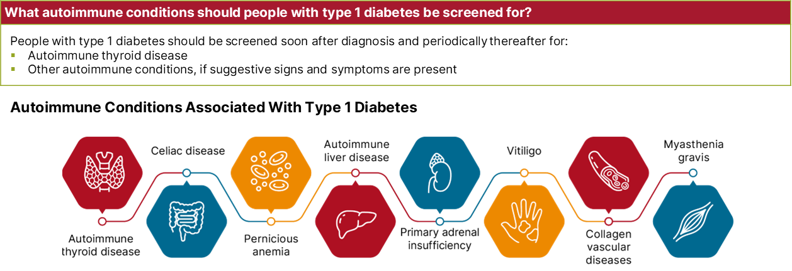
Section 4 | Abridged Standards of Care
Assessment of Comorbidities
American Diabetes Association Primary Care Advisory Group. 4. Comprehensive medical evaluation and assessment of comorbidities: Standards of Care in Diabetes—2025 Abridged for Primary Care. Clin Diabetes 2025;43:190–193 (doi: 10.2337/cd25-a004). ©2025 by the American Diabetes Association.

Slide 19
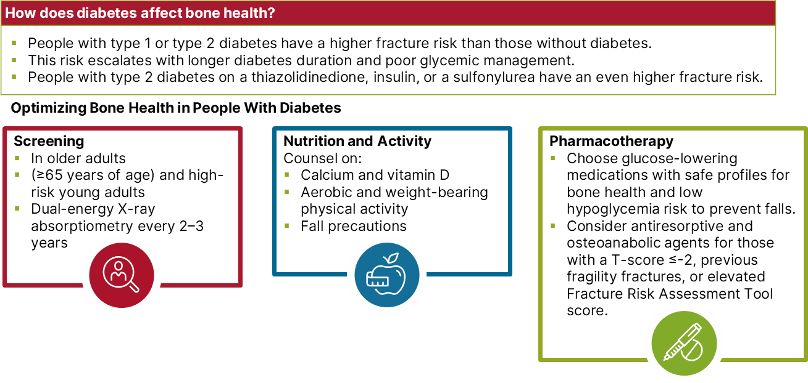
Section 4 | Abridged Standards of Care
American Diabetes Association Primary Care Advisory Group. 4. Comprehensive medical evaluation and assessment of comorbidities: Standards of Care in Diabetes—2025 Abridged for Primary Care. Clin Diabetes 2025;43:190–193 (doi: 10.2337/cd25-a004). ©2025 by the American Diabetes Association.

Slide 20
Section 4 | Abridged Standards of Care
American Diabetes Association Primary Care Advisory Group. 4. Comprehensive medical evaluation and assessment of comorbidities: Standards of Care in Diabetes—2025 Abridged for Primary Care. Clin Diabetes 2025;43:190–193 (doi: 10.2337/cd25-a004). ©2025 by the American Diabetes Association.

Slide 21
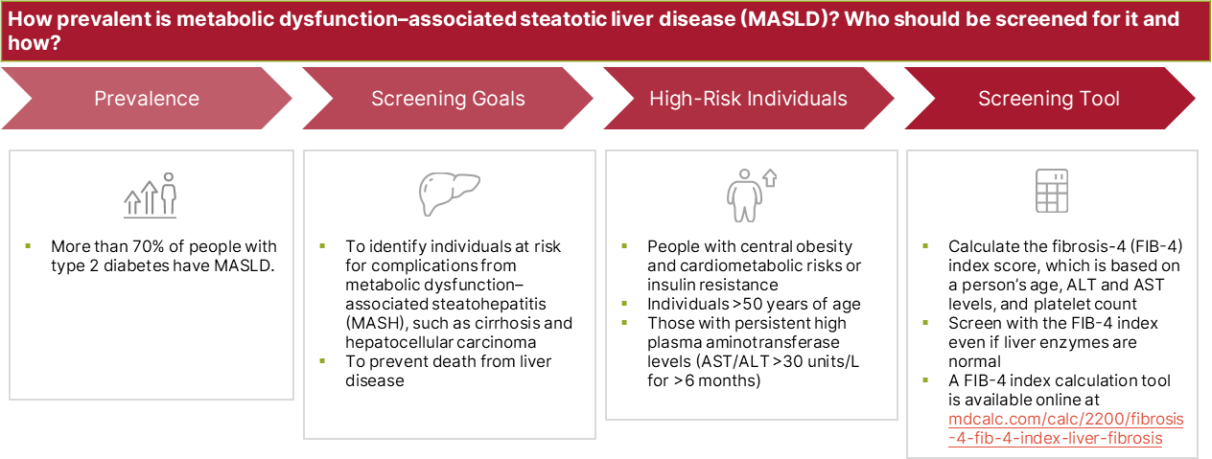
Section 4 | Abridged Standards of Care
American Diabetes Association Primary Care Advisory Group. 4. Comprehensive medical evaluation and assessment of comorbidities: Standards of Care in Diabetes—2025 Abridged for Primary Care. Clin Diabetes 2025;43:190–193 (doi: 10.2337/cd25-a004). ©2025 by the American Diabetes Association.

Slide 22
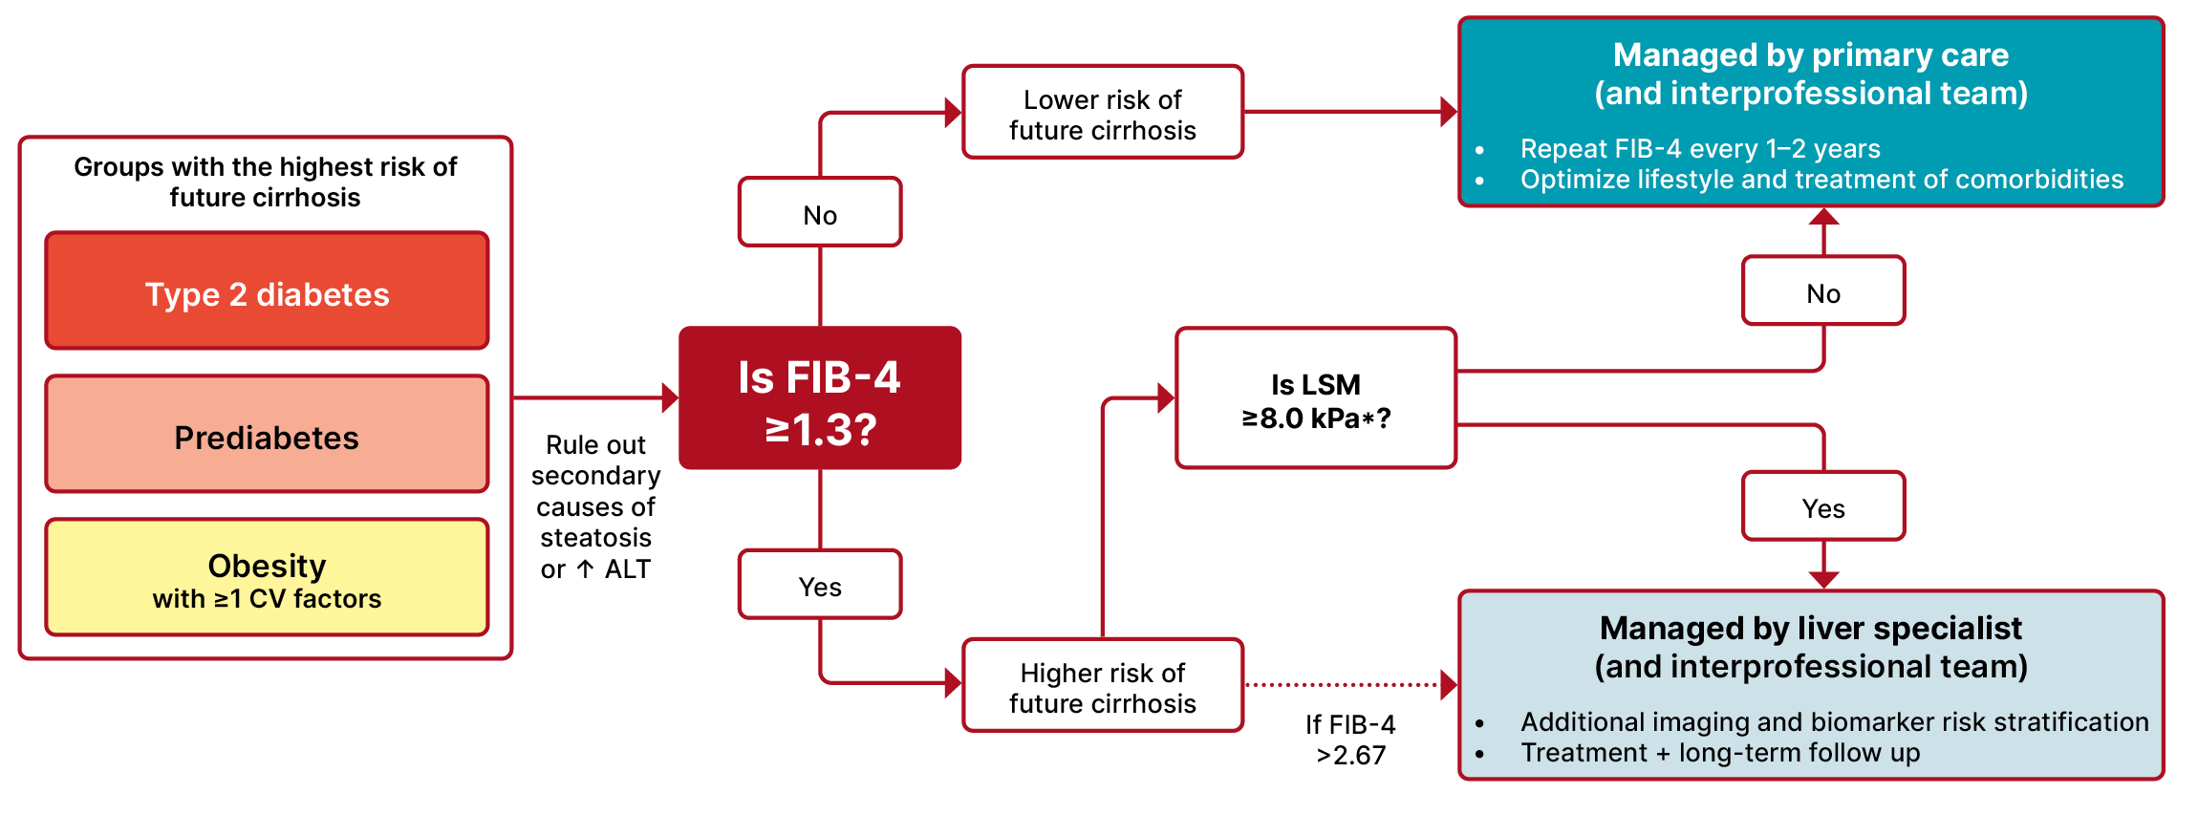
Section 4 | Abridged Standards of Care
Diagnostic Algorithm for the Prevention of
Cirrhosis in People With MASLD
CV, cardiovascular; ELF, enhanced liver fibrosis test; LSM, liver stiffness measurement, as measured by vibration-controlled transient elastography.
*In the absence of LSM, consider ELF a diagnostic alternative. If ELF ≥9.8, an individual is at high risk of MASLD with advanced liver fibrosis (≥F3–F4) and should be referred to a liver specialist.
American Diabetes Association Primary Care Advisory Group. 4. Comprehensive medical evaluation and assessment of comorbidities: Standards of Care in Diabetes—2025 Abridged for Primary Care. Clin Diabetes 2025;43:190–193 (doi: 10.2337/cd25-a004). ©2025 by the American Diabetes Association.

Slide 23
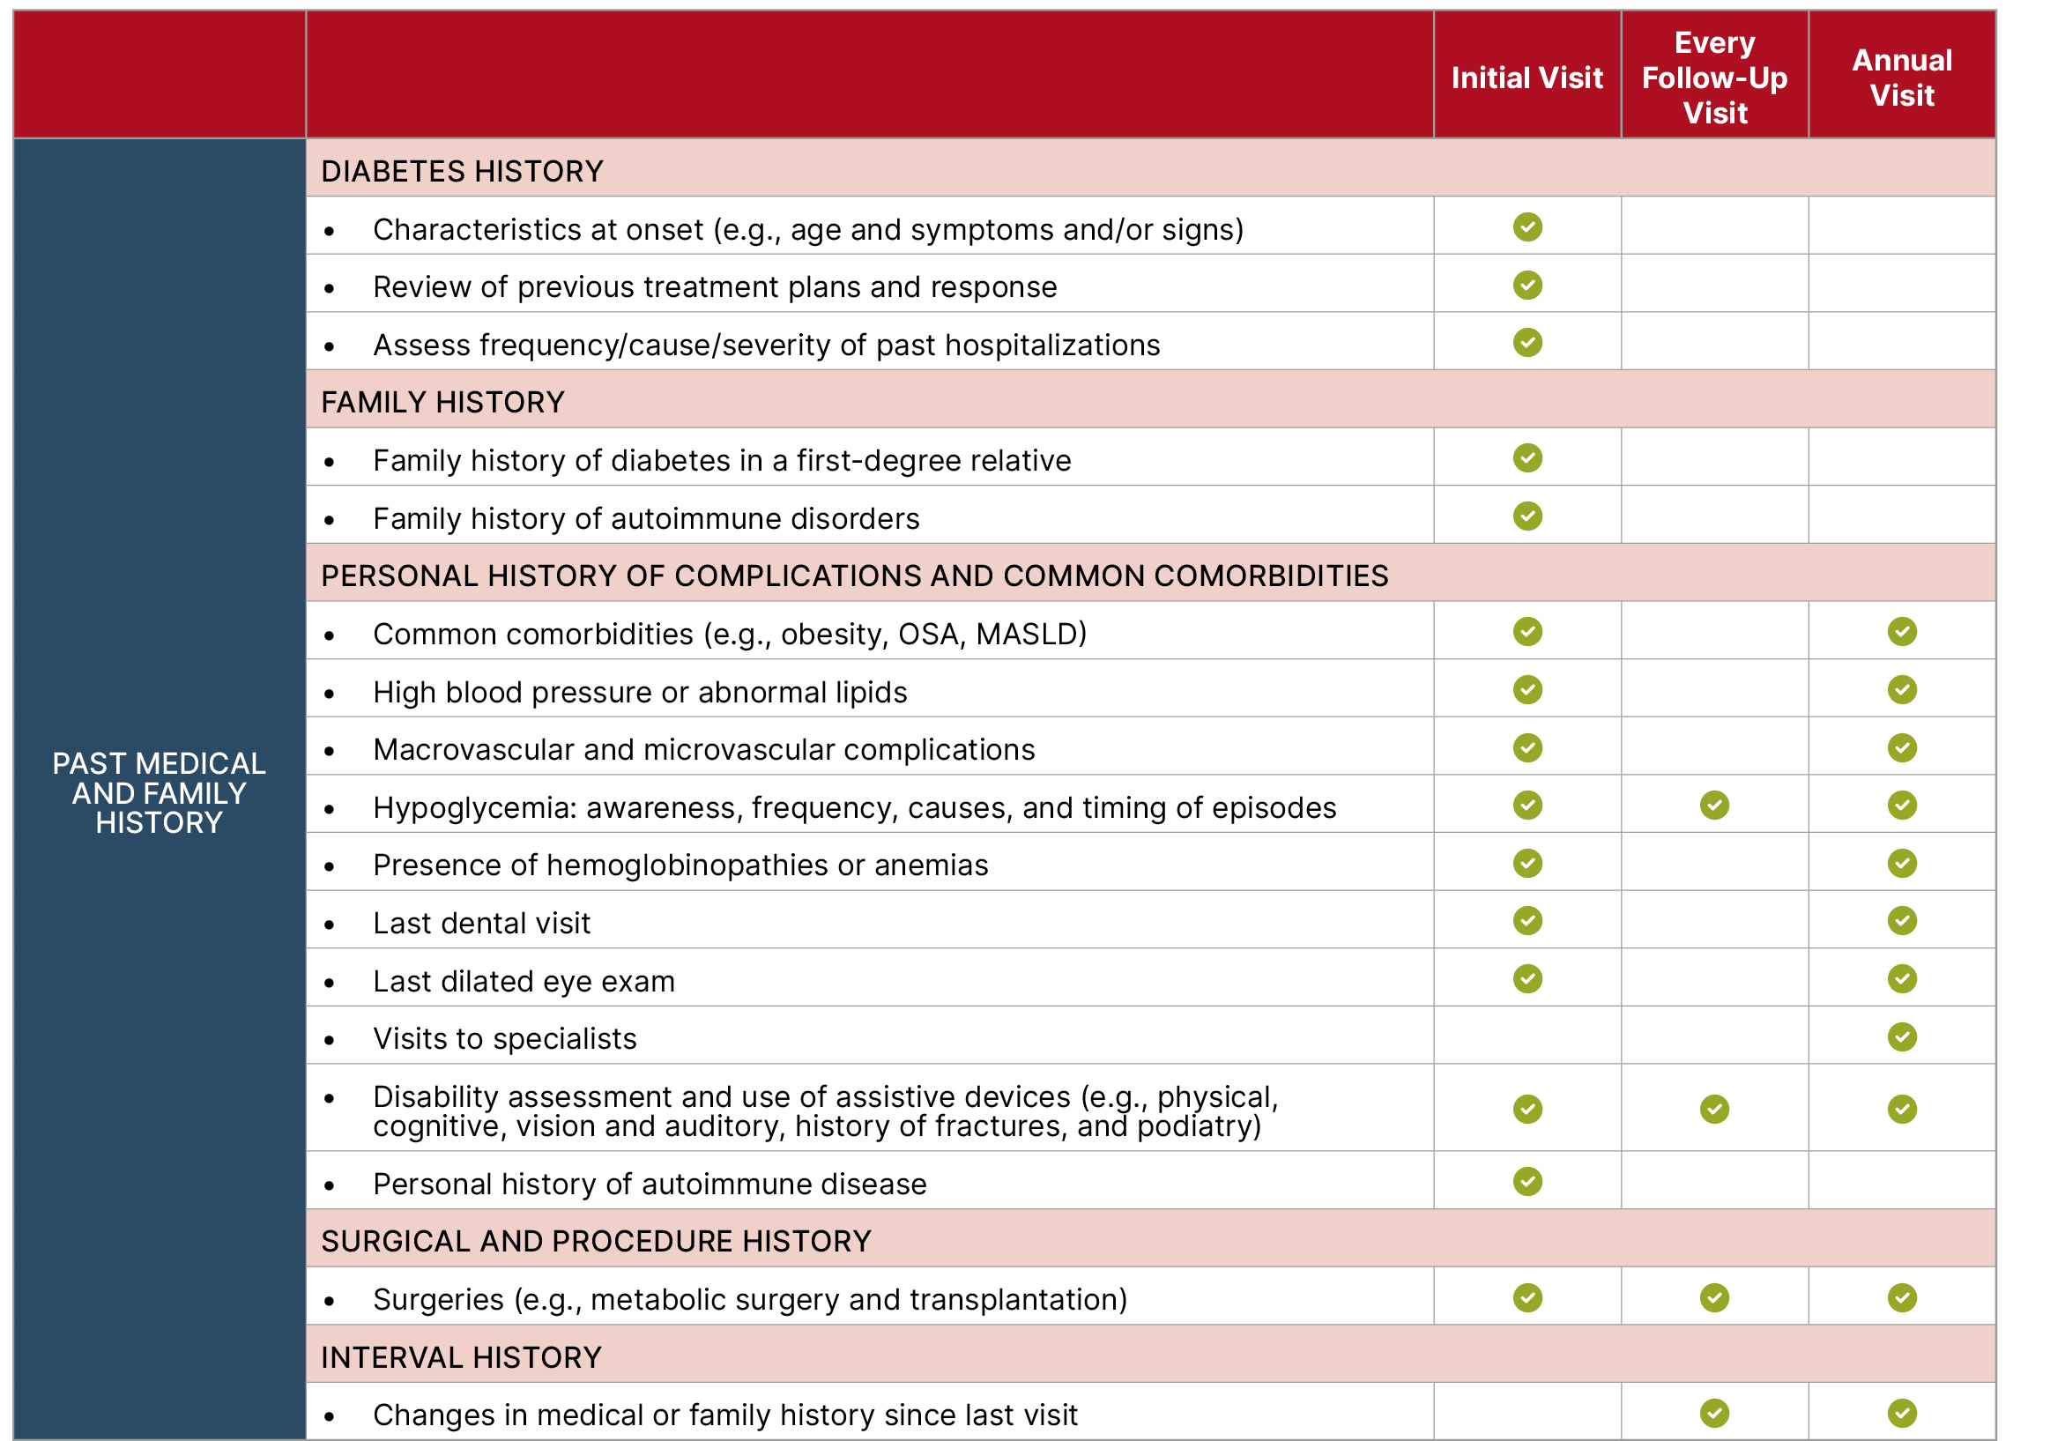
Section 4 | Abridged Standards of Care
Components of the Comprehensive Diabetes Medical Evaluation at Initial, Follow-Up, and Annual Visits
American Diabetes Association Primary Care Advisory Group. 4. Comprehensive medical evaluation and assessment of comorbidities: Standards of Care in Diabetes—2025 Abridged for Primary Care. Clin Diabetes 2025;43:190–193 (doi: 10.2337/cd25-a004). ©2025 by the American Diabetes Association.

Slide 24
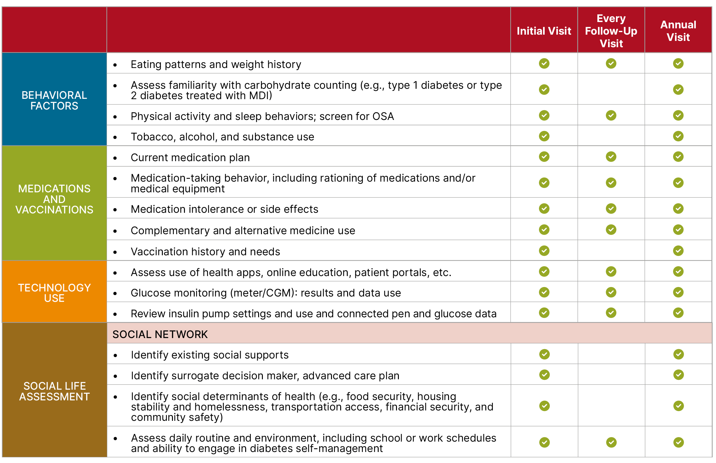
Section 4 | Abridged Standards of Care
Components of the Comprehensive Diabetes Medical Evaluation at Initial, Follow-Up, and Annual Visits
American Diabetes Association Primary Care Advisory Group. 4. Comprehensive medical evaluation and assessment of comorbidities: Standards of Care in Diabetes—2025 Abridged for Primary Care. Clin Diabetes 2025;43:190–193 (doi: 10.2337/cd25-a004). ©2025 by the American Diabetes Association.

Slide 25
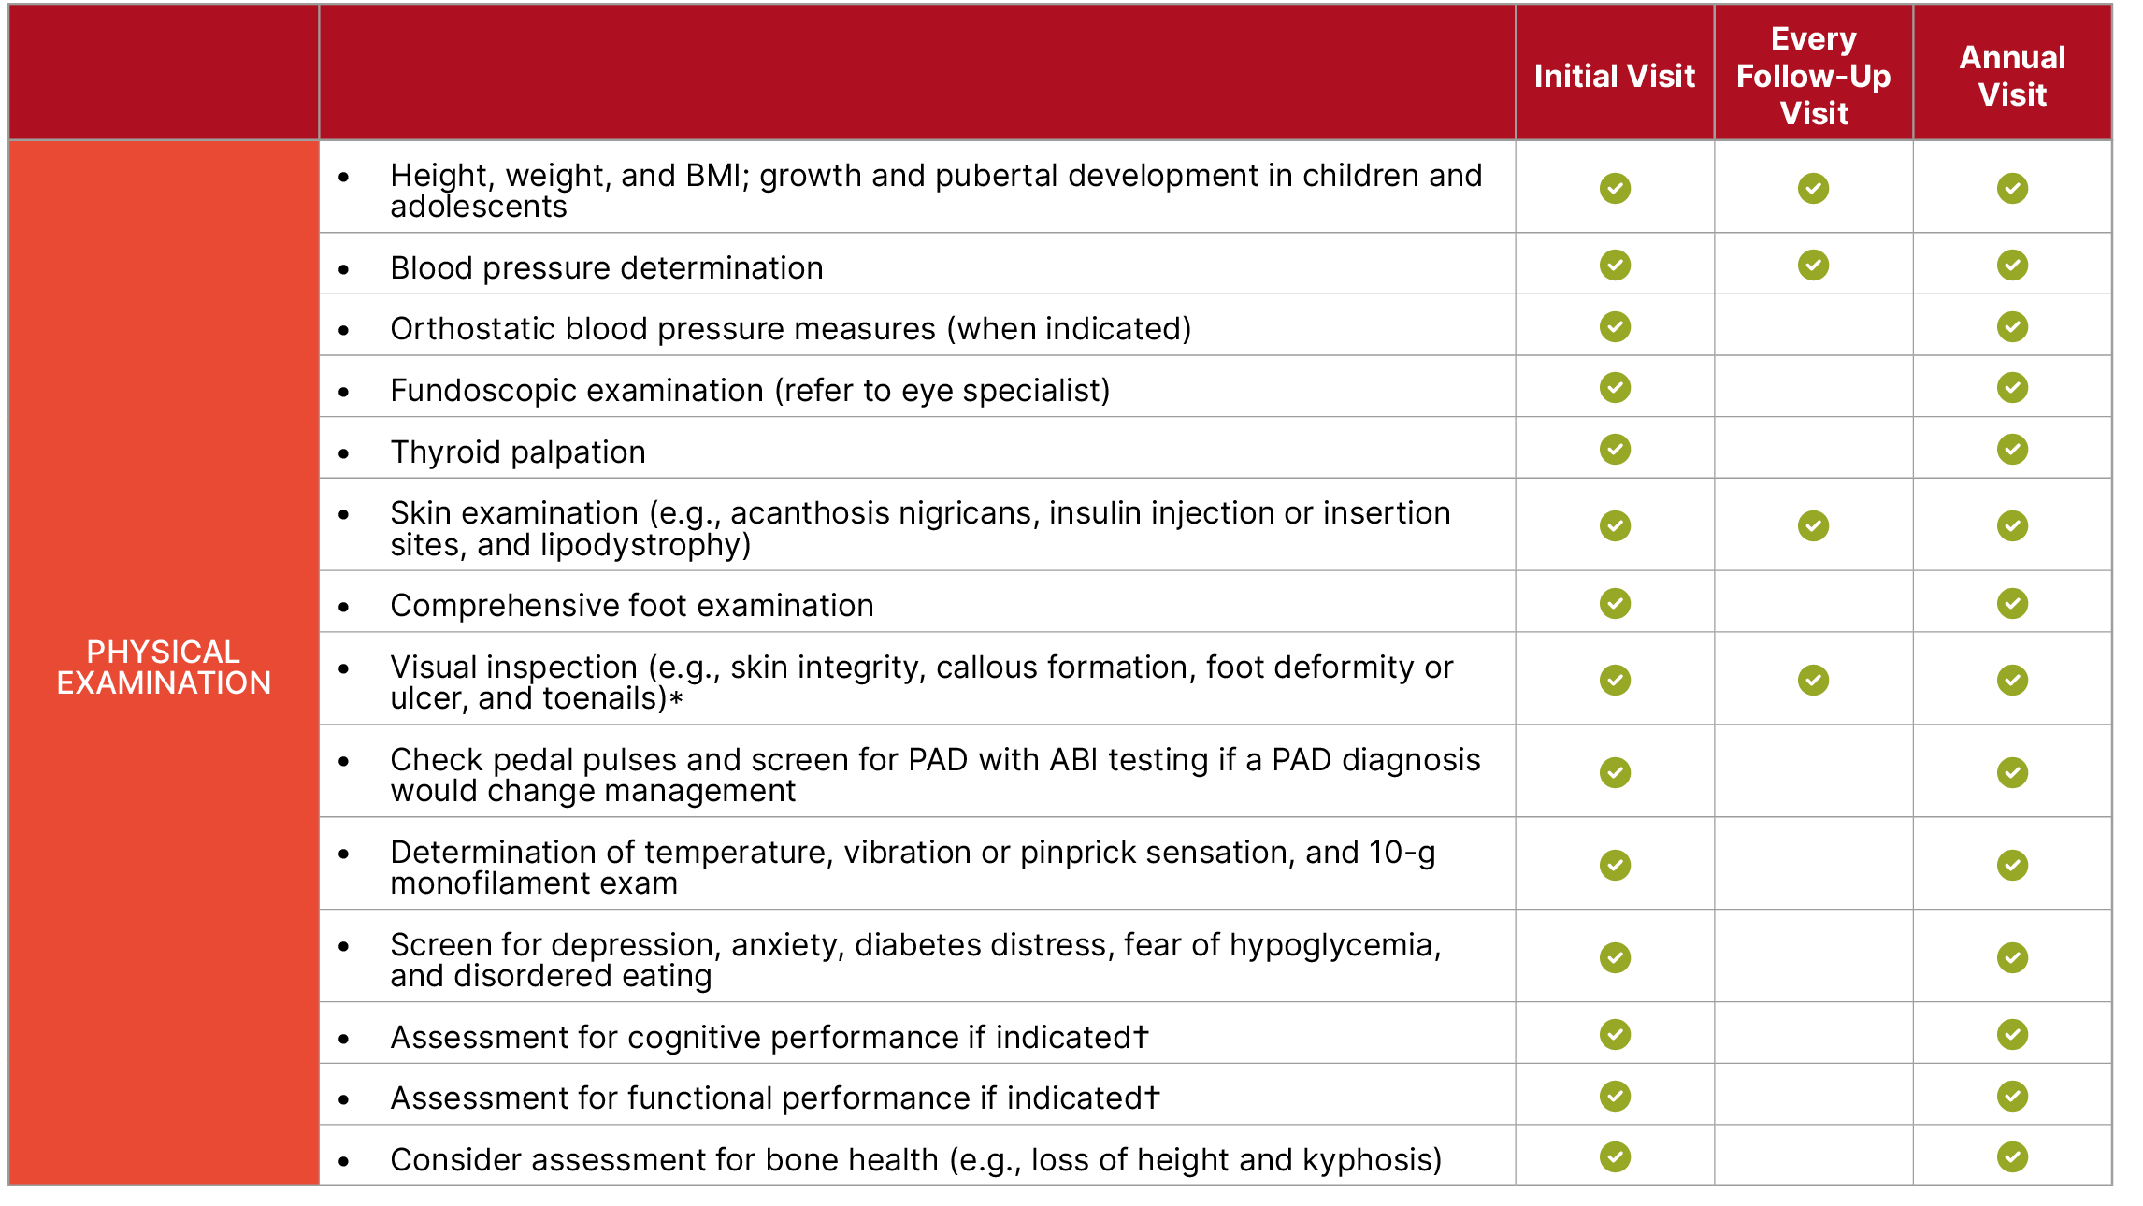
Section 4 | Abridged Standards of Care
Components of the Comprehensive Diabetes Medical Evaluation at Initial, Follow-Up, and Annual Visits
American Diabetes Association Primary Care Advisory Group. 4. Comprehensive medical evaluation and assessment of comorbidities: Standards of Care in Diabetes—2025 Abridged for Primary Care. Clin Diabetes 2025;43:190–193 (doi: 10.2337/cd25-a004). ©2025 by the American Diabetes Association.

Slide 26
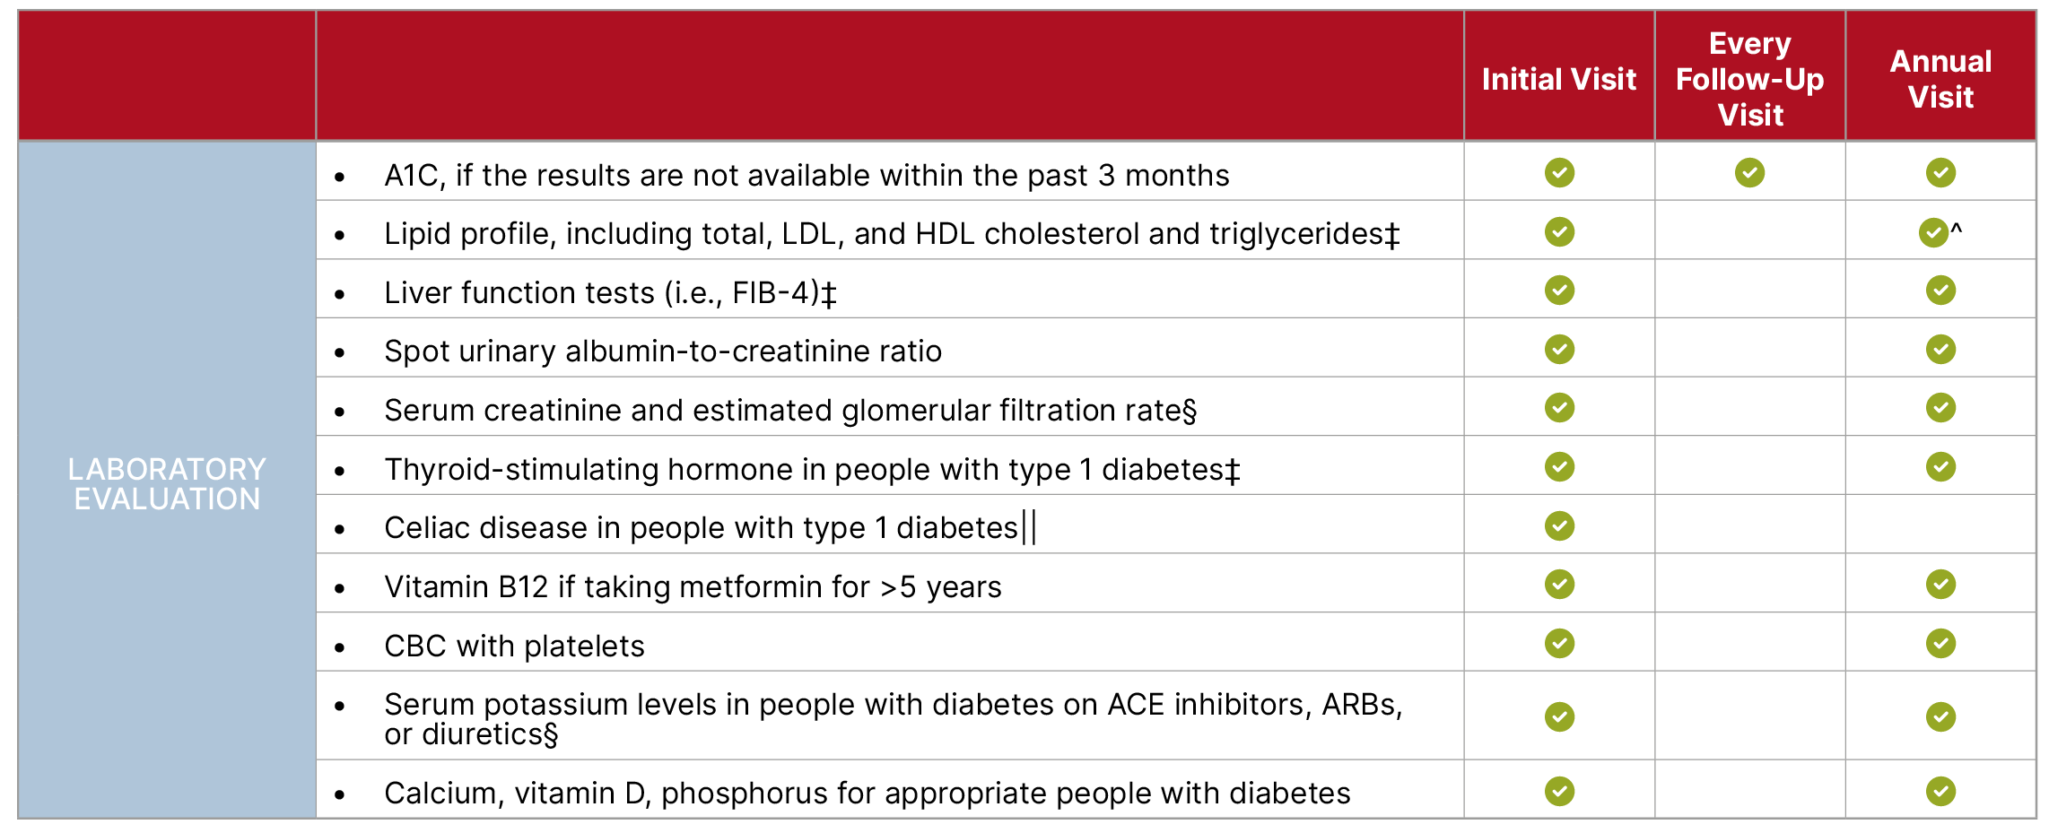
Section 4 | Abridged Standards of Care
Components of the Comprehensive Diabetes Medical Evaluation at Initial, Follow-Up, and Annual Visits
American Diabetes Association Primary Care Advisory Group. 4. Comprehensive medical evaluation and assessment of comorbidities: Standards of Care in Diabetes—2025 Abridged for Primary Care. Clin Diabetes 2025;43:190–193 (doi: 10.2337/cd25-a004). ©2025 by the American Diabetes Association.

Slide 27
Facilitating Positive Health Behaviors and
Well-Being to Improve Health Outcomes
Section 5

Slide 28
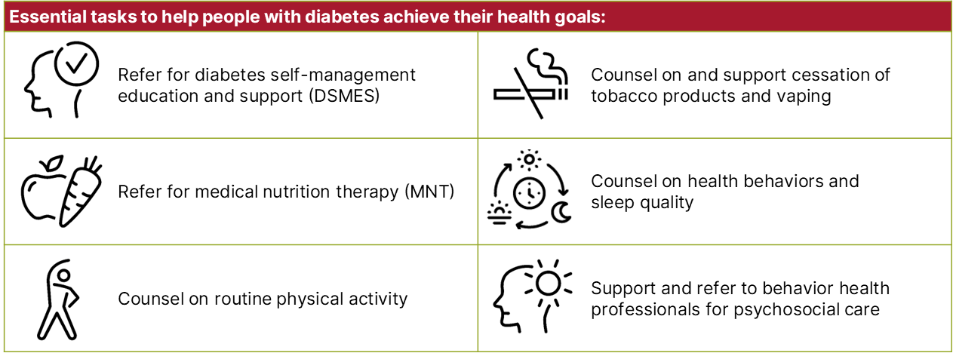
Section 5 | Abridged Standards of Care
Building positive health behaviors and maintaining psychological well-being are foundational for achieving diabetes management goals and maximizing quality of life.
American Diabetes Association Primary Care Advisory Group. 5. Facilitating positive health behaviors and well-being to improve health outcomes: Standards of Care in Diabetes—2025 Abridged for Primary Care. Clin Diabetes 2025;43:194–197 (doi: 10.2337/cd25-a005). ©2025 by the American Diabetes Association.

Slide 29
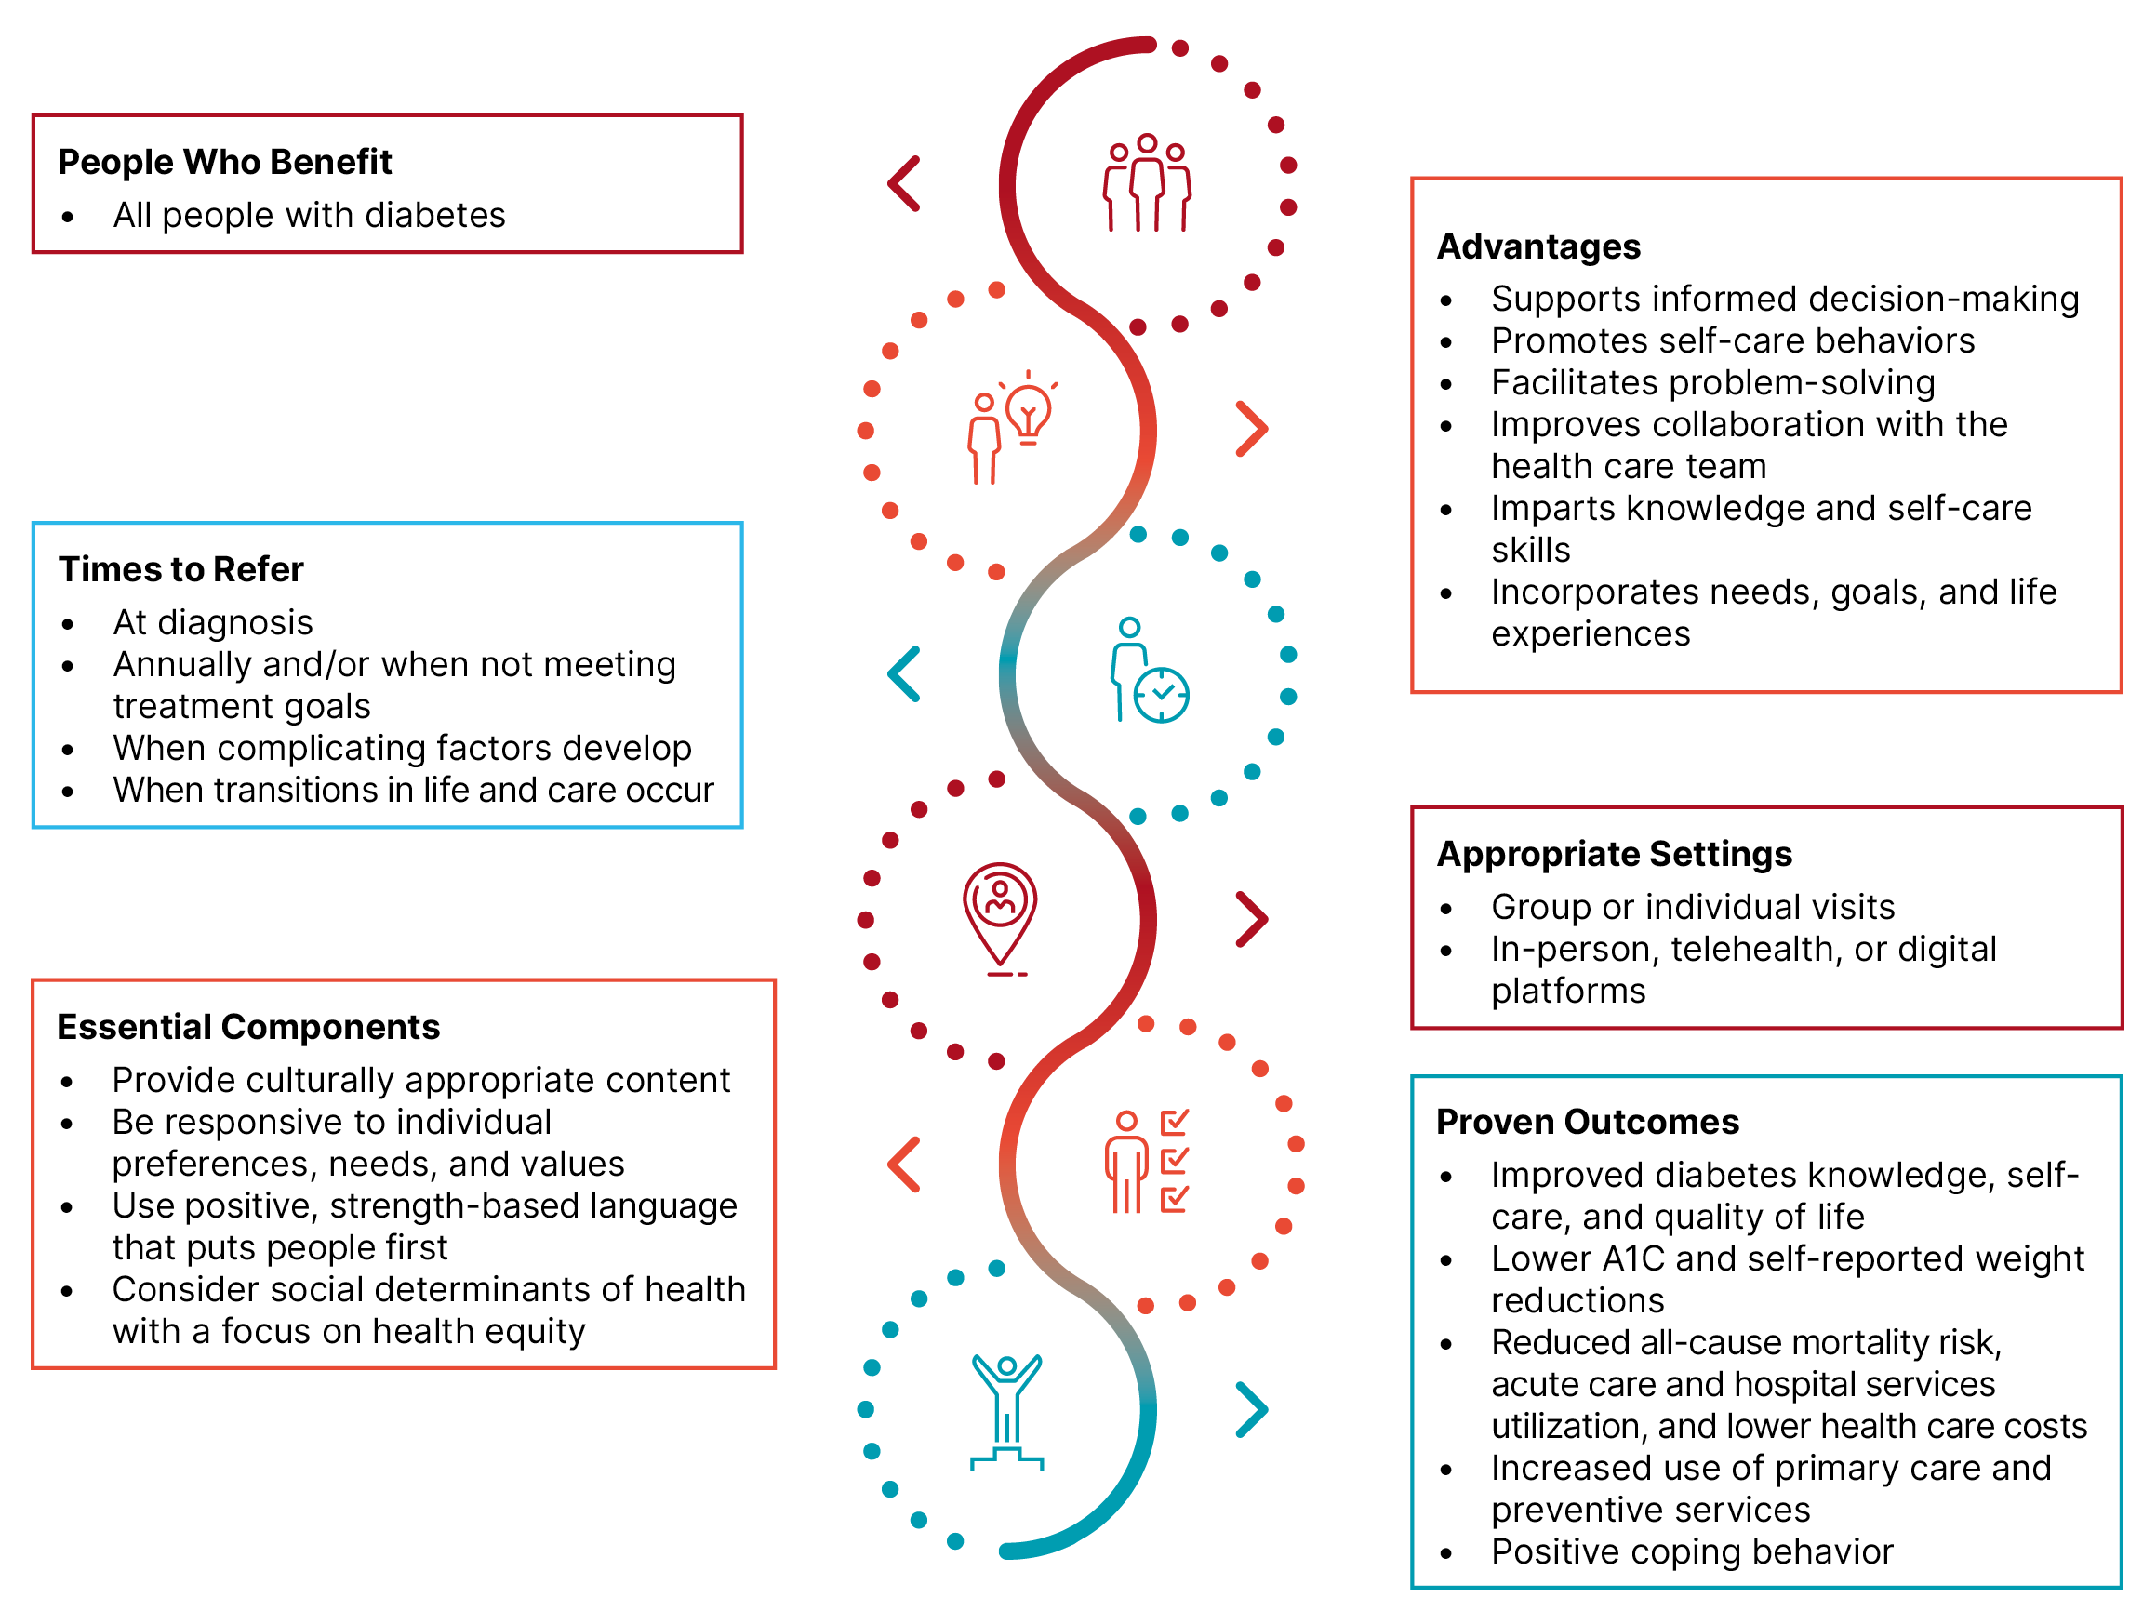
Section 5 | Abridged Standards of Care
DSMES Is Critical
American Diabetes Association Primary Care Advisory Group. 5. Facilitating positive health behaviors and well-being to improve health outcomes: Standards of Care in Diabetes—2025 Abridged for Primary Care. Clin Diabetes 2025;43:194–197 (doi: 10.2337/cd25-a005). ©2025 by the American Diabetes Association.

Slide 30
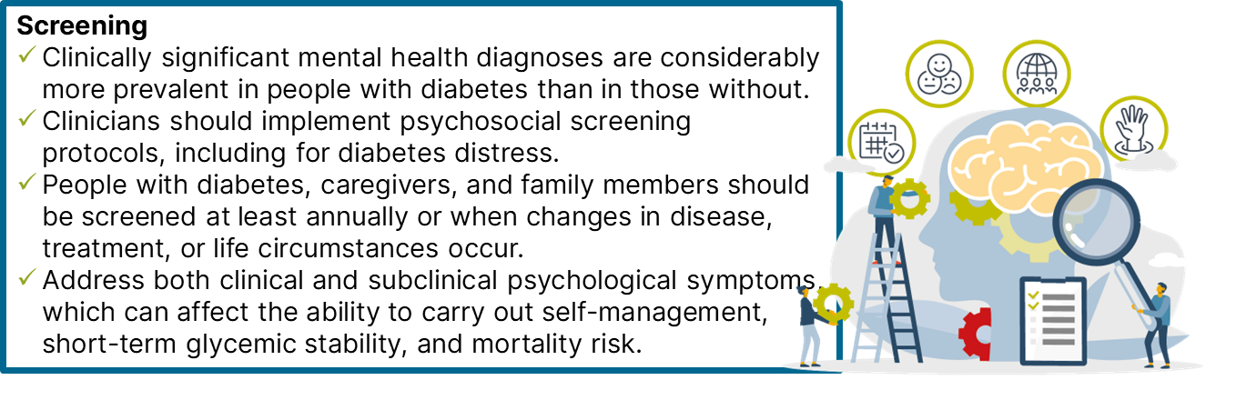
Section 5 | Abridged Standards of Care
Psychosocial Care for All People With Diabetes:
Considerations and Recommendations
Resources are available to help health care professionals support behavioral and mental health in people with diabetes. Find them at https://professional.diabetes.org/meetings/behavioral-health-toolkit.
American Diabetes Association Primary Care Advisory Group. 5. Facilitating positive health behaviors and well-being to improve health outcomes: Standards of Care in Diabetes—2025 Abridged for Primary Care. Clin Diabetes 2025;43:194–197 (doi: 10.2337/cd25-a005). ©2025 by the American Diabetes Association.

Slide 31
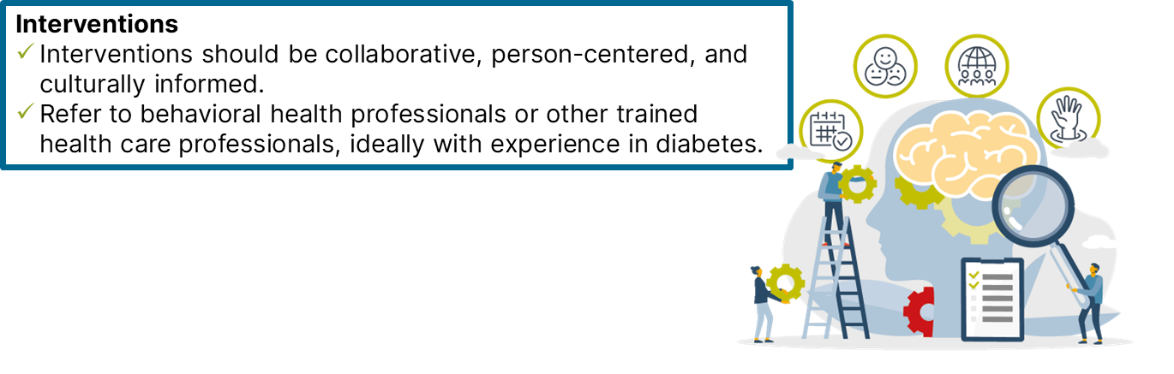
Section 5 | Abridged Standards of Care
Psychosocial Care for All People With Diabetes:
Considerations and Recommendations
Resources are available to help health care professionals support behavioral and mental health in people with diabetes. Find them at https://professional.diabetes.org/meetings/behavioral-health-toolkit.
American Diabetes Association Primary Care Advisory Group. 5. Facilitating positive health behaviors and well-being to improve health outcomes: Standards of Care in Diabetes—2025 Abridged for Primary Care. Clin Diabetes 2025;43:194–197 (doi: 10.2337/cd25-a005). ©2025 by the American Diabetes Association.

Slide 32
Section 5 | Abridged Standards of Care
Diabetes Distress
The ongoing demands of diabetes self-care and the potential or actual disease progression are directly linked to reports of diabetes distress.
High levels of distress:
Significantly affect medication-taking behaviors
Are linked to higher A1C, lower self-efficacy, and less-optimal eating and exercise behaviors
American Diabetes Association Primary Care Advisory Group. 5. Facilitating positive health behaviors and well-being to improve health outcomes: Standards of Care in Diabetes—2025 Abridged for Primary Care. Clin Diabetes 2025;43:194–197 (doi: 10.2337/cd25-a005). ©2025 by the American Diabetes Association.

Slide 33
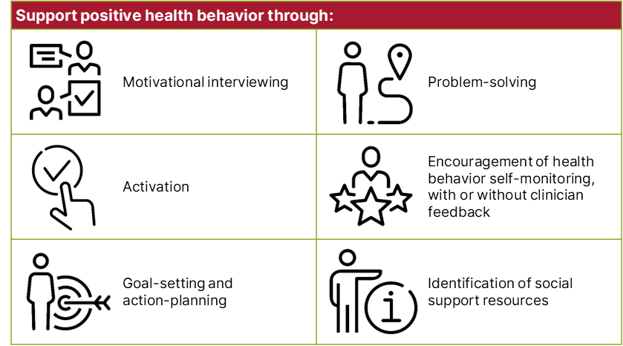
Section 5 | Abridged Standards of Care
American Diabetes Association Primary Care Advisory Group. 5. Facilitating positive health behaviors and well-being to improve health outcomes: Standards of Care in Diabetes—2025 Abridged for Primary Care. Clin Diabetes 2025;43:194–197 (doi: 10.2337/cd25-a005). ©2025 by the American Diabetes Association.

Slide 34
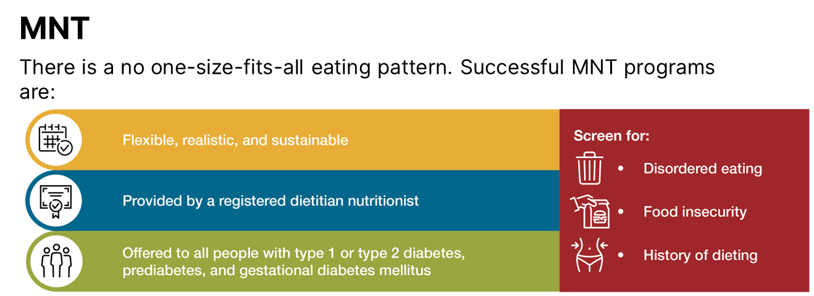
Section 5 | Abridged Standards of Care
American Diabetes Association Primary Care Advisory Group. 5. Facilitating positive health behaviors and well-being to improve health outcomes: Standards of Care in Diabetes—2025 Abridged for Primary Care. Clin Diabetes 2025;43:194–197 (doi: 10.2337/cd25-a005). ©2025 by the American Diabetes Association.

Slide 35
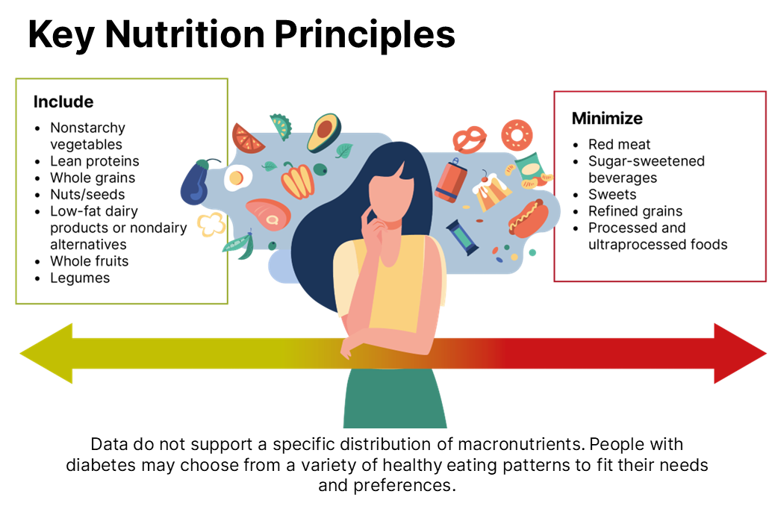
Section 5 | Abridged Standards of Care
American Diabetes Association Primary Care Advisory Group. 5. Facilitating positive health behaviors and well-being to improve health outcomes: Standards of Care in Diabetes—2025 Abridged for Primary Care. Clin Diabetes 2025;43:194–197 (doi: 10.2337/cd25-a005). ©2025 by the American Diabetes Association.

Slide 36
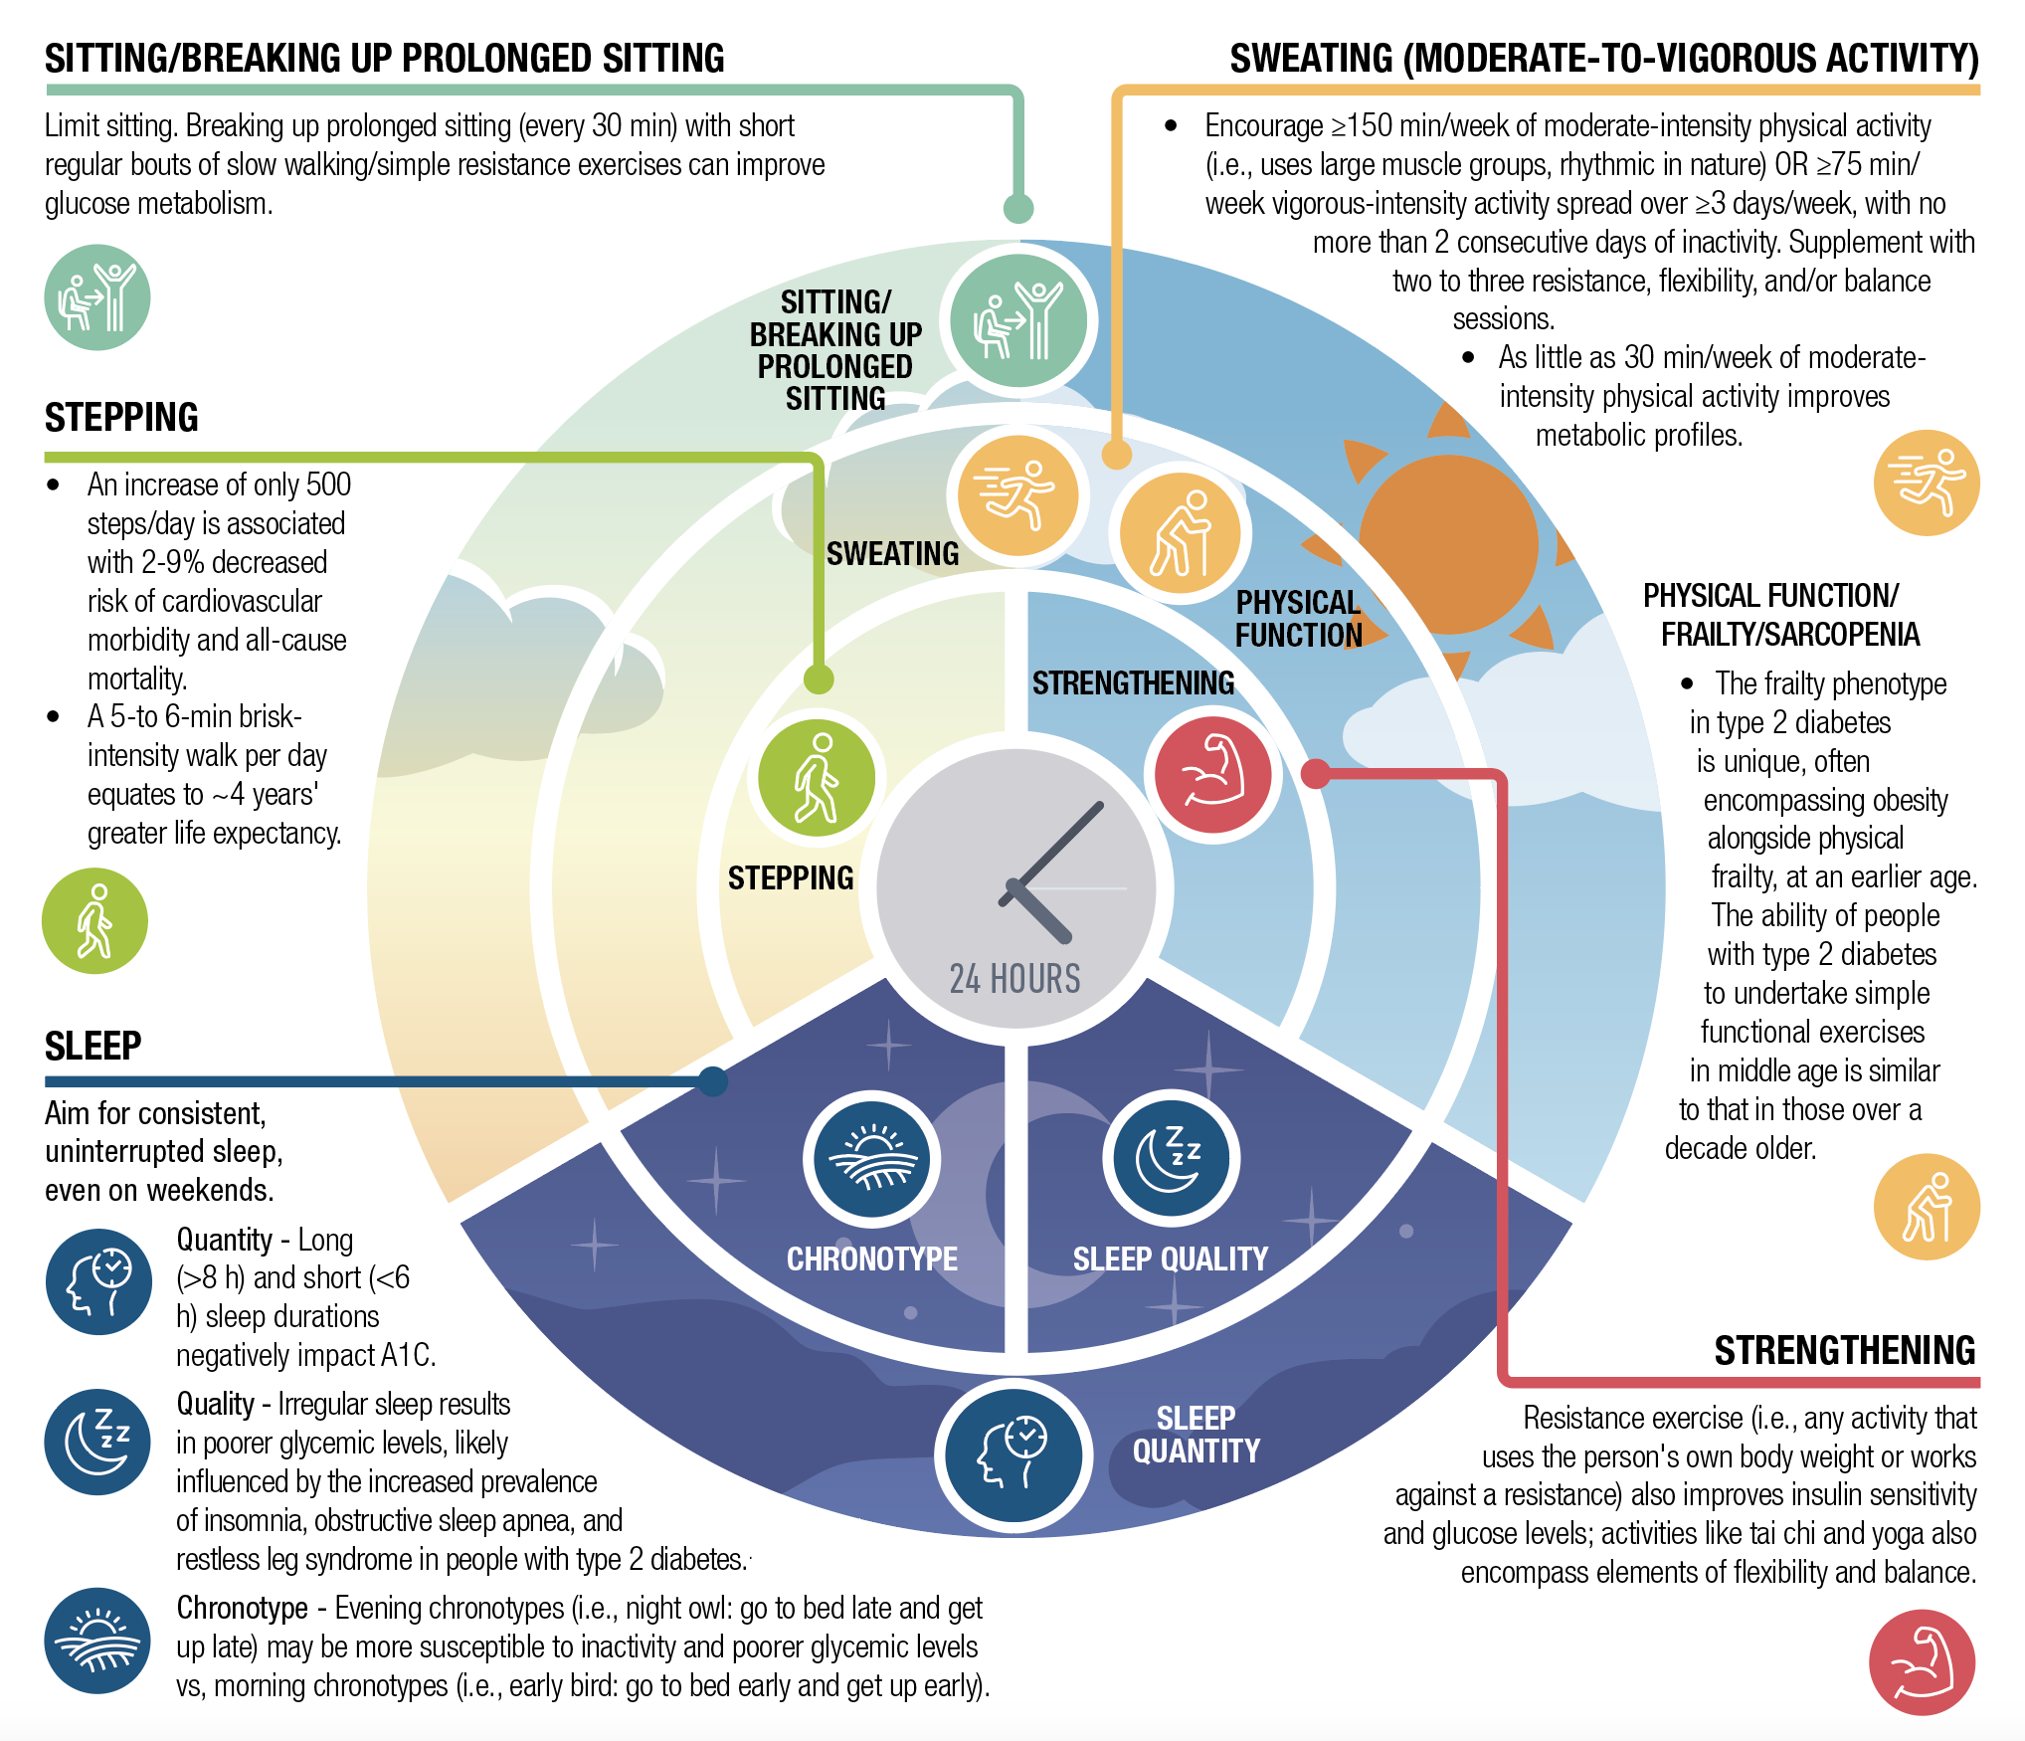
Section 5 | Abridged Standards of Care
Importance of 24-Hour Physical Behaviors for Type 2 Diabetes
American Diabetes Association Primary Care Advisory Group. 5. Facilitating positive health behaviors and well-being to improve health outcomes: Standards of Care in Diabetes—2025 Abridged for Primary Care. Clin Diabetes 2025;43:194–197 (doi: 10.2337/cd25-a005). ©2025 by the American Diabetes Association.

Slide 37
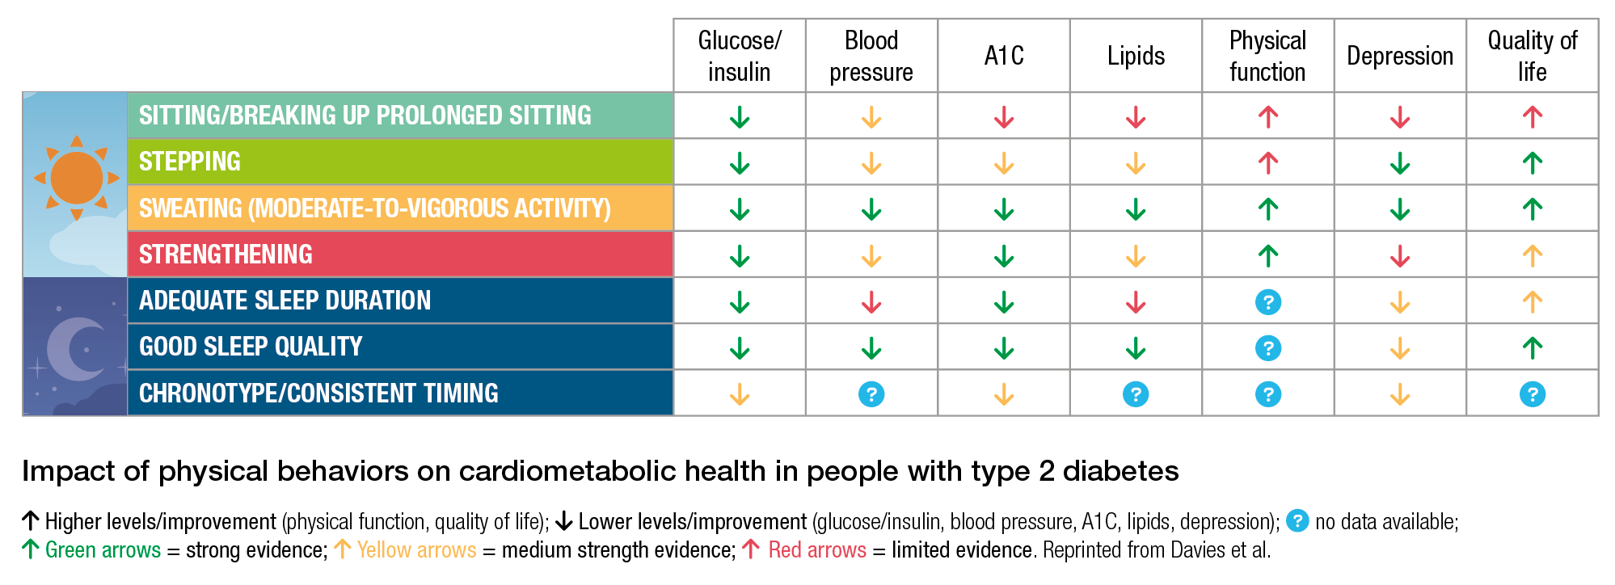
Section 5 | Abridged Standards of Care
Importance of 24-Hour Physical Behaviors for Type 2 Diabetes
American Diabetes Association Primary Care Advisory Group. 5. Facilitating positive health behaviors and well-being to improve health outcomes: Standards of Care in Diabetes—2025 Abridged for Primary Care. Clin Diabetes 2025;43:194–197 (doi: 10.2337/cd25-a005). ©2025 by the American Diabetes Association.

Slide 38
Glycemic Goals and Hypoglycemia
Section 6

Slide 39
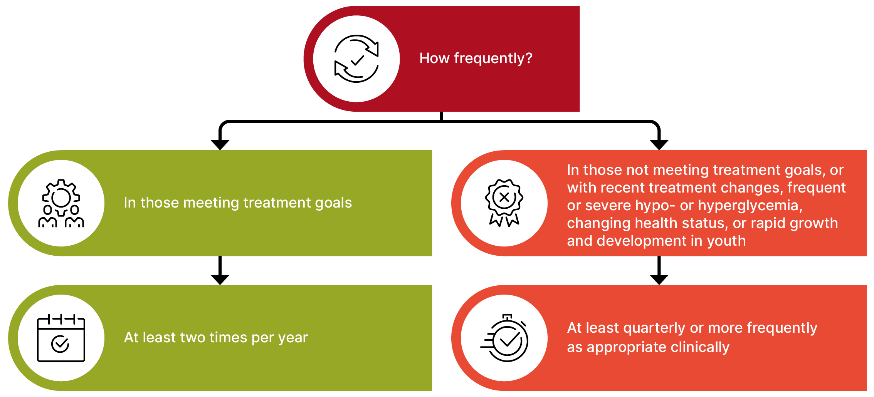
Section 6 | Abridged Standards of Care
Assessment of Glycemic Status
How to Assess
A1C measurement
Continuous glucose monitoring (CGM) using appropriate metrics (e.g., time in range [TIR], time above range [TAR], and time below range [TBR])
When to Assess Glycemic Status With an A1C Test
American Diabetes Association Primary Care Advisory Group. 6. Glycemic goals and hypoglycemia: Standards of Care in Diabetes—2025 Abridged for Primary Care. Clin Diabetes 2025;43:198–203 (doi: 10.2337/cd25-a006). ©2025 by the American Diabetes Association.

Slide 40
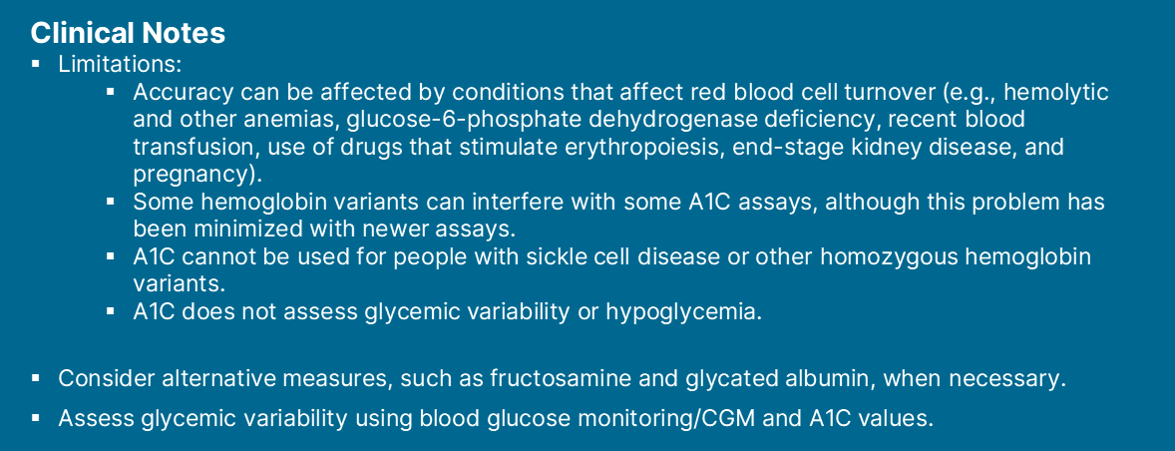
Section 6 | Abridged Standards of Care
Assessment of Glycemic Status
American Diabetes Association Primary Care Advisory Group. 6. Glycemic goals and hypoglycemia: Standards of Care in Diabetes—2025 Abridged for Primary Care. Clin Diabetes 2025;43:198–203 (doi: 10.2337/cd25-a006). ©2025 by the American Diabetes Association.

Slide 41
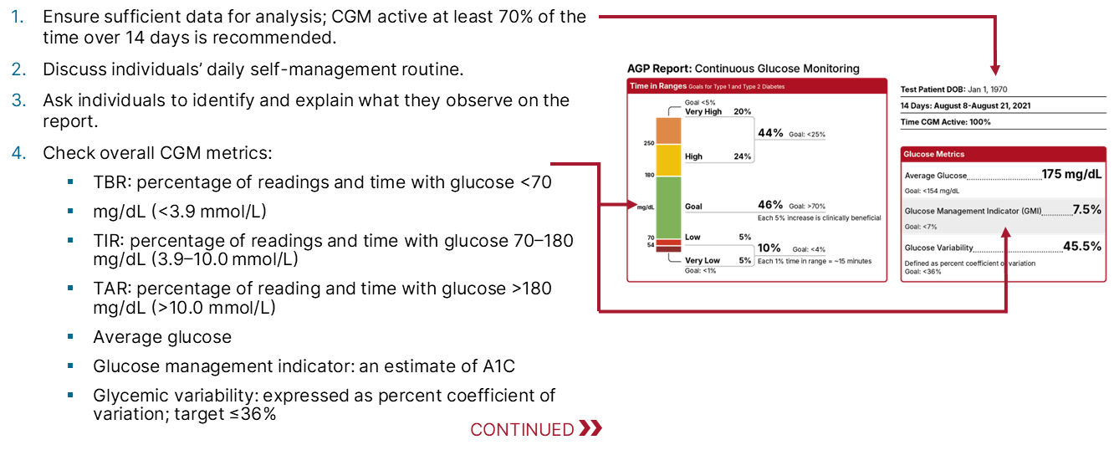
Section 6 | Abridged Standards of Care
Glucose Assessment via CGM:
The Ambulatory Glucose Profile (AGP) Report
American Diabetes Association Primary Care Advisory Group. 6. Glycemic goals and hypoglycemia: Standards of Care in Diabetes—2025 Abridged for Primary Care. Clin Diabetes 2025;43:198–203 (doi: 10.2337/cd25-a006). ©2025 by the American Diabetes Association.

Slide 42
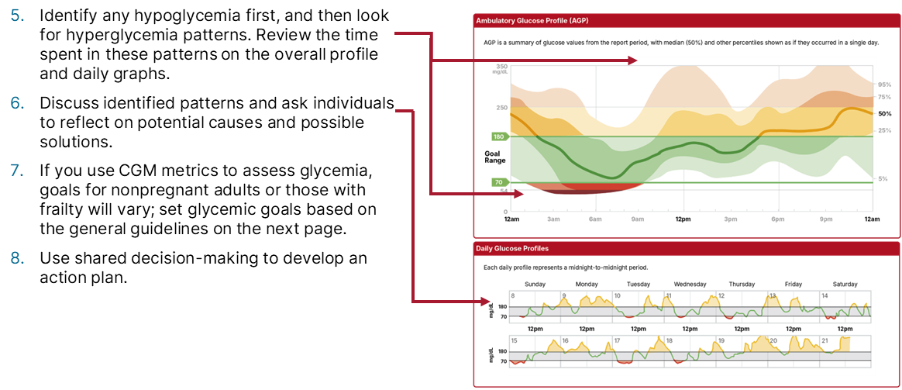
Section 6 | Abridged Standards of Care
Glucose Assessment via CGM:
The Ambulatory Glucose Profile (AGP) Report
American Diabetes Association Primary Care Advisory Group. 6. Glycemic goals and hypoglycemia: Standards of Care in Diabetes—2025 Abridged for Primary Care. Clin Diabetes 2025;43:198–203 (doi: 10.2337/cd25-a006). ©2025 by the American Diabetes Association.

Slide 43
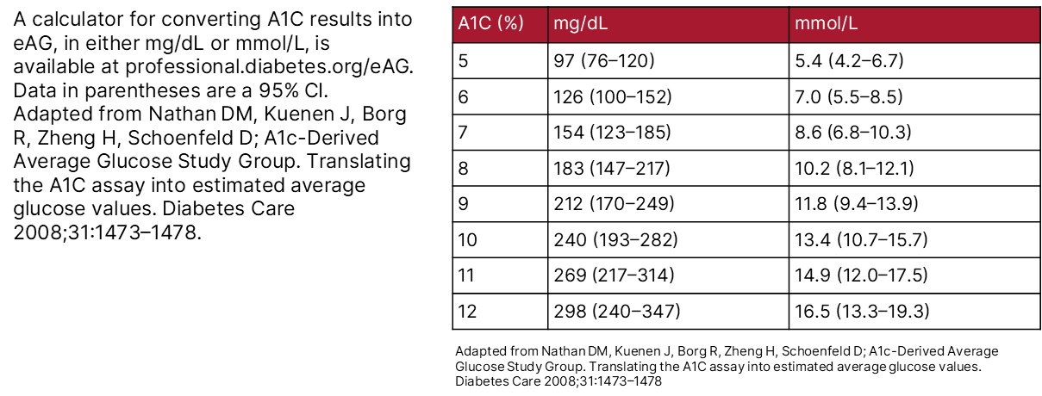
Section 6 | Abridged Standards of Care
Correlation Between A1C and
Estimated Average Glucose (eAG)
American Diabetes Association Primary Care Advisory Group. 6. Glycemic goals and hypoglycemia: Standards of Care in Diabetes—2025 Abridged for Primary Care. Clin Diabetes 2025;43:198–203 (doi: 10.2337/cd25-a006). ©2025 by the American Diabetes Association.

Slide 44
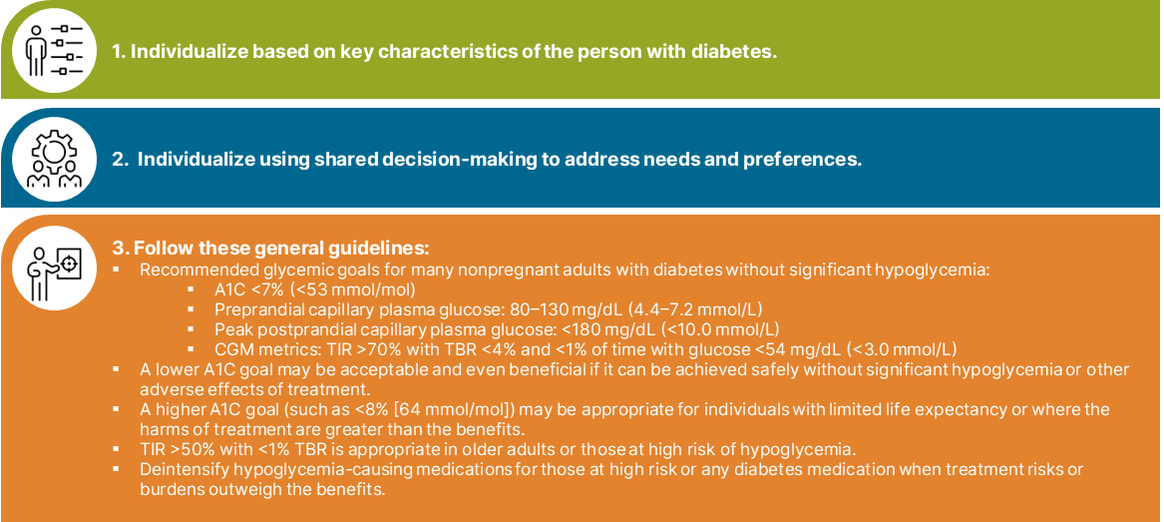
Section 6 | Abridged Standards of Care
Setting and Modifying Glycemic Goals
Glycemic goals should be individualized and periodically reevaluated.
American Diabetes Association Primary Care Advisory Group. 6. Glycemic goals and hypoglycemia: Standards of Care in Diabetes—2025 Abridged for Primary Care. Clin Diabetes 2025;43:198–203 (doi: 10.2337/cd25-a006). ©2025 by the American Diabetes Association.

Slide 45
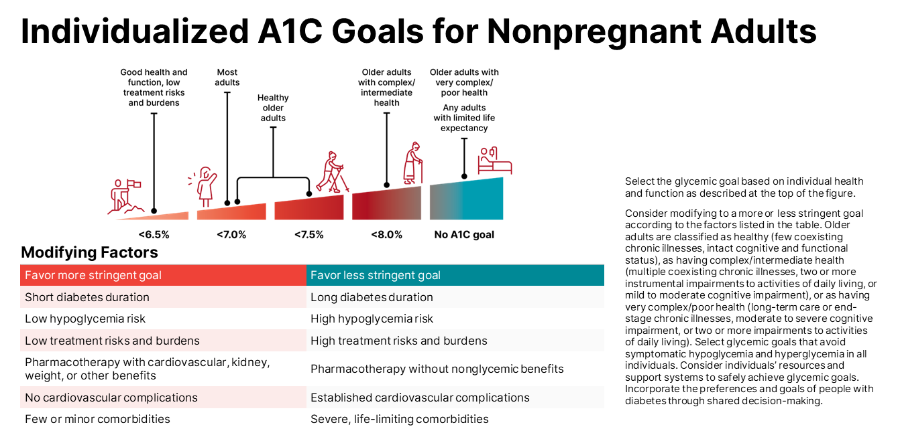
Section 6 | Abridged Standards of Care
American Diabetes Association Primary Care Advisory Group. 6. Glycemic goals and hypoglycemia: Standards of Care in Diabetes—2025 Abridged for Primary Care. Clin Diabetes 2025;43:198–203 (doi: 10.2337/cd25-a006). ©2025 by the American Diabetes Association.

Slide 46
Section 6 | Abridged Standards of Care
Hyperglycemic Crises:
Diagnosis, Management, and Prevention
Diabetic ketoacidosis (DKA) and the hyperglycemic hyperosmolar state (HHS) are serious, acute, and life-threatening hyperglycemic emergencies in individuals with diabetes that incur substantial morbidity, mortality, and costs.
Clinicians should review history of hyperglycemic crises (e.g., DKA and HHS) at every clinical encounter for all individuals with diabetes at risk for these events.
Provide structured education on the recognition, prevention, and management of hyperglycemic crisis. Individuals who have experienced DKA or HHS should be screened for social determinants of health and referred to appropriate health care and/or community services to mitigate these barriers to care.
Individuals at risk for DKA should be counseled on its early signs and symptoms and educated on timely self-management of hyperglycemia and ketonemia (“sick day advice”). Clinicians should provide detailed instructions on insulin dose adjustments in the setting of illness or fasting to prevent DKA occurrence and worsening.
American Diabetes Association Primary Care Advisory Group. 6. Glycemic goals and hypoglycemia: Standards of Care in Diabetes—2025 Abridged for Primary Care. Clin Diabetes 2025;43:198–203 (doi: 10.2337/cd25-a006). ©2025 by the American Diabetes Association.

Slide 47
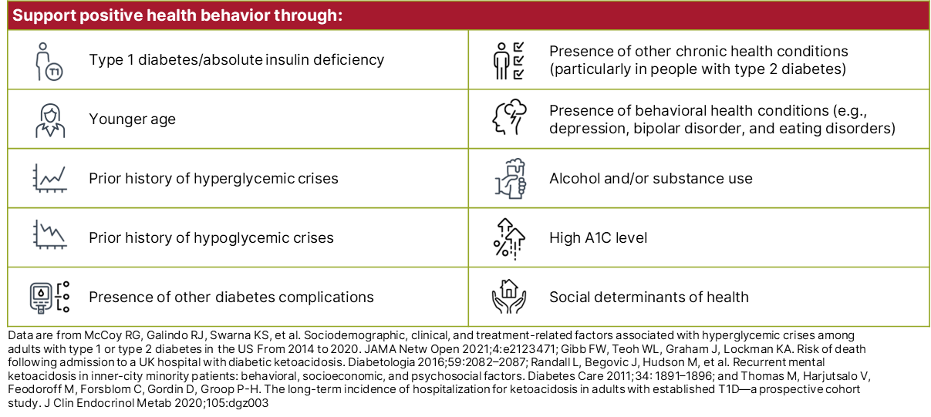
Section 6 | Abridged Standards of Care
Risk Factors for Hyperglycemic Crises
American Diabetes Association Primary Care Advisory Group. 6. Glycemic goals and hypoglycemia: Standards of Care in Diabetes—2025 Abridged for Primary Care. Clin Diabetes 2025;43:198–203 (doi: 10.2337/cd25-a006). ©2025 by the American Diabetes Association.

Slide 48
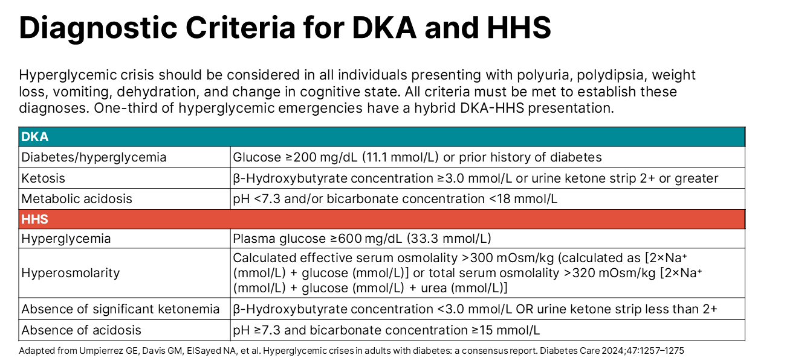
Section 6 | Abridged Standards of Care
American Diabetes Association Primary Care Advisory Group. 6. Glycemic goals and hypoglycemia: Standards of Care in Diabetes—2025 Abridged for Primary Care. Clin Diabetes 2025;43:198–203 (doi: 10.2337/cd25-a006). ©2025 by the American Diabetes Association.

Slide 49
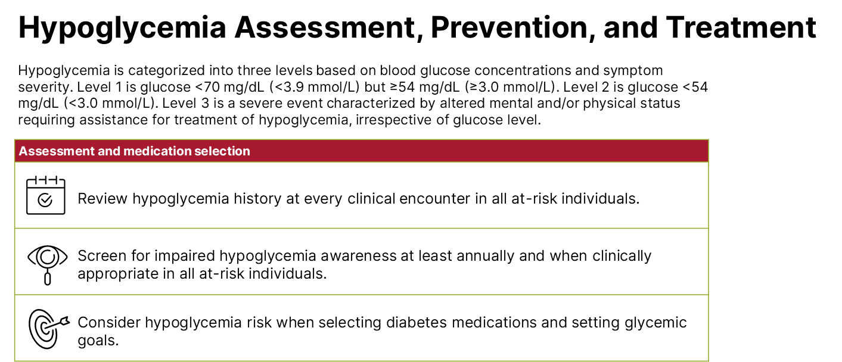
Section 6 | Abridged Standards of Care
American Diabetes Association Primary Care Advisory Group. 6. Glycemic goals and hypoglycemia: Standards of Care in Diabetes—2025 Abridged for Primary Care. Clin Diabetes 2025;43:198–203 (doi: 10.2337/cd25-a006). ©2025 by the American Diabetes Association.

Slide 50
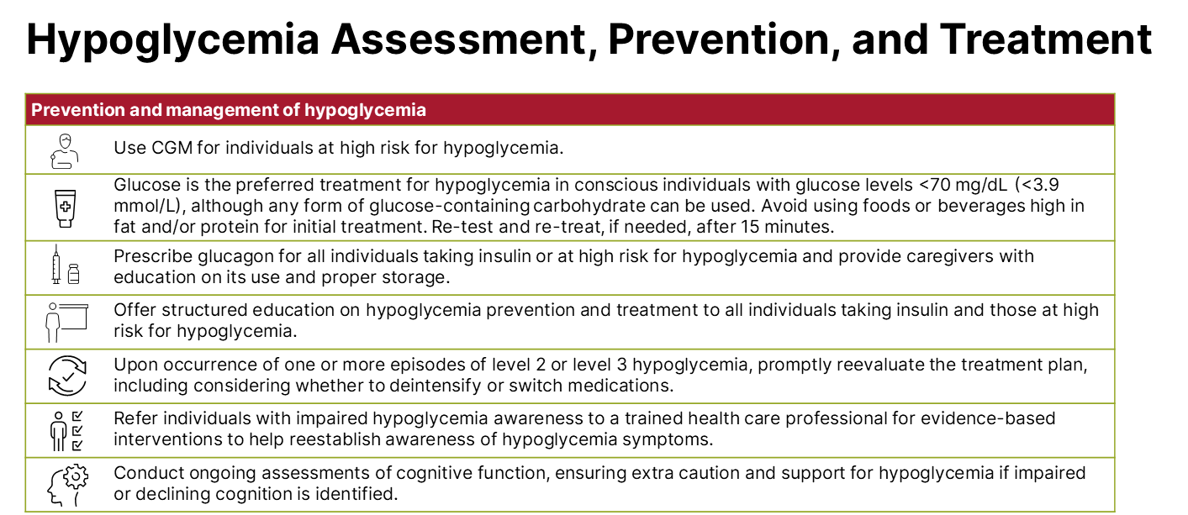
Section 6 | Abridged Standards of Care
American Diabetes Association Primary Care Advisory Group. 6. Glycemic goals and hypoglycemia: Standards of Care in Diabetes—2025 Abridged for Primary Care. Clin Diabetes 2025;43:198–203 (doi: 10.2337/cd25-a006). ©2025 by the American Diabetes Association.

Slide 51
Diabetes Technology
Section 7

Slide 52
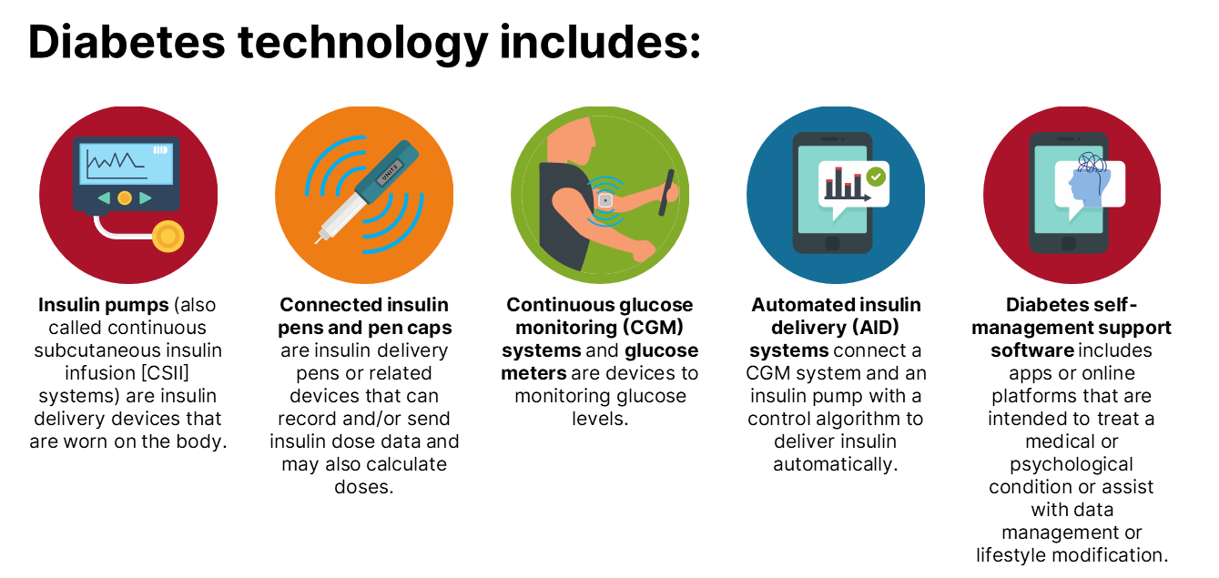
Section 7 | Abridged Standards of Care
American Diabetes Association Primary Care Advisory Group. 7. Diabetes technology: Standards of Care in Diabetes—2025 Abridged for Primary Care. Clin Diabetes 2025;43:204–206 (doi: 10.2337/cd25-a007). ©2025 by the American Diabetes Association.

Slide 53
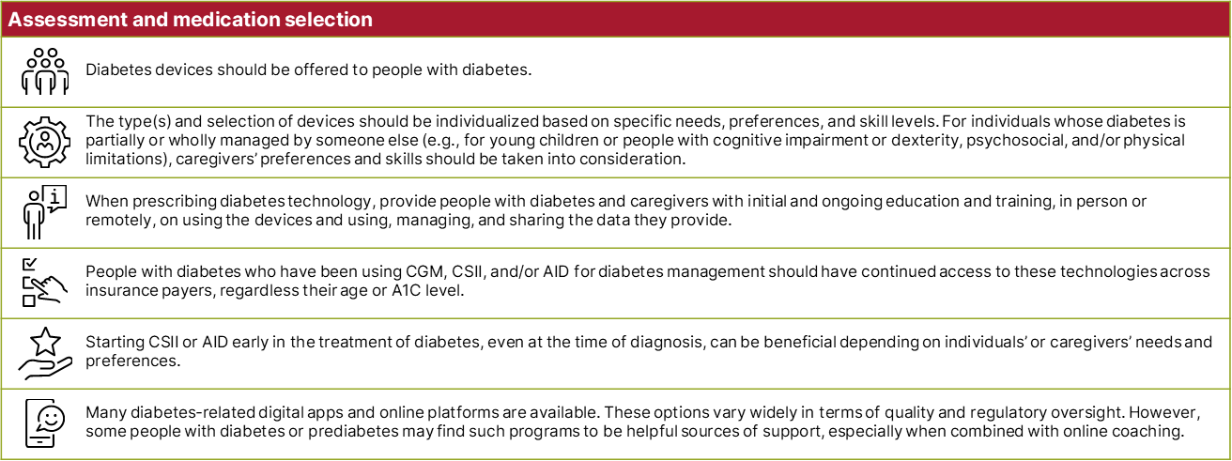
Section 7 | Abridged Standards of Care
General Diabetes Technology Principles
American Diabetes Association Primary Care Advisory Group. 7. Diabetes technology: Standards of Care in Diabetes—2025 Abridged for Primary Care. Clin Diabetes 2025;43:204–206 (doi: 10.2337/cd25-a007). ©2025 by the American Diabetes Association.

Slide 54
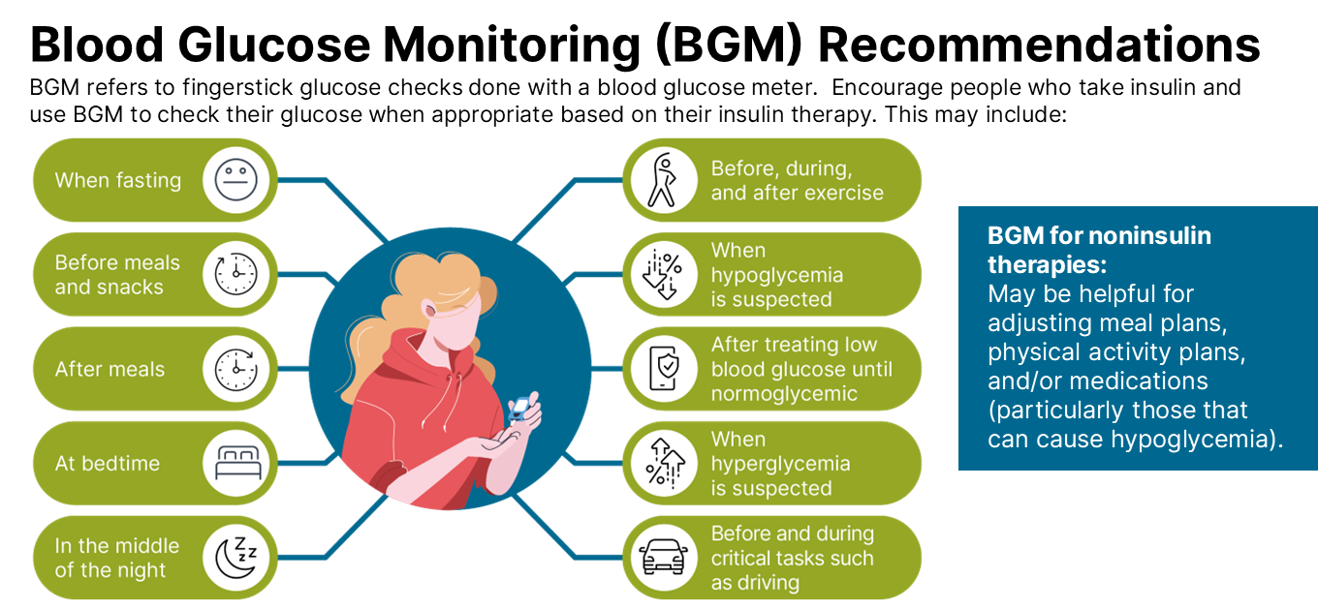
Section 7 | Abridged Standards of Care
American Diabetes Association Primary Care Advisory Group. 7. Diabetes technology: Standards of Care in Diabetes—2025 Abridged for Primary Care. Clin Diabetes 2025;43:204–206 (doi: 10.2337/cd25-a007). ©2025 by the American Diabetes Association.

Slide 55
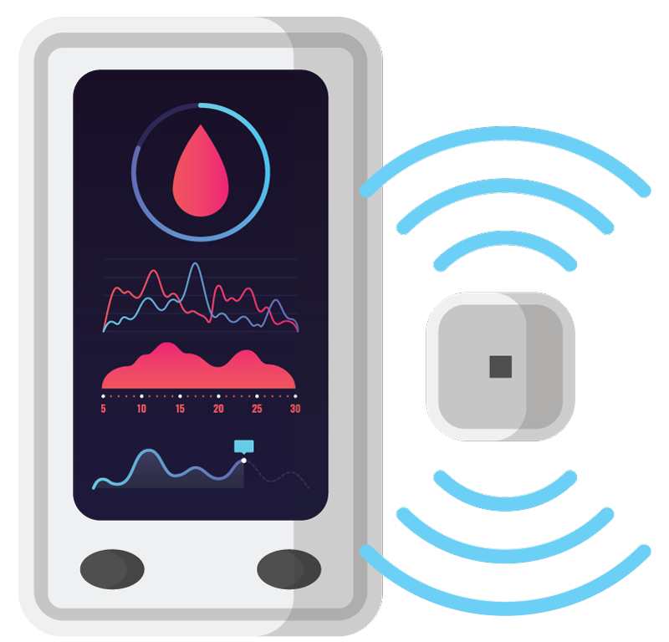
Section 7 | Abridged Standards of Care
CGM Recommendations
There are different types of CGM systems, including:
Real-time CGM systems, which are owned by individuals and measure and display glucose levels continuously.
Intermittently scanned CGM systems, which are owned by individuals and measure glucose levels continuously but require scanning for visualization and storage of glucose values.
Professional CGM systems, which are owned by clinics and intended to be used temporarily for 7–14 days to assess glycemic patterns and trends, with data either blinded or visible to the person wearing the device.
Over-the-counter CGM systems (biosensors), measure glucose continuously and display the levels at various times, have insights rather than alarms and are indicated for people with prediabetes or with diabetes not on insulin.
American Diabetes Association Primary Care Advisory Group. 7. Diabetes technology: Standards of Care in Diabetes—2025 Abridged for Primary Care. Clin Diabetes 2025;43:204–206 (doi: 10.2337/cd25-a007). ©2025 by the American Diabetes Association.

Slide 56
Section 7 | Abridged Standards of Care
CGM Recommendations
Who can benefit from CGM?
CGM should be offered to youth and adults with diabetes on any type of insulin therapy.
CGM should be considered in adults with type 2 diabetes treated with glucose-lowering medications other than insulin to achieve and maintain individualized glycemic goals.
CGM can help achieve glycemic goals and A1C goals in type 1 diabetes and pregnancy and may be beneficial for other types of diabetes in pregnancy.
Periodic use of personal or professional CGM can be helpful to adjust medication and/or lifestyle when consistent use is not desired or available.
American Diabetes Association Primary Care Advisory Group. 7. Diabetes technology: Standards of Care in Diabetes—2025 Abridged for Primary Care. Clin Diabetes 2025;43:204–206 (doi: 10.2337/cd25-a007). ©2025 by the American Diabetes Association.

Slide 57
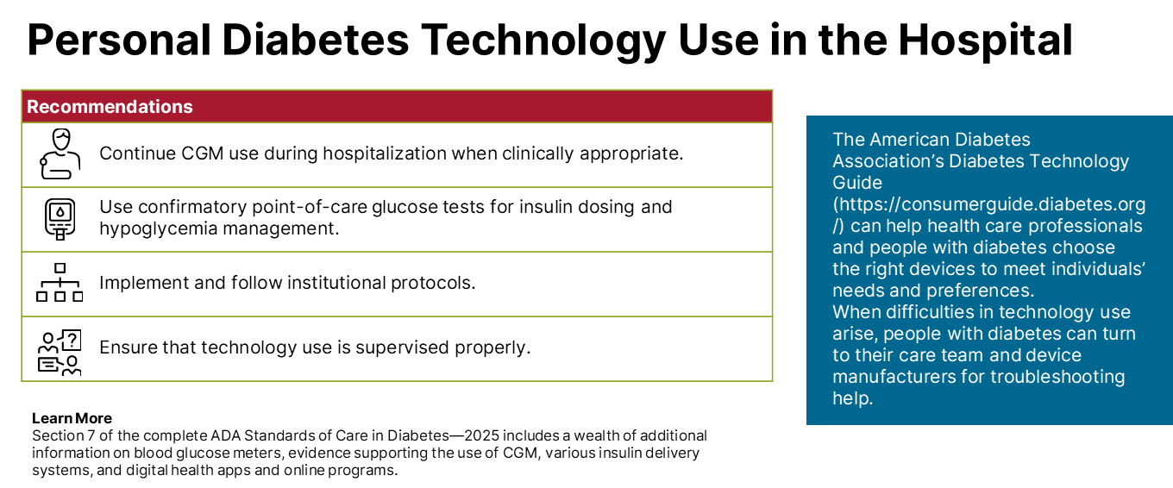
Section 7 | Abridged Standards of Care
American Diabetes Association Primary Care Advisory Group. 7. Diabetes technology: Standards of Care in Diabetes—2025 Abridged for Primary Care. Clin Diabetes 2025;43:204–206 (doi: 10.2337/cd25-a007). ©2025 by the American Diabetes Association.

Slide 58
Obesity and Weight Management for the Prevention and Treatment of Type 2 Diabetes
Section 8

Slide 59
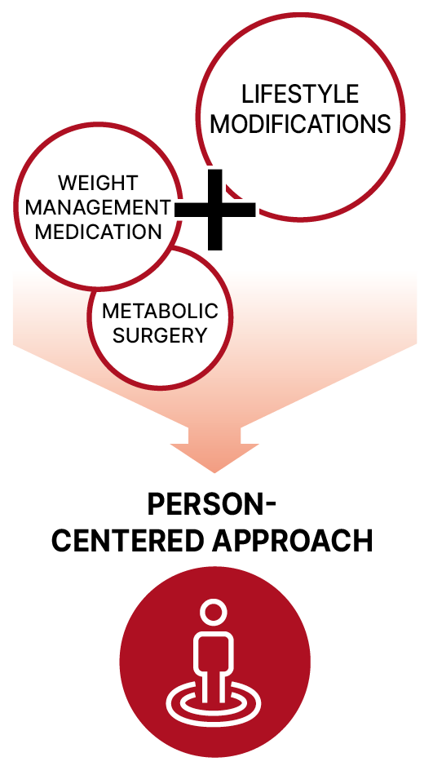
Section 8 | Abridged Standards of Care
A holistic approach to weight management is essential. Individualized strategies may include nutrition and exercise interventions, behavioral counseling, pharmacotherapy, and metabolic surgery.
In people with type 2 diabetes and overweight or obesity, weight management should represent a primary goal of treatment along with glycemic management.
Weight management is crucially important because it:
Delays progression from prediabetes to type 2 diabetes
Is highly beneficial in treating type 2 diabetes
Improves glycemia and reduces the need for glucose-lowering medications
Reduces cardiovascular risk factors, lowering long-term cardiovascular and mortality risks
Reduces other obesity-related health risks
When addressing weight management:
Use person-centered, nonjudgmental, person-first language (e.g., “person with obesity” rather than “obese person” and “person with diabetes” rather than “diabetic person”).
Calculate BMI and measure body fat distribution (e.g., waist circumference, waist-to-hip ratio, and/or waist-to-height ratio) if BMI is indeterminant. Monitor these parameters at least annually.
Identify and overcome any implicit and explicit weight-based attitudes to improve care for people with obesity.
American Diabetes Association Primary Care Advisory Group. 8. Obesity and weight management for the prevention and treatment of type 2 diabetes: Standards of Care in Diabetes—2025 Abridged for Primary Care. Clin Diabetes 2025;43:207–208 (doi: 10.2337/cd25-a008). ©2025 by the American Diabetes Association.

Slide 60
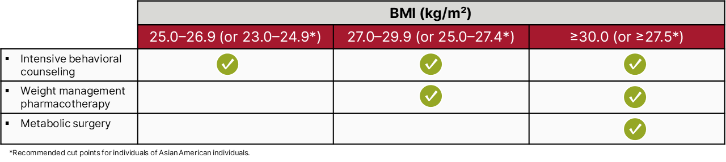
Section 8 | Abridged Standards of Care
Person-Centered Treatment Options for Overweight and Obesity in Type 2 Diabetes
American Diabetes Association Primary Care Advisory Group. 8. Obesity and weight management for the prevention and treatment of type 2 diabetes: Standards of Care in Diabetes—2025 Abridged for Primary Care. Clin Diabetes 2025;43:207–208 (doi: 10.2337/cd25-a008). ©2025 by the American Diabetes Association.

Slide 61
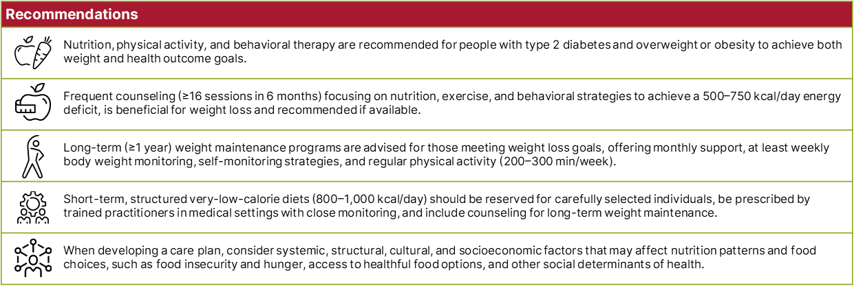
Section 8 | Abridged Standards of Care
Nutrition, Physical Activity, and Behavioral Therapy for People With Overweight and Obesity
American Diabetes Association Primary Care Advisory Group. 8. Obesity and weight management for the prevention and treatment of type 2 diabetes: Standards of Care in Diabetes—2025 Abridged for Primary Care. Clin Diabetes 2025;43:207–208 (doi: 10.2337/cd25-a008). ©2025 by the American Diabetes Association.

Slide 62
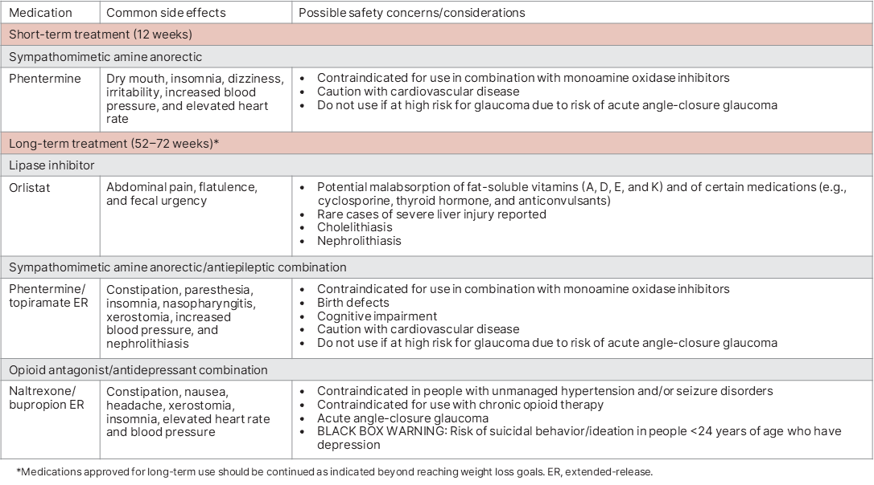
Section 8 | Abridged Standards of Care
Weight Management Pharmacotherapy
CONTINUED
American Diabetes Association Primary Care Advisory Group. 8. Obesity and weight management for the prevention and treatment of type 2 diabetes: Standards of Care in Diabetes—2025 Abridged for Primary Care. Clin Diabetes 2025;43:207–208 (doi: 10.2337/cd25-a008). ©2025 by the American Diabetes Association.

Slide 63
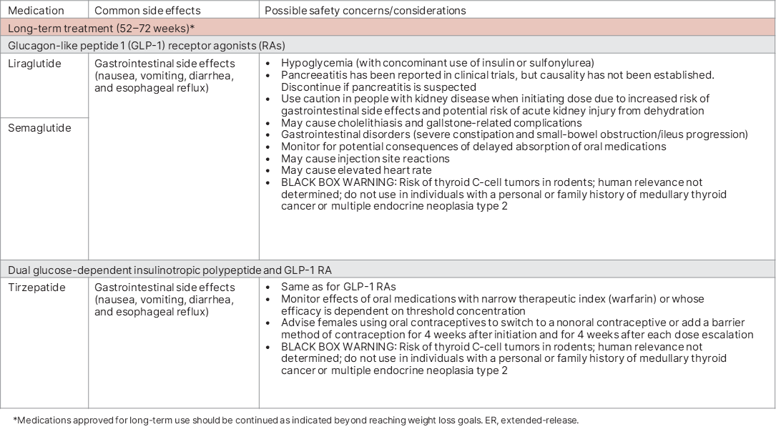
Section 8 | Abridged Standards of Care
Weight Management Pharmacotherapy
American Diabetes Association Primary Care Advisory Group. 8. Obesity and weight management for the prevention and treatment of type 2 diabetes: Standards of Care in Diabetes—2025 Abridged for Primary Care. Clin Diabetes 2025;43:207–208 (doi: 10.2337/cd25-a008). ©2025 by the American Diabetes Association.

Slide 64
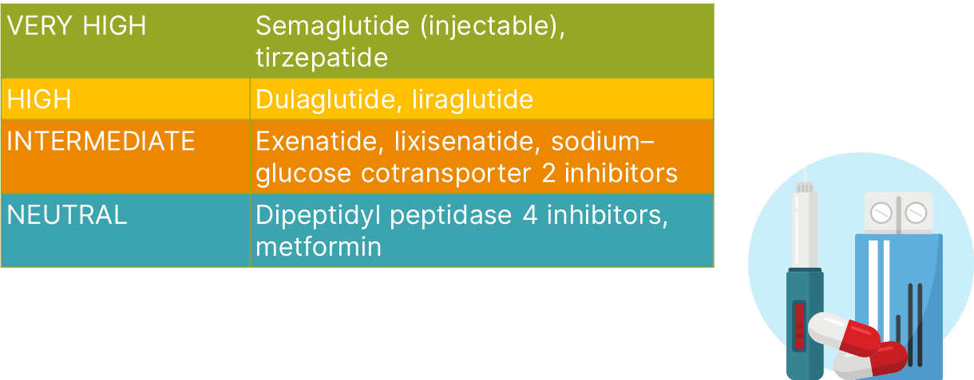
Section 8 | Abridged Standards of Care
Weight Loss Efficacy of Glucose-Lowering Medications
American Diabetes Association Primary Care Advisory Group. 8. Obesity and weight management for the prevention and treatment of type 2 diabetes: Standards of Care in Diabetes—2025 Abridged for Primary Care. Clin Diabetes 2025;43:207–208 (doi: 10.2337/cd25-a008). ©2025 by the American Diabetes Association.

Slide 65
Section 8 | Abridged Standards of Care
Weight Loss Efficacy of Glucose-Lowering Medications
Glucose-Lowering Medications
Consider weight when choosing glucose-lowering medications for individuals with type 2 diabetes and overweight or obesity.
When possible, avoid prescribing medications that cause weight gain to treat comorbid conditions.
Weight management pharmacotherapy should be considered for people with diabetes and overweight or obesity along with lifestyle changes. Potential benefits and risks must be considered.
Continue weight management pharmacotherapy if it is effective (>5% weight loss after 3 months).
Consider changing or stopping treatment if weight loss is <5% after 3 months or if significant safety/tolerability issues arise.
American Diabetes Association Primary Care Advisory Group. 8. Obesity and weight management for the prevention and treatment of type 2 diabetes: Standards of Care in Diabetes—2025 Abridged for Primary Care. Clin Diabetes 2025;43:207–208 (doi: 10.2337/cd25-a008). ©2025 by the American Diabetes Association.

Slide 66
Pharmacologic Approaches to
Glycemic Treatment
Section 9

Slide 67
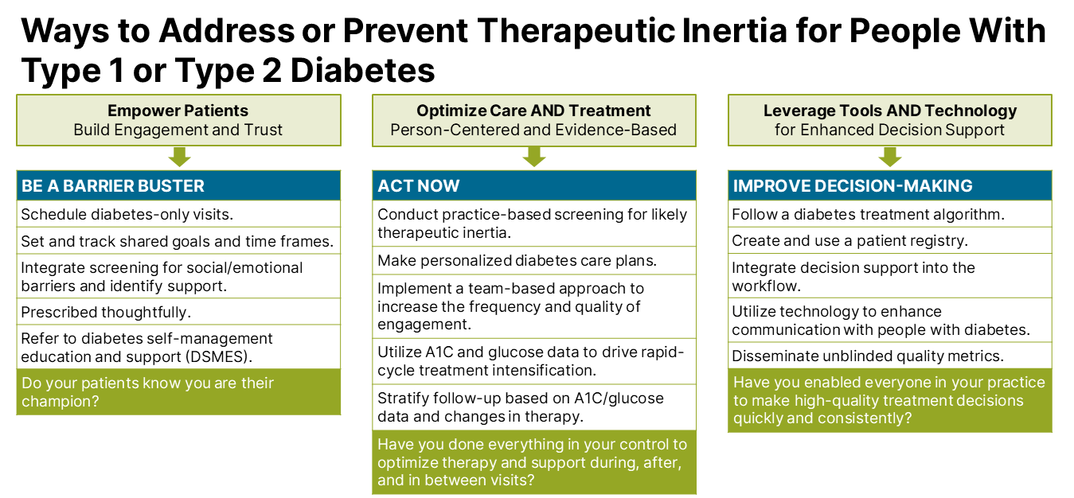
Section 9 | Abridged Standards of Care
American Diabetes Association Primary Care Advisory Group. 9. Pharmacologic approaches to glycemic treatment: Standards of Care in Diabetes—2025 Abridged for Primary Care. Clin Diabetes 2025;43:209–211 (doi: 10.2337/cd25-a009). ©2025 by the American Diabetes Association.

Slide 68
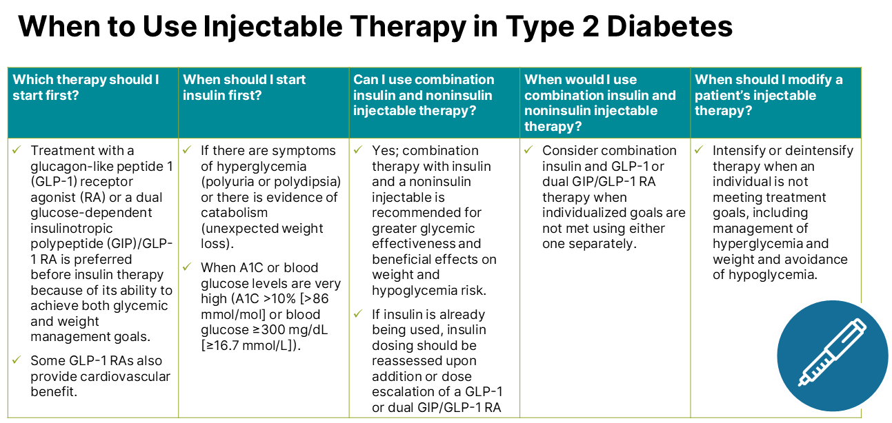
Section 9 | Abridged Standards of Care
American Diabetes Association Primary Care Advisory Group. 9. Pharmacologic approaches to glycemic treatment: Standards of Care in Diabetes—2025 Abridged for Primary Care. Clin Diabetes 2025;43:209–211 (doi: 10.2337/cd25-a009). ©2025 by the American Diabetes Association.

Slide 69

Section 9 | Abridged Standards of Care
Use of Glucose-Lowering Medications in the Management of Type 2 Diabetes
American Diabetes Association Primary Care Advisory Group. 9. Pharmacologic approaches to glycemic treatment: Standards of Care in Diabetes—2025 Abridged for Primary Care. Clin Diabetes 2025;43:209–211 (doi: 10.2337/cd25-a009). ©2025 by the American Diabetes Association.
Notes:
The left side of the algorithm prioritizes mitigation of diabetes-related complications and end-organ effects, while the right side addresses weight and glucose management goals. ACEi, angiotensin-converting enzyme inhibitor; ACR, albumin-to-creatinine ratio; ARB, angiotensin receptor blocker; ASCVD, atherosclerotic cardiovascular disease; CGM, continuous glucose monitoring; CKD, chronic kidney disease; CV, cardiovascular; CVD, cardiovascular disease; CVOT, cardiovascular outcomes trial; DPP-4i, dipeptidyl peptidase 4 inhibitor; eGFR, estimated glomerular filtration rate; GIP, glucose-dependent insulinotropic polypeptide; GLP-1 RA, glucagon-like peptide 1 receptor agonist; dual GIP/GLP-1 RA, dual glucose-dependent insulinotropic polypeptide and glucagon-like peptide 1 receptor agonist; HF, heart failure; HFpEF, heart failure with preserved ejection fraction; HFrEF, heart failure with reduced ejection fraction; HHF, hospitalization for heart failure; MACE, major adverse cardiovascular events; MI, myocardial infarction; SDOH, social determinants of health; SGLT2i, sodium-glucose cotransporter 2 inhibitor; T2D, type 2 diabetes; TZD, thiazolidinedione. Adapted from Davies MJ, Aroda VR, Collins BS, et al. Management of hyperglycemia in type 2 diabetes, 2022. A consensus report by the American Diabetes Association (ADA) and the European Association for the Study of Diabetes (EASD). Diabetes Care 2022;45:2753–2786.
* In people with HF, CKD, established CVD, or multiple risk factors for CVD, the decision to use a GLP-1 RA or SGLT2i with proven benefit should be made irrespective of background use of metformin or A1C.
† ASCVD: Defined differently across CVOTs but all included individuals with established CVD (e.g., MI, stroke, and arterial revascularization procedure) and variably included conditions such as transient ischemic attack, unstable angina, amputation, and symptomatic or asymptomatic coronary artery disease. Indicators of high risk: While definitions vary, most comprise ≥55 years of age with two or more additional risk factors (including obesity, hypertension, smoking, dyslipidemia, or albuminuria).
≈ A strong recommendation is warranted for people with CVD and a weaker recommendation for those with indicators of high-risk CVD. Moreover, a higher absolute risk reduction and thus lower numbers needed to treat are seen at higher levels of baseline risk and should be factored into the shared decision-making process. See text for details.
# For GLP-1 Ras, CVOTs demonstrate their efficacy in reducing composite MACE, CV death, all-cause mortality, MI, stroke, and kidney end points in individuals with T2D with established or high risk of CVD. One kidney outcome trial demonstrated benefit in reducing persistent eGFR reduction and CV death for a GLP-1 RA in individuals with CKD and T2D.
‡ For SGLT2is, CV and kidney outcomes trials demonstrate their efficacy in reducing the risks of composite MACE, CV death, all-cause mortality, MI, HHF, and kidney outcomes in individuals with T2D and established or high risk of CVD.
^ Low-dose pioglitazone may be better tolerated and similarly effective as higher doses.

Slide 70

Section 9 | Abridged Standards of Care
Use of Glucose-Lowering Medications in the Management of Type 2 Diabetes
The left side of the algorithm prioritizes the mitigation of diabetes-related complications and end-organ effects.
American Diabetes Association Primary Care Advisory Group. 9. Pharmacologic approaches to glycemic treatment: Standards of Care in Diabetes—2025 Abridged for Primary Care. Clin Diabetes 2025;43:209–211 (doi: 10.2337/cd25-a009). ©2025 by the American Diabetes Association.
Notes:
The left side of the algorithm prioritizes mitigation of diabetes-related complications and end-organ effects, while the right side addresses weight and glucose management goals. ACEi, angiotensin-converting enzyme inhibitor; ACR, albumin-to-creatinine ratio; ARB, angiotensin receptor blocker; ASCVD, atherosclerotic cardiovascular disease; CGM, continuous glucose monitoring; CKD, chronic kidney disease; CV, cardiovascular; CVD, cardiovascular disease; CVOT, cardiovascular outcomes trial; DPP-4i, dipeptidyl peptidase 4 inhibitor; eGFR, estimated glomerular filtration rate; GIP, glucose-dependent insulinotropic polypeptide; GLP-1 RA, glucagon-like peptide 1 receptor agonist; dual GIP/GLP-1 RA, dual glucose-dependent insulinotropic polypeptide and glucagon-like peptide 1 receptor agonist; HF, heart failure; HFpEF, heart failure with preserved ejection fraction; HFrEF, heart failure with reduced ejection fraction; HHF, hospitalization for heart failure; MACE, major adverse cardiovascular events; MI, myocardial infarction; SDOH, social determinants of health; SGLT2i, sodium-glucose cotransporter 2 inhibitor; T2D, type 2 diabetes; TZD, thiazolidinedione. Adapted from Davies MJ, Aroda VR, Collins BS, et al. Management of hyperglycemia in type 2 diabetes, 2022. A consensus report by the American Diabetes Association (ADA) and the European Association for the Study of Diabetes (EASD). Diabetes Care 2022;45:2753–2786.
* In people with HF, CKD, established CVD, or multiple risk factors for CVD, the decision to use a GLP-1 RA or SGLT2i with proven benefit should be made irrespective of background use of metformin or A1C.
† ASCVD: Defined differently across CVOTs but all included individuals with established CVD (e.g., MI, stroke, and arterial revascularization procedure) and variably included conditions such as transient ischemic attack, unstable angina, amputation, and symptomatic or asymptomatic coronary artery disease. Indicators of high risk: While definitions vary, most comprise ≥55 years of age with two or more additional risk factors (including obesity, hypertension, smoking, dyslipidemia, or albuminuria).
≈ A strong recommendation is warranted for people with CVD and a weaker recommendation for those with indicators of high-risk CVD. Moreover, a higher absolute risk reduction and thus lower numbers needed to treat are seen at higher levels of baseline risk and should be factored into the shared decision-making process. See text for details.
# For GLP-1 Ras, CVOTs demonstrate their efficacy in reducing composite MACE, CV death, all-cause mortality, MI, stroke, and kidney end points in individuals with T2D with established or high risk of CVD. One kidney outcome trial demonstrated benefit in reducing persistent eGFR reduction and CV death for a GLP-1 RA in individuals with CKD and T2D.
‡ For SGLT2is, CV and kidney outcomes trials demonstrate their efficacy in reducing the risks of composite MACE, CV death, all-cause mortality, MI, HHF, and kidney outcomes in individuals with T2D and established or high risk of CVD.
^ Low-dose pioglitazone may be better tolerated and similarly effective as higher doses.

Slide 71

Section 9 | Abridged Standards of Care
Use of Glucose-Lowering Medications in the Management of Type 2 Diabetes
The right side of the algorithm addresses weight and glucose management goals.
American Diabetes Association Primary Care Advisory Group. 9. Pharmacologic approaches to glycemic treatment: Standards of Care in Diabetes—2025 Abridged for Primary Care. Clin Diabetes 2025;43:209–211 (doi: 10.2337/cd25-a009). ©2025 by the American Diabetes Association.
Notes:
The left side of the algorithm prioritizes mitigation of diabetes-related complications and end-organ effects, while the right side addresses weight and glucose management goals. ACEi, angiotensin-converting enzyme inhibitor; ACR, albumin-to-creatinine ratio; ARB, angiotensin receptor blocker; ASCVD, atherosclerotic cardiovascular disease; CGM, continuous glucose monitoring; CKD, chronic kidney disease; CV, cardiovascular; CVD, cardiovascular disease; CVOT, cardiovascular outcomes trial; DPP-4i, dipeptidyl peptidase 4 inhibitor; eGFR, estimated glomerular filtration rate; GIP, glucose-dependent insulinotropic polypeptide; GLP-1 RA, glucagon-like peptide 1 receptor agonist; dual GIP/GLP-1 RA, dual glucose-dependent insulinotropic polypeptide and glucagon-like peptide 1 receptor agonist; HF, heart failure; HFpEF, heart failure with preserved ejection fraction; HFrEF, heart failure with reduced ejection fraction; HHF, hospitalization for heart failure; MACE, major adverse cardiovascular events; MI, myocardial infarction; SDOH, social determinants of health; SGLT2i, sodium-glucose cotransporter 2 inhibitor; T2D, type 2 diabetes; TZD, thiazolidinedione. Adapted from Davies MJ, Aroda VR, Collins BS, et al. Management of hyperglycemia in type 2 diabetes, 2022. A consensus report by the American Diabetes Association (ADA) and the European Association for the Study of Diabetes (EASD). Diabetes Care 2022;45:2753–2786.
* In people with HF, CKD, established CVD, or multiple risk factors for CVD, the decision to use a GLP-1 RA or SGLT2i with proven benefit should be made irrespective of background use of metformin or A1C.
† ASCVD: Defined differently across CVOTs but all included individuals with established CVD (e.g., MI, stroke, and arterial revascularization procedure) and variably included conditions such as transient ischemic attack, unstable angina, amputation, and symptomatic or asymptomatic coronary artery disease. Indicators of high risk: While definitions vary, most comprise ≥55 years of age with two or more additional risk factors (including obesity, hypertension, smoking, dyslipidemia, or albuminuria).
≈ A strong recommendation is warranted for people with CVD and a weaker recommendation for those with indicators of high-risk CVD. Moreover, a higher absolute risk reduction and thus lower numbers needed to treat are seen at higher levels of baseline risk and should be factored into the shared decision-making process. See text for details.
# For GLP-1 Ras, CVOTs demonstrate their efficacy in reducing composite MACE, CV death, all-cause mortality, MI, stroke, and kidney end points in individuals with T2D with established or high risk of CVD. One kidney outcome trial demonstrated benefit in reducing persistent eGFR reduction and CV death for a GLP-1 RA in individuals with CKD and T2D.
‡ For SGLT2is, CV and kidney outcomes trials demonstrate their efficacy in reducing the risks of composite MACE, CV death, all-cause mortality, MI, HHF, and kidney outcomes in individuals with T2D and established or high risk of CVD.
^ Low-dose pioglitazone may be better tolerated and similarly effective as higher doses.

Slide 72

Section 9 | Abridged Standards of Care
To-Do List for Clinicians Treating
People With Insulin Therapy
Provide or refer people with diabetes and caregivers for education about injection technique and timing and problem-solving for issues related to insulin therapy (e.g., hypoglycemia, missed or incorrect doses, and dose adjustments).
Ensure that individuals have all supplies necessary for injections (e.g., pen needles for insulin pens or appropriate syringes for insulin dose size or concentration when using insulin in vials) and glucose monitoring.
Evaluate individuals with type 2 diabetes to determine whether they are candidates for GLP-1 or dual GIP/GLP-1 RA therapy.
Evaluate all people on insulin therapy to determine whether they could benefit from continuous glucose monitoring.
Ensure that people on insulin therapy have the education and supplies needed to prevent and treat hypoglycemia, including glucagon, glucose monitoring supplies, and appropriate sources of carbohydrates to treat low glucose levels.
Schedule timely and routine follow-up visits to reassess therapy and adjust care plans to avoid therapeutic inertia.
American Diabetes Association Primary Care Advisory Group. 9. Pharmacologic approaches to glycemic treatment: Standards of Care in Diabetes—2025 Abridged for Primary Care. Clin Diabetes 2025;43:209–211 (doi: 10.2337/cd25-a009). ©2025 by the American Diabetes Association.

Slide 73
Cardiovascular Disease and Risk Management
Section 10

Slide 74

Section 10 | Abridged Standards of Care
Atherosclerotic cardiovascular disease (ASCVD), defined as a history of acute coronary syndrome, myocardial infarction, stable or unstable angina or coronary or other arterial revascularization, stroke, transient ischemic attack, or peripheral artery disease (PAD) including aortic aneurysm and is the primary cause of morbidity and mortality in individuals with diabetes. Managing multiple risk factors simultaneously can prevent or slow the progression of ASCVD. Heart failure (HF) is another major cause of morbidity and mortality from cardiovascular disease. (CVD). Hypertension is a major risk factor for ASCVD, heart failure, and microvascular complications.
*An ACE inhibitor (ACEi) or angiotensin receptor blocker (ARB) is suggested for treatment of hypertension in people with coronary artery disease (CAD) or urine albumin-to-creatinine ratio 30–299 mg/g creatinine and is strongly recommended for individuals with urine albumin-to-creatinine ratio ≥300 mg/g creatinine. †Dihydropyridine calcium channel blocker (CCB). ‡Thiazide-like diuretic; long-acting agents shown to reduce cardiovascular events, such as chlorthalidone and indapamide, are preferred. BP, blood pressure. Adapted from de Boer IH, Bangalore S, Benetos A, et al. Diabetes and hypertension: a position statement by the American Diabetes Association. Diabetes Care 2017;40:1273–1284.
American Diabetes Association Primary Care Advisory Group. 10. Cardiovascular disease and risk management: Standards of Care in Diabetes—2025 Abridged for Primary Care. Clin Diabetes 2025;43:212–214 (doi: 10.2337/cd25-a010). ©2025 by the American Diabetes Association.

Slide 75

Section 10 | Abridged Standards of Care
Screening for Asymptomatic and Undiagnosed CVD
American Diabetes Association Primary Care Advisory Group. 10. Cardiovascular disease and risk management: Standards of Care in Diabetes—2025 Abridged for Primary Care. Clin Diabetes 2025;43:212–214 (doi: 10.2337/cd25-a010). ©2025 by the American Diabetes Association.

Slide 76

Section 10 | Abridged Standards of Care
Preventing the Development of Symptomatic HF in People With Diabetes
ACEi, ACE inhibitor; ARB, angiotensin receptor blocker; CKD, chronic kidney disease; LVEF, left ventricle ejection fraction; SGLT2, sodium–glucose cotransporter 2.
American Diabetes Association Primary Care Advisory Group. 10. Cardiovascular disease and risk management: Standards of Care in Diabetes—2025 Abridged for Primary Care. Clin Diabetes 2025;43:212–214 (doi: 10.2337/cd25-a010). ©2025 by the American Diabetes Association.

Slide 77

Section 10 | Abridged Standards of Care
How often should you check lipids?
For people with prediabetes or diabetes not on lipid-lowering therapy, check at diagnosis and at least annually thereafter.
Check lipids at initiation of lipid-lowering therapy, 4–12 weeks after initiation or dose changes, and annually thereafter.
American Diabetes Association Primary Care Advisory Group. 10. Cardiovascular disease and risk management: Standards of Care in Diabetes—2025 Abridged for Primary Care. Clin Diabetes 2025;43:212–214 (doi: 10.2337/cd25-a010). ©2025 by the American Diabetes Association.

Slide 78

Section 10 | Abridged Standards of Care
Lipid Management for Primary Prevention of ASCVD Events in People With Diabetes in Addition to Health Behavior Modification
American Diabetes Association Primary Care Advisory Group. 10. Cardiovascular disease and risk management: Standards of Care in Diabetes—2025 Abridged for Primary Care. Clin Diabetes 2025;43:212–214 (doi: 10.2337/cd25-a010). ©2025 by the American Diabetes Association.

Slide 79

Section 10 | Abridged Standards of Care
Lipid Management for Secondary Prevention of ASCVD Events in People With Diabetes
American Diabetes Association Primary Care Advisory Group. 10. Cardiovascular disease and risk management: Standards of Care in Diabetes—2025 Abridged for Primary Care. Clin Diabetes 2025;43:212–214 (doi: 10.2337/cd25-a010). ©2025 by the American Diabetes Association.

Slide 80
Chronic Kidney Disease and Risk Management
Section 11

Slide 81

Section 11 | Abridged Standards of Care
American Diabetes Association Primary Care Advisory Group. 11. Chronic kidney disease and risk management: Standards of Care in Diabetes—2025 Abridged for Primary Care. Clin Diabetes 2025;43:215–216 (doi: 10.2337/cd25-a011). ©2025 by the American Diabetes Association.

Slide 82

Section 11 | Abridged Standards of Care
Classification of CKD
Risk of CKD progression, CVD risk, and mortality; frequency of visits; and referral to nephrology according to GFR and albuminuria. Numbers in the boxes are the number of times per year to screen or monitor. Green reflects no evidence of CKD, with screening indicated once per year. Suggested monitoring of prevalent CKD varies from once (yellow) to four or more times (deep red) per year. Adapted from de Boer IH, Khunti K, Sadusky T, et al. Diabetes management in chronic kidney disease: a consensus report by the American Diabetes Association (ADA) and Kidney Disease: Improving Global Outcomes (KDIGO). Diabetes Care 2022;45:3075–3090.
American Diabetes Association Primary Care Advisory Group. 11. Chronic kidney disease and risk management: Standards of Care in Diabetes—2025 Abridged for Primary Care. Clin Diabetes 2025;43:215–216 (doi: 10.2337/cd25-a011). ©2025 by the American Diabetes Association.

Slide 83

Section 11 | Abridged Standards of Care
Why Manage CKD?
American Diabetes Association Primary Care Advisory Group. 11. Chronic kidney disease and risk management: Standards of Care in Diabetes—2025 Abridged for Primary Care. Clin Diabetes 2025;43:215–216 (doi: 10.2337/cd25-a011). ©2025 by the American Diabetes Association.

Slide 84


Section 11 | Abridged Standards of Care
Holistic Approach to Improving Outcomes in People With Diabetes and CKD
American Diabetes Association Primary Care Advisory Group. 11. Chronic kidney disease and risk management: Standards of Care in Diabetes—2025 Abridged for Primary Care. Clin Diabetes 2025;43:215–216 (doi: 10.2337/cd25-a011). ©2025 by the American Diabetes Association.

Slide 85
Section 11 | Abridged Standards of Care
Clinical Tips
Monitor for ↑serum creatinine and for ↑serum K+ levels when ACEi, ARBs, and MRAs are used, or for ↓K+ levels when diuretics are used at routine visits and 7–14 days after initiation or after a dose change.
Continue ACE inhibitor or ARB therapy for ≤30% increases in serum creatinine in the absence of volume depletion.
Aim for a urinary albumin reduction ≥30% in people with CKD and urinary albumin ≥300 mg/g to slow CKD progression.
Optimize blood pressure management (aim for <130/80 mmHg).
Women of childbearing age not using reliable contraceptives should be on a safe antihypertensive medication before conception and during pregnancy.
American Diabetes Association Primary Care Advisory Group. 11. Chronic kidney disease and risk management: Standards of Care in Diabetes—2025 Abridged for Primary Care. Clin Diabetes 2025;43:215–216 (doi: 10.2337/cd25-a011). ©2025 by the American Diabetes Association.

Slide 86
Retinopathy, Neuropathy, and Foot Care
Section 12

Slide 87

Section 12 | Abridged Standards of Care
Optimizing the management of glycemia, blood pressure, and lipids can reduce or slow the progression of microvascular complications of diabetes.
American Diabetes Association Primary Care Advisory Group. 12. Retinopathy, neuropathy, and foot care: Standards of Care in Diabetes—2025 Abridged for Primary Care. Clin Diabetes 2025;43:217–218 (doi: 10.2337/cd25-a012). ©2025 by the American Diabetes Association.

Slide 88

Section 12 | Abridged Standards of Care
Diabetic Retinopathy (DR)
American Diabetes Association Primary Care Advisory Group. 12. Retinopathy, neuropathy, and foot care: Standards of Care in Diabetes—2025 Abridged for Primary Care. Clin Diabetes 2025;43:217–218 (doi: 10.2337/cd25-a012). ©2025 by the American Diabetes Association.

Slide 89

Section 12 | Abridged Standards of Care
Diabetic Retinopathy (DR)
American Diabetes Association Primary Care Advisory Group. 12. Retinopathy, neuropathy, and foot care: Standards of Care in Diabetes—2025 Abridged for Primary Care. Clin Diabetes 2025;43:217–218 (doi: 10.2337/cd25-a012). ©2025 by the American Diabetes Association.

Slide 90
Section 12 | Abridged Standards of Care
Neuropathy
All people with diabetes should be assessed for diabetic peripheral neuropathy (DPN):
Starting at the diagnosis of type 2 diabetes
5 years after the diagnosis of type 1 diabetes
At least annually thereafter
Symptoms and signs of autonomic neuropathy should be assessed:
Starting at the diagnosis of type 2 diabetes
5 years after the diagnosis of type 1 diabetes
At least annually thereafter
With evidence of other microvascular complications, particularly kidney disease and DPN
American Diabetes Association Primary Care Advisory Group. 12. Retinopathy, neuropathy, and foot care: Standards of Care in Diabetes—2025 Abridged for Primary Care. Clin Diabetes 2025;43:217–218 (doi: 10.2337/cd25-a012). ©2025 by the American Diabetes Association.

Slide 91

Section 12 | Abridged Standards of Care
Treatment Options for DPN and Autonomic Neuropathy
American Diabetes Association Primary Care Advisory Group. 12. Retinopathy, neuropathy, and foot care: Standards of Care in Diabetes—2025 Abridged for Primary Care. Clin Diabetes 2025;43:217–218 (doi: 10.2337/cd25-a012). ©2025 by the American Diabetes Association.

Slide 92

Section 12 | Abridged Standards of Care
Foot Care
Initial treatment recommendations should include:
Daily foot inspection
Use of moisturizers for dry, scaly skin and avoidance of self-care of ingrown nails and calluses
Well-fitted athletic or walking shoes with customized pressure-relieving orthoses for people with increased plantar pressures (e.g., with plantar calluses).
Specialized therapeutic footwear for people at high risk for ulceration
Smoking cessation for individuals who smoke and referral to a foot care specialist for those who smoke and have a history of diabetes-related foot complications
Perform a comprehensive foot evaluation at least annually to identify risk factors for ulcers and amputations; more frequent examinations are needed for those with loss of protective sensation, peripheral artery disease, or other serious complications.
American Diabetes Association Primary Care Advisory Group. 12. Retinopathy, neuropathy, and foot care: Standards of Care in Diabetes—2025 Abridged for Primary Care. Clin Diabetes 2025;43:217–218 (doi: 10.2337/cd25-a012). ©2025 by the American Diabetes Association.

Slide 93
Older Adults
Section 13

Slide 94

Section 13 | Abridged Standards of Care
Individualization of Treatment Goals and Medication Plans for Older Adults With Diabetes
*Continuous glucose monitoring glycemic metrics: TIR, time in range (70–180 mg/dL [3.9–10.0 mmol/L]); TBR, time below range (<70 mg/dL [<3.9 mmol/L]).
†Upon discharge, consider reinstating home treatment if inpatient treatment was more complex. ADL, activities of daily living.
American Diabetes Association Primary Care Advisory Group. 13. Older adults: Standards of Care in Diabetes—2025 Abridged for Primary Care. Clin Diabetes 2025;43:219–220 (doi: 10.2337/cd25-a013). ©2025 by the American Diabetes Association.

Slide 95


Section 13 | Abridged Standards of Care
Simplification of Complex Insulin Therapy
American Diabetes Association Primary Care Advisory Group. 13. Older adults: Standards of Care in Diabetes—2025 Abridged for Primary Care. Clin Diabetes 2025;43:219–220 (doi: 10.2337/cd25-a013). ©2025 by the American Diabetes Association.

Slide 96
Children and Adolescents
Section 14

Slide 97

Section 14 | Abridged Standards of Care
Children and adolescents with diabetes and their parents and caregivers should receive culturally sensitive and developmentally appropriate individualized diabetes self-management education and support (DSMES) according to national standards at diagnosis and routinely thereafter. Recommendations for managing type 1 diabetes are comprehensively addressed in the complete American Diabetes Association (ADA) Standards of Care in Diabetes—2025.
American Diabetes Association Primary Care Advisory Group. 14. Children and adolescents: Standards of Care in Diabetes—2025 Abridged for Primary Care. Clin Diabetes 2025;43:221–222 (doi: 10.2337/cd25-a014). ©2025 by the American Diabetes Association.

Slide 98

Section 14 | Abridged Standards of Care
American Diabetes Association Primary Care Advisory Group. 14. Children and adolescents: Standards of Care in Diabetes—2025 Abridged for Primary Care. Clin Diabetes 2025;43:221–222 (doi: 10.2337/cd25-a014). ©2025 by the American Diabetes Association.

Slide 99

Section 14 | Abridged Standards of Care
Addressing Probable New Cases of Type 2 Diabetes in Youth
A1C 8.5% = 69 mmol/mol. BGM, blood glucose monitoring; DKA, diabetic ketoacidosis; GLP-1, glucagon-like peptide 1; HHS, hyperosmolar hyperglycemic state; MDI, multiple daily injection; SGLT2, sodium–glucose cotransporter 2. Adapted from Arslanian S, Bacha F, Grey M, Marcus MD, White NH, Zeitler P. Evaluation and management of youth-onset type 2 diabetes: a position statement by the American Diabetes Association. Diabetes Care 2018;41:2648–2668
American Diabetes Association Primary Care Advisory Group. 14. Children and adolescents: Standards of Care in Diabetes—2025 Abridged for Primary Care. Clin Diabetes 2025;43:221–222 (doi: 10.2337/cd25-a014). ©2025 by the American Diabetes Association.

Slide 100
Management of Diabetes in Pregnancy
Section 15

Slide 101
Section 15 | Abridged Standards of Care
Preconception Counseling:
Incorporate preconception counseling into diabetes care starting at puberty and continuing in all people with diabetes and childbearing potential.
Discuss family planning and prescribe effective contraception to be used until an individual’s treatment plan and A1C are optimized for pregnancy.
Address the importance of achieving glucose levels as close to normal as is safely possible, ideally A1C <6.5% (<48 mmol/mol) to reduce the risk of congenital anomalies, preeclampsia, macrosomia, preterm birth, and other complications.
Focus on nutrition, physical activity, diabetes education, and screening for diabetes comorbidities and complications, in addition to achieving glycemic goals.
Counsel those with preexisting diabetes on the risk of development and/or progression of diabetic retinopathy. Ideally, a dilated eye examination should occur before pregnancy as well as in the first trimester, with continued monitoring every trimester and for 1 year postpartum based on findings.
The preconception care of people with diabetes is detailed in Table 15.1 of the complete American Diabetes Association Standards of Care in Diabetes—2025.
American Diabetes Association Primary Care Advisory Group. 15. Management of diabetes in pregnancy: Standards of Care in Diabetes—2025 Abridged for Primary Care. Clin Diabetes 2025;43:223–224 (doi: 10.2337/cd25-a015). ©2025 by the American Diabetes Association.

Slide 102
Section 15 | Abridged Standards of Care
Glycemic Management and Goals in Pregnancy
Perform fasting, preprandial, and postprandial blood glucose monitoring (BGM).
Glucose goals are fasting plasma glucose <95 mg/dL (<5.3 mmol/L) and either 1-hour postprandial glucose <140 mg/dL (<7.8 mmol/L) or 2-hour postprandial glucose <120 mg/dL (<6.7 mmol/L).
Ideally, the A1C goal in pregnancy is <6% (<42 mmol/mol) if this can be achieved without significant hypoglycemia; the goal may be relaxed to <7% (<53 mmol/mol) to prevent hypoglycemia.
When used in addition to pre- and postprandial BGM, continuous glucose monitoring (CGM) can help to achieve glycemic goals and the A1C goal in type 1 diabetes and may be beneficial for other types of diabetes in pregnancy.
American Diabetes Association Primary Care Advisory Group. 15. Management of diabetes in pregnancy: Standards of Care in Diabetes—2025 Abridged for Primary Care. Clin Diabetes 2025;43:223–224 (doi: 10.2337/cd25-a015). ©2025 by the American Diabetes Association.

Slide 103

Section 15 | Abridged Standards of Care
CGM Metrics and Goals During Pregnancy
American Diabetes Association Primary Care Advisory Group. 15. Management of diabetes in pregnancy: Standards of Care in Diabetes—2025 Abridged for Primary Care. Clin Diabetes 2025;43:223–224 (doi: 10.2337/cd25-a015). ©2025 by the American Diabetes Association.

Slide 104
Section 15 | Abridged Standards of Care
Management of Gestational Diabetes Mellitus (GDM)
GDM refers specifically to diabetes diagnosed after the first trimester of pregnancy in individuals who did not have diabetes before pregnancy. Diabetes detected before or in early pregnancy is usually considered to be preexisting type 2 diabetes. Individuals without diabetes before or early in pregnancy should be screened for GDM at 24–28 weeks of pregnancy.
Lifestyle behavior change is an essential component of GDM management and may suffice as treatment.
Insulin is the preferred medication for treating hyperglycemia in GDM.
Metformin and glyburide should not be used as first-line agents for diabetes in pregnancy. Other oral and noninsulin injectable glucose-lowering medications lack long-term safety data and are not recommended.
American Diabetes Association Primary Care Advisory Group. 15. Management of diabetes in pregnancy: Standards of Care in Diabetes—2025 Abridged for Primary Care. Clin Diabetes 2025;43:223–224 (doi: 10.2337/cd25-a015). ©2025 by the American Diabetes Association.

Slide 105
Section 15 | Abridged Standards of Care
Additional Drug Considerations During Pregnancy
Initiate or titrate blood pressure medication at a threshold of 140/90 mmHg. A goal of 110–135/85 mmHg is suggested. Therapy should be reduced if blood pressure is <90/60 mmHg.
Stop potentially harmful medications in pregnancy (i.e., ACE inhibitors, angiotensin receptor blockers, and mineralocorticoid receptor antagonists) prior to conception and avoid in sexually active individuals of childbearing potential who are not using reliable contraception.
In most cases, lipid-lowering agents (PCSK9 inhibitor, bempedoic acid, fibrates, and statins should be stopped before conception and avoided in sexually active individuals of child-bearing potential with diabetes who are not using reliable conception). In some circumstances, statin therapy may be continued when benefits outweigh risks.
American Diabetes Association Primary Care Advisory Group. 15. Management of diabetes in pregnancy: Standards of Care in Diabetes—2025 Abridged for Primary Care. Clin Diabetes 2025;43:223–224 (doi: 10.2337/cd25-a015). ©2025 by the American Diabetes Association.

Slide 106

Section 15 | Abridged Standards of Care
Postpartum Care
American Diabetes Association Primary Care Advisory Group. 15. Management of diabetes in pregnancy: Standards of Care in Diabetes—2025 Abridged for Primary Care. Clin Diabetes 2025;43:223–224 (doi: 10.2337/cd25-a015). ©2025 by the American Diabetes Association.

Slide 107
Diabetes Care in the Hospital
Section 16

Slide 108
Section 16 | Abridged Standards of Care
Glycemic Management During Hospitalization
Carefully managing people with diabetes during hospitalization can reduce the risk of hyperglycemia, hypoglycemia, or glucose variability, which all lead to adverse outcomes, including death. Consult with a specialized diabetes or glucose management team when possible.
Hospital Care Delivery Standards
Institute validated order sets for management of dysglycemia in the hospital.
State the type of diabetes on the initial evaluation when it is known.
Perform an A1C test on all hospitalized people with diabetes or hyperglycemia (random
blood glucose >140 mg/dL [7.8 mmol/L]) if no A1C result is available from the prior 3 months.
Assess diabetes self-management knowledge and behaviors on admission and provide
self-management education when needed.
If feasible, continue use of personal continuous glucose monitoring and/or insulin pump therapy when clinically appropriate, with confirmatory point-of-care blood glucose monitoring for insulin dosing decisions and hypoglycemia assessment and treatment.
Initiate or intensify insulin and/or other glucose-lowering therapies for persistent hyperglycemia at a threshold of ≥180 mg/dL.
American Diabetes Association Primary Care Advisory Group. 16. Diabetes care in the hospital: Standards of Care in Diabetes—2025 Abridged for Primary Care. Clin Diabetes 2025;43:225–226 (doi: 10.2337/cd25-a016). ©2025 by the American Diabetes Association.

Slide 109

Section 16 | Abridged Standards of Care
American Diabetes Association Primary Care Advisory Group. 16. Diabetes care in the hospital: Standards of Care in Diabetes—2025 Abridged for Primary Care. Clin Diabetes 2025;43:225–226 (doi: 10.2337/cd25-a016). ©2025 by the American Diabetes Association.

Slide 110
Section 16 | Abridged Standards of Care
Transition From the Hospital to the Ambulatory Setting
Tailor a structured discharge plan to the individual with diabetes:
Transmit discharge summaries to the primary care clinician as soon as possible after discharge.
Provide diabetes self-management education before discharge.
Ensure medication reconciliation and access.
Arrange virtual or in-person follow-up visits post-discharge:
  Schedule a visit with the primary care clinician, endocrinologist, or a diabetes care and education specialist within 1 month of discharge.
  Schedule earlier follow-up (1–2 weeks) if medications change or glucose goals are not met at discharge.
American Diabetes Association Primary Care Advisory Group. 16. Diabetes care in the hospital: Standards of Care in Diabetes—2025 Abridged for Primary Care. Clin Diabetes 2025;43:225–226 (doi: 10.2337/cd25-a016). ©2025 by the American Diabetes Association.

Slide 111

Section 16 | Abridged Standards of Care
American Diabetes Association Primary Care Advisory Group. 16. Diabetes care in the hospital: Standards of Care in Diabetes—2025 Abridged for Primary Care. Clin Diabetes 2025;43:225–226 (doi: 10.2337/cd25-a016). ©2025 by the American Diabetes Association.

Slide 112
©American Diabetes Association. All Rights Reserved.

