Slide 1
Welcome to the
83
Scientific Sessions
^{RD}

Slide 2
The Need for Separate Studies in People with T2D
Robust body weight reduction was observed in the SURMOUNT-1 trial in people with obesity without T2D.
However, people with obesity and T2D often have less weight reduction in response to treatment with AOMs compared to those without diabetes.
Therefore, dedicated studies in people with T2D and obesity are warranted.

Slide 3
The Rationale for SURMOUNT-2
Tirzepatide demonstrated HbA1c lowering and body weight reduction in the SURPASS trials.
However, these trials were primarily designed to assess glycemic control, rather than weight management, in people with T2D.
SURMOUNT-2 was therefore designed to assess the safety and efficacy of tirzepatide for treatment of obesity in T2D.
Studies designed for glycemic control in T2D | Studies designed for weight management in T2D
Also include lower BMIs (as low as 22 kg/m²) | BMI >27 kg/m² (AOM-eligible population)
Less prescriptive lifestyle intervention | Dietitian-guided diet and exercise counseling
Generally shorter duration (primary outcome at ~40-52 weeks) | 72 weeks and at least 52 weeks after dose escalation (per regulatory guidance)
HbA1c primary outcome | Weight loss primary outcome

Slide 4
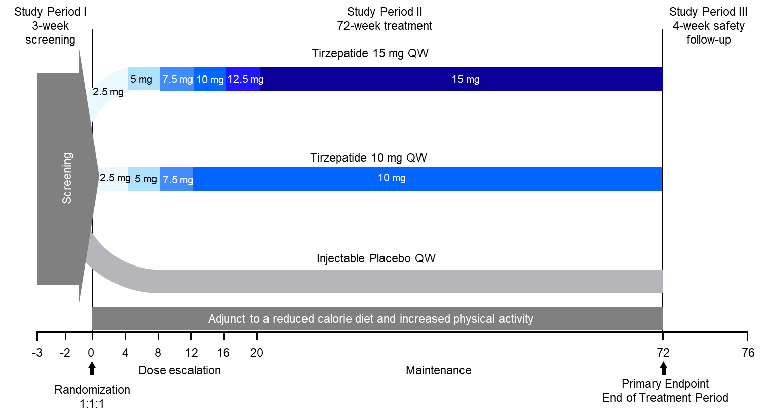
SURMOUNT-2 Study Design¹ A Randomized, Double-Blind, Multicenter, Placebo-Controlled Trial
Key Inclusion Criteria
T2D
≥18 years old
BMI ≥27 kg/m²
HbA1c ≥7% to ≤10%
Stable weight and T2D treatment.
On any oral agent (except DPP-4i or GLP-1 RA)
Randomization stratified by country, sex, and weight effect of baseline antihyperglycemic medications
One study drug dose reduction permitted to help manage intolerable gastrointestinal symptoms.
1. Le Roux C, et al. Obesity (Silver Spring). 2023;31(1):96-110

Slide 5
Objectives of the SURMOUNT 2 Trial
To demonstrate that tirzepatide 10 mg and/or 15 mg a once-weekly is superior to placebo at 72 weeks for:
Primary Objectives
percent change in body weight, AND ≥5% body weight reduction
Key Secondary Objectives
body weight reduction thresholds of: 10% or more, 15% or more, and 20% or more
change in HbA1c achieving HbA1c <7%, HbA1c ≤6.5%, and HbA1c <5.7%; change in fasting glucose
change in waist circumference
change in fasting triglycerides, HDL-cholesterol, non-HDL-cholesterol; systolic blood pressure

Slide 6
Baseline Characteristics
Age | 58.8 years
Female | 57.9 %
Race / Ethnicity
Black | 17.5 %
White | 77.8 %
Hispanic/Latino | 40.9 %
BMI | 36.1 kg/m²
Waist | 114.9 cm
Systolic BP | 130.5 mmHg
HbA1c | 8.02 %
Diabetes Duration | 8.5 years
Note:
Well balanced across treatment groups: placebo, tirzepatide 10 mg, and tirzepatide 15 mg

Slide 7
Weight Reduction Over 72 Weeks
Percent Change
placebo
tirzepatide 10mg
tirzepatide 15mg
Tirzepatide vs. placebo at 72 weeks: p<0.001.
Garvey WT, et al. The Lancet. In Press.

Slide 8
Proportion of Participants Achieving Weight-Reduction Thresholds at 72 Weeks
In Trial
Treatment-Regimen Estimand
On Treatment
Efficacy Estimand
placebo
tirzepatide 10mg
***
***
***
tirzepatide 15mg
***
***
***
***
***
***
***
***
***
***
***
***
***
***
***
***
***
Tirzepatide vs. placebo at 72 weeks: ***p<0.001.
Garvey WT, et al. The Lancet. In Press.

Slide 9
Change in HbA1c
Overall mean HbA1c at baseline = 8.02%
In Trial
Treatment-Regimen Estimand
On Treatment
Efficacy Estimand
placebo
tirzepatide 10mg
tirzepatide 15mg
Change in HbA1c (%)
Change in HbA1c (%)
Tirzepatide vs. placebo at 72 weeks: ***p<0.001.
Garvey WT, et al. The Lancet. In Press.

Slide 10
Proportion of Participants Achieving HbA1c Targets
In Trial
Treatment-Regimen Estimand
On Treatment
Efficacy Estimand
>80% achieved ADA’s recommended target <7%
>75% achieved AACE’s recommended target ≤6.5%
~50% achieved normoglycemia (<5.7%)
placebo
tirzepatide 10mg
tirzepatide 15mg
Tirzepatide vs. placebo at 72 weeks: ***p<0.001. Garvey WT, et al. The Lancet. In Press.

Slide 11
Incidence of Documented Hypoglycemia
No cases of severe hypoglycemia were reported.
mITT population (safety analysis set)

Slide 12
Cardiometabolic Disease Risk Factors
Tirzepatide 15 mg, on treatment
 | Tirzepatide 15 mg | Placebo
Waist Circumference (in) | -13.8 | -3.4
BMI (kg/m²) | -5.7 | -1.2
Systolic BP mmHg | -7.2 | -1.0
Diastolic BP mmHg | -2.6 | -0.2
Triglycerides | -28.6 | -5.8
HDL-c | +8.2 | +1.1
Non-HDL-c | -6.6 | +2.3
Fasting Glucose | -51.7 | -2.4
Fasting Insulin (% of baseline) | -41 | -15
Garvey WT, et al. The Lancet. In Press.

Slide 13
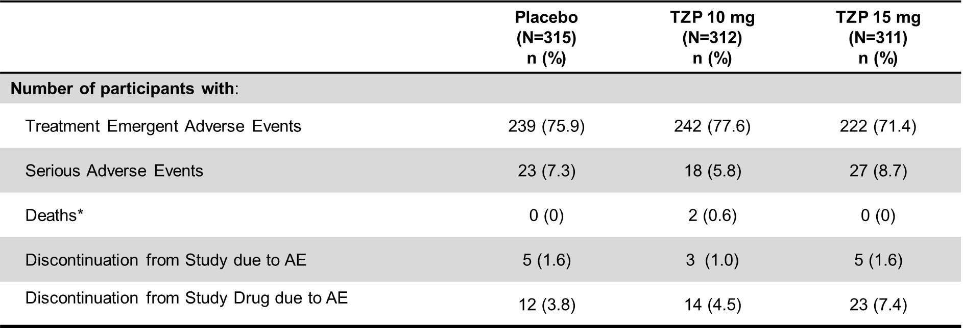
Overview of Adverse Events
Note: Participants may be counted in more than 1 category. mITT population (safety analysis set)
*Deaths are also included as SAEs and discontinuations due to AE.
Similar percentages of participants in the tirzepatide and placebo groups
reported serious adverse events.

Slide 14
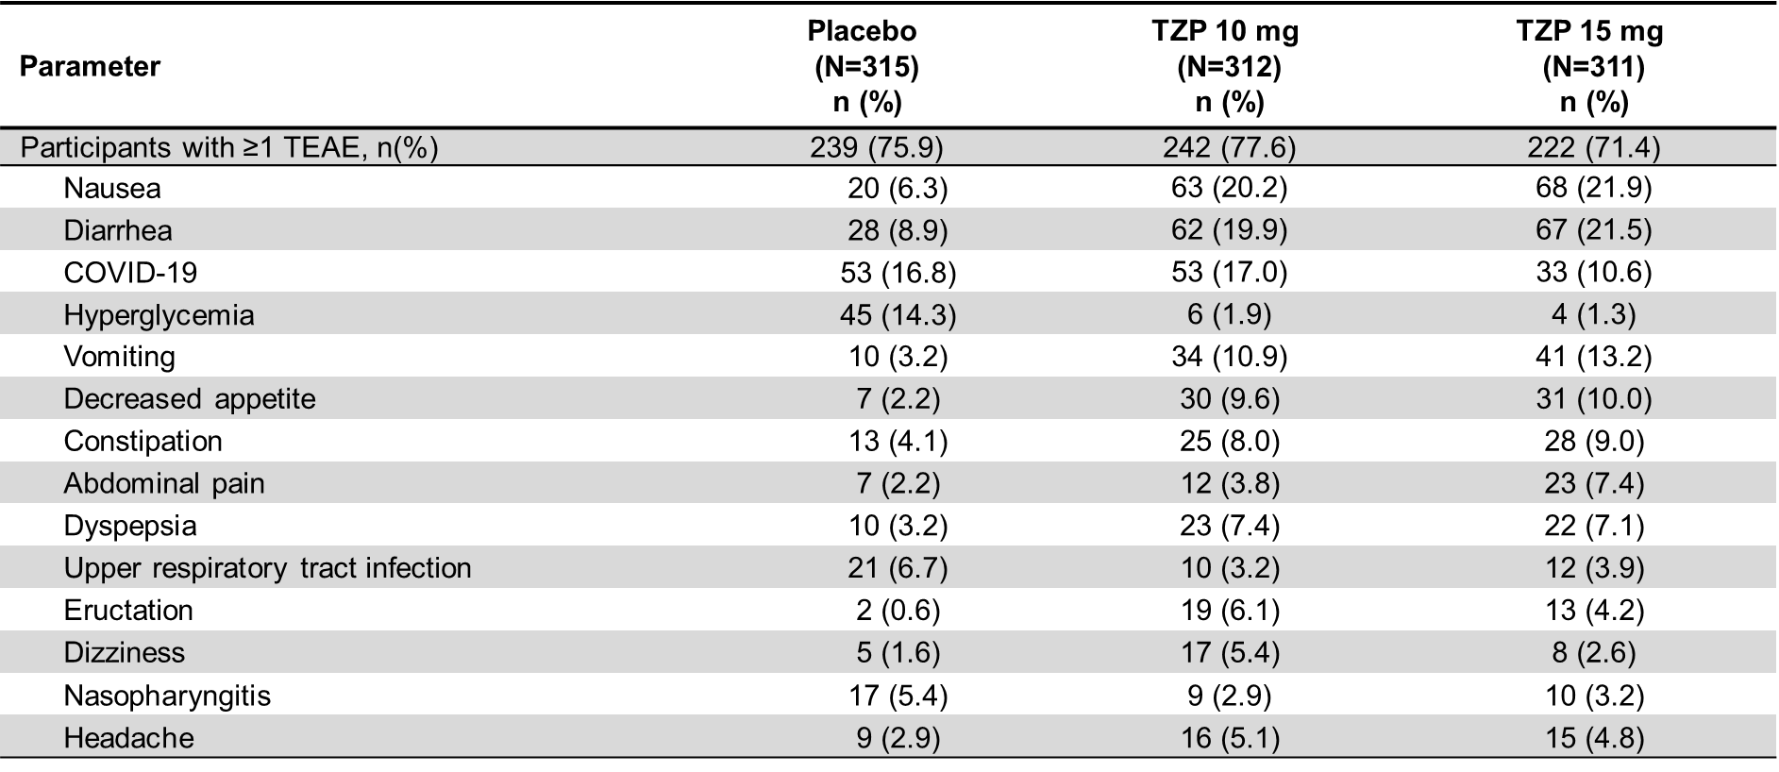
Treatment Emergent Adverse Events
With >5% Frequency in Any Treatment Arm
mITT population (safety analysis set); n (%)=number (percentage) of participants; TEAE=treatment emergent adverse event.
The majority of TEAEs were gastrointestinal in nature.

Slide 15
Conclusions
Both tirzepatide 10 mg and 15 mg demonstrated superior and clinically meaningful body weight reduction versus placebo in participants with obesity/overweight and T2D with ~50% achieving weight loss of 15%
HbA1c fell from 8% at baseline to 5.9%, and was normalized in ~ 50% of participants. This occurred without any episodes of severe hypoglycemia.
Treatment with tirzepatide at both doses translated to clinically meaningful improvements in cardiometabolic risk factors.
The safety profile of tirzepatide in people with obesity/overweight and T2D is consistent with the safety profile of safety profile of tirzepatide observed in the SURPASS studies and other incretin-based therapies for obesity.

Slide 16
Weight Loss Therapies in T2D: Range of Efficacy
0%
35%
5%
10%
15%
20%
25%
30%
2-7%
12-20%
25-40%
Lifestyle
LapBand
Gastric Bypass
2-6%
20-35%
T2D Meds
Gastric Sleeve
4% to up to $≥$22 with second generation meds
Current Obesity Meds without diabetes
4-10%
Current Obesity Meds in T2D
Sufficient to prevent and treat obesity complications and provide glycemic control.
Weight loss becomes primary therapeutic modality in many patients
2nd Generation Obesity Meds in T2D

