Slide 1
This slide deck contains content created, reviewed, and approved by the American Diabetes Association® (ADA). You are free to use the slides in presentations without further permission as long as the slide content is not altered in any way and appropriate attribution is made to the ADA (the ADA's name and logo on the slides constitutes appropriate attribution). Permission is required from the ADA for any commercial use or for reproduction in any print materials (contact permissions@diabetes.org).

Slide 2
Standards of Care in Diabetes—2024 (Standards of Care)

Slide 3
The Standards
Intended to provide clinicians, patients, researchers, payers, and other interested individuals with the components of diabetes care, general treatment goals, and tools to evaluate the quality of care.

Slide 4
Search of scientific diabetes literature over past year
Recommendations revised per new evidence
EVIDENCE
Professional Practice Committee
External peer-review
Reviewed by the ADA’s Board of Directors
Living Standards
PROCESS
FUNDING
Funded out of the ADA’s general revenues
Does not use industry support

Slide 5
The ADA’s Standards of Care—a Living Document
Beginning with the 2018 ADA Standards of Care in Diabetes, the Standards document became a “living” document where notable updates are incorporated
Living Standards updates available at care.diabetesjournals.org/living-standards

Slide 6
The ADA’s Standards of Care—a Living Document
Updates will be made in response to important events inclusive of, but not limited to:
Approval of new treatments (medications or devices) with the potential to impact patient care;
Publication of new findings that support a change to a recommendation and/or evidence level of a recommendation; or
Publication of a consensus document endorsed by the ADA that necessitates an update of the Standards to align content of the documents

Slide 7
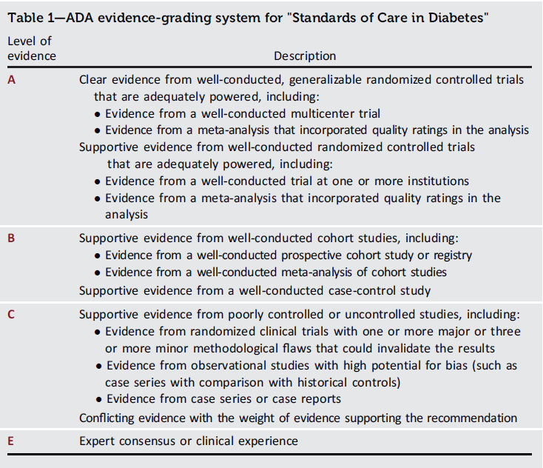
Introduction: Standards of Care in Diabetes - 2024. Diabetes Care 2024;47(Suppl. 1):S1-S4
7
Introduction: Standards of Medical Care in Diabetes - 2019. Diabetes Care 2019;42(Suppl. 1):S1-S2

Slide 8
Table of Contents
Improving Care and Promoting Health in Populations
Diagnosis and Classification of Diabetes
Prevention or Delay of Diabetes and Associated Comorbidities
Comprehensive Medical Evaluation and Assessment of Comorbidities
Facilitating Positive Health Behaviors and Well-being to Improve Health Outcomes
Glycemic Goals and Hypoglycemia
Diabetes Technology
Obesity and Weight Management for the Prevention and Treatment of Type 2 Diabetes
Pharmacologic Approaches to Glycemic Treatment
CVD and Risk Management
CKD and Risk Management
Retinopathy, Neuropathy, and Foot Care
Older Adults
Children and Adolescents
Management of Diabetes in Pregnancy
Diabetes Care in the Hospital
Diabetes and Advocacy
8
Introduction: Standards of Medical Care in Diabetes - 2019. Diabetes Care 2019;42(Suppl. 1):S1-S2

Slide 9
Section 1. Improving Care and Promoting Health in Populations

Slide 10
Diabetes and Population Health
Improving Care and Promoting Health in Populations
1.1 Ensure treatment decisions are timely, rely on evidence-based guidelines, capture key elements within the social determinants of health, and are made collaboratively with people with diabetes and care partners based on individual preferences, prognoses, comorbidities, and informed financial considerations. B
1.2 Align approaches to diabetes management with the Chronic Care Model. This model emphasizes person-centered team care, integrated long-term treatment approaches to diabetes and comorbidities, and ongoing collaborative communication and goal setting between all team members. A

Slide 11
Diabetes and Population Health (continued)
Improving Care and Promoting Health in Populations
1.3 Care systems should facilitate in-person and virtual team-based care; include those knowledgeable and experienced in diabetes management as part of the team; and utilize patient registries, decision support tools, and community involvement to meet needs of individuals with diabetes. B
1.4 Assess diabetes health care maintenance (Table 4.1) using reliable and relevant data metrics to improve processes of care and health outcomes, with attention to care costs, individual preferences and goals for care, and treatment burden. B

Slide 12
Chronic Care Model The Chronic Care Model includes six core elements to optimize the care of people with chronic disease.
1. Delivery system design (moving from a reactive to a proactive care delivery system where planned visits are coordinated through a team-based approach)
2. Self-management support
3. Decision support, particularly at the point of care during a clinical encounter (basing care on evidence-based, effective care guidelines)
4. Clinical information systems (using registries that can provide person-specific and population-based support to the care team)
5. Community resources and policies (identifying or developing resources to support healthy lifestyles)
6. Health systems (to create a quality-oriented
culture)

Slide 13
Tailoring Treatment for Social Context
Improving Care and Promoting Health in Populations
1.5 Assess food insecurity, housing insecurity/homelessness, financial barriers, and social capital/social community support to inform treatment decisions, with referral to appropriate local community resources. A
1.6 Provide people with diabetes with additional self-management support from lay health coaches, navigators, or community health when available. A
1.7 Consider the involvement of community health workers to support the management of diabetes and cardiovascular risk factors, especially in underserved communities and health care systems. B

Slide 14
Section 2. Diagnosis and Classification of Diabetes

Slide 15
Diagnostic Tests for Diabetes
DIAGNOSIS AND CLASSIFICATION of Diabetes
2.1a Diagnose diabetes based on A1C or plasma glucose criteria, either the fasting plasma glucose (FPG) value, 2-h plasma glucose (2-h PG) value during a 75-g oral glucose tolerance test (OGTT), or random glucose value accompanied by classic hyperglycemic symptoms/crises criteria (Table 2.1). A
2.1b In the absence of unequivocal hyperglycemia (e.g., hyperglycemic crises), diagnosis requires confirmatory testing (Table 2.1). A

Slide 16
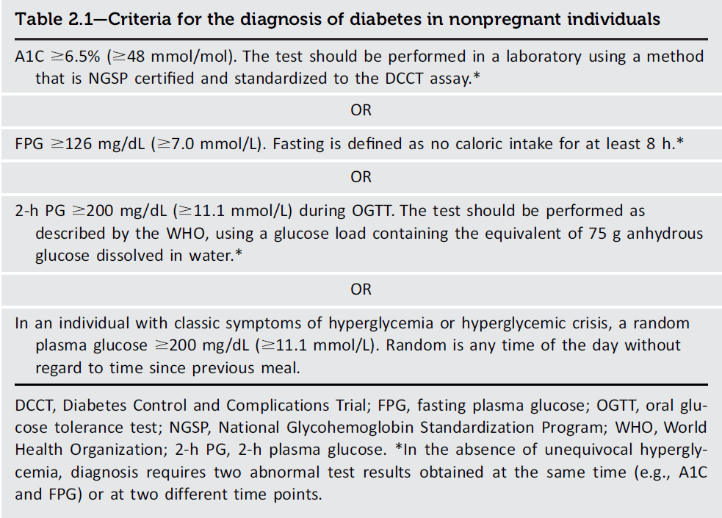
DIAGNOSIS AND CLASSIFICATION of Diabetes
Diagnosis and Classification of Diabetes: Standards of Care in Diabetes - 2024. Diabetes Care 2024;47(Suppl. 1):S20-S42
16
Introduction and Methodology: ElSayed NA, Aleppo G, Aroda VR, et al., American Diabetes Association. Introduction and methodology: Standards of Care in Diabetes—2023. Diabetes Care 2023;46(Suppl. 1):S1–S4

Slide 17
Use of A1C for Screening and Diagnosis of Diabetes
DIAGNOSIS AND CLASSIFICATION of Diabetes
2.2a The A1C test should be performed using a method that is certified by the National Glycohemoglobin Standardization Program (NGSP) as traceable to the Diabetes Control and Complications Trial (DCCT) reference assay. B
2.2b Point-of-care A1C testing for diabetes screening and diagnosis should be restricted to U.S. Food and Drug Administration- approved devices at Clinical Laboratory Improvement Amendments (CLIA)-certified laboratories that perform testing of moderate complexity or higher by trained personnel. B

Slide 18
Use of A1C for Screening and Diagnosis of Diabetes (continued)
DIAGNOSIS AND CLASSIFICATION of Diabetes
2.3 Marked discordance between A1C and repeat blood glucose values should raise the possibility of a problem or interference with either test. B
2.4 In conditions associated with an altered relationship between A1C and glycemia, such as some hemoglobin variants, pregnancy (second and third trimesters and the postpartum period), glucose-6- phosphate dehydrogenase deficiency, HIV, hemodialysis, recent blood loss or transfusion, or erythropoietin therapy, plasma glucose criteria should be used to diagnose diabetes. B

Slide 19
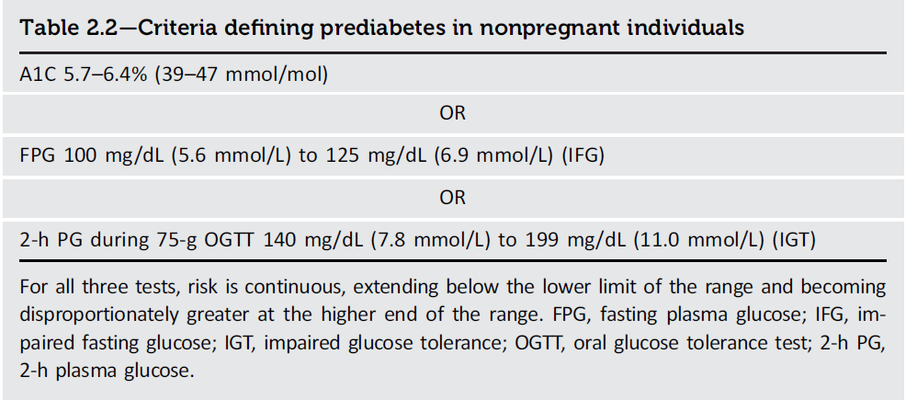
DIAGNOSIS AND CLASSIFICATION of Diabetes
Diagnosis and Classification of Diabetes: Standards of Care in Diabetes - 2024. Diabetes Care 2024;47(Suppl. 1):S20-S42
19
Introduction and Methodology: ElSayed NA, Aleppo G, Aroda VR, et al., American Diabetes Association. Introduction and methodology: Standards of Care in Diabetes—2023. Diabetes Care 2023;46(Suppl. 1):S1–S4

Slide 20
Classification
DIAGNOSIS AND CLASSIFICATION of Diabetes
2.5 Classify people with hyperglycemia into appropriate diagnostic categories to aid in personalized management. E

Slide 21
Classification (continued)
DIAGNOSIS AND CLASSIFICATION of Diabetes
Diabetes can be classified into the following general categories:
Type 1 diabetes (due to autoimmune β-cell destruction, usually leading to absolute insulin deficiency, including latent autoimmune diabetes of adulthood)
Type 2 diabetes (due to a non-autoimmune progressive loss of adequate β-cell insulin secretion, frequently on the background of insulin resistance and metabolic syndrome)
Specific types of diabetes due to other causes, e.g., monogenic diabetes syndromes (such as neonatal diabetes and maturity-onset diabetes of the young), diseases of the exocrine pancreas (such as cystic fibrosis and pancreatitis), and drug- or chemical-induced diabetes (such as with glucocorticoid use, in the treatment of HIV, or after organ transplantation)
Gestational diabetes mellitus (diabetes diagnosed in the second or third trimester of pregnancy that was not clearly overt diabetes prior to gestation or other types of diabetes occurring throughout pregnancy, such as type 1 diabetes).

Slide 22
Type 1 Diabetes
DIAGNOSIS AND CLASSIFICATION of Diabetes
2.6 Screening for presymptomatic type 1 diabetes may be done by detection of autoantibodies to insulin, glutamic acid decarboxylase (GAD), islet antigen 2 (IA-2), or zinc transporter 8 (ZnT8). B
2.7 Having multiple confirmed islet autoantibodies is a risk factor for clinical diabetes. Testing for dysglycemia may be used to further forecast near-term risk. When multiple islet autoantibodies are identified, referral to a specialized center for further evaluation and/or consideration of a clinical trial or approved therapy to potentially delay development of clinical diabetes should be considered. B
2.8 Standardized islet autoantibody tests are recommended for classification of diabetes in adults who have phenotypic risk factors that overlap with those for type 1 diabetes (e.g., younger age at diagnosis, unintentional weight loss, ketoacidosis, or short time to insulin treatment). E

Slide 23
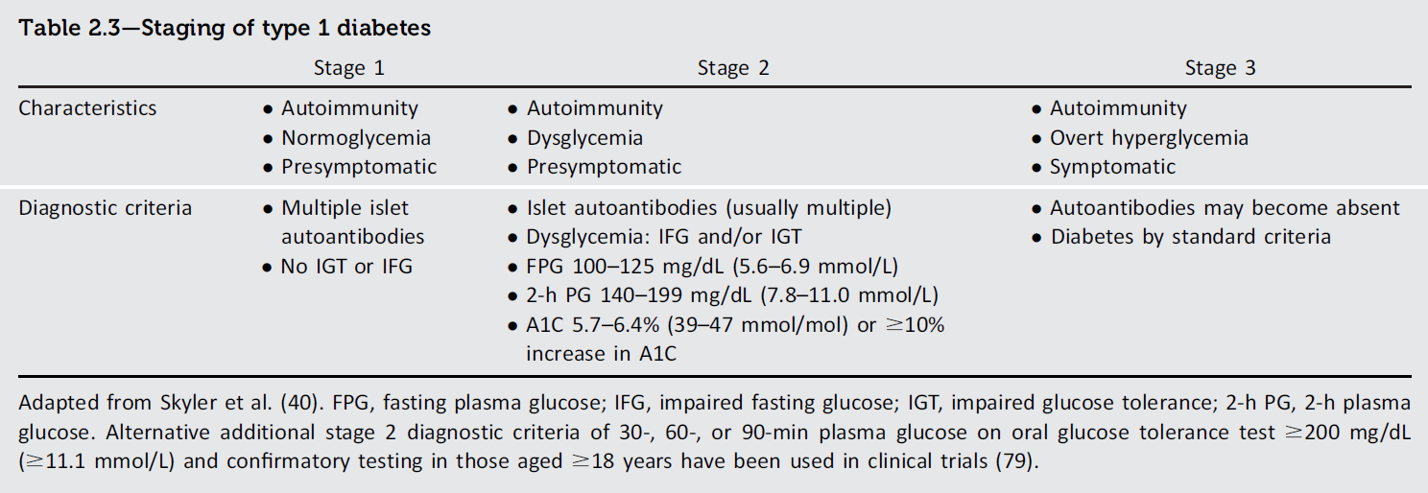
DIAGNOSIS AND CLASSIFICATION of Diabetes
Diagnosis and Classification of Diabetes: Standards of Care in Diabetes - 2024. Diabetes Care 2024;47(Suppl. 1):S20-S42
23
Introduction and Methodology: ElSayed NA, Aleppo G, Aroda VR, et al., American Diabetes Association. Introduction and methodology: Standards of Care in Diabetes—2023. Diabetes Care 2023;46(Suppl. 1):S1–S4

Slide 24
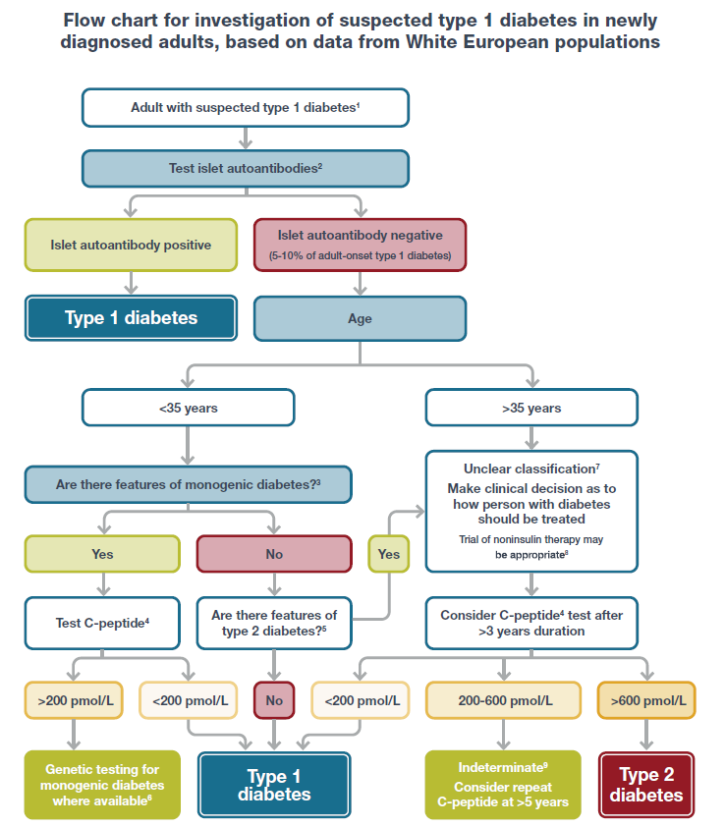
DIAGNOSIS AND CLASSIFICATION of Diabetes
Diagnosis and Classification of Diabetes: Standards of Care in Diabetes - 2024. Diabetes Care 2024;47(Suppl. 1):S20-S42
24
Introduction and Methodology: ElSayed NA, Aleppo G, Aroda VR, et al., American Diabetes Association. Introduction and methodology: Standards of Care in Diabetes—2023. Diabetes Care 2023;46(Suppl. 1):S1–S4

Slide 25
Prediabetes and Type 2 Diabetes
DIAGNOSIS AND CLASSIFICATION of Diabetes
2.9 Screening for prediabetes and type 2 diabetes with an assessment of risk factors or validated risk calculator should be done in asymptomatic adults. B
2.10a Testing for prediabetes or type 2 diabetes in asymptomatic people should be considered in adults of any age with overweight or obesity who have one or more risk factors (Table 2.4). B Testing for prediabetes or type 2 diabetes in asymptomatic people should be considered in adults of any age with overweight or obesity who have one or more risk factors (Table 2.4). B
2.10b For all other people, screening should begin at age 35 years. B

Slide 26
Prediabetes and Type 2 Diabetes (continued)
DIAGNOSIS AND CLASSIFICATION of Diabetes
2.11 If tests are normal, repeat screening recommended at a minimum of 3-year intervals is reasonable, sooner with symptoms or change in risk (e.g., weight gain). C
2.12 To screen for prediabetes and type 2 diabetes, FPG, 2-h PG during 75-g OGTT, and A1C are each appropriate (Table 2.1 and Table 2.2). B
2.13 When using OGTT as a screen for prediabetes or diabetes, adequate carbohydrate intake (at least 150 g/day) should be assured for 3 days prior to testing. A

Slide 27
Prediabetes and Type 2 Diabetes (continued)
DIAGNOSIS AND CLASSIFICATION of Diabetes
2.14 Risk-based screening for prediabetes or type 2 diabetes should be considered after the onset of puberty or after 10 years of age, whichever occurs earlier, in children and adolescents with overweight (BMI ≥ 85th percentile) or obesity (BMI ≥ 95th percentile) and who have one or more risk factors for diabetes. (See Table 2.5 for evidence grading of risk factors.) B
2.15a Consider screening people for prediabetes or diabetes if on certain medications, such as glucocorticoids, statins, thiazide diuretics, some HIV medications, and second-generation antipsychotic medications, as these agents are known to increase the risk of these conditions. E

Slide 28
Prediabetes and Type 2 Diabetes (continued)
DIAGNOSIS AND CLASSIFICATION of Diabetes
2.15b In people who are prescribed second-generation antipsychotic medications, screen for prediabetes and diabetes at baseline and repeat 12–16 weeks after medication initiation or sooner, if clinically indicated, and annually. B
2.16 People with HIV should be screened for diabetes and prediabetes with an FPG test before starting antiretroviral therapy, at the time of switching antiretroviral therapy, and 3–6 months after starting or switching antiretroviral therapy. If initial screening results are normal, FPG should be checked annually. E

Slide 29
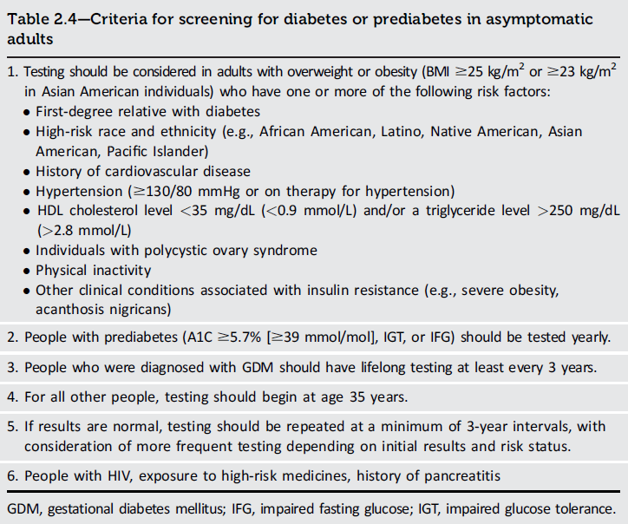
DIAGNOSIS AND CLASSIFICATION of Diabetes
Diagnosis and Classification of Diabetes: Standards of Care in Diabetes - 2024. Diabetes Care 2024;47(Suppl. 1):S20-S42

Slide 30
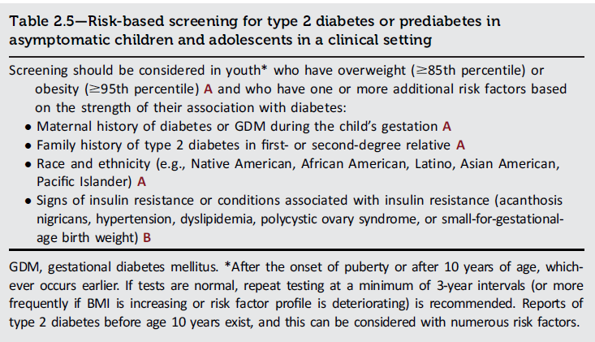
DIAGNOSIS AND CLASSIFICATION of Diabetes
Diagnosis and Classification of Diabetes: Standards of Care in Diabetes - 2024. Diabetes Care 2024;47(Suppl. 1):S20-S42

Slide 31
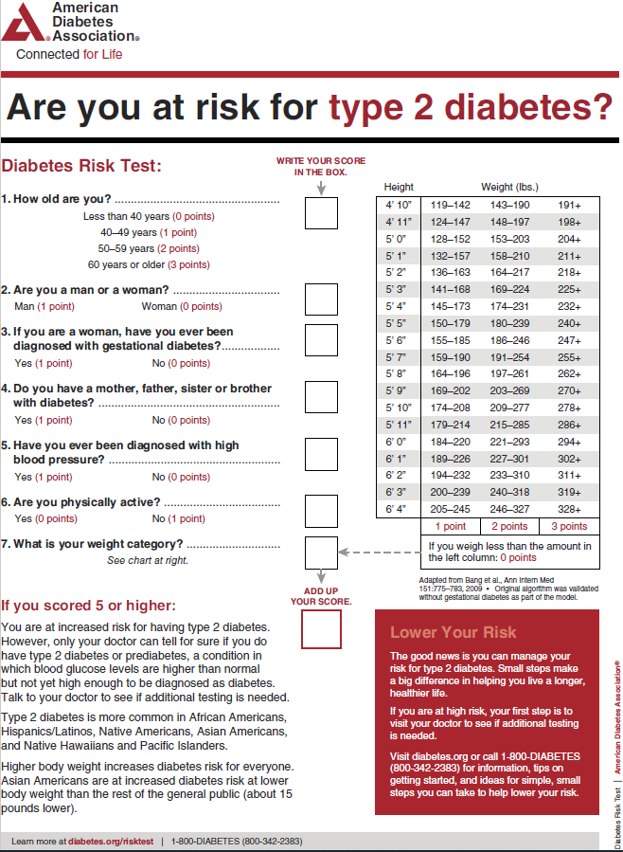
DIAGNOSIS AND CLASSIFICATION of Diabetes
diabetes.org/socrisktest
Diagnosis and Classification of Diabetes: Standards of Care in Diabetes - 2024. Diabetes Care 2024;47(Suppl. 1):S20-S42

Slide 32
Pancreatic Diabetes or Diabetes in the Context of the Exocrine Pancreas
DIAGNOSIS AND CLASSIFICATION of Diabetes
2.17 Screen people for diabetes within 3–6 months following an episode of acute pancreatitis and annually thereafter. Screening for diabetes is recommended annually for people with chronic pancreatitis. E

Slide 33
Cystic Fibrosis-Related Diabetes
DIAGNOSIS AND CLASSIFICATION of Diabetes
2.18 Annual screening for cystic fibrosis-related diabetes (CFRD) with an OGTT should begin by age 10 years in all people with cystic fibrosis not previously diagnosed with CFRD. B
2.19 A1C is not recommended as a screening test for CFRD due to low sensitivity. However, a value of ≥ 6.5% (≥48 mmol/mol) is consistent with a diagnosis of CFRD. B
2.20 Beginning 5 years after the diagnosis of CFRD, annual monitoring for complications of diabetes is recommended. E

Slide 34
Posttransplantation Diabetes Mellitus
DIAGNOSIS AND CLASSIFICATION of Diabetes
2.21 After organ transplantation, screening for hyperglycemia should be done. A formal diagnosis of posttransplantation diabetes mellitus (PTDM) is best made once the individual is stable on an immunosuppressive plan and in the absence of an acute infection. B
2.22 The OGTT is the preferred test to make a diagnosis of PTDM. B
2.23 Immunosuppressive plans shown to provide the best outcomes for individuals and graft survival should be used, irrespective of PTDM risk. E

Slide 35
Monogenic Diabetes Syndromes
DIAGNOSIS AND CLASSIFICATION of Diabetes
2.24a Regardless of current age, all people diagnosed with diabetes in the first 6 months of life should have immediate genetic testing for neonatal diabetes. A
2.24b Children and young adults who do not have typical characteristics of type 1 or type 2 diabetes and who often have a family history of diabetes in successive generations (suggestive of an autosomal dominant pattern of inheritance) should have genetic testing for maturity-onset diabetes of the young (MODY). A
2.24c In both instances, consultation with a center specializing in diabetes genetics is recommended to understand the significance of genetic mutations and how best to approach further evaluation, treatment, and genetic counseling. E

Slide 36
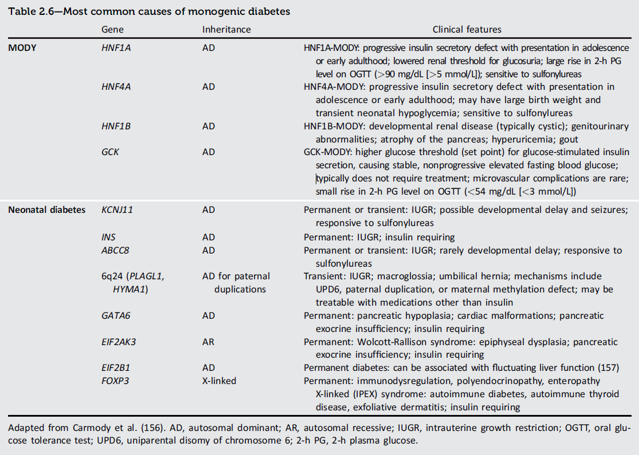
DIAGNOSIS AND CLASSIFICATION of Diabetes
Diagnosis and Classification of Diabetes: Standards of Care in Diabetes - 2024. Diabetes Care 2024;47(Suppl. 1):S20-S42

Slide 37
DIAGNOSIS AND CLASSIFICATION of Diabetes
The diagnosis of monogenic diabetes should be considered in children and adults diagnosed with diabetes in early adulthood with the following findings:
Diabetes diagnosed within the first 6 months of life (with occasional cases presenting later, mostly INS and ABCC8 mutations)
Diabetes without typical features of type 1 or type 2 diabetes (negative diabetes-associated autoantibodies, no obesity, and lacking other metabolic features, especially with strong family history of diabetes)
Stable, mild fasting hyperglycemia (100–150 mg/dL [5.6–8.5 mmol/L]), stable A1C between 5.6% and 7.6% (between 38 and 60 mmol/mol), especially if no obesity

Slide 38
Gestational Diabetes Mellitus
DIAGNOSIS AND CLASSIFICATION of Diabetes
2.25 In individuals who are planning pregnancy, screen those with risk factors (Table 2.4) B and consider testing all individuals of childbearing potential for undiagnosed prediabetes or diabetes. E
2.26a Before 15 weeks of gestation, test individuals with risk factors (Table 2.4) B and consider testing all individuals E for undiagnosed diabetes at the first prenatal visit using standard diagnostic criteria if not screened preconception.
2.26b Before 15 weeks of gestation, screen for abnormal glucose metabolism to identify individuals who are at higher risk of adverse pregnancy and neonatal outcomes, are more likely to need insulin, and are at high risk of a later gestational diabetes mellitus (GDM) diagnosis. B Early treatment for individuals with abnormal glucose metabolism may provide some benefit. E

Slide 39
Gestational Diabetes Mellitus (continued)
DIAGNOSIS AND CLASSIFICATION of Diabetes
2.26c Screen for early abnormal glucose metabolism with dysglycemia using FPG of 110–125 mg/dL (6.1–6.9 mmol/L) or A1C 5.9–6.4% (41–47 mmol/mol). B
2.27 Screen for GDM at 24–28 weeks of gestation in pregnant individuals not previously found to have diabetes or high-risk abnormal glucose metabolism detected earlier in the current pregnancy. A
2.28 Screen individuals with GDM for prediabetes or diabetes at 4–12 weeks postpartum, using the 75-g OGTT and clinically appropriate nonpregnancy diagnostic criteria. A
2.29 Individuals with a history of GDM should have lifelong screening for the development of prediabetes or diabetes at least every 3 years. B

Slide 40
DIAGNOSIS AND CLASSIFICATION of Diabetes
GDM diagnosis (Table 2.7) can be accomplished with either of two strategies:
1. The “one-step” 75-g OGTT derived from the IADPSG criteria, or
2. The older “two-step” approach with a 50-g (nonfasting) screen followed by a 100-g OGTT for those who screen positive based on the work of Carpenter-Coustan’s interpretation of the older O’Sullivan and Mahan criteria.

Slide 41
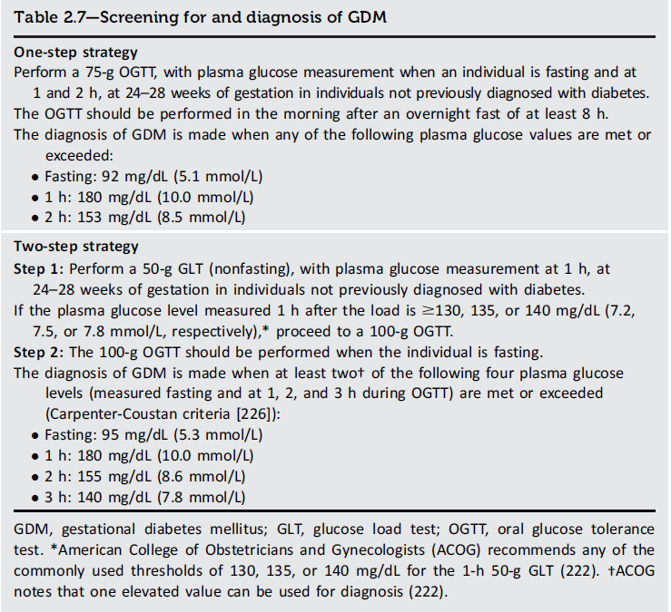
DIAGNOSIS AND CLASSIFICATION of Diabetes
Diagnosis and Classification of Diabetes: Standards of Care in Diabetes - 2024. Diabetes Care 2024;47(Suppl. 1):S20-S42

Slide 42
Section 3. Prevention or Delay of Diabetes and Associated Comorbidities

Slide 43
Overall Recommendations
Prevention or Delay of Diabetes AND ASSOCIATED COMORBIDITIES
3.1 In people with prediabetes, monitor for the development of type 2 diabetes at least annually. Modify based on individual risk assessment. E
3.2 In people with preclinical type 1 diabetes, monitor for disease progression using A1C approximately every 6 months and 75-g oral glucose tolerance test (i.e., fasting and 2-h plasma glucose) annually. Modify frequency of monitoring based on individual risk assessment based on age, number and type of autoantibodies, and glycemic metrics. E

Slide 44
Lifestyle Behavior Change for Diabetes Prevention
Prevention or Delay of Diabetes AND ASSOCIATED COMORBIDITIES
3.3 Refer adults with overweight or obesity at high risk of type 2 diabetes, as seen in the Diabetes Prevention Program (DPP), to an intensive lifestyle behavior change program to achieve and maintain a weight reduction of at least 7% of initial body weight through healthy reduced-calorie diet and ≥ 150 min/week of moderate- intensity physical activity. A
3.4 A variety of eating patterns can be considered to prevent type 2 diabetes in individuals with prediabetes. B

Slide 45
Lifestyle Behavior Change for Diabetes Prevention (continued)
Prevention or Delay of Diabetes AND ASSOCIATED COMORBIDITIES
3.5 Given the cost-effectiveness of lifestyle behavior modification programs for diabetes prevention, such diabetes prevention programs should be offered to adults at high risk of type 2 diabetes. A Diabetes prevention programs should be covered by third-party payers, and inconsistencies in access should be addressed. E
3.6 Based on individual preference, certified technology-assisted diabetes prevention programs may be effective in preventing type 2 diabetes and should be considered. B

Slide 46
Pharmacologic Interventions
Prevention or Delay of Diabetes AND ASSOCIATED COMORBIDITIES
3.7 Metformin for the prevention of type 2 diabetes should be considered in adults at high risk of type 2 diabetes, as typified by the DPP, especially those aged 25–59 years with BMI ≥35 kg/m², higher fasting plasma glucose (e.g., ≥ 110 mg/dL [≥ 6 mmol/L]), and higher A1C (e.g., ≥ 6.0% [≥ 42 mmol/mol]), and in individuals with prior gestational diabetes mellitus. A
3.8 Long-term use of metformin may be associated with vitamin B12 deficiency. Consider periodic assessment of vitamin B12 level in metformin-treated individuals, especially in those with anemia or peripheral neuropathy. B

Slide 47
Prevention of Vascular Disease and Mortality
Prevention or Delay of Diabetes AND ASSOCIATED COMORBIDITIES
3.9 Prediabetes is associated with heightened cardiovascular risk, therefore, screening for and treatment of modifiable risk factors for cardiovascular disease are suggested. B
3.10 Statin therapy may increase the risk of type 2 diabetes in people at high risk of developing type 2 diabetes. In such individuals, glucose status should be monitored regularly and diabetes prevention approaches reinforced. It is not recommended that statins be discontinued for this adverse effect. B
3.11 In people with a history of stroke and evidence of insulin resistance and prediabetes, pioglitazone may be considered to lower the risk of stroke or myocardial infarction. However, this benefit needs to be balanced with the increased risk of weight gain, edema, and fractures. A Lower doses may mitigate the risk of adverse effects but may be less effective. C

Slide 48
Person-Centered Care Goals
Prevention or Delay of Diabetes AND ASSOCIATED COMORBIDITIES
3.12 In adults with overweight or obesity at high risk of type 2 diabetes, care goals should include weight loss and maintenance, minimizing the progression of hyperglycemia, and attention to cardiovascular risk. B
3.13 Pharmacotherapy (e.g., for weight management, minimizing the progression of hyperglycemia, and cardiovascular risk reduction) may be considered to support person-centered care goals. B
3.14 More intensive preventive approaches should be considered in individuals who are at particularly high risk of progression to diabetes, including individuals with BMI ≥35 kg/m2, those at higher glucose levels (e.g., fasting plasma glucose 110–125 mg/dL [6.1–6.9mmol/L], 2–h post-challenge glucose 173–199mg/dL [9.6–11.0mmol/L], and A1C ≥ 6.0% [≥ 42 mmol/mol]), and individuals with a history of gestational diabetes mellitus. A

Slide 49
Pharmacologic Interventions do Delay Symptomatic Type 1 Diabetes
Prevention or Delay of Diabetes AND ASSOCIATED COMORBIDITIES
3.15 Teplizumab-mzwv infusion to delay the onset of symptomatic type 1 diabetes (stage 3) should be considered in selected individuals aged ≥8 years with stage 2 type 1 diabetes. Management should be in a specialized setting with appropriately trained personnel. B

Slide 50
Section 4. Comprehensive Medical Evaluation and Assessment of Comorbidities

Slide 51
Person-Centered Collaborative Care
Comprehensive Medical Evaluation and Assessment of Comorbidities
4.1 A person-centered communication style that uses person-centered, culturally sensitive, strength-based language and active listening that elicits individual preferences and beliefs and assesses literacy, numeracy, and potential barriers to care should be used to optimize health outcomes and health-related quality of life. B
4.2 People with diabetes can benefit from a coordinated interprofessional team that may include and is not limited to diabetes care and education specialists, primary care and subspecialty clinicians, nurses, registered dietitian nutritionists, exercise specialists, pharmacists, dentists, podiatrists, and behavioral health professionals. E

Slide 52
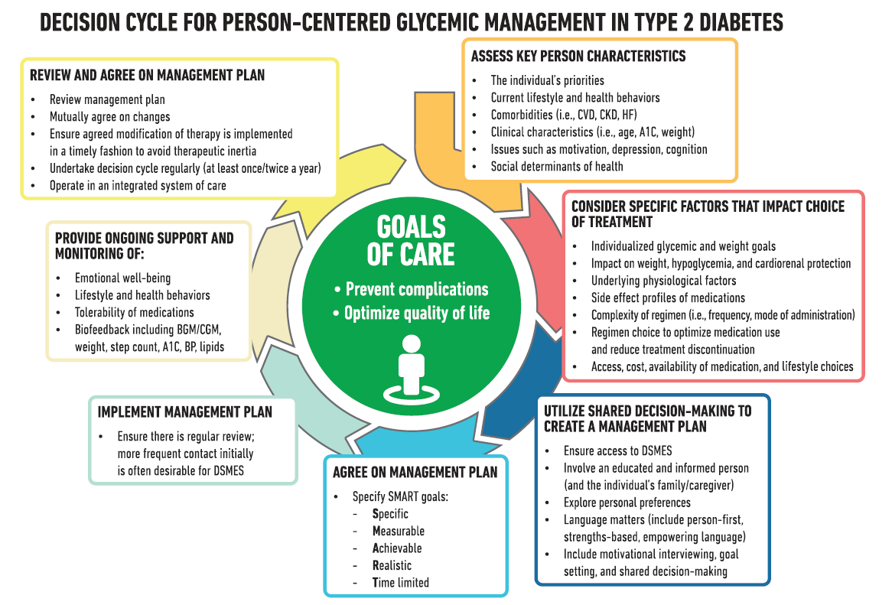
Comprehensive Medical Evaluation and Assessment of Comorbidities
Comprehensive Medical Evaluation and Assessment of Comorbidities: Standards of Care in Diabetes - 2024. Diabetes Care 2024;47(Suppl. 1):S52-S76

Slide 53
Use of Empowering Language
Comprehensive Medical Evaluation and Assessment of Comorbidities
Five key consensus recommendations for language use:
Use language that is neutral, non-judgmental, and based on facts, actions, or physiology/biology.
Use language that is free from stigma.
Use language that is strength based, respectful, and inclusive and that imparts hope.
Use language that fosters collaboration between people with diabetes and health care professionals.
Use language that is person centered (e.g., “person with diabetes” is preferred over “diabetic”).

Slide 54
Comprehensive Medical Evaluation
Comprehensive Medical Evaluation and Assessment of Comorbidities
4.3 A complete medical evaluation should be performed at the initial visit to:
• Confirm the diagnosis and classify diabetes. A
• Evaluate for diabetes complications, potential comorbid conditions, and overall health status. A
• Identify care partners and support system. E
• Assess social determinants of health and structural barriers to optimal health and health care. A
• Review previous treatment and risk factor management in people with established diabetes. A
• Begin engagement with the person with diabetes in the formulation of a care management plan including initial goals of care. A
• Develop a plan for continuing care. A

Slide 55
Comprehensive Medical Evaluation (continued)
Comprehensive Medical Evaluation and Assessment of Comorbidities
4.4 A follow-up visit should include most components of the initial comprehensive medical evaluation (Table 4.1). A
4.5 Ongoing management should be guided by the assessment of overall health status, diabetes complications, cardiovascular risk, hypoglycemia risk, and shared decision-making to set therapeutic goals. B

Slide 56
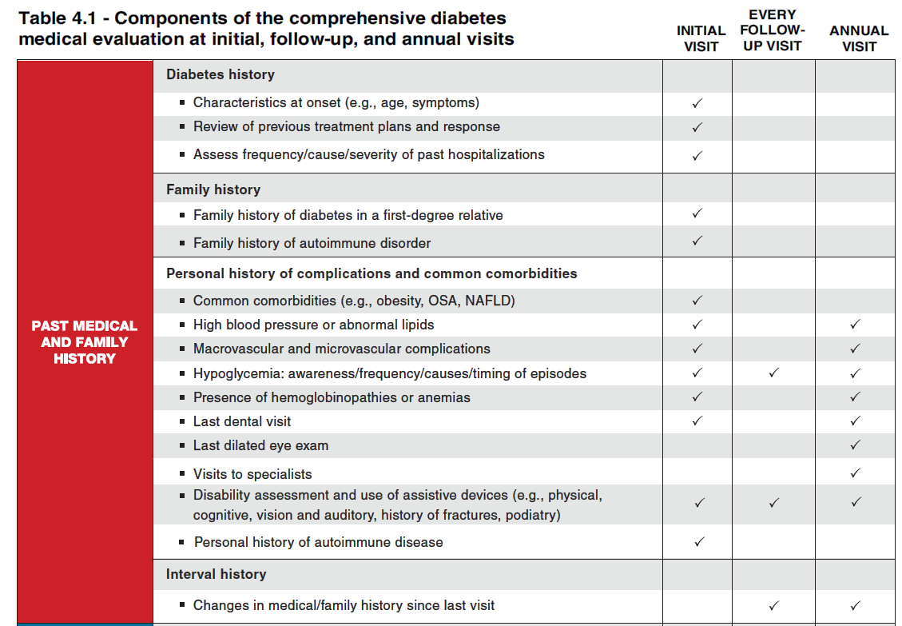
Comprehensive Medical Evaluation and Assessment of Comorbidities
Comprehensive Medical Evaluation and Assessment of Comorbidities: Standards of Care in Diabetes - 2024. Diabetes Care 2024;47(Suppl. 1):S52-S76

Slide 57
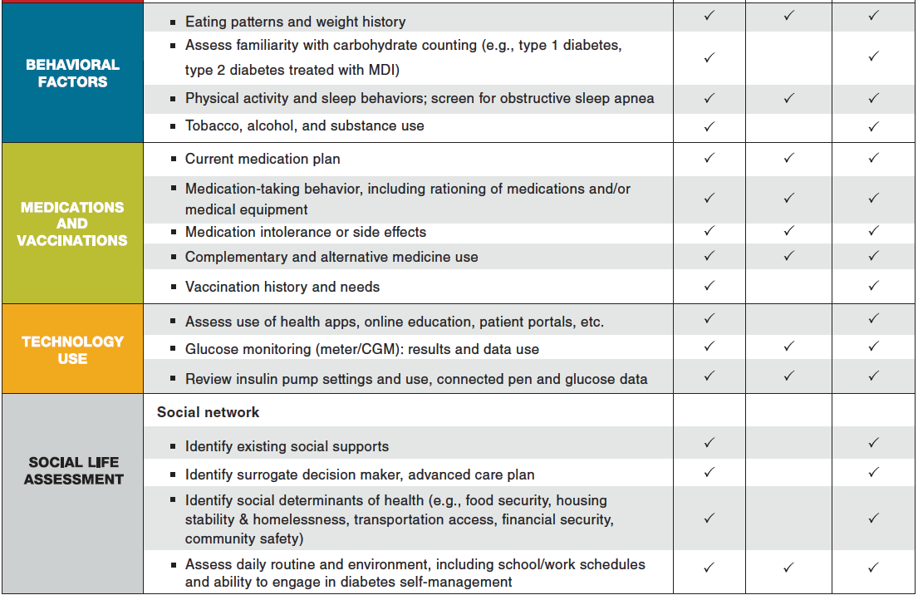
Comprehensive Medical Evaluation and Assessment of Comorbidities
Comprehensive Medical Evaluation and Assessment of Comorbidities: Standards of Care in Diabetes - 2024. Diabetes Care 2024;47(Suppl. 1):S52-S76

Slide 58
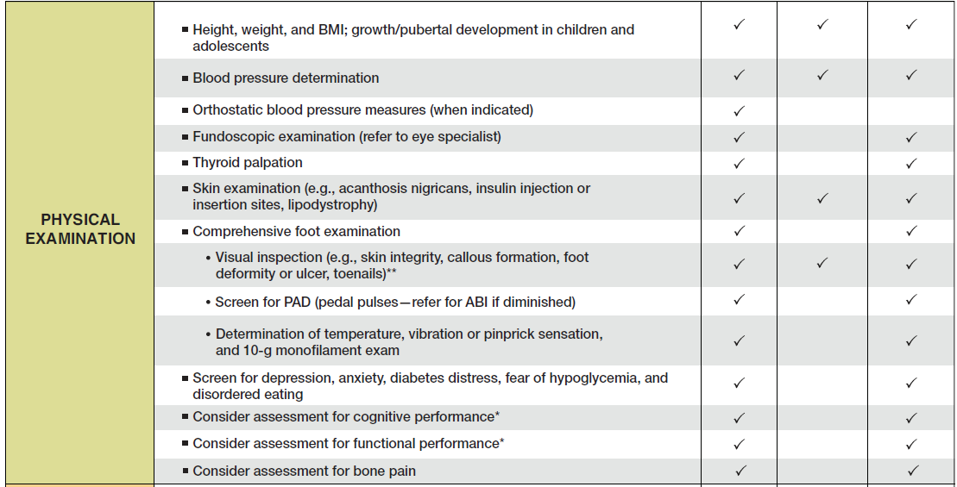
Comprehensive Medical Evaluation and Assessment of Comorbidities
Comprehensive Medical Evaluation and Assessment of Comorbidities: Standards of Care in Diabetes - 2024. Diabetes Care 2024;47(Suppl. 1):S52-S76

Slide 59
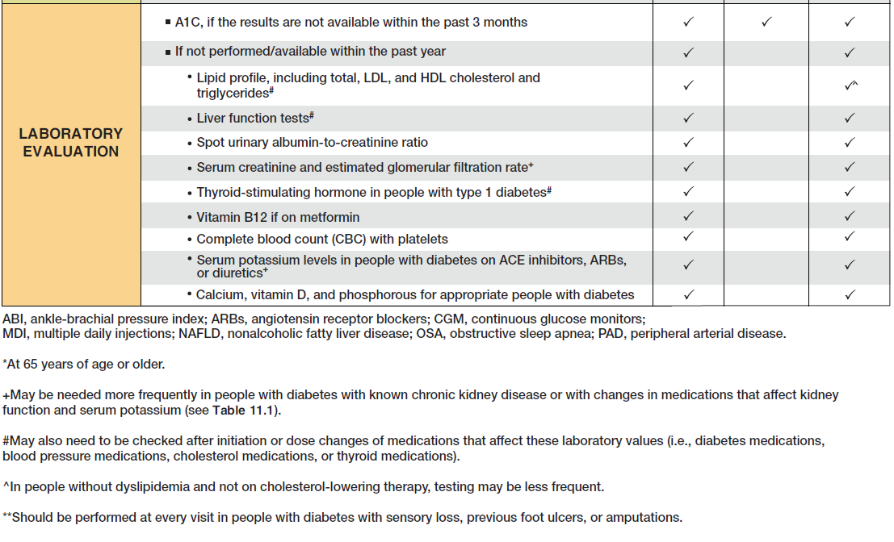
Comprehensive Medical Evaluation and Assessment of Comorbidities
Comprehensive Medical Evaluation and Assessment of Comorbidities: Standards of Care in Diabetes - 2024. Diabetes Care 2024;47(Suppl. 1):S52-S76

Slide 60
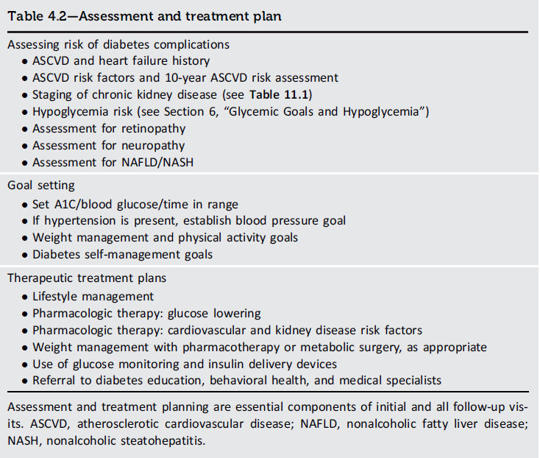
Comprehensive Medical Evaluation and Assessment of Comorbidities
Comprehensive Medical Evaluation and Assessment of Comorbidities: Standards of Care in Diabetes - 2024. Diabetes Care 2024;47(Suppl. 1):S52-S76

Slide 61
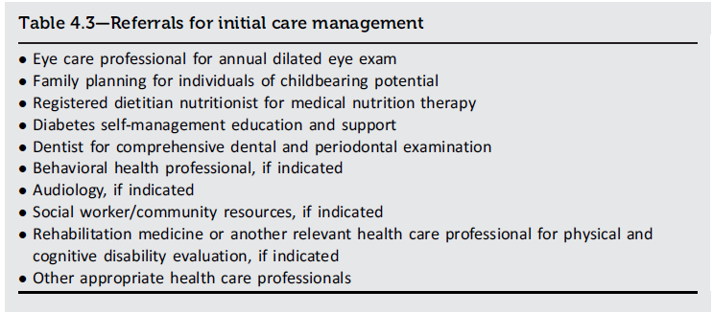
Comprehensive Medical Evaluation and Assessment of Comorbidities
Comprehensive Medical Evaluation and Assessment of Comorbidities: Standards of Care in Diabetes - 2024. Diabetes Care 2024;47(Suppl. 1):S52-S76

Slide 62
Immunizations
Comprehensive Medical Evaluation and Assessment of Comorbidities
4.6 Provide routinely recommended vaccinations for children and adults diabetes as indicated by age (see Table 4.4). A

Slide 63
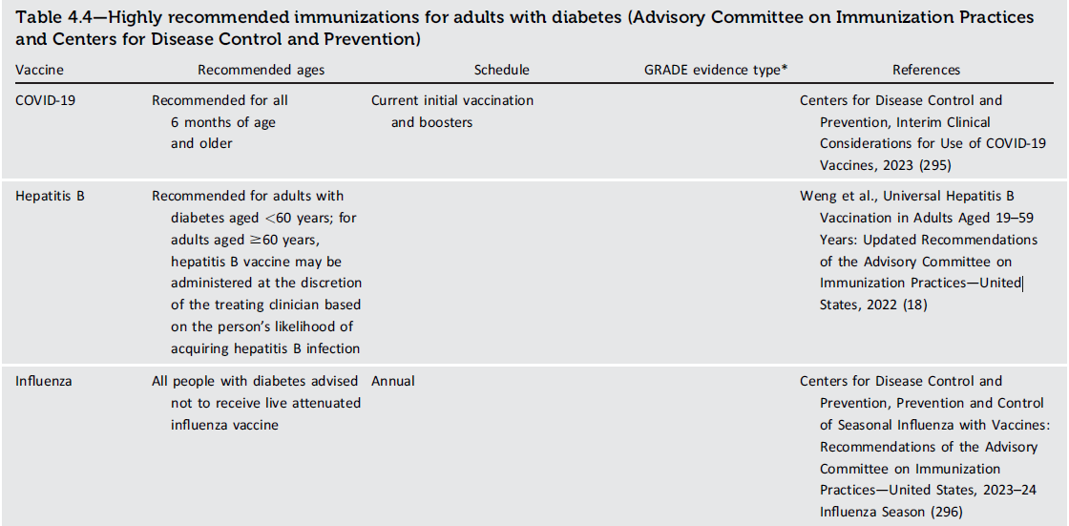
Immunizations (continued)
Comprehensive Medical Evaluation and Assessment of Comorbidities

Slide 64
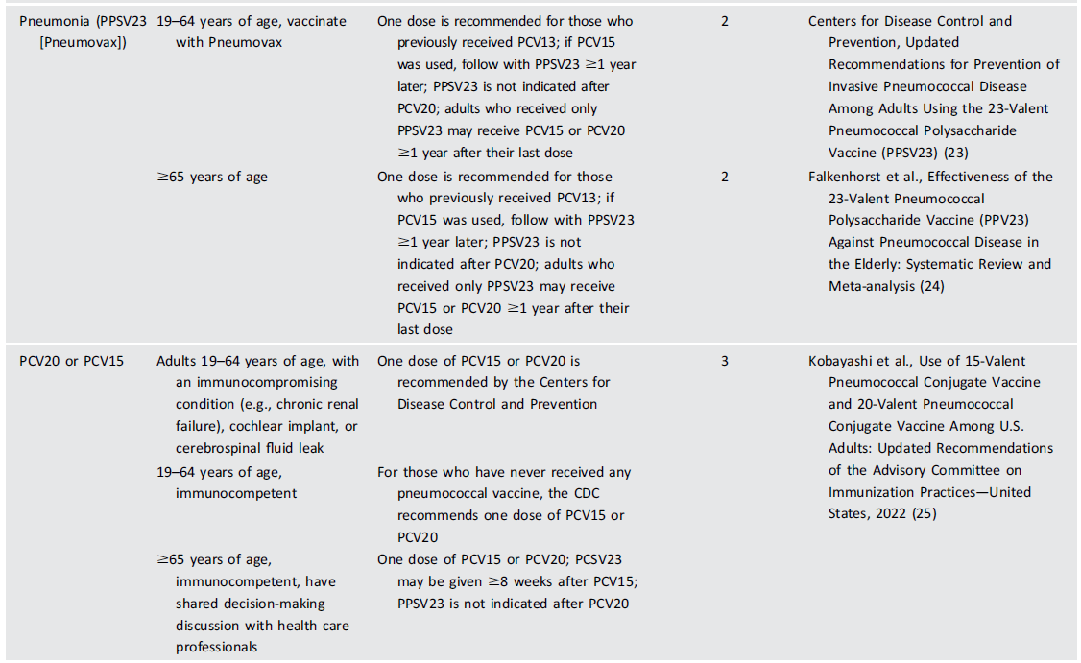
Immunizations (continued)
Comprehensive Medical Evaluation and Assessment of Comorbidities

Slide 65
Immunizations (continued)
Comprehensive Medical Evaluation and Assessment of Comorbidities

Slide 66
Autoimmune Diseases
Comprehensive Medical Evaluation and Assessment of Comorbidities
4.7 People with type 1 diabetes should be screened for autoimmune thyroid disease soon after diagnosis and periodically thereafter. B
4.8 Adults with type 1 diabetes should be screened for celiac disease in the presence of gastrointestinal symptoms, signs, laboratory manifestations, or clinical suspicion suggestive of celiac disease. B

Slide 67
Bone Health
Comprehensive Medical Evaluation and Assessment of Comorbidities
4.9 Fracture risk should be assessed in older adults with diabetes as a part of routine care in diabetes clinical practice, according to risk factors and comorbidities. A
4.10 Monitor bone mineral density using dual-energy X-ray absorptiometry of high-risk older adults with diabetes (aged >65 years) and younger individuals with diabetes and multiple risk factors every 2–3 years. A
4.11 Clinicians should consider the potential adverse impact on bone health when selecting pharmacological options to lower glucose levels in people with diabetes. Prioritizing medications with a proven safety profile for bones is recommended, particularly for those at elevated risk for fractures. A

Slide 68
Bone Health (continued)
Comprehensive Medical Evaluation and Assessment of Comorbidities
4.12 To reduce the risk of falls and fractures, glycemic management goals should be individualized for people with diabetes at a higher risk of fracture. C Prioritize use of glucose-lowering medications that are associated with low risk for hypoglycemia to avoid falls. E
4.13 Advise people with diabetes on their intake of calcium and vitamin D to ensure it meets the recommended daily allowance for those at risk for fracture, either through their diet or supplemental means. B
4.14 Antiresorptive medications and osteoanabolic agents should be considered for people with diabetes who have low bone mineral density with a T-score ≤ -2.0 or have experienced fragility fractures. B

Slide 69
Cognitive Impairment/Dementia
Comprehensive Medical Evaluation and Assessment of Comorbidities
4.15 In the presence of cognitive impairment, diabetes treatment plans should be simplified as much as possible and tailored to minimize the risk of hypoglycemia. B

Slide 70
Diabetes and COVID-19
Comprehensive Medical Evaluation and Assessment of Comorbidities
4.16 Health care professionals should help people with diabetes aim to achieve individualized glycemic goals to reduce the risk of macrovascular and microvascular risk as well as reduce the risk of coronavirus disease 2019 (COVID-19) and its complications. B
4.17 As we move into the recovery phase, diabetes health care services and practitioners should address the impact of the COVID-19 pandemic in higher- risk groups, including minority, socioeconomically deprived, and older populations. B
4.18 People with diabetes who have been infected with severe acute respiratory syndrome coronavirus 2 (SARSCoV-2) should be followed up in the longer term to assess complications and symptoms of long COVID-19. E

Slide 71
Diabetes and COVID-19 (continued)
Comprehensive Medical Evaluation and Assessment of Comorbidities
4.19 New-onset diabetes cases should receive routine clinic follow-up to determine if the condition is transient. B
4.20 There is no clear indication to change prescribing of glucose-lowering therapies in people with diabetes infected by SARS-CoV-2. B
4.21 People with diabetes should be prioritized and offered SARS-CoV-2 vaccines and vaccine boosters. B

Slide 72
Disability
Comprehensive Medical Evaluation and Assessment of Comorbidities
4.22 An assessment of disability should be performed at each visit for people with diabetes. If a disability is impacting functional ability or capacity to manage their diabetes, a referral should be made to an appropriate health care professional specializing in disability (e.g., physical medicine and rehabilitation specialist, physical therapist, occupational therapist, speech-language pathologist). E

Slide 73
Low Testosterone in Men
Comprehensive Medical Evaluation and Assessment of Comorbidities
4.23 In men with diabetes who have symptoms or signs of hypogonadism, such as decreased sexual desire (libido) or activity or erectile dysfunction, consider screening with a morning serum testosterone level. B

Slide 74
Nonalcoholic Fatty Liver Disease and Nonalcoholic Steatohepatitis
Comprehensive Medical Evaluation and Assessment of Comorbidities
4.24a Adults with type 2 diabetes or prediabetes, particularly those with obesity or cardiometabolic risk factors or established cardiovascular disease, should be screened/risk stratified for clinically significant liver fibrosis (defined as moderate fibrosis to cirrhosis) using a calculated fibrosis-4 index (FIB-4) (derived from age, ALT, AST, and platelets [mdcalc.com/calc/2200/ fibrosis4-fib-4-index-liver-fibrosis]), even if they have normal liver enzymes. B
4.24b Adults with diabetes or prediabetes with persistently elevated plasma aminotransferase levels for > 6 months and low FIB-4 should be evaluated for other causes of liver disease. B

Slide 75
Nonalcoholic Fatty Liver Disease and Nonalcoholic Steatohepatitis (continued)
Comprehensive Medical Evaluation and Assessment of Comorbidities
4.25 Adults with type 2 diabetes or prediabetes with an indeterminate or high FIB-4 should have additional risk stratification by liver stiffness measurement with transient elastography or the blood biomarker enhanced liver fibrosis (ELF). B
4.26 Adults with type 2 diabetes or prediabetes with indeterminate results or at high risk for significant liver fibrosis (i.e., by FIB-4, liver stiffness measurement, or ELF) should be referred to a gastroenterologist or hepatologist for further workup. Interprofessional care is recommended for long-term management. B

Slide 76
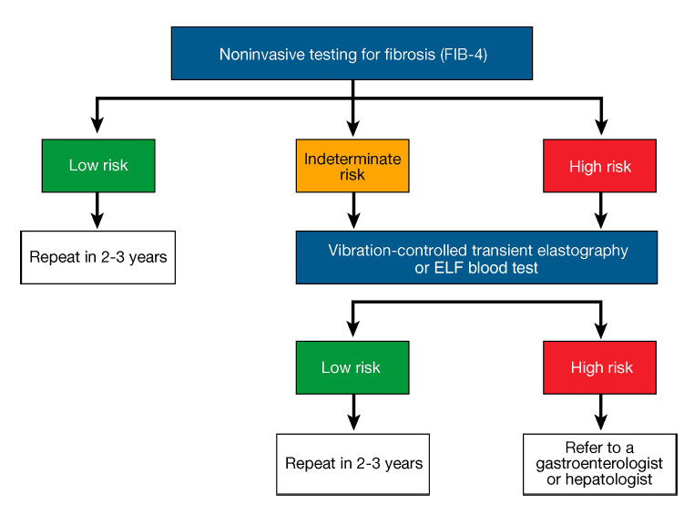
Comprehensive Medical Evaluation and Assessment of Comorbidities
Comprehensive Medical Evaluation and Assessment of Comorbidities: Standards of Care in Diabetes - 2024. Diabetes Care 2024;47(Suppl. 1):S52-S76

Slide 77
Nonalcoholic Fatty Liver Disease and Nonalcoholic Steatohepatitis (continued)
Comprehensive Medical Evaluation and Assessment of Comorbidities
4.27 Adults with type 2 diabetes or prediabetes, particularly with overweight or obesity, with nonalcoholic fatty liver disease (NAFLD) should be recommended lifestyle changes that promote weight loss, ideally within a structured nutrition plan and physical activity program for cardiometabolic benefits B and histological improvement. C
4.28 For adults with type 2 diabetes, particularly with overweight or obesity, with NAFLD, consider using a glucagon-like peptide 1 (GLP-1) receptor agonist with demonstrated benefits in nonalcoholic steatohepatitis (NASH) as an adjunctive therapy to lifestyle interventions for weight loss. B
4.29 Pioglitazone or GLP-1 receptor agonists are the preferred agents for the treatment of hyperglycemia in adults with type 2 diabetes with biopsy-proven NASH or those at high risk with clinically significant liver fibrosis using noninvasive tests. A

Slide 78
Nonalcoholic Fatty Liver Disease and Nonalcoholic Steatohepatitis (continued)
Comprehensive Medical Evaluation and Assessment of Comorbidities
4.30a In adults with type 2 diabetes and NAFLD, use of glucose-lowering therapies other than pioglitazone or GLP-1 receptor agonists may be continued as clinically indicated, but these therapies lack evidence of benefit in NASH. B
4.30b Insulin therapy is the preferred agent for the treatment of hyperglycemia in adults with type 2 diabetes with decompensated cirrhosis. C

Slide 79
Nonalcoholic Fatty Liver Disease and Nonalcoholic Steatohepatitis (continued)
Comprehensive Medical Evaluation and Assessment of Comorbidities
4.31a Adults with type 2 diabetes and NAFLD are at increased cardiovascular risk, therefore, comprehensive management of cardiovascular risk factors is recommended. B
4.31b Statin therapy is safe in adults with type 2 diabetes and compensated cirrhosis from NAFLD and should be initiated or continued for cardiovascular risk reduction as clinically indicated. B Statin therapy should be used with caution and close monitoring in people with decompensated cirrhosis, given limited safety and efficacy data. B

Slide 80
Nonalcoholic Fatty Liver Disease and Nonalcoholic Steatohepatitis (continued)
Comprehensive Medical Evaluation and Assessment of Comorbidities
4.32a Consider metabolic surgery in appropriate candidates as an option to treat NASH in adults with type 2 diabetes B and to improve cardiovascular outcomes. B
4.32b Metabolic surgery should be used with caution in adults with type 2 diabetes with compensated cirrhosis from NAFLD B and is not recommended in decompensated cirrhosis. B

Slide 81
Section 5. Facilitating Positive Behaviors and Wellbeing to Improve Health Outcomes

Slide 82
Diabetes Self-Management Education and Support
Facilitating POSITIVE HEALTH Behaviors and Well-being to Improve Health Outcomes
5.1 Strongly encourage all people with diabetes to participate in diabetes self- management education and support (DSMES) to facilitate informed decision- making, self-care behaviors, problem-solving, and active collaboration with the health care team. A
5.2 There are five critical times to evaluate the need for DSMES to promote skills acquisition to aid treatment plan implementation, medical nutrition therapy, and wellbeing: at diagnosis, when not meeting treatment goals, annually, when complicating factors develop (medical, physical, and psychosocial), and when transitions in life and care occur. E
5.3 Clinical outcomes, health status, and wellbeing are key goals of DSMES that should be assessed as part of routine care. C

Slide 83
Diabetes Self-Management Education and Support (continued)
Facilitating POSITIVE HEALTH Behaviors and Well-being to Improve Health Outcomes
5.4 DSMES should be culturally sensitive and responsive to individual preferences, needs, and values and may be offered in group or individual settings. A Such education and support should be documented and made available to members of the entire diabetes care team. E
5.5 Consider offering DSMES via telehealth and/or digital interventions to address barriers to access and improve satisfaction. B
5.6 Since DSMES can improve outcomes and reduce costs, reimbursement by third-party payers is recommended. B

Slide 84
Diabetes Self-Management Education and Support (continued)
Facilitating POSITIVE HEALTH Behaviors and Well-being to Improve Health Outcomes
5.7 Identify and address barriers to DSMES that exist at the payer, health system, clinic, health care professional, and individual levels. E
5.8 Include social determinants of health of the target population in guiding design and delivery of DSMES C with the ultimate goal of health equity across all populations.

Slide 85
Diabetes Self-Management Education and Support (continued)
Facilitating POSITIVE HEALTH Behaviors and Well-being to Improve Health Outcomes
There are five critical time points when the need for DSMES should be evaluated by the health care professional and/or interprofessional team, with referrals made as needed:
1. At diagnosis
2. Annually
3. When not meeting treatment targets
4. When complicating factors (e.g., health conditions, physical limitations, emotional factors, or basic living needs) that influence self-management develop
5. When transitions in life and care occur

Slide 86
Goals of Nutrition Therapy for Adults With Diabetes
Facilitating POSITIVE HEALTH Behaviors and Well-being to Improve Health Outcomes
1. To promote and support healthful eating patterns, emphasizing a variety of nutrient-dense foods in appropriate portion sizes, to improve overall health and:
Achieve and maintain body weight goals
Attain individualized glycemic, blood pressure, and lipid goals
Delay or prevent the complications of diabetes
2. To address individual nutrition needs based on personal and cultural preferences, health literacy and numeracy, access to healthful foods, willingness and ability to make behavioral changes, and existing barriers to change

Slide 87
Facilitating POSITIVE HEALTH Behaviors and Well-being to Improve Health Outcomes
Goals of Nutrition Therapy for Adults With Diabetes (continued)
3. To maintain the pleasure of eating by providing nonjudgmental messages about food choices while limiting food choices only when indicated by scientific evidence.
4. To provide an individual with diabetes the practical tools for developing healthy eating patterns rather than focusing on individual macronutrients, micronutrients, or single foods.

Slide 88
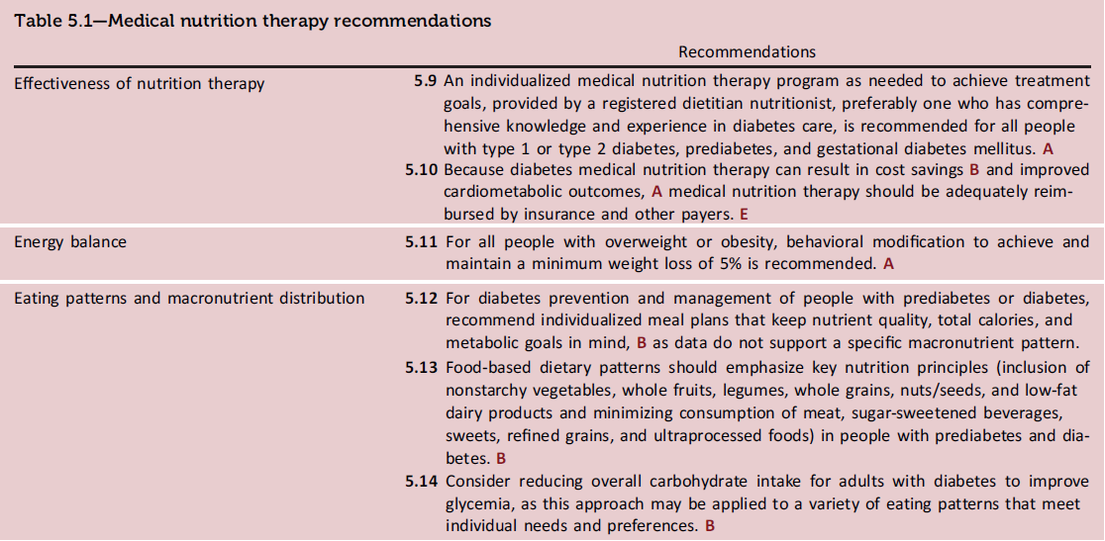
Medical Nutrition Therapy
Facilitating POSITIVE HEALTH Behaviors and Well-being to Improve Health Outcomes
Facilitating Positive Health Behaviors and Well-being to Improve Health Outcomes: Standards of Care in Diabetes - 2024. Diabetes Care 2024;47(Suppl. 1):S77-S110

Slide 89
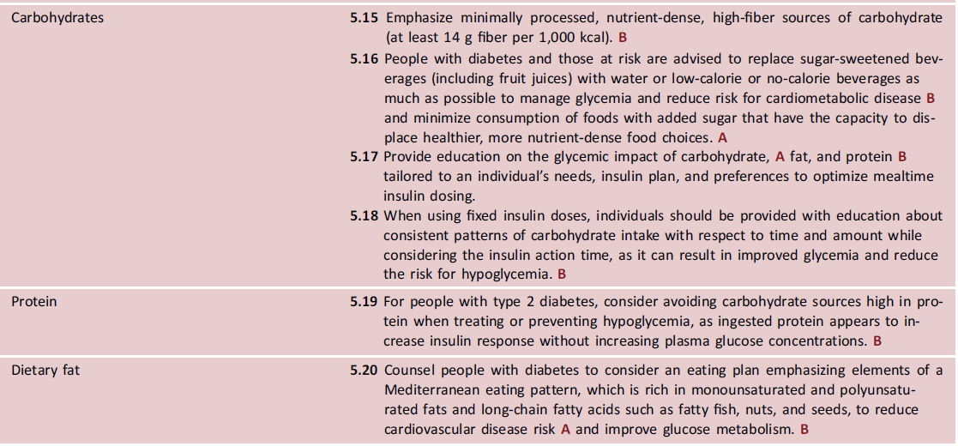
Medical Nutrition Therapy (continued)
Facilitating POSITIVE HEALTH Behaviors and Well-being to Improve Health Outcomes
Facilitating Positive Health Behaviors and Well-being to Improve Health Outcomes: Standards of Care in Diabetes - 2024. Diabetes Care 2024;47(Suppl. 1):S77-S110

Slide 90
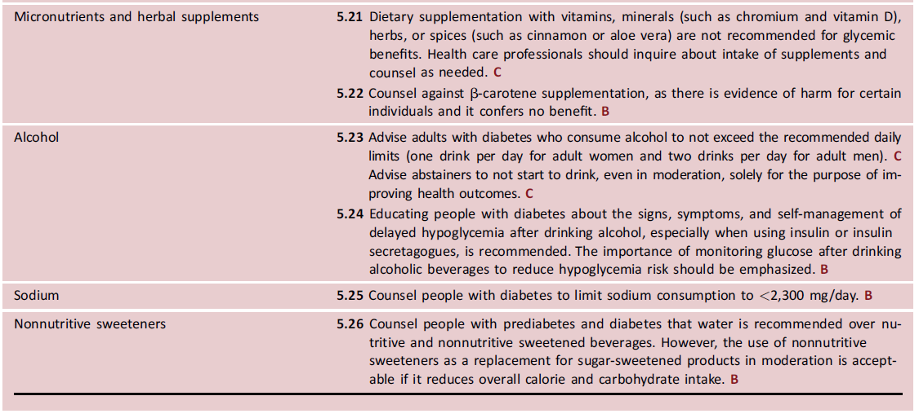
Medical Nutrition Therapy (continued)
Facilitating POSITIVE HEALTH Behaviors and Well-being to Improve Health Outcomes
Facilitating Positive Health Behaviors and Well-being to Improve Health Outcomes: Standards of Care in Diabetes - 2024. Diabetes Care 2024;47(Suppl. 1):S77-S110

Slide 91
Physical Activity
Facilitating POSITIVE HEALTH Behaviors and Well-being to Improve Health Outcomes
5.27 Counsel youth with type 1 diabetes C or type 2 diabetes B to engage in 60 min/day or more of moderate- or vigorous-intensity aerobic activity, with vigorous muscle-strengthening and bone-strengthening activities at least 3 days/week.
5.28 Counsel most adults with type 1 diabetes C and type 2 diabetes B to engage in 150 min or more of moderate- to vigorous-intensity aerobic activity per week, spread over at least 3 days/week, with no more than 2 consecutive days without activity. Shorter durations (minimum 75 min/week) of vigorous-intensity or interval training may be sufficient for younger and more physically fit individuals.
5.29 Counsel adults with type 1 diabetes C and type 2 diabetes B to engage in 2–3 sessions/week of resistance exercise on nonconsecutive days.

Slide 92
Physical Activity (continued)
Facilitating POSITIVE HEALTH Behaviors and Well-being to Improve Health Outcomes
5.30 Recommend flexibility training and balance training 2–3 times/week for older adults with diabetes. Yoga and tai chi may be included based on individual preferences to increase flexibility, muscular strength, and balance. C
5.31 For all people with diabetes, evaluate baseline physical activity and time spent in sedentary behavior (i.e., quiet sitting, lying, and leaning). For people who do not meet activity guidelines, encourage increase in physical activities (e.g., walking, yoga, housework, gardening, swimming, and dancing) above baseline (type 1 diabetes E and type 2 diabetes B). Counsel that prolonged sitting should be interrupted every 30 min for blood glucose benefits. C

Slide 93
Smoking Cessation: Tobacco, E-Cigarettes, and Cannabis
Facilitating POSITIVE HEALTH Behaviors and Well-being to Improve Health Outcomes
5.32 Advise all people with diabetes not to use cigarettes and other tobacco products or e-cigarettes. A
5.33 As a routine component of diabetes care and education, ask people with diabetes about the use of cigarettes or other tobacco products. After identification of use, recommend and refer for combination treatment consisting of both tobacco/smoking cessation counseling and pharmacological therapy. A

Slide 94
Supporting Positive Health Behaviors
Facilitating POSITIVE HEALTH Behaviors and Well-being to Improve Health Outcomes
5.34 Behavioral strategies should be used to support diabetes self- management and engagement in health behaviors (e.g., taking medications, using diabetes technologies, and engaging in physical activity and healthy eating) to promote optimal diabetes health outcomes. A

Slide 95
Psychosocial Care
Facilitating POSITIVE HEALTH Behaviors and Well-being to Improve Health Outcomes
5.35 Psychosocial care should be provided to all people with diabetes, with the goal of optimizing health-related quality of life and health outcomes. Such care should be integrated with routine medical care and delivered by trained health care professionals using a collaborative, person- centered, culturally informed approach. A
5.36 Diabetes care teams should implement psychosocial screening protocols for general and diabetes-related mood concerns as well as other topics such as stress, quality of life, available resources (financial, social, family, and emotional), and/or psychiatric history. Screening should occur at least annually or when there is a change in disease, treatment, or life circumstances. C

Slide 96
Psychosocial Care (continued)
Facilitating POSITIVE HEALTH Behaviors and Well-being to Improve Health Outcomes
5.37 When indicated, refer to behavioral health professionals or other trained health care professionals, ideally those with experience in diabetes, for further assessment and treatment for symptoms of diabetes distress, depression, suicidality, anxiety, treatment-related fear of hypoglycemia, disordered eating, and/or cognitive capacities. Such specialized psychosocial care should use age-appropriate standardized and validated tools and treatment approaches. B
5.38 Consider developmental factors and use age-appropriate validated tools for psychosocial screening in people with diabetes. E

Slide 97
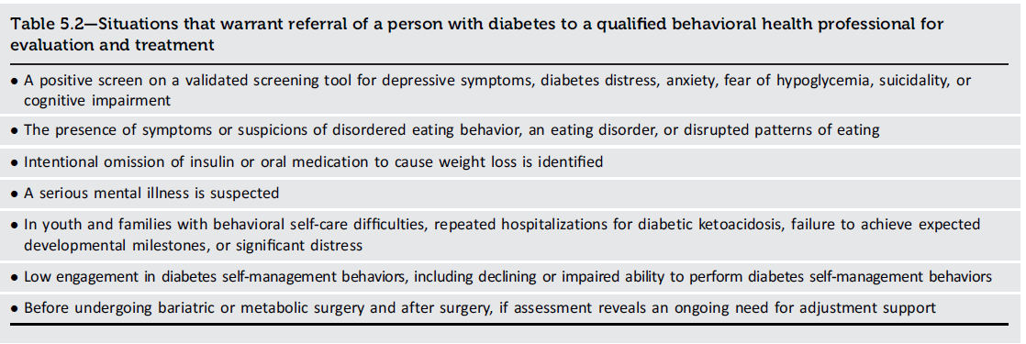
Referral to a Behavioral Health Professional
Facilitating POSITIVE HEALTH Behaviors and Well-being to Improve Health Outcomes
Facilitating Positive Health Behaviors and Well-being to Improve Health Outcomes: Standards of Care in Diabetes - 2024. Diabetes Care 2024;47(Suppl. 1):S77-S110

Slide 98
Diabetes Distress
Facilitating POSITIVE HEALTH Behaviors and Well-being to Improve Health Outcomes
5.39 Screen people with diabetes, caregivers, and family members for diabetes distress at least annually, and consider more frequent monitoring when treatment targets are not met, at transitional times, and/or in the presence of diabetes complications. Health care professionals can address diabetes distress and may consider referral to a qualified behavioral health professional, ideally one with experience in diabetes, for further assessment and treatment if indicated. B

Slide 99
Anxiety
Facilitating POSITIVE HEALTH Behaviors and Well-being to Improve Health Outcomes
5.40 Consider screening people with diabetes for anxiety symptoms, fear of hypoglycemia, or diabetes-related worries. Health care professionals can discuss diabetes-related worries and should consider referral to a qualified behavioral health professional for further assessment and treatment if anxiety symptoms indicate interference with diabetes self- management behaviors or quality of life. B

Slide 100
Depression
Facilitating POSITIVE HEALTH Behaviors and Well-being to Improve Health Outcomes
5.41 Conduct at least annual screening of depressive symptoms in all people with diabetes and more frequently among those with a self-reported history of depression. Use age-appropriate, validated depression screening measures, recognizing that further evaluation will be necessary for individuals who have a positive screen. B
5.42 Beginning at diagnosis of complications or when there are significant changes in medical status, consider assessment for depression. B
5.43 Refer to qualified behavioral health professionals or other trained health care professionals with experience using evidence-based treatment approaches for depression in conjunction with collaborative care with the diabetes treatment team. A

Slide 101
Disordered Eating Behavior
Facilitating POSITIVE HEALTH Behaviors and Well-being to Improve Health Outcomes
5.44 Consider screening for disordered or disrupted eating using validated screening measures when hyperglycemia and weight loss are unexplained based on self-reported behaviors related to medication dosing, meal plan, and physical activity. In addition, a review of the medical treatment plan is recommended to identify potential treatment-related effects on hunger/caloric intake. B
5.45 Consider reevaluating the treatment plan of people with diabetes who present with symptoms of disordered eating behavior, an eating disorder, or disrupted patterns of eating, in consultation with a qualified professional. Key qualifications include familiarity with diabetes disease physiology, treatments for diabetes and disordered eating behaviors, and weight-related and psychological risk factors for disordered eating behaviors. B

Slide 102
Serious Mental Illness
Facilitating POSITIVE HEALTH Behaviors and Well-being to Improve Health Outcomes
5.46 Provide an increased level of support for people with diabetes and serious mental illness through enhanced monitoring of and assistance with diabetes self-management behaviors. B
5.47 Monitor changes in body weight, glycemia, and lipids in adolescents and adults with diabetes who are prescribed second-generation antipsychotic medications. Adjust the treatment plan accordingly, if needed. C

Slide 103
Cognitive Capacity/Impairment
Facilitating POSITIVE HEALTH Behaviors and Well-being to Improve Health Outcomes
5.48 Cognitive capacity should be monitored throughout the life span for all individuals with diabetes, particularly in those who have documented cognitive disabilities, those who experience severe hypoglycemia, very young children, and older adults. B
5.49 If cognitive capacity changes or appears to be suboptimal for decision-making and/or behavioral self-management, referral for a formal assessment should be considered. E

Slide 104
Sleep Health
Facilitating POSITIVE HEALTH Behaviors and Well-being to Improve Health Outcomes
5.50 Consider screening for sleep health in people with diabetes, including symptoms of sleep disorders, disruptions to sleep due to diabetes symptoms or management needs, and worries about sleep. Refer to sleep medicine specialists and/or qualified behavioral health professionals as indicated. B
5.51 Counsel people with diabetes to practice sleep-promoting routines and habits (e.g., maintaining consistent sleep schedule and limiting caffeine in the afternoon). A

Slide 105
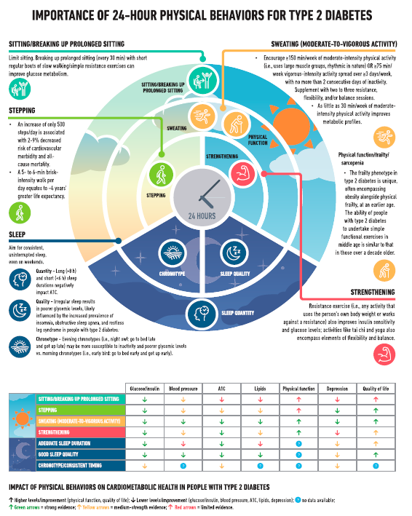
Facilitating POSITIVE HEALTH Behaviors and Well-being to Improve Health Outcomes
Facilitating Positive Health Behaviors and Well-being to Improve Health Outcomes: Standards of Care in Diabetes - 2024. Diabetes Care 2024;47(Suppl. 1):S77-S110

Slide 106
Section 6. Glycemic Goals and Hypoglycemia

Slide 107
Glycemic Assessment
Glycemic GOALS AND HYPOGLYCEMIA
6.1 Assess glycemic status by A1C and/or appropriate continuous glucose monitoring (CGM) metrics at least two times a year. Assess more frequently (e.g., every 3 months) for individuals not meeting treatment goals, with frequent or severe hypoglycemia or hyperglycemia, changing health status, or growth and development in youth. E
6.2 Assess glycemic status at least quarterly and as needed in individuals whose therapy has recently changed and/or who are not meeting glycemic goals. E

Slide 108
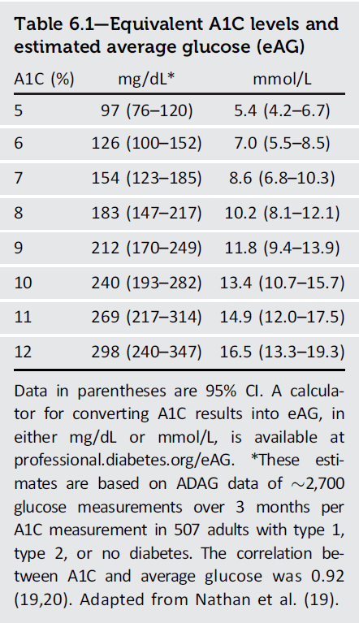
Equivalent A1C levels and estimated average glucose (eAG)
Glycemic GOALS AND HYPOGLYCEMIA
Glycemic Goals and Hypoglycemia: Standards of Care in Diabetes - 2024. Diabetes Care 2024;45(Suppl. 1):S111-S125

Slide 109
Glucose Assessment by Continuous Glucose Monitoring
Glycemic GOALS AND HYPOGLYCEMIA
6.3 Standardized, single-page glucose reports from CGM devices with visual cues, such as the ambulatory glucose profile, should be considered as a standard summary for all CGM devices. E
6.4 Time in range (TIR) is associated with the risk of microvascular complications and can be used for assessment of glycemic status. Additionally, time below range and time above range are useful parameters for the evaluation of the treatment plan (Table 6.2). C

Slide 110
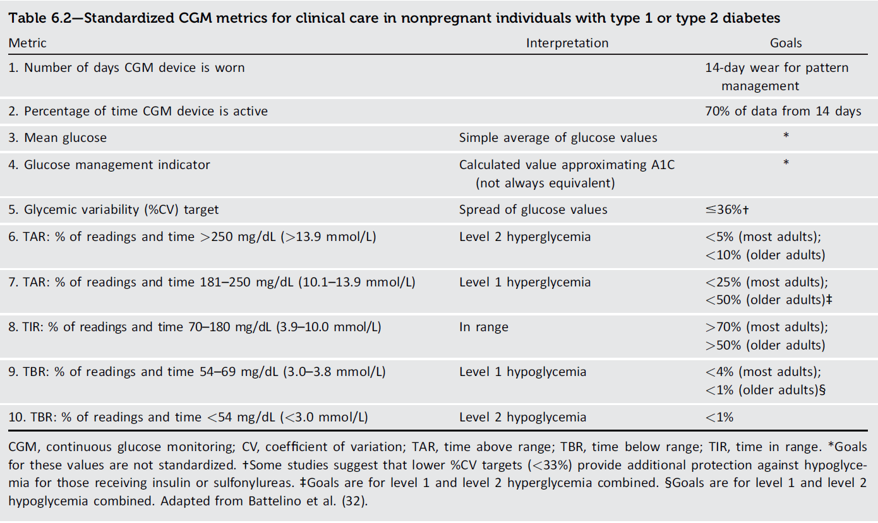
Standardized CGM Metrics
Glycemic GOALS AND HYPOGLYCEMIA
Glycemic Goals and Hypoglycemia: Standards of Care in Diabetes - 2024. Diabetes Care 2024;45(Suppl. 1):S111-S125

Slide 111
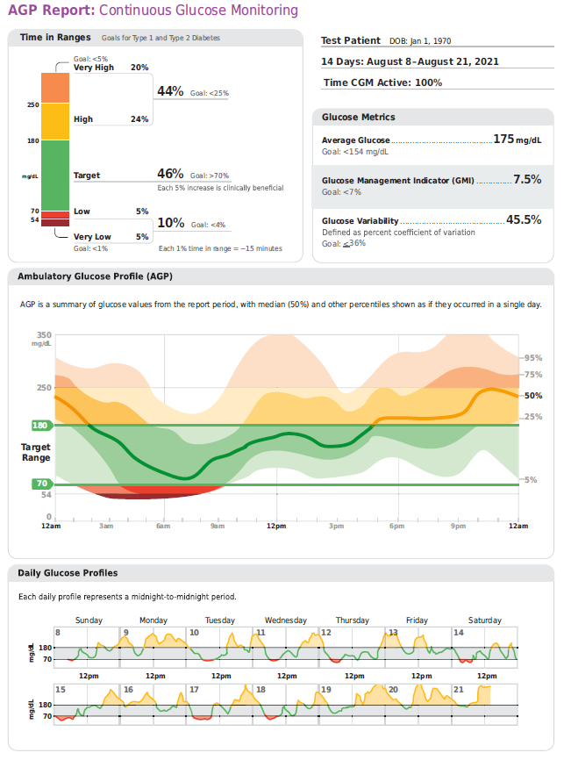
Glycemic GOALS AND HYPOGLYCEMIA
Glycemic Goals and Hypoglycemia: Standards of Care in Diabetes - 2024. Diabetes Care 2024;45(Suppl. 1):S111-S125

Slide 112
Glycemic Goals
Glycemic GOALS AND HYPOGLYCEMIA
6.5a An A1C goal for many nonpregnant adults of <7% (<53 mmol/mol) without significant hypoglycemia is appropriate. A
6.5b If using an ambulatory glucose profile/glucose management indicator to assess glycemia, a parallel goal for many nonpregnant adults is TIR >70% with time below range <4% and time <54 mg/dL (<3 mmol/L) <1%. For those with frailty or at high risk of hypoglycemia, a goal of >50% TIR with <1% time below range is recommended (Fig. 6.1 and Table 6.2). B
6.6 On the basis of health care professional judgment and the preference of the person with diabetes, achievement of lower A1C levels than the goal of 7% (53 mmol/mol) may be acceptable and even beneficial if it can be achieved safely without significant hypoglycemia or other adverse effects of treatment. B

Slide 113
Glycemic Goals (continued)
Glycemic GOALS AND HYPOGLYCEMIA
6.7 Less stringent glycemic goals may be appropriate for individuals with limited life expectancy or where the harms of treatment are greater than the benefits. B
6.8a Deintensify hypoglycemia-causing medications (insulin, sulfonylureas, or meglitinides), or switch to a medication class with lower hypoglycemia risk, for individuals who are at high risk for hypoglycemia, within individualized glycemic goals. B
6.8b Deintensify diabetes medications for individuals for whom the harms and/or burdens of treatment may be greater than the benefits, within individualized glycemic goals. B

Slide 114
Glycemic Goals (continued)
Glycemic GOALS AND HYPOGLYCEMIA
6.9 Reassess glycemic goals based on the individualized criteria shown in Fig. 6.2. E
6.10 Setting a glycemic goal during consultations is likely to improve patient outcomes. E

Slide 115
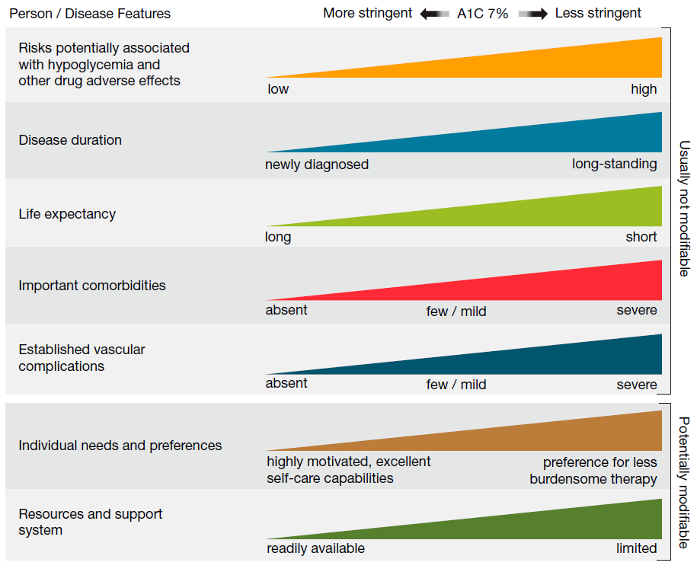
Glycemic GOALS AND HYPOGLYCEMIA
Glycemic Goals and Hypoglycemia: Standards of Care in Diabetes - 2024. Diabetes Care 2024;45(Suppl. 1):S111-S125

Slide 116
Cardiovascular Disease and Type 2 Diabetes
Glycemic GOALS AND HYPOGLYCEMIA
As outlined in more detail in Section 9, “Pharmacologic Approaches to Glycemic Treatment,” and Section 10, “Cardiovascular Disease and Risk Management,” the cardiovascular benefits of SGLT2 inhibitors or GLP-1 receptor agonists are not contingent upon A1C lowering. Therefore, initiation can be considered in people with type 2 diabetes and CVD independent of the current A1C or A1C goal or metformin therapy. Based on these considerations, the following two strategies are offered:
1. If already on dual therapy or multiple glucose-lowering therapies and not on an SGLT2 inhibitor or a GLP-1 receptor agonist, consider switching to one of these agents with proven cardiovascular benefit.
2. Introduce SGLT2 inhibitors or GLP-1 receptor agonists in people with CVD at A1C goal (independent of metformin) for cardiovascular benefit, independent of baseline A1C or individualized A1C goal.

Slide 117
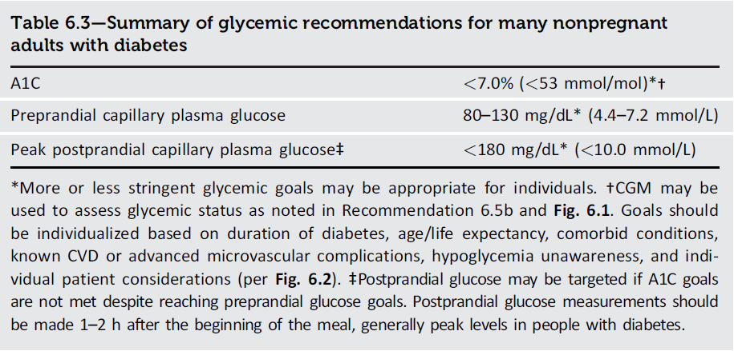
Glycemic GOALS AND HYPOGLYCEMIA
Glycemic Goals and Hypoglycemia: Standards of Care in Diabetes - 2024. Diabetes Care 2024;45(Suppl. 1):S111-S125

Slide 118
Hypoglycemia Assessment, Prevention, and Treatment
Glycemic GOALS AND HYPOGLYCEMIA
6.11a History of hypoglycemia should be reviewed at every clinical encounter for all individuals at risk for hypoglycemia and evaluated as indicated. C
6.11b Clinicians should screen all individuals at risk for hypoglycemia for impaired hypoglycemia awareness. E
6.11c Clinicians should consider an individual’s risk for hypoglycemia (see Table 6.5) when selecting diabetes medications and glycemic goals. E
6.11d Use of CGM is beneficial and recommended for individuals at high risk for hypoglycemia. A
6.12 Glucose is the preferred treatment for the conscious individual with glucose <70 mg/dL (<3.9 mmol/L), although any form of carbohydrate that contains glucose may be used. Fifteen minutes after initial treatment, repeat the treatment if hypoglycemia persists. B

Slide 119
Hypoglycemia Assessment, Prevention, and Treatment (continued)
Glycemic GOALS AND HYPOGLYCEMIA
6.13 Glucagon should be prescribed for all individuals taking insulin or at high risk for hypoglycemia. Family, caregivers, school personnel, and others providing support to these individuals should know its location and be educated on how to administer it. Glucagon preparations that do not have to be reconstituted are preferred. E
6.14 All individuals taking insulin A or at risk for hypoglycemia C should receive structured education for hypoglycemia prevention and treatment, with ongoing education for those who experience hypoglycemic events.
6.15 One or more episodes of level 2 or 3 hypoglycemia should prompt reevaluation of the treatment plan, including deintensifying or switching diabetes medications if appropriate. E

Slide 120
Hypoglycemia Assessment, Prevention, and Treatment (continued)
Glycemic GOALS AND HYPOGLYCEMIA
6.16 Refer individuals with impaired hypoglycemia awareness to a trained health care professional to receive evidence-based intervention to help reestablish awareness of symptoms of hypoglycemia. A
6.17 Ongoing assessment of cognitive function is suggested with increased vigilance for hypoglycemia by the clinician, patient, and caregivers if impaired or declining cognition is found. B

Slide 121
Glycemic GOALS AND HYPOGLYCEMIA
Glycemic Goals and Hypoglycemia: Standards of Care in Diabetes - 2024. Diabetes Care 2024;45(Suppl. 1):S111-S125

Slide 122
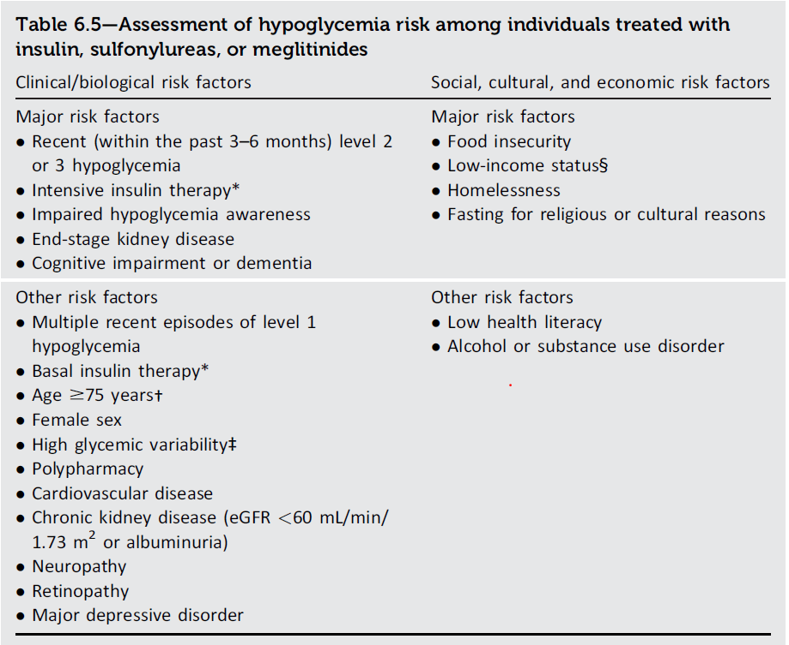
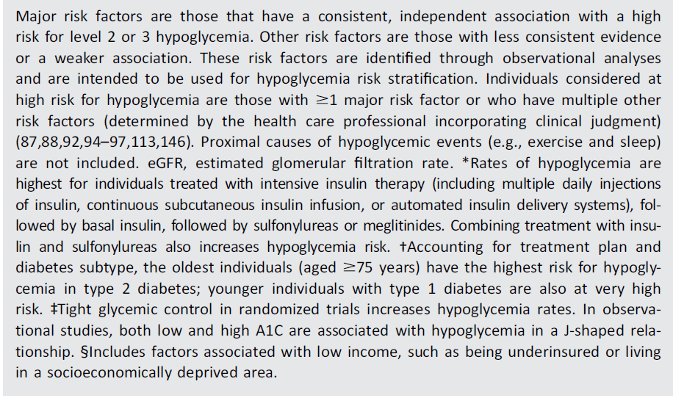
Glycemic GOALS AND HYPOGLYCEMIA
Glycemic Goals and Hypoglycemia: Standards of Care in Diabetes - 2024. Diabetes Care 2024;45(Suppl. 1):S111-S125

Slide 123
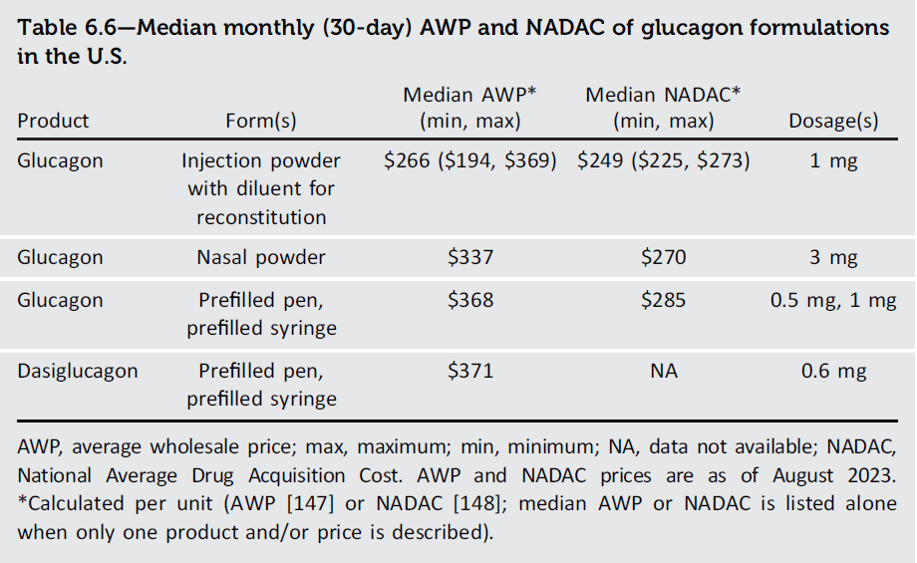
Glycemic GOALS AND HYPOGLYCEMIA
Glycemic Goals and Hypoglycemia: Standards of Care in Diabetes - 2024. Diabetes Care 2024;45(Suppl. 1):S111-S125

Slide 124
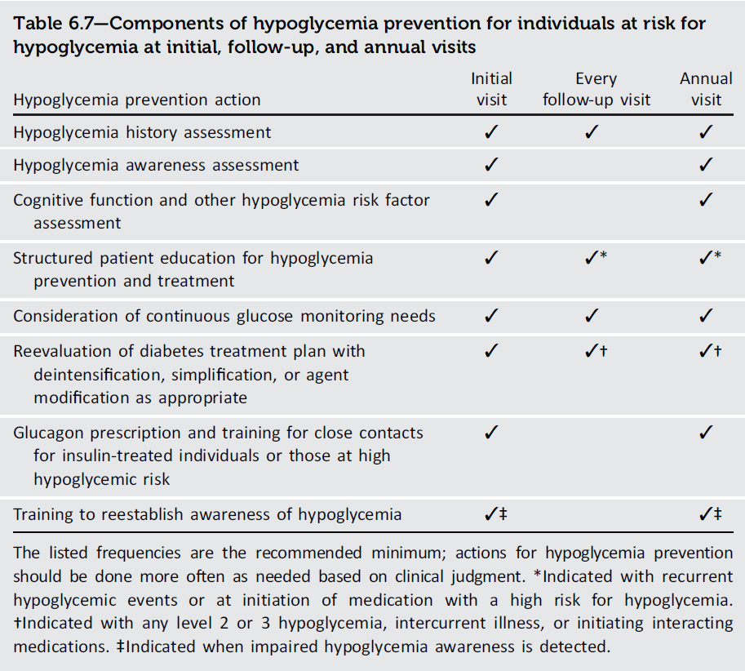
Glycemic GOALS AND HYPOGLYCEMIA
Glycemic Goals and Hypoglycemia: Standards of Care in Diabetes - 2024. Diabetes Care 2024;45(Suppl. 1):S111-S125

Slide 125
Section 7. Diabetes Technology

Slide 126
General Device Principles
Diabetes Technology
7.1 Diabetes devices should be offered to people with diabetes. A
7.2 Initiation of continuous glucose monitoring (CGM) should be offered to people with type 1 diabetes early in the disease, even at time of diagnosis. A
7.3 Consider establishing competencies based on role in practice setting for health care professionals working with diabetes technology. E
7.4 The type(s) and selection of devices should be individualized based on a person’s specific needs, preferences, and skill level. In the setting of an individual whose diabetes is partially or wholly managed by someone else (e.g., a young child or a person with cognitive impairment or dexterity, psychosocial, and/or physical limitations), the caregiver’s skills and preferences are integral to the decision-making process. E

Slide 127
General Device Principles (continued)
Diabetes Technology
7.5 When prescribing a device, ensure that people with diabetes and caregivers receive initial and ongoing education and training, either in person or remotely, and ongoing evaluation of technique, results, and the ability to utilize data, including uploading/sharing data (if applicable), to monitor and adjust therapy. C
7.6 People with diabetes who have been using CGM, continuous subcutaneous insulin infusion (CSII), and/or automated insulin delivery (AID) for diabetes management should have continued access across third-party payers, regardless of age or A1C levels. E

Slide 128
General Device Principles (continued)
Diabetes Technology
7.7 Students should be supported at school in the use of diabetes technology, such as CGM systems, CSII, connected insulin pens, and AID systems, as recommended or prescribed by their health care team. E
7.8 Initiation of CSII and/or AID early, even at diagnosis, in the treatment of diabetes can be beneficial depending on a person’s or caregiver’s needs and preferences. C

Slide 129
Blood Glucose Monitoring
Diabetes Technology
7.9 People with diabetes should be provided with blood glucose monitoring (BGM) devices as indicated by their circumstances, preferences, and treatment. People using CGM devices must also have access to BGM at all times. A
7.10 People who are taking insulin and using BGM should be encouraged to check their blood glucose levels when appropriate based on their insulin therapy. This may include checking when fasting, prior to meals and snacks, after meals, at bedtime, in the middle of the night, prior to, during, and after exercise, when hypoglycemia is suspected, after treating low blood glucose levels until they are normoglycemic, when hyperglycemia is suspected, and prior to and while performing critical tasks such as driving. B

Slide 130
Blood Glucose Monitoring (continued)
Diabetes Technology
7.11 Health care professionals should be aware of the differences in accuracy among blood glucose meters. Only meters approved by the U.S. Food and Drug Administration (FDA) (or comparable regulatory agencies for other geographical locations) with proven accuracy should be used, with unexpired test strips purchased from a pharmacy or licensed distributor and properly stored. E
7.12 Although BGM in people on noninsulin therapies has not consistently shown clinically significant reductions in A1C levels, it may be helpful when altering meal plans, physical activity plans, and/or medications (particularly medications that can cause hypoglycemia) in conjunction with a treatment adjustment program. E
7.13 Health care professionals should be aware of medications and other factors that can interfere with glucose meter accuracy and provide clinical management as indicated. E

Slide 131
Diabetes Technology
Diabetes Technology: Standards of Care in Diabetes - 2024. Diabetes Care 2024;47(Suppl. 1):S126-S144

Slide 132
Continuous Glucose Monitoring Devices
Diabetes Technology
7.14 Real-time CGM (rtCGM) A or intermittently scanned CGM (isCGM) B should be offered for diabetes management in adults with diabetes on multiple daily injections (MDI) or CSII who are capable of using the devices safely (either by themselves or with a caregiver). The choice of device should be made based on the individual’s circumstances, preferences, and needs.
7.15 rtCGM A or isCGM B should be offered for diabetes management in adults with diabetes on basal insulin who are capable of using the devices safely (either by themselves or with a caregiver). The choice of device should be made based on the individual’s circumstances, preferences, and needs.

Slide 133
Continuous Glucose Monitoring Devices (continued)
Diabetes Technology
7.16 rtCGM A or isCGM E should be offered for diabetes management in youth with type 1 diabetes on MDI or CSII who are capable of using the devices safely (either by themselves or with a caregiver). The choice of device should be made based on the individual’s circumstances, preferences, and needs.
7.17 rtCGM or isCGM should be offered for diabetes management in youth with type 2 diabetes on MDI or CSII who are capable of using the devices safely (either by themselves or with a caregiver). The choice of device should be made based on the individual’s circumstances, preferences, and needs. E

Slide 134
Continuous Glucose Monitoring Devices (continued)
Diabetes Technology
7.18 In people with diabetes on MDI or CSII, rtCGM devices should be used as close to daily as possible for maximal benefit. A isCGM devices should be scanned frequently, at a minimum once every 8 h to avoid gaps in data. A People with diabetes should have uninterrupted access to their supplies to minimize gaps in CGM. A
7.19 When used as an adjunct to preprandial and postprandial BGM, CGM can help to achieve A1C targets in diabetes and pregnancy. B

Slide 135
Continuous Glucose Monitoring Devices (continued)
Diabetes Technology
7.20 Periodic use of rtCGM or isCGM or use of professional CGM can be helpful for diabetes management in circumstances where consistent use of CGM is not desired or available. C
7.21 Skin reactions, either due to irritation or allergy, should be assessed and addressed to aid in successful use of devices. E
7.22 People who wear CGM devices should be educated on potential interfering substances and other factors that may affect accuracy. C

Slide 136
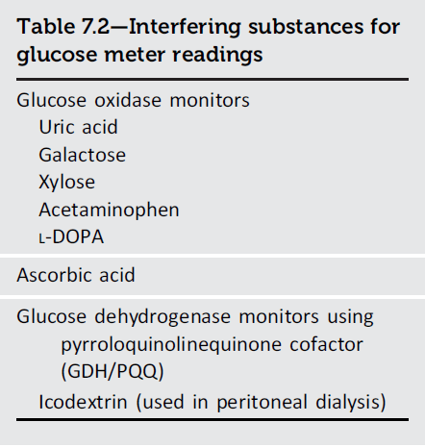
Diabetes Technology
Diabetes Technology: Standards of Care in Diabetes - 2024. Diabetes Care 2024;47(Suppl. 1):S126-S144

Slide 137
Diabetes Technology
Diabetes Technology: Standards of Care in Diabetes - 2024. Diabetes Care 2024;47(Suppl. 1):S126-S144

Slide 138
Diabetes Technology
Diabetes Technology: Standards of Care in Diabetes - 2024. Diabetes Care 2024;47(Suppl. 1):S126-S144

Slide 139
Insulin Syringes and Pens
Diabetes Technology
7.23 For people with insulin-requiring diabetes on MDI, insulin pens are preferred in most cases. Still, insulin syringes may be used for insulin delivery considering individual and caregiver preference, insulin type, availability in vials, dosing therapy, cost, and self-management capabilities. C
7.24 Insulin pens or insulin injection aids are recommended for people with dexterity issues or vision impairment or when decided by shared decision- making to facilitate the accurate dosing and administration of insulin. C
7.25 Connected insulin pens can be helpful for diabetes management and may be used in people with diabetes taking subcutaneous insulin. E
7.26 FDA-approved insulin dose calculators/decision support systems may be helpful for calculating insulin doses. C

Slide 140
Insulin Pumps and Automated Insulin Delivery Systems
Diabetes Technology
7.27 AID systems should be offered for diabetes management to youth and adults with type 1 diabetes A and other types of insulin-deficient diabetes E who are capable of using the device safely (either by themselves or with a caregiver). The choice of device should be made based on the individual’s circumstances, preferences, and needs. A
7.28 Insulin pump therapy alone with or without a sensor-augmented pump low- glucose suspend feature should be offered for diabetes management to youth and adults on MDI with type 1 diabetes A or other types of insulin-deficient diabetes E who are capable of using the device safely (either by themselves or with a caregiver) and are not able to use or do not choose an AID system. The choice of device should be made based on the individual’s circumstances, preferences, and needs. A

Slide 141
Insulin Pumps and Automated Insulin Delivery Systems (continued)
Diabetes Technology
7.29 Insulin pump therapy can be offered for diabetes management to youth and adults on MDI with type 2 diabetes who are capable of using the device safely (either by themselves or with a caregiver). The choice of device should be made based on the individual’s circumstances, preferences, and needs. A
7.30 Individuals with diabetes who have been using CSII should have continued access across third-party payers. E

Slide 142
Do-It-Yourself Closed-Loop Systems
Diabetes Technology
7.31 Individuals with diabetes may be using systems not approved by the FDA, such as do-it-yourself closed-loop systems and others. Health care professionals cannot prescribe these systems but should assist in diabetes management to ensure the safety of people with diabetes. E

Slide 143
Digital Health Technology
Diabetes Technology
7.32 Systems that combine technology and online coaching can be beneficial in managing prediabetes and diabetes for some individuals. B

Slide 144
Inpatient Care
Diabetes Technology
7.33 In people with diabetes using personal CGM, the use of CGM should be continued when clinically appropriate during hospitalization, with confirmatory point-of-care glucose measurements for insulin dosing and hypoglycemia assessment and treatment under an institutional protocol. B
7.34 People with diabetes who are competent to safely use diabetes devices such as insulin pumps and CGM systems should be supported to continue using them in an inpatient setting or during outpatient procedures, whenever possible, and when proper supervision is available. E

Slide 145
Section 8. Obesity and Weight Management for the Prevention and Treatment of Type 2 Diabetes

Slide 146
Assessment and Monitoring of the Individual with Overweight and Obesity
Obesity AND WEIGHT Management for the PREVENTION AND Treatment of Type 2 Diabetes
8.1 Use person-centered, nonjudgmental language that fosters collaboration between individuals and health care professionals, including person-first language (e.g., “person with obesity” rather than “obese person” and “person with diabetes” rather than “diabetic person”). E
8.2a To support the diagnosis of obesity, measure height and weight to calculate BMI and perform additional measurements of body fat distribution, like waist circumference, waist-to-hip ratio, and/or waist-to-height ratio. E
8.2b Monitor obesity-related anthropometric measurements at least annually to inform treatment considerations. E
8.3 Accommodations should be made to provide privacy during anthropometric measurements. E

Slide 147
Assessment and Monitoring of the Individual with Overweight and Obesity (continued)
Obesity AND WEIGHT Management for the PREVENTION AND Treatment of Type 2 Diabetes
8.4 In people with type 2 diabetes and overweight or obesity, weight management should represent a primary goal of treatment along with glycemic management. A
8.5 People with diabetes and overweight or obesity may benefit from any magnitude of weight loss. Weight loss of 3–7% of baseline weight improves glycemia and other intermediate cardiovascular risk factors. A Sustained loss of >10% of body weight usually confers greater benefits, including disease-modifying effects and possible remission of type 2 diabetes, and may improve long-term cardiovascular outcomes and mortality. B
8.6 Individualize initial treatment approaches for obesity (i.e., lifestyle and nutritional therapy, pharmacologic agents, or metabolic surgery) A based on the person’s medical history, life circumstances, preferences, and motivation. C Consider combining treatment approaches if appropriate. E

Slide 148
Nutritional, Physical Activity, & Behavioral Therapy
Obesity AND WEIGHT Management for the PREVENTION AND Treatment of Type 2 Diabetes
8.7 Nutrition, physical activity, and behavioral therapy to achieve and maintain ≥5% weight loss are recommended for people with type 2 diabetes and overweight or obesity. B
8.8a Interventions including high frequency of counseling (≥16 sessions in 6 months) with focus on nutrition changes, physical activity, and behavioral strategies to achieve a 500–750 kcal/day energy deficit have been shown to be beneficial for weight loss and should be considered when available. A
8.8b Consider structured programs delivering behavioral counseling (face-to-face or remote) to address barriers to access. E

Slide 149
Nutritional, Physical Activity, & Behavioral Therapy (continued)
Obesity AND WEIGHT Management for the PREVENTION AND Treatment of Type 2 Diabetes
8.9 Nutrition recommendations should be individualized to the person’s preferences and nutritional needs. Use nutritional plans that create an energy deficit, regardless of macronutrient composition, to achieve weight loss. A
8.10 When developing a plan of care, consider systemic, structural, and socioeconomic factors that may impact nutrition patterns and food choices, such as food insecurity and hunger, access to healthful food options, cultural circumstances, and other social determinants of health. C

Slide 150
Nutritional, Physical Activity, & Behavioral Therapy (continued)
Obesity AND WEIGHT Management for the PREVENTION AND Treatment of Type 2 Diabetes
8.11a For those who achieve weight loss goals, long-term (≥1 year) weight maintenance programs are recommended, when available. Effective programs provide monthly contact and support, recommend ongoing monitoring of body weight (weekly or more frequently) and other self- monitoring strategies, and encourage regular physical activity (200–300 min/week). A
8.11b For those who achieve weight loss goals, continue to monitor progress periodically, provide ongoing support, and recommend continuing adopted interventions to maintain goals long term. E

Slide 151
Nutritional, Physical Activity, & Behavioral Therapy (continued)
Obesity AND WEIGHT Management for the PREVENTION AND Treatment of Type 2 Diabetes
8.12 When short-term nutrition intervention using structured, very-low calorie meals (800–1,000 kcal/day) is considered, it should be prescribed to carefully selected individuals by trained practitioners in medical settings with close monitoring. Long-term, comprehensive weight maintenance strategies and counseling should be integrated to maintain weight loss. B
8.13 Nutritional supplements have not been shown to be effective for weight loss and are not recommended. A

Slide 152
Pharmacotherapy
Obesity AND WEIGHT Management for the PREVENTION AND Treatment of Type 2 Diabetes
8.14 Whenever possible, minimize medications for comorbid conditions that are associated with weight gain. E
8.15 When choosing glucose-lowering medications for people with type 2 diabetes and overweight or obesity, prioritize medications with beneficial effect on weight. B
8.16 Obesity pharmacotherapy should be considered for people with diabetes and overweight or obesity along with lifestyle changes. Potential benefits and risks must be considered. A

Slide 153
Pharmacotherapy (continued)
Obesity AND WEIGHT Management for the PREVENTION AND Treatment of Type 2 Diabetes
8.17 In people with diabetes and overweight or obesity, the preferred pharmacotherapy should be a glucagon-like peptide 1 receptor agonist or dual glucose-dependent insulinotropic polypeptide and glucagon-like peptide 1 receptor agonist with greater weight loss efficacy (i.e., semaglutide or tirzepatide), especially considering their added weight-independent benefits (e.g., glycemic and cardiometabolic). A
8.18 To prevent therapeutic inertia, for those not reaching goals, reevaluate weight management therapies and intensify treatment with additional approaches (e.g., metabolic surgery, additional pharmacologic agents, and structured lifestyle management programs). A

Slide 154
Metabolic Surgery
Obesity AND WEIGHT Management for the PREVENTION AND Treatment of Type 2 Diabetes
8.19 Consider metabolic surgery as a weight and glycemic management approach in people with diabetes with BMI ≥30.0 kg/m² (or ≥ 27.5 kg/m² in Asian American individuals) who are otherwise good surgical candidates. A
8.20 Metabolic surgery should be performed in high-volume centers with interprofessional teams knowledgeable about and experienced in managing obesity, diabetes, and gastrointestinal surgery (facs.org/quality- programs/accreditationand-verification/metabolic-and-bariatricsurgery- accreditation-and-quality-improvement-program/). E
8.21 People being considered for metabolic surgery should be evaluated for comorbid psychological conditions and social and situational circumstances that have the potential to interfere with surgery outcomes. B

Slide 155
Metabolic Surgery (continued)
Obesity AND WEIGHT Management for the PREVENTION AND Treatment of Type 2 Diabetes
8.22 People who undergo metabolic surgery should receive long-term medical and behavioral support and routine micronutrient, nutritional, and metabolic status monitoring. B
8.23 If post-metabolic surgery hypoglycemia is suspected, clinical evaluation should exclude other potential disorders contributing to hypoglycemia, and management should include education, medical nutrition therapy with a registered dietitian/nutritionist experienced in post-metabolic surgery hypoglycemia, and medication treatment, as needed. A Continuous glucose monitoring should be considered as an important adjunct to improve safety by alerting individuals to hypoglycemia, especially for those with severe hypoglycemia or hypoglycemia unawareness. E

Slide 156
Metabolic Surgery (continued)
Obesity AND WEIGHT Management for the PREVENTION AND Treatment of Type 2 Diabetes
8.24 In people who undergo metabolic surgery, routinely screen for psychosocial and behavioral health changes and refer to a qualified behavioral health professional as needed. C
8.25 Monitor individuals who have undergone metabolic surgery for insufficient weight loss or weight recurrence at least every 6–12 months. E In those who have insufficient weight loss or experience weight recurrence, assess for potential predisposing factors and, if appropriate, consider additional weight loss interventions (e.g., obesity pharmacotherapy). C

Slide 157
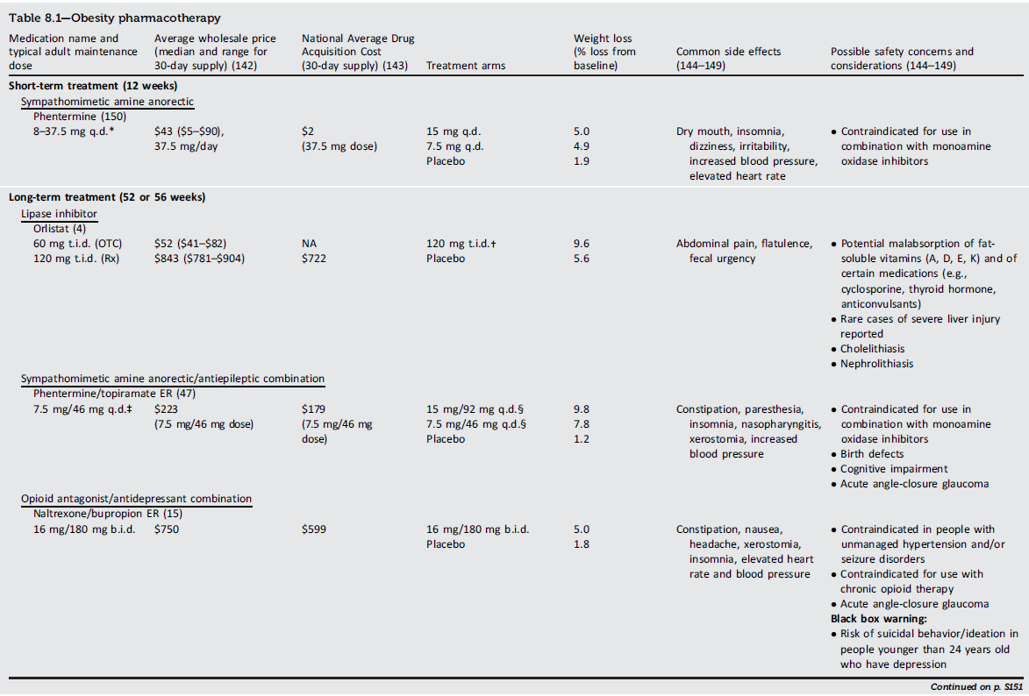
Obesity AND WEIGHT Management for the PREVENTION AND Treatment of Type 2 Diabetes
Obesity Management for the Treatment of Type 2 Diabetes: Standards of Care in Diabetes - 2024. Diabetes Care 2024;47(Suppl. 1):S145-S157

Slide 158
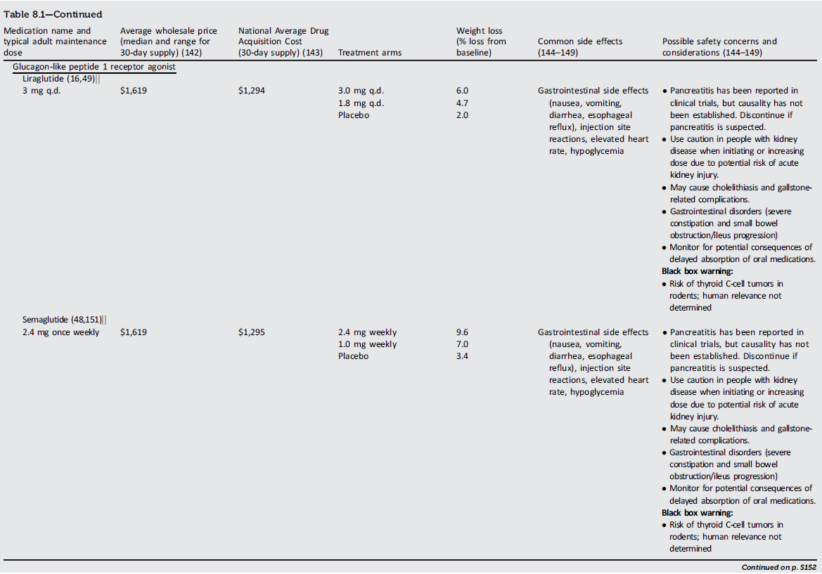
Obesity AND WEIGHT Management for the PREVENTION AND Treatment of Type 2 Diabetes
Obesity Management for the Treatment of Type 2 Diabetes: Standards of Care in Diabetes - 2024. Diabetes Care 2024;47(Suppl. 1):S145-S157

Slide 159
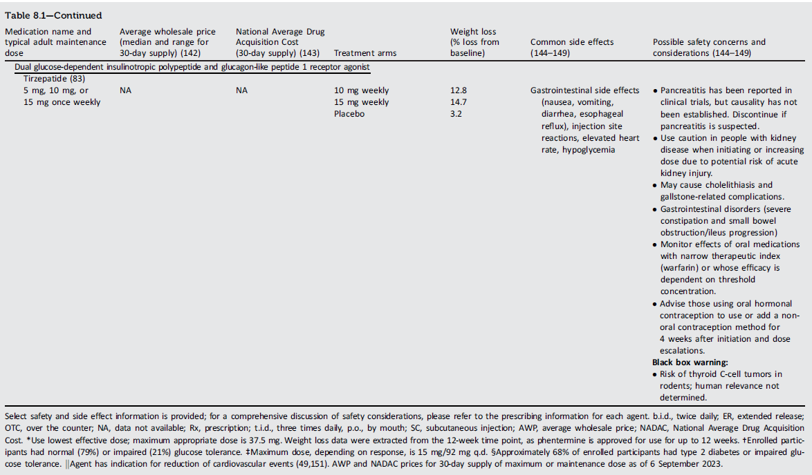
Obesity AND WEIGHT Management for the PREVENTION AND Treatment of Type 2 Diabetes
Obesity Management for the Treatment of Type 2 Diabetes: Standards of Care in Diabetes - 2024. Diabetes Care 2024;47(Suppl. 1):S145-S157

Slide 160
Section 9. Pharmacologic Approaches to Glycemic Treatment

Slide 161
Pharmacologic Therapy for Adults With Type 1 Diabetes
Pharmacologic Approaches to Glycemic Treatment
9.1 Treat most adults with type 1 diabetes with continuous subcutaneous insulin infusion or multiple daily doses of prandial (injected or inhaled) and basal insulin. A
9.2 For most adults with type 1 diabetes, insulin analogs (or inhaled insulin) are preferred over injectable human insulins to minimize hypoglycemia risk. A
9.3 Early use of continuous glucose monitoring is recommended for adults with type 1 diabetes to improve glycemic outcomes and quality of life and minimize hypoglycemia. B
9.4 Automated insulin delivery systems should be considered for all adults with type 1 diabetes. A

Slide 162
Pharmacologic Therapy for Adults With Type 1 Diabetes (continued)
Pharmacologic Approaches to Glycemic Treatment
9.5 To improve glycemic outcomes and quality of life and minimize hypoglycemia risk, most adults with type 1 diabetes should receive education on how to match mealtime insulin doses to carbohydrate intake and, additionally, to fat and protein intake. They should also be taught how to modify the insulin dose (correction dose) based on concurrent glycemia, glycemic trends (if available), sick-day management, and anticipated physical activity. B
9.6 Glucagon should be prescribed for all individuals taking insulin or at high risk for hypoglycemia. Family, caregivers, school personnel, and others providing support to these individuals should know its location and be educated on how to administer it. Glucagon preparations that do not require reconstitution are preferred. E

Slide 163
Pharmacologic Therapy for Adults With Type 1 Diabetes (continued)
Pharmacologic Approaches to Glycemic Treatment
9.7 Insulin treatment plan and insulin-taking behavior should be reevaluated at regular intervals (e.g., every 3–6 months) and adjusted to incorporate specific factors that impact choice of treatment and ensure achievement of individualized glycemic goals. E

Slide 164
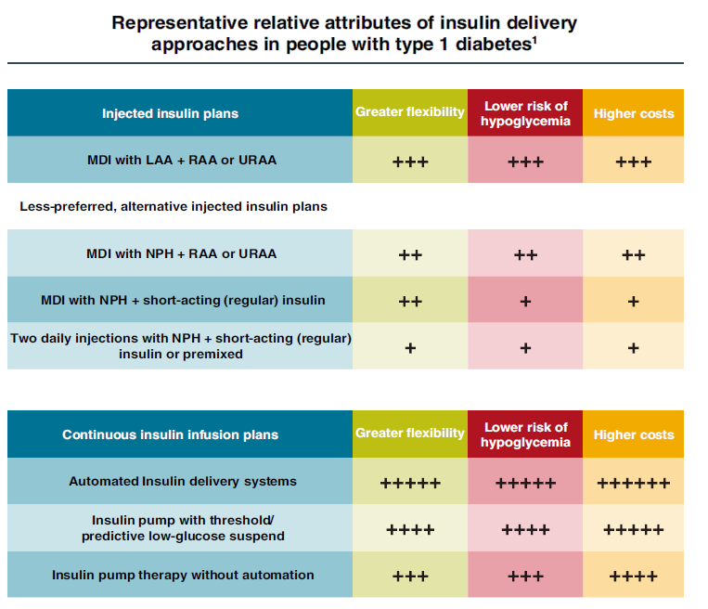
Pharmacologic Approaches to Glycemic Treatment
Pharmacologic Approaches to Glycemic Treatment: Standards of Care in Diabetes - 2024. Diabetes Care 2024;47(Suppl. 1):S158-S178

Slide 165
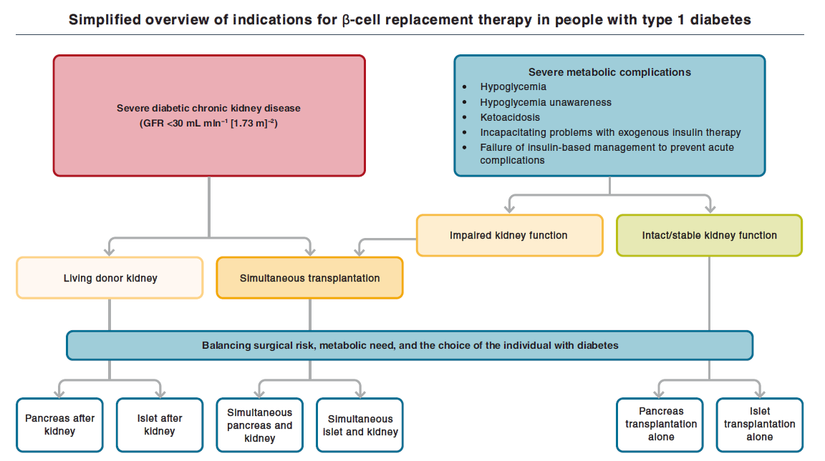
Pharmacologic Approaches to Glycemic Treatment
Pharmacologic Approaches to Glycemic Treatment: Standards of Care in Diabetes - 2024. Diabetes Care 2024;47(Suppl. 1):S158-S178

Slide 166
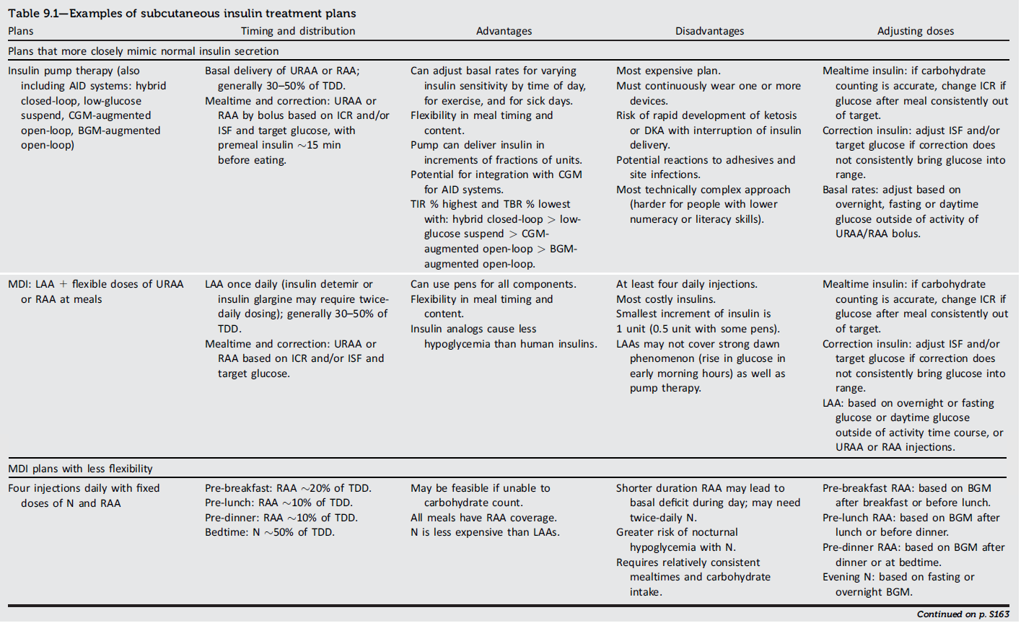
Pharmacologic Approaches to Glycemic Treatment
Pharmacologic Approaches to Glycemic Treatment: Standards of Care in Diabetes - 2024. Diabetes Care 2024;47(Suppl. 1):S158-S178

Slide 167
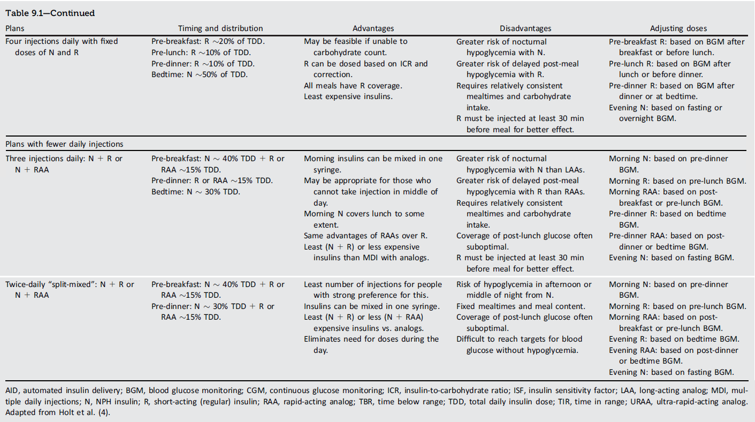
Pharmacologic Approaches to Glycemic Treatment
Pharmacologic Approaches to Glycemic Treatment: Standards of Care in Diabetes - 2024. Diabetes Care 2024;47(Suppl. 1):S158-S178

Slide 168
Pharmacologic Therapy for Adults With Type 2 Diabetes
Pharmacologic Approaches to Glycemic Treatment
9.8 Healthy lifestyle behaviors, diabetes self-management education and support, avoidance of therapeutic inertia, and social determinants of health should be considered in the glucose-lowering management of type 2 diabetes. A
9.9 A person-centered shared decision-making approach should guide the choice of pharmacologic agents for adults with type 2 diabetes. Consider the effects on cardiovascular and renal comorbidities; effectiveness; hypoglycemia risk; impact on weight, cost, and access; risk for adverse reactions and tolerability; and individual preferences (Fig. 9.3 and Table 9.2). E
9.10 The glucose-lowering treatment plan should consider approaches that support weight management goals (Fig. 9.3 and Table 9.2) for adults with type 2 diabetes. A

Slide 169
Pharmacologic Therapy for Adults With Type 2 Diabetes (continued)
Pharmacologic Approaches to Glycemic Treatment
9.11 For adults with type 2 diabetes, use pharmacological strategies that provide sufficient effectiveness to achieve and maintain the intended treatment goals. A
9.12 Treatment modification (intensification or deintensification) for adults not meeting individualized treatment goals should not be delayed. A
9.13 Medication plan and medication-taking behavior should be reevaluated at regular intervals (e.g., every 3–6 months) and adjusted as needed to incorporate specific factors that impact choice of treatment (Fig. 4.1 and Table 9.2). E

Slide 170
Pharmacologic Therapy for Adults With Type 2 Diabetes (continued)
Pharmacologic Approaches to Glycemic Treatment
9.14 Early combination therapy can be considered in adults with type 2 diabetes at treatment initiation to shorten time to attainment of individualized treatment goals. A
9.15 In adults with type 2 diabetes without cardiovascular and/or kidney disease, pharmacologic agents should address both the individualized glycemic and weight goals (Fig. 9.3). A
9.16 In adults with type 2 diabetes without cardiovascular and/or kidney disease, pharmacologic agents should address both the individualized glycemic and weight goals (Fig. 9.3). A

Slide 171
Pharmacologic Therapy for Adults With Type 2 Diabetes (continued)
Pharmacologic Approaches to Glycemic Treatment
9.17 In adults with type 2 diabetes who have not achieved their individualized weight goals, additional weight management interventions (e.g., intensification of lifestyle modifications, structured weight management programs, pharmacologic agents, or metabolic surgery, as appropriate) are recommended. A
9.18 In adults with type 2 diabetes and established or high risk of atherosclerotic cardiovascular disease, heart failure (HF), and/or chronic kidney disease (CKD), the treatment plan should include agent(s) that reduce cardiovascular and kidney disease risk (e.g., sodium-glucose cotransporter 2 inhibitor [SGLT2] and/or glucagon-like peptide 1 receptor agonist [GLP-1 RA]) (Fig. 9.3, Table 9.2, Table 10.3B, and Table 10.3C) for glycemic management and comprehensive cardiovascular risk reduction, independent of A1C and in consideration of person- specific factors (Fig. 9.3) (see Section 10, “Cardiovascular Disease and Risk Management,” for details on cardiovascular risk reduction recommendations). A

Slide 172
Pharmacologic Therapy for Adults With Type 2 Diabetes (continued)
Pharmacologic Approaches to Glycemic Treatment
9.19 In adults with type 2 diabetes who have HF (with either reduced or preserved ejection fraction), an SGLT2 inhibitor is recommended, for glycemic management and prevention of HF hospitalizations (see Section 10, “Cardiovascular Disease and Risk Management,” for details on cardiovascular risk reduction recommendations). A
9.20 In adults with type 2 diabetes who have CKD (with confirmed estimated glomerular filtration rate [eGFR] of 20–60 mL/min per 1.73 m² and/or albuminuria), an SGLT2 inhibitor should be used for minimizing progression of CKD, reduction in cardiovascular events, and reduction in hospitalizations for HF (Fig. 9.3); however, the glycemic benefits of SGLT2 inhibitors are reduced at eGFR <45 mL/min per 1.73 m² (see Section 11, “Chronic Kidney Disease and Risk Management” for details on renal risk reduction recommendations). A

Slide 173
Pharmacologic Therapy for Adults With Type 2 Diabetes (continued)
Pharmacologic Approaches to Glycemic Treatment
9.21 In adults with type 2 diabetes and advanced CKD (eGFR <30 mL/min per 1.73 m²), a GLP-1 RA is preferred for glycemic management due to lower risk of hypoglycemia and for cardiovascular event reduction. B
9.22 In adults with type 2 diabetes, initiation of insulin should be considered regardless of background glucose-lowering therapy or disease stage if there is evidence of ongoing catabolism (e.g., unexpected weight loss), if symptoms of hyperglycemia are present, or when A1C or blood glucose levels are very high (i.e., A1C >10% [>86 mmol/mol] or blood glucose ≥300 mg/dL [≥ 16.7 mmol/L]). E
9.23 In adults with type 2 diabetes, a GLP-1 RA, including a dual glucose-dependent insulinotropic polypeptide (GIP) and GLP-1 RA, is preferred to insulin (Fig. 9.4). A

Slide 174
Pharmacologic Therapy for Adults With Type 2 Diabetes (continued)
Pharmacologic Approaches to Glycemic Treatment
9.24 If insulin is used, combination therapy with a GLP-1 RA, including a dual GIP and GLP-1 RA, is recommended for greater glycemic effectiveness as well as beneficial effects on weight and hypoglycemia risk for adults with type 2 diabetes. Insulin dosing should be reassessed upon addition or dose escalation of a GLP-1 RA or dual GIP and GLP-1 RA. A
9.25 In adults with type 2 diabetes, glucose-lowering agents may be continued upon initiation of insulin therapy (unless contraindicated or not tolerated) for ongoing glycemic and metabolic benefits (i.e., weight, cardiometabolic, or kidney benefits). A
9.26 To minimize the risk of hypoglycemia and treatment burden when starting insulin therapy in adults with type 2 diabetes, reassess the need for and/or dose of glucose-lowering agents with higher hypoglycemia risk (i.e., sulfonylureas and meglitinides). A

Slide 175
Pharmacologic Therapy for Adults With Type 2 Diabetes (continued)
Pharmacologic Approaches to Glycemic Treatment
9.27 Monitor for signs of overbasalization during insulin therapy, such as basal dose exceeding 0.5 units/kg/day, significant bedtime-to-morning or postprandial-to- preprandial glucose differential, occurrences of hypoglycemia (aware or unaware), and high glycemic variability. When overbasalization is suspected, a thorough reevaluation should occur promptly to further tailor therapy to the individual’s needs. E
9.28 Routinely assess all people with diabetes for financial obstacles that could impede their diabetes management. Clinicians, members of the diabetes care team, and social services professionals should work collaboratively, as appropriate and feasible, to support these individuals by implementing strategies to reduce costs, thereby improving their access to evidence-based care. E

Slide 176
Pharmacologic Therapy for Adults With Type 2 Diabetes (continued)
Pharmacologic Approaches to Glycemic Treatment
9.29 In adults with diabetes and cost-related barriers, consider use of lower-cost medications for glycemic management (i.e., metformin, sulfonylureas, thiazolidinediones, and human insulin) within the context of their risks for hypoglycemia, weight gain, cardiovascular and kidney events, and other adverse effects. E

Slide 177
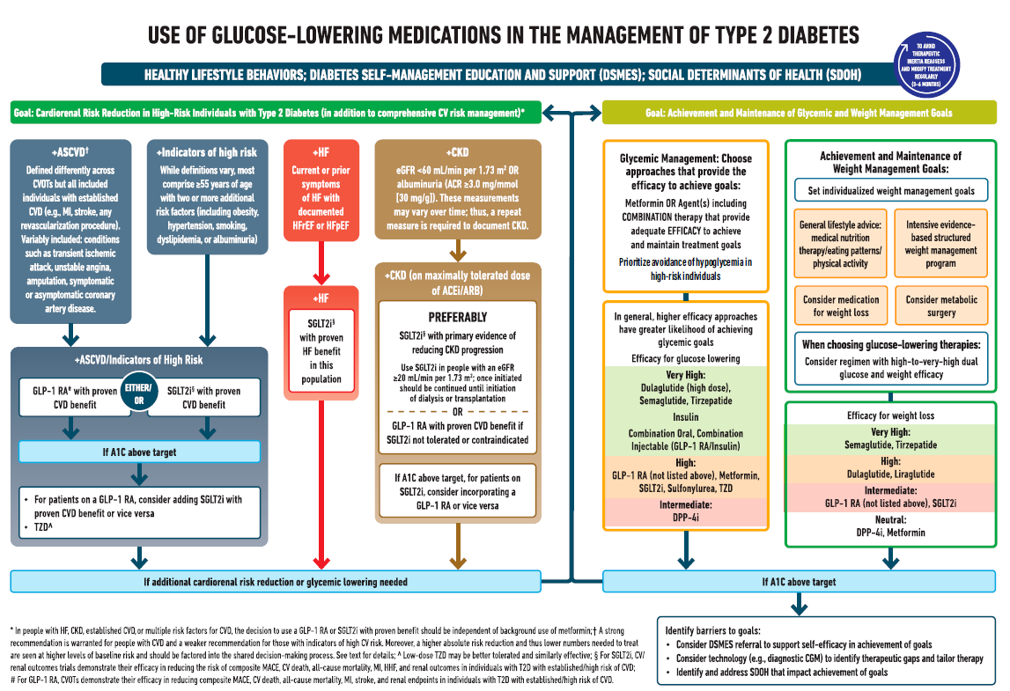
Pharmacologic Approaches to Glycemic Treatment: Standards of Care in Diabetes - 2024. Diabetes Care 2024;47(Suppl. 1):S158-S178

Slide 178
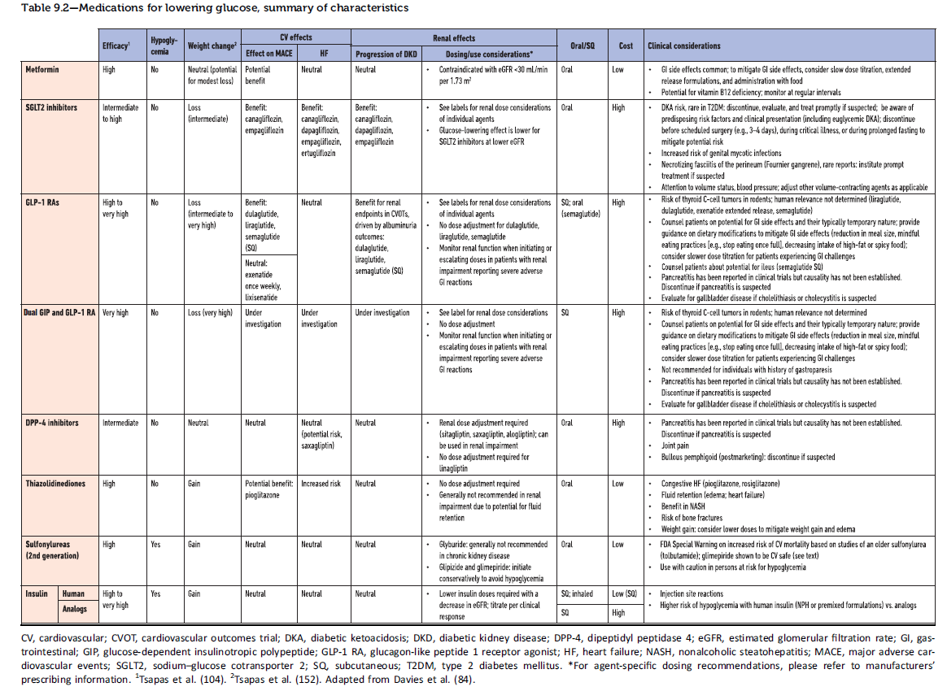
Pharmacologic Approaches to Glycemic Treatment: Standards of Care in Diabetes - 2024. Diabetes Care 2024;47(Suppl. 1):S158-S178

Slide 179
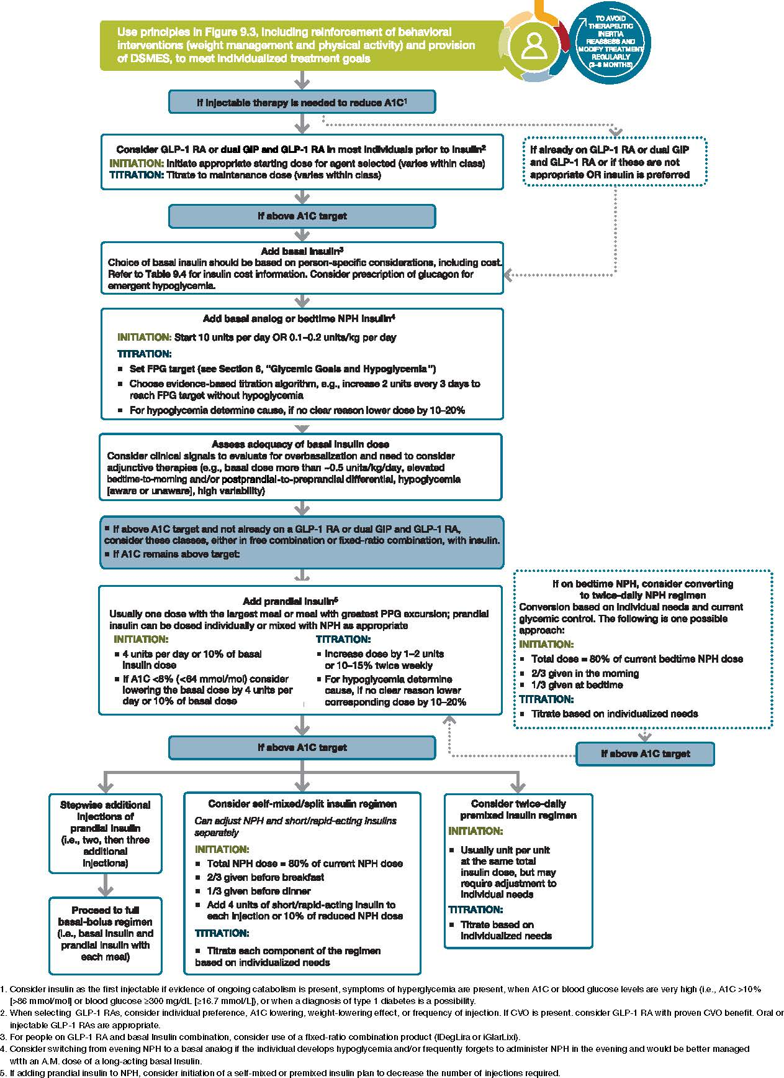
Pharmacologic Approaches to Glycemic Treatment: Standards of Care in Diabetes - 2024. Diabetes Care 2024;47(Suppl. 1):S158-S178

Slide 180
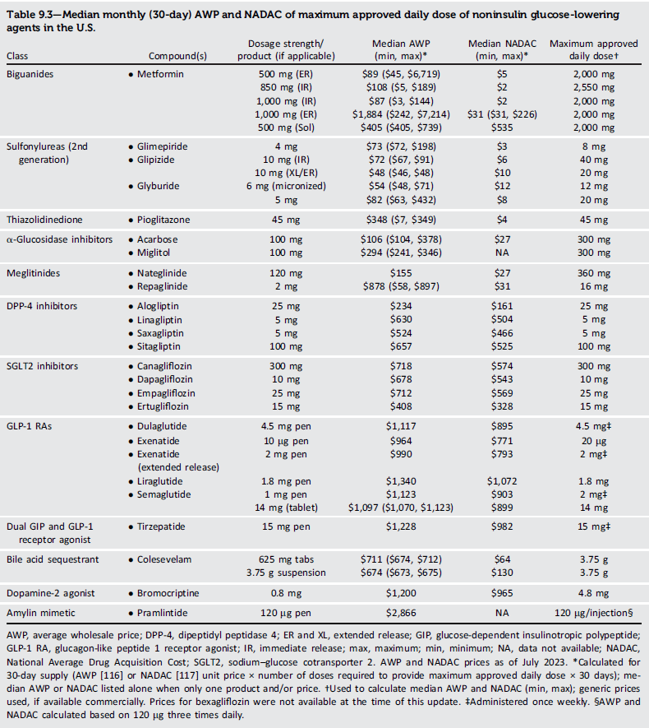
Median monthly cost AWP and NADAC of maximum approved daily dose of noninsulin glucose-lowering agents in the U.S.
Pharmacologic Approaches to Glycemic Treatment: Standards of Care in Diabetes - 2024. Diabetes Care 2024;47(Suppl. 1):S158-S178

Slide 181
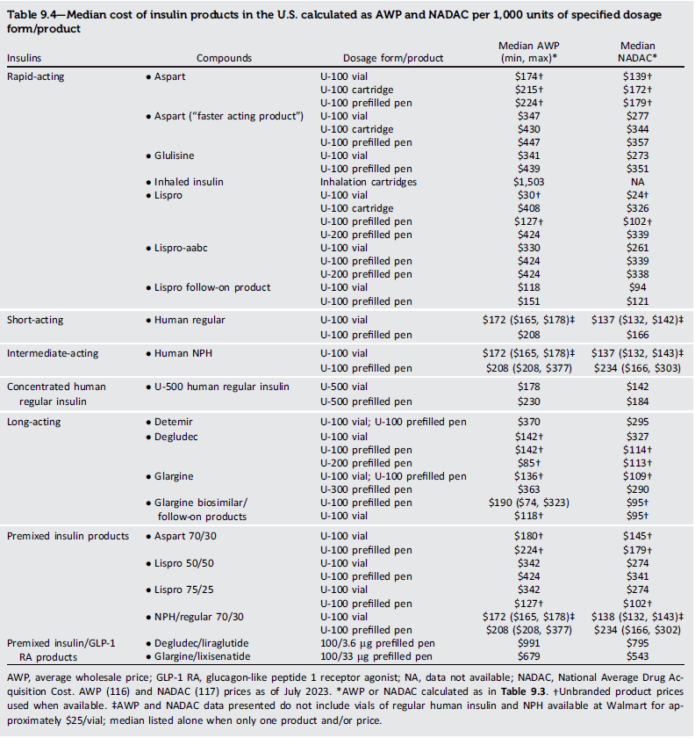
Median cost of insulin products in the U.S. calculated as AWP and NADAC per 1,000 units of specified dosage
Pharmacologic Approaches to Glycemic Treatment: Standards of Care in Diabetes - 2024. Diabetes Care 2024;47(Suppl. 1):S158-S178

Slide 182
Section 10. Cardiovascular Disease and Risk Management

Slide 183
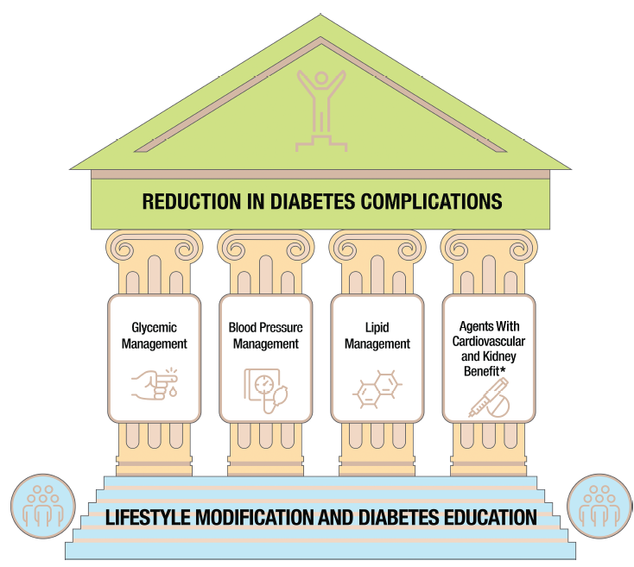
Cardiovascular Disease and Risk Management
Cardiovascular Disease and Risk Management: Standards of Care in Diabetes - 2024. Diabetes Care 2024;47(Suppl. 1):S179-S218

Slide 184
Screening and Diagnosis
Cardiovascular Disease and Risk Management
10.1 Blood pressure should be measured at every routine clinical visit. When possible, individuals found to have elevated blood pressure (systolic blood pressure 120–129 mmHg and diastolic <80 mmHg) should have blood pressure confirmed using multiple readings, including measurements on a separate day, to diagnose hypertension. A Hypertension is defined as a systolic blood pressure ≥130 mmHg or a diastolic blood pressure ≥80 mmHg based on an average of two or more measurements obtained on two or more occasions. A Individuals with blood pressure ≥ 180/110 mmHg and cardiovascular disease could be diagnosed with hypertension at a single visit. E
10.2 All people with hypertension and diabetes should be counseled to monitor their blood pressure at home after appropriate education. A

Slide 185
Treatment Goals
Cardiovascular Disease and Risk Management
10.3 For people with diabetes and hypertension, blood pressure targets should be individualized through a shared decision-making process that addresses cardiovascular risk, potential adverse effects of antihypertensive medications, and individual preferences. B
10.4 The on-treatment target blood pressure goal is <130/80 mmHg, if it can be safely attained. A

Slide 186
Treatment Goals (continued)
Cardiovascular Disease and Risk Management
10.5 In pregnant individuals with diabetes and chronic hypertension, a blood pressure threshold of 140/90 mmHg for initiation or titration of therapy is associated with better pregnancy outcomes than reserving treatment for severe hypertension, with no increase in risk of small-for-gestational-age birth weight. A There are limited data on the optimal lower limit, but therapy should be deintensified for blood pressure <90/60 mmHg. E A blood pressure target of 110–135/85 mmHg is suggested in the interest of reducing the risk for accelerated maternal hypertension. A

Slide 187
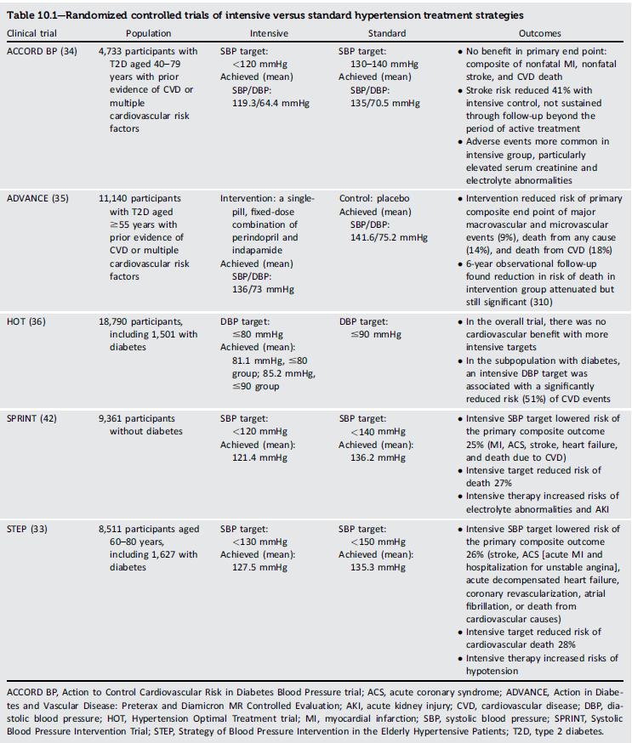
Randomized controlled trials of intensive versus standard hypertension treatment strategies
Cardiovascular Disease and Risk Management: Standards of Care in Diabetes - 2024. Diabetes Care 2024;47(Suppl. 1):S179-S218

Slide 188
Treatment Strategies—Lifestyle Intervention
Cardiovascular Disease and Risk Management
10.6 For people with blood pressure >120/80 mmHg, lifestyle intervention consists of weight loss when indicated, a Dietary Approaches to Stop Hypertension (DASH)–style eating pattern including reducing sodium and increasing potassium intake, moderation of alcohol intake, smoking cessation, and increased physical activity. A

Slide 189
Treatment Strategies—Pharmacologic Interventions
Cardiovascular Disease and Risk Management
10.7 Individuals with confirmed office-based blood pressure ≥130/80 mmHg qualify for initiation and titration of pharmacologic therapy to achieve the recommended blood pressure goal of <130/80 mmHg. A
10.8 Individuals with confirmed office-based blood pressure ≥ 150/90 mmHg should, in addition to lifestyle therapy, have prompt initiation and timely titration of two drugs or a single-pill combination of drugs demonstrated to reduce cardiovascular events in people with diabetes. A
10.9 Treatment for hypertension should include drug classes demonstrated to reduce cardiovascular events in people with diabetes. A ACE inhibitors or angiotensin receptor blockers (ARBs) are recommended first-line therapy for hypertension in people with diabetes and coronary artery disease. A

Slide 190
Treatment Strategies—Pharmacologic Interventions (continued)
Cardiovascular Disease and Risk Management
10.10 Multiple-drug therapy is generally required to achieve blood pressure targets. However, combinations of ACE inhibitors and ARBs and combinations of ACE inhibitors or ARBs (including ARBs/neprilysin inhibitors) with direct renin inhibitors should not be used. A
10.11 An ACE inhibitor or ARB, at the maximum tolerated dose indicated for blood pressure treatment, is the recommended first-line treatment for hypertension in people with diabetes and urinary albumin-to-creatinine ratio ≥300 mg/g creatinine A or 30–299mg/g creatinine. B If one class is not tolerated, the other should be substituted. B
10.12 For adults treated with an ACE inhibitor, ARB, mineralocorticoid receptor antagonist (MRA), or diuretic, serum creatinine/estimated glomerular filtration rate and serum potassium levels should be monitored within 7–14 days after initiation of therapy and at least annually. B

Slide 191
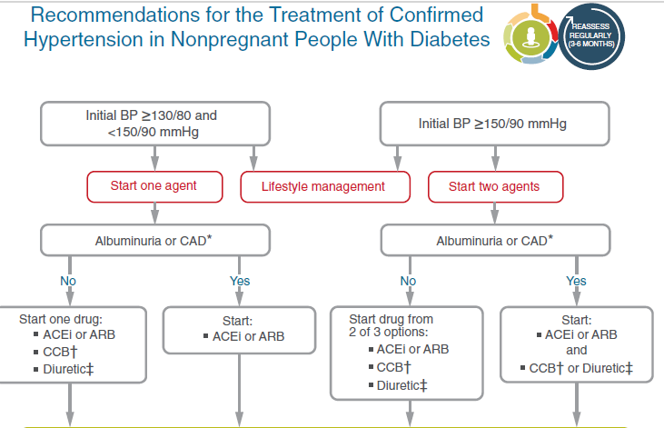
Cardiovascular Disease and Risk Management
Recommendations for the Treatment of Confirmed Hypertension in People with Diabetes (1 of 2)
Cardiovascular Disease and Risk Management: Standards of Care in Diabetes - 2024. Diabetes Care 2024;47(Suppl. 1):S179-S218

Slide 192
Cardiovascular Disease and Risk Management
Recommendations for the Treatment of Confirmed Hypertension in People with Diabetes (2 of 2)
Cardiovascular Disease and Risk Management: Standards of Care in Diabetes - 2024. Diabetes Care 2024;47(Suppl. 1):S179-S218

Slide 193
Treatment Strategies—Resistant Hypertension
Cardiovascular Disease and Risk Management
10.13 Individuals with hypertension who are not meeting blood pressure targets on three classes of antihypertensive medications (including a diuretic) should be considered for MRA therapy. A

Slide 194
Lipid Management—Lifestyle Intervention
Cardiovascular Disease and Risk Management
10.14 Lifestyle modification focusing on weight loss (if indicated); application of a Mediterranean or DASH eating pattern; reduction of saturated fat and trans fat; increase of dietary n-3 fatty acids, viscous fiber, and plant stanol/sterol intake; and increased physical activity should be recommended to improve the lipid profile and reduce the risk of developing atherosclerotic cardiovascular disease (ASCVD) in people with diabetes. A
10.15 Intensify lifestyle therapy and optimize glycemic control for people with diabetes with elevated triglyceride levels (≥150 mg/dL [≥ 1.7 mmol/L]) and/or low HDL cholesterol (<40 mg/dL [<1.0 mmol/L] for men and <50mg/dL [<1.3 mmol/L] for women). C

Slide 195
Lipid Management—Ongoing Therapy and Monitoring with Lipid Panel
Cardiovascular Disease and Risk Management
10.16 In adults with prediabetes or diabetes not taking statins or other lipid-lowering therapy, it is reasonable to obtain a lipid profile at the time of diagnosis, at an initial medical evaluation, annually thereafter, or more frequently if indicated. E
10.17 Obtain a lipid profile at initiation of statins or other lipid-lowering therapy, 4– 12 weeks after initiation or a change in dose, and annually thereafter, as it may help to monitor the response to therapy and inform medication taking. A

Slide 196
Statin Treatment—Primary Prevention
Cardiovascular Disease and Risk Management
10.18 For people with diabetes aged 40–75 years without ASCVD, use moderate- intensity statin therapy in addition to lifestyle therapy. A
10.19 For people with diabetes aged 20–39 years with additional ASCVD risk factors, it may be reasonable to initiate statin therapy in addition to lifestyle therapy. C
10.20 For people with diabetes aged 40–75 years at higher cardiovascular risk, including those with one or more ASCVD risk factors, it is recommended to use high-intensity statin therapy to reduce LDL cholesterol by ≥50% of baseline and to target an LDL cholesterol goal of <70 mg/dL (<1.8 mmol/L). A
10.21 For people with diabetes aged 40–75 years at higher cardiovascular risk, especially those with multiple ASCVD risk factors and an LDL cholesterol ≥ 70 mg/dL (≥ 1.8 mmol/L), it may be reasonable to add ezetimibe or a PCSK9 inhibitor to maximum tolerated statin therapy. B

Slide 197
Statin Treatment—Primary Prevention (continued)
Cardiovascular Disease and Risk Management
10.22 In adults with diabetes aged >75 years already on statin therapy, it is reasonable to continue statin treatment. B
10.23 In adults with diabetes aged >75 years, it may be reasonable to initiate moderate-intensity statin therapy after discussion of potential benefits and risks. C
10.24 In people with diabetes intolerant to statin therapy, treatment with bempedoic acid is recommended to reduce cardiovascular event rates as an alternative cholesterol-lowering plan. A
10.25 Statin therapy is contraindicated in pregnancy. B

Slide 198
Statin Treatment—Secondary Prevention
Cardiovascular Disease and Risk Management
10.26 For people of all ages with diabetes and ASCVD, high-intensity statin therapy should be added to lifestyle therapy. A
10.27 For people with diabetes and ASCVD, treatment with high-intensity statin therapy is recommended to target an LDL cholesterol reduction of ≥50% from baseline and an LDL cholesterol goal of <55 mg/dL (<1.4 mmol/L). Addition of ezetimibe or a PCSK9 inhibitor with proven benefit in this population is recommended if this goal is not achieved on maximum tolerated statin therapy. B
10.28a For individuals who do not tolerate the intended statin intensity, the maximum tolerated statin dose should be used. E
10.28b For people with diabetes and ASCVD intolerant to statin therapy, PCSK9 inhibitor therapy with monoclonal antibody treatment, A bempedoic acid therapy, A or PCSK9 inhibitor therapy with inclisiran siRNA E should be considered as an alternative cholesterol-lowering therapy.

Slide 199
Cardiovascular Disease and Risk Management
Cardiovascular Disease and Risk Management: Standards of Care in Diabetes - 2024. Diabetes Care 2024;47(Suppl. 1):S179-S218

Slide 200
Treatment of Other Lipoprotein Fractions or Targets
Cardiovascular Disease and Risk Management
10.29 For individuals with fasting triglyceride levels ≥500 mg/dL (≥5.7 mmol/L), evaluate for secondary causes of hypertriglyceridemia and consider medical therapy to reduce the risk of pancreatitis. C
10.30 In adults with moderate hypertriglyceridemia (fasting or nonfasting triglycerides 175–499 mg/dL [2.0–5.6 mmol/L]), clinicians should address and treat lifestyle factors (obesity and metabolic syndrome), secondary factors (diabetes, chronic liver or kidney disease and/or nephrotic syndrome, and hypothyroidism), and medications that raise triglycerides. C
10.31 In individuals with ASCVD or other cardiovascular risk factors on a statin with controlled LDL cholesterol but elevated triglycerides (135–499 mg/dL [1.5–5.6 mmol/L]), the addition of icosapent ethyl can be considered to reduce cardiovascular risk. A

Slide 201
Other Combination Therapy
Cardiovascular Disease and Risk Management
10.32 Statin plus fibrate combination therapy has not been shown to improve ASCVD outcomes and is generally not recommended. A
10.33 Statin plus niacin combination therapy has not been shown to provide additional cardiovascular benefit above statin therapy alone, may increase the risk of stroke with additional side effects, and is generally not recommended. A

Slide 202
Antiplatelet Agents
Cardiovascular Disease and Risk Management
10.34 Use aspirin therapy (75–162 mg/day) as a secondary prevention strategy in those with diabetes and a history of ASCVD. A
10.35a For individuals with ASCVD and documented aspirin allergy, clopidogrel (75 mg/day) should be used. B
10.35b The length of treatment with dual antiplatelet therapy using low-dose aspirin and a P2Y12 inhibitor in individuals with diabetes after an acute coronary syndrome or acute ischemic stroke/transient ischemic attack should be determined by an interprofessional team approach that includes a cardiovascular or neurological specialist, respectively. E

Slide 203
Antiplatelet Agents (continued)
Cardiovascular Disease and Risk Management
10.36 Combination therapy with aspirin plus low-dose rivaroxaban should be considered for individuals with stable coronary and/or peripheral artery disease (PAD) and low bleeding risk to prevent major adverse limb and cardiovascular events. A
10.37 Aspirin therapy (75–162 mg/day) may be considered as a primary prevention strategy in those with diabetes who are at increased cardiovascular risk, after a comprehensive discussion with the individual on the benefits versus the increased risk of bleeding. A

Slide 204
Cardiovascular Disease—Screening
Cardiovascular Disease and Risk Management
10.38a In asymptomatic individuals, routine screening for coronary artery disease is not recommended, as it does not improve outcomes as long as ASCVD risk factors are treated. A
10.38b Consider investigations for coronary artery disease in the presence of any of the following: atypical cardiac symptoms; signs or symptoms of associated vascular disease, including carotid bruits, transient ischemic attack, stroke, claudication, or PAD; or electrocardiogram abnormalities (e.g., Q waves). E
10.39a Adults with diabetes are at increased risk for the development of asymptomatic cardiac structural or functional abnormalities (stage B heart failure) or symptomatic (stage C) heart failure. Consider screening adults with diabetes by measuring a natriuretic peptide (B-type natriuretic peptide [BNP] or N-terminal pro-BNP [NTproBNP]) to facilitate prevention of stage C heart failure. B

Slide 205
Cardiovascular Disease—Screening (continued)
Cardiovascular Disease and Risk Management
10.39b In asymptomatic individuals with diabetes and abnormal natriuretic peptide levels, echocardiography is recommended to identify stage B heart failure. A
10.40 In asymptomatic individuals with diabetes and age ≥ 50 years, microvascular disease in any location, or foot complications or any end-organ damage from diabetes, screening for PAD with ankle-brachial index testing is recommended to guide treatment for cardiovascular disease prevention and limb preservation. A In individuals with diabetes duration ≥10 years, screening for PAD should be considered. B

Slide 206
Cardiovascular Disease—Treatment
Cardiovascular Disease and Risk Management
10.41 Among people with type 2 diabetes who have established ASCVD or established kidney disease, a sodium–glucose cotransporter 2 (SGLT2) inhibitor or glucagon-like peptide 1 (GLP-1) receptor agonist with demonstrated cardiovascular disease benefit (Table 10.3B and Table 10.3C) is recommended as part of the comprehensive cardiovascular risk reduction and/or glucose-lowering treatment plans. A
10.41a In people with type 2 diabetes and established ASCVD, multiple ASCVD risk factors, or diabetic kidney disease, an SGLT2 inhibitor with demonstrated cardiovascular benefit is recommended to reduce the risk of major adverse cardiovascular events and/or heart failure hospitalization. A
10.41b In people with type 2 diabetes and established ASCVD or multiple risk factors for ASCVD, a GLP-1 receptor agonist with demonstrated cardiovascular benefit is recommended to reduce the risk of major adverse cardiovascular events. A

Slide 207
Cardiovascular Disease—Treatment (continued)
Cardiovascular Disease and Risk Management
10.41c In people with type 2 diabetes and established ASCVD or multiple risk factors for ASCVD, combined therapy with an SGLT2 inhibitor with demonstrated cardiovascular benefit and a GLP-1 receptor agonist with demonstrated cardiovascular benefit may be considered for additive reduction of the risk of adverse cardiovascular and kidney events. A
10.42a In people with type 2 diabetes and established heart failure with either preserved or reduced ejection fraction, an SGLT2 inhibitor (including SGLT1/2 inhibitor) with proven benefit in this patient population is recommended to reduce the risk of worsening heart failure and cardiovascular death. A
10.42b In people with type 2 diabetes and established heart failure with either preserved or reduced ejection fraction, an SGLT2 inhibitor with proven benefit in this patient population is recommended to improve symptoms, physical limitations, and quality of life. A

Slide 208
Cardiovascular Disease—Treatment (continued)
Cardiovascular Disease and Risk Management
10.43 For individuals with type 2 diabetes and chronic kidney disease with albuminuria treated with maximum tolerated doses of ACE inhibitor or ARB, addition of finerenone is recommended to improve cardiovascular outcomes and reduce the risk of chronic kidney disease progression. A
10.44 In individuals with diabetes with established ASCVD or aged ≥55 years with additional cardiovascular risk factors, ACE inhibitor or ARB therapy is recommended to reduce the risk of cardiovascular events and mortality. A
10.45a In individuals with diabetes and asymptomatic stage B heart failure, an interprofessional approach to optimize guideline-directed medical therapy, which should include a cardiovascular disease specialist, is recommended to reduce the risk for progression to symptomatic (stage C) heart failure. A

Slide 209
Cardiovascular Disease—Treatment (continued)
Cardiovascular Disease and Risk Management
10.45b In individuals with diabetes and asymptomatic stage B heart failure, ACE inhibitors/ARBs and b-blockers are recommended to reduce the risk for progression to symptomatic (stage C) heart failure. A
10.45c In individuals with type 2 diabetes and asymptomatic stage B heart failure or with high risk of or heart failure or with high risk of or established cardiovascular disease, treatment with an SGLT inhibitor (including SGLT2 or SGLT1/2 inhibitors) is recommended to reduce the risk of hospitalization for heart failure. A
10.45d In individuals with type 2 diabetes and diabetic kidney disease, finerenone is recommended to reduce the risk of hospitalization for heart failure. A

Slide 210
Cardiovascular Disease—Treatment (continued)
Cardiovascular Disease and Risk Management
10.45e In individuals with diabetes, guideline-directed medical therapy for myocardial infarction and symptomatic stage C heart failure is recommended with ACE inhibitors/ARBs, MRAs, angiotensin receptor/neprilysin inhibitor, β-blockers, and SGLT2 inhibitors, similar to guideline-directed medical therapy for people without diabetes. A
10.46 In people with type 2 diabetes with stable heart failure, metformin may be continued for glucose lowering if estimated glomerular filtration rate remains >30 mL/min/1.73 m² but should be avoided in unstable or hospitalized individuals with heart failure. B
10.47 Individuals with type 1 diabetes and those with type 2 diabetes who are ketosis prone and/or those consuming ketogenic diets who are treated with SGLT inhibition should be educated on the risks and signs of ketoacidosis and methods of risk management and provided with appropriate tools for accurate ketone measurement (i.e., serum β-hydroxybutyrate). E

Slide 211
Table 10.3A—Cardiovascular and cardiorenal outcomes trials of available antihyperglycemic medications completed after the issuance of the FDA 2008 guidelines: DPP-4 inhibitors
Cardiovascular Disease and Risk Management: Standards of Care in Diabetes - 2024. Diabetes Care 2024;47(Suppl. 1):S179-S218

Slide 212
Cardiovascular Disease and Risk Management
Table 10.3B—Cardiovascular and cardiorenal outcomes trials of available antihyperglycemic medications completed after the issuance
of the FDA 2008 guidelines: GLP-1 receptor agonists (1 of 2)
Cardiovascular Disease and Risk Management: Standards of Care in Diabetes - 2024. Diabetes Care 2024;47(Suppl. 1):S179-S218

Slide 213
Cardiovascular Disease and Risk Management
Table 10.3B—Cardiovascular and cardiorenal outcomes trials of available antihyperglycemic medications completed after the issuance
of the FDA 2008 guidelines: GLP-1 receptor agonists (2 of 2)
Cardiovascular Disease and Risk Management: Standards of Care in Diabetes - 2024. Diabetes Care 2024;47(Suppl. 1):S179-S218

Slide 214
Cardiovascular Disease and Risk Management
Table 10.3C—Cardiovascular and cardiorenal outcomes trials of available antihyperglycemic medications completed after the issuance
of the FDA 2008 guidelines: SGLT2 inhibitors (1 of 2)
Cardiovascular Disease and Risk Management: Standards of Care in Diabetes - 2024. Diabetes Care 2024;47(Suppl. 1):S179-S218

Slide 215
Cardiovascular Disease and Risk Management
Table 10.3C—Cardiovascular and cardiorenal outcomes trials of available antihyperglycemic medications completed after the issuance
of the FDA 2008 guidelines: SGLT2 inhibitors (2 of 2)
Cardiovascular Disease and Risk Management: Standards of Care in Diabetes - 2024. Diabetes Care 2024;47(Suppl. 1):S179-S218

Slide 216
Cardiovascular Disease and Risk Management
Figure 10.3—Approach to risk reduction with SGLT2 inhibitor or GLP-1 receptor agonist therapy in conjunction with other traditional, guideline-based preventive medical therapies for blood pressure, lipids, and glycemia and antiplatelet therapy
Cardiovascular Disease and Risk Management: Standards of Care in Diabetes - 2024. Diabetes Care 2024;47(Suppl. 1):S179-S218

Slide 217
Section 11. Chronic Kidney Disease and Risk Management

Slide 218
Chronic Kidney Disease—Screening
CHRONIC KIDNEY DISEASE AND RISK MANAGEMENT
11.1a At least annually, urinary albumin (e.g., spot urinary albumin-to- creatinine ratio [UACR]) and estimated glomerular filtration rate [eGFR] should be assessed in people with type 1 diabetes with duration of ≥5 years and in all people with type 2 diabetes regardless of treatment. B
11.1b In people with established chronic kidney disease (CKD), urinary albumin (e.g., spot UACR) and eGFR should be monitored 1–4 times per year depending on the stage of the kidney disease (Fig. 11.1). B

Slide 219
Chronic Kidney Disease—Treatment
CHRONIC KIDNEY DISEASE AND RISK MANAGEMENT
11.2 Optimize glucose management to reduce the risk or slow the progression of CKD. A
11.3 Optimize blood pressure control and reduce blood pressure variability to reduce the risk or slow the progression of CKD and reduce cardiovascular risk. A
11.4a In nonpregnant people with diabetes and hypertension, either an ACE inhibitor or an angiotensin receptor blocker (ARB) is recommended for those with moderately increased albuminuria (UACR 30–299 mg/g creatinine) B and is strongly recommended for those with severely increased albuminuria (UACR ≥300 mg/g creatinine) and/or eGFR <60 mL/min/1.73 m² to prevent the progression of kidney disease and reduce cardiovascular events. A

Slide 220
Chronic Kidney Disease—Treatment (continued)
CHRONIC KIDNEY DISEASE AND RISK MANAGEMENT
11.4b Periodically monitor for increased serum creatinine and potassium levels when ACE inhibitors, ARBs, and mineralocorticoid receptor antagonists are used, or for hypokalemia when diuretics are used. B
11.4c An ACE inhibitor or an ARB is not recommended for the primary prevention of CKD in people with diabetes who have normal blood pressure, normal UACR (<30 mg/g creatinine), and normal eGFR. A
11.4d Do not discontinue renin-angiotensin system blockade for mild to moderate increases in serum creatinine (≤30%) in the absence of signs of extracellular fluid volume depletion. A

Slide 221
Chronic Kidney Disease—Treatment (continued)
CHRONIC KIDNEY DISEASE AND RISK MANAGEMENT
11.5a For people with type 2 diabetes and CKD, use of a sodium–glucose cotransporter 2 (SGLT2) inhibitor is recommended to reduce CKD progression and cardiovascular events in individuals with eGFR ≥ 20 mL/min/ 1.73 m² and urinary albumin ≥ 200 mg/g creatinine. A
11.5b For people with type 2 diabetes and CKD, use of an SGLT2 inhibitor is recommended to reduce CKD progression and cardiovascular events in individuals with eGFR ≥ 20 mL/min/ 1.73 m² and urinary albumin ranging from normal to 200 mg/g creatinine. B
11.5c For cardiovascular risk reduction in people with type 2 diabetes and CKD, consider use of an SGLT2 inhibitor (if eGFR is ≥ 20 mL/min/ 1.73 m²), a glucagon-like peptide 1 agonist, or a nonsteroidal mineralocorticoid receptor antagonist (if eGFR is ≥ 25 mL/min/1.73 m²). A

Slide 222
Chronic Kidney Disease—Treatment (continued)
CHRONIC KIDNEY DISEASE AND RISK MANAGEMENT
11.5d As people with CKD and albuminuria are at increased risk for cardiovascular events and CKD progression, a nonsteroidal mineralocorticoid receptor antagonist that has been shown to be effective in clinical trials is recommended to reduce cardiovascular events and CKD progression (if eGFR is ≥ 25 mL/min/1.73 m²). Potassium levels should be monitored. A
11.6 In people with CKD who have ≥ 300 mg/g urinary albumin, a reduction of 30% or greater in mg/g urinary albumin is recommended to slow CKD progression. C
11.7 For people with non-dialysis-dependent stage G3 or higher CKD, dietary protein intake should be aimed to a target level of 0.8 g/kg body weight per day. A For individuals on dialysis, 1.0–1.2 g/kg/day of dietary protein intake should be considered since protein energy wasting is a major problem in some individuals on dialysis. B

Slide 223
Chronic Kidney Disease—Treatment (continued)
CHRONIC KIDNEY DISEASE AND RISK MANAGEMENT
11.8 Individuals should be referred for evaluation by a nephrologist if they have continuously increasing urinary albumin levels and/or continuously decreasing eGFR and/or if the eGFR is <30 mL/min/1.73 m². A
11.9 Promptly refer to a nephrologist for uncertainty about the etiology of kidney disease, difficult management issues, and rapidly progressing kidney disease. B

Slide 224
CHRONIC KIDNEY DISEASE AND RISK MANAGEMENT
Figure 11.1—Risk of chronic kidney disease (CKD) progression, frequency of visits, and referral to nephrology according to glomerular filtration rate
(GFR) and albuminuria.
Chronic Kidney Disease and Risk management: Standards of Care in Diabetes - 2024. Diabetes Care 2024;47(Suppl. 1):S219-230

Slide 225
CHRONIC KIDNEY DISEASE AND RISK MANAGEMENT
Chronic Kidney Disease and Risk management: Standards of Care in Diabetes - 2024. Diabetes Care 2024;47(Suppl. 1):S219-230

Slide 226
CHRONIC KIDNEY DISEASE AND RISK MANAGEMENT
Figure 11.2— Holistic approach for improving outcomes in people with diabetes and chronic kidney disease (CKD).
Chronic Kidney Disease and Risk management: Standards of Care in Diabetes - 2024. Diabetes Care 2024;47(Suppl. 1):S219-230

Slide 227
Section 12. Retinopathy, Neuropathy, and Foot Care

Slide 228
Diabetic Retinopathy
Retinopathy, neuropathy, and foot care
12.1 Implement strategies to help people with diabetes reach glycemic goals to reduce the risk or slow the progression of diabetic retinopathy. A
12.2 Implement strategies to help people with diabetes reach blood pressure and lipid goals to reduce the risk or slow the progression of diabetic retinopathy. A

Slide 229
Diabetic Retinopathy—Screening
Retinopathy, neuropathy, and foot care
12.3 Adults with type 1 diabetes should have an initial dilated and comprehensive eye examination by an ophthalmologist or optometrist within 5 years after the onset of diabetes. B
12.4 People with type 2 diabetes should have an initial dilated and comprehensive eye examination by an ophthalmologist or optometrist at the time of the diabetes diagnosis. B
12.5 If there is no evidence of retinopathy from one or more annual eye exams and glycemic indicators are within the goal range, then screening every 1–2 years may be considered. If any level of diabetic retinopathy is present, subsequent dilated retinal examinations should be repeated at least annually by an ophthalmologist or optometrist. If retinopathy is progressing or sight-threatening, examinations will be required more frequently. B

Slide 230
Diabetic Retinopathy—Screening (continued)
Retinopathy, neuropathy, and foot care
12.6 Programs that use retinal photography with remote reading or the use of U.S. Food and Drug Administration-approved artificial intelligence algorithms to improve access to diabetic retinopathy screening are appropriate screening strategies for diabetic retinopathy. Such programs need to provide pathways for timely referral for a comprehensive eye examination when indicated. B
12.7 Counsel individuals of childbearing potential with preexisting type 1 or type 2 diabetes who are planning pregnancy or who are pregnant on the risk of development and/or progression of diabetic retinopathy. B
12.8 Individuals with preexisting type 1 or type 2 diabetes should receive an eye exam before pregnancy and in the first trimester and should be monitored every trimester and for 1 year postpartum as indicated by the degree of retinopathy. B

Slide 231
Diabetic Retinopathy—Treatment
Retinopathy, neuropathy, and foot care
12.9 Promptly refer individuals with any level of diabetic macular edema, moderate or worse non-proliferative diabetic retinopathy (a precursor of proliferative diabetic retinopathy [PDR]), or any PDR to an ophthalmologist who is knowledgeable and experienced in the management of diabetic retinopathy. A
12.10 Panretinal laser photocoagulation therapy is indicated to reduce the risk of vision loss in individuals with high-risk PDR and, in some cases, severe non-proliferative diabetic retinopathy. A
12.11 Intravitreous injections of anti-vascular endothelial growth factor (anti-VEGF) are a reasonable alternative to traditional panretinal laser photocoagulation for some individuals with PDR and also reduce the risk of vision loss in these individuals. A

Slide 232
Diabetic Retinopathy—Treatment (continued)
Retinopathy, neuropathy, and foot care
12.12 Intravitreous injections of anti- VEGF are indicated as first-line treatment for most eyes with diabetic macular edema that involves the foveal center and impairs vision acuity. A
12.13 Macular focal/grid photocoagulation and intravitreal injections of corticosteroid are reasonable treatments in eyes with persistent diabetic macular edema despite previous anti-VEGF therapy or eyes that are not candidates or this first-line approach. A
12.14 The presence of retinopathy is not a contraindication to aspirin therapy for cardioprotection, as aspirin does not increase the risk of retinal hemorrhage. A

Slide 233
Visual Rehabilitation
Retinopathy, neuropathy, and foot care
12.15 People who experience vision loss from diabetes should be counseled on the availability and scope of vision rehabilitation care and provided, or referred for, a comprehensive evaluation of their visual impairment by a practitioner experienced in vision rehabilitation. E
12.16 People with vision loss from diabetes should receive educational materials and resources for eye care support in addition to self-management education (e.g., glycemic management and hypoglycemia awareness). E

Slide 234
Neuropathy—Screening
Retinopathy, neuropathy, and foot care
12.17 All people with diabetes should be assessed for diabetic peripheral neuropathy starting at diagnosis of type 2 diabetes and 5 years after the diagnosis of type 1 diabetes and at least annually thereafter. B
12.18 Assessment for distal symmetric polyneuropathy should include a careful history and assessment of either temperature or pinprick sensation (small-fiber function) and vibration sensation using a 128-Hz tuning fork (for large-fiber function). All people with diabetes should have annual 10- g monofilament testing to identify feet at risk for ulceration and amputation. B

Slide 235
Neuropathy—Screening (continued)
Retinopathy, neuropathy, and foot care
12.19 Symptoms and signs of autonomic neuropathy should be assessed in people with diabetes starting at diagnosis of type 2 diabetes and 5 years after the diagnosis of type 1 diabetes, and at least annually thereafter, and with evidence of other microvascular complications, particularly kidney disease and diabetic peripheral neuropathy. Screening can include asking about orthostatic dizziness, syncope, or dry cracked skin in the extremities. Signs of autonomic neuropathy include orthostatic hypotension, a resting tachycardia, or evidence of peripheral dryness or cracking of skin. E

Slide 236
Retinopathy, neuropathy, and foot care
The early recognition and appropriate management of neuropathy in people with diabetes is important. Points to be aware of include the following:
Diabetic neuropathy is a diagnosis of exclusion. Nondiabetic neuropathies may be present in people with diabetes and may be treatable.
Up to 50% of diabetic peripheral neuropathy may be asymptomatic. If not recognized and if preventive foot care is not implemented, people with diabetes are at risk for injuries as well as diabetic foot ulcers (DFUs) and amputations.
Recognition and treatment of autonomic neuropathy may improve symptoms, reduce sequelae, and improve quality of life.

Slide 237
Retinopathy, neuropathy, and foot care
The following clinical tests may be used to assess small- and large-fiber function and protective sensation:
Small-fiber function: pinprick and temperature sensation.
Large-fiber function: lower-extremity reflexes, vibration perception, and 10-g monofilament.
Protective sensation: 10-g monofilament.

Slide 238
Neuropathy—Treatment
Retinopathy, neuropathy, and foot care
12.20 Optimize glucose management to prevent or delay the development of neuropathy in people with type 1 diabetes A and to slow the progression of neuropathy in people with type 2 diabetes. C Optimize blood pressure and serum lipid control to reduce the risk or slow the progression of diabetic neuropathy. B
12.21 Assess and treat pain related to diabetic peripheral neuropathy B and symptoms of autonomic neuropathy to improve quality of life. E
12.22 Gabapentinoids, serotonin norepinephrine reuptake inhibitors, tricyclic antidepressants, and sodium channel blockers are recommended as initial pharmacologic treatments for neuropathic pain in diabetes. A Refer to neurologist or pain specialist when adequate pain management is not achieved within the scope of practice of the treating clinician. E

Slide 239
Foot Care
Retinopathy, neuropathy, and foot care
12.23 Perform a comprehensive foot evaluation at least annually to identify risk factors for ulcers and amputations. A
12.24 The examination should include inspection of the skin, assessment of foot deformities, neurological assessment (10-g monofilament testing with at least one other assessment: pinprick, temperature, or vibration), and vascular assessment, including pulses in the legs and feet. B
12.25 Individuals with evidence of sensory loss or prior ulceration or amputation should have their feet inspected at every visit. A

Slide 240
Foot Care (continued)
Retinopathy, neuropathy, and foot care
12.26 Obtain a prior history of ulceration, amputation, Charcot foot, angioplasty or vascular surgery, cigarette smoking, retinopathy, and renal disease and assess current symptoms of neuropathy (pain, burning, numbness) and vascular disease (leg fatigue, claudication). B
12.27 Initial screening for peripheral arterial disease (PAD) should include assessment of lower-extremity pulses, capillary refill time, rubor on dependency, pallor on elevation, and venous filling time. Individuals with a history of leg fatigue, claudication, and rest pain relieved with dependency or decreased or absent pedal pulses should be referred for ankle-brachial index with toe pressures and for further vascular assessment as appropriate. B

Slide 241
Foot Care (continued)
Retinopathy, neuropathy, and foot care
12.28 An interprofessional approach facilitated by a podiatrist in conjunction with other appropriate team members is recommended for individuals with foot ulcers and high-risk feet (e.g., those on dialysis, those with Charcot foot, those with a history of prior ulcers or amputation, and those with PAD). B
12.29 Refer individuals who smoke and have a history of prior lower-extremity complications, loss of protective sensation, structural abnormalities, or PAD to foot care specialists for ongoing preventive care and lifelong surveillance. B
12.30 Provide general preventive foot self-care education to all people with diabetes, including those with loss of protective sensation, on appropriate ways to examine their feet (palpation or visual inspection with an unbreakable mirror) for daily surveillance of early foot problems. B

Slide 242
Foot Care (continued)
Retinopathy, neuropathy, and foot care
12.31 The use of specialized therapeutic footwear is recommended for people with diabetes at high risk for ulceration, including those with loss of protective sensation, foot deformities, ulcers, callous formation, poor peripheral circulation, or history of amputation. B
12.32 For chronic diabetic foot ulcers that have failed to heal with optimal standard care alone, adjunctive treatment with randomized controlled trial-proven advanced agents should be considered. Considerations might include negative-pressure wound therapy, placental membranes, bioengineered skin substitutes, several acellular matrices, autologous fibrin and leukocyte platelet patches, and topical oxygen therapy. A

Slide 243
Retinopathy, neuropathy, and foot care
Factors that are associated with the at-risk foot include the following:
Poor glycemic management
Peripheral neuropathy/LOPS
PAD
Foot deformities (bunions, hammertoes, Charcot joint, etc.)
Preulcerative corns or calluses
Prior ulceration
Prior amputation
Smoking
Retinopathy
Nephropathy (particularly individuals on dialysis or posttransplant)

Slide 244
Retinopathy, Neuropathy, and Foot Care
Retinopathy, Neuropathy, and Foot Care: Standards of Care in Diabetes - 2024. Diabetes Care 2024;47(Suppl. 1):S231-S243

Slide 245
Retinopathy, Neuropathy, and Foot Care
Retinopathy, Neuropathy, and Foot Care: Standards of Care in Diabetes - 2024. Diabetes Care 2024;47(Suppl. 1):S231-S243

Slide 246
Section 13. Older Adults

Slide 247
Overall
Older adults
13.1 Consider the assessment of medical, psychological, functional (self- management abilities), and social domains in older adults with diabetes to provide a framework to determine goals and therapeutic approaches for diabetes management. B
13.2 Screen for geriatric syndromes (e.g., cognitive impairment, depression, urinary incontinence, falls, persistent pain, and frailty) and polypharmacy in older adults with diabetes, as they may affect diabetes self-management and diminish quality of life. B

Slide 248
Neurocognitive Function
Older adults
13.3 Screening for early detection of mild cognitive impairment or dementia should be performed for adults 65 years of age or older at the initial visit, annually, and as appropriate. B

Slide 249
Hypoglycemia
Older adults
13.4 Because older adults with diabetes have a greater risk of hypoglycemia, especially when treated with hypoglycemic agents (e.g., sulfonylureas, meglitinides, and insulin), than younger adults, episodes of hypoglycemia should be ascertained and addressed at routine visits. B
13.5 For older adults with type 1 diabetes, continuous glucose monitoring is recommended to reduce hypoglycemia. A
13.6 For older adults with type 2 diabetes on insulin therapy, continuous glucose monitoring should be considered to improve glycemic outcomes and reduce hypoglycemia. B
13.7 For older adults with type 1 diabetes, consider the use of automated insulin delivery (AID) systems A and other advanced insulin delivery devices such as connected pens E to reduce risk of hypoglycemia, based on individual ability and support system.

Slide 250
Treatment Goals
Older adults
13.8a Older adults with diabetes who are otherwise healthy with few and stable coexisting chronic illnesses and intact cognitive function and functional status should have lower glycemic goals (such as A1C <7.0–7.5% [<53–58 mmol/mol]). C
13.8b Older adults with diabetes and intermediate or complex health are clinically heterogeneous with variable life expectancy. Selection of glycemic goals should be individualized, with less stringent goals (such as A1C <8.0% [<64 mmol/mol]) for those with significant cognitive and/or functional limitations, frailty, severe comorbidities, and a less favorable risk-to-benefit ratio of diabetes medications. C
13.8c Older adults with very complex or poor health receive minimal benefit from stringent glycemic control, and clinicians should avoid reliance on glycemic goals and instead focus on avoiding hypoglycemia and symptomatic hyperglycemia. C

Slide 251
Treatment Goals (continued)
Older adults
13.9 Screening for diabetes complications should be individualized in older adults with diabetes. Particular attention should be paid to complications that would lead to impairment of functional status or quality of life. C
13.10 Treatment of hypertension to individualized goal levels is indicated in most older adults with diabetes. B
13.11 Treatment of other cardiovascular risk factors should be individualized in older adults with diabetes, considering the time frame of benefit. Lipid-lowering therapy and antiplatelet agents may benefit those with life expectancies at least equal to the time frame of primary prevention or secondary intervention trials. E

Slide 252
Table 13.1—Framework for considering treatment goals for glycemia, blood pressure, and dyslipidemia in older adults with
diabetes
Older Adults: Standards of Care in Diabetes - 2024. Diabetes Care 2024;47(Suppl. 1):S244-S257

Slide 253
Lifestyle Management
Older adults
13.12 Optimal nutrition and protein intake is recommended for older adults with diabetes—regular exercise, including aerobic activity, weight-bearing exercise, and/or resistance training, should be encouraged in all older adults with diabetes who can safely engage in such activities. B
13.13 For older adults with type 2 diabetes, overweight/obesity, and capacity to safely exercise, an intensive lifestyle intervention focused on dietary changes, physical activity, and modest weight loss (e.g., 5–7%) should be considered for its benefits on quality of life, mobility, and physical functioning, and cardiometabolic risk factor control. A

Slide 254
Pharmacologic Therapy
Older adults
13.14 In older adults with type 2 diabetes, medications with low risk of hypoglycemia are preferred, especially for those with hypoglycemia risk factors. B
13.15 Overtreatment of diabetes is common in older adults and should be avoided. B
13.16a In older adults with diabetes, deintensify hypoglycemia-causing medications (e.g., insulin, sulfonylureas, or meglitinides) or switch to a medication class with low hypoglycemia risk for individuals who are at high risk for hypoglycemia, using individualized glycemic goals. B
13.16b In older adults with diabetes, deintensify diabetes medications for individuals for whom the harms and/or burdens of treatment may be greater than the benefits, within individualized glycemic goals. E

Slide 255
Pharmacologic Therapy (continued)
Older adults
13.16c Simplification of complex treatment plans (especially insulin) is recommended to reduce the risk of hypoglycemia and polypharmacy and decrease the treatment burden if it can be achieved using the individualized glycemic goals. B
13.16d In older adults with type 2 diabetes and established or high risk of atherosclerotic cardiovascular disease, heart failure, and/or chronic kidney disease, the treatment plan should include agents that reduce cardiorenal risk, irrespective of glycemia. A
13.17 Consider costs of care and coverage when developing treatment plans in order to reduce risk of cost-related barriers to medication taking and self-management behaviors. B

Slide 256
Older adults
Figure 13.1—Algorithm to simplify insulin regimen for older patients with type 2 diabetes.
Older Adults: Standards of Care in Diabetes - 2024. Diabetes Care 2024;47(Suppl. 1):S244-S257

Slide 257
Table 13.2—Considerations for treatment regimen simplification and deintensification/deprescribing in older adults with
diabetes.
(1 of 2)
Older Adults: Standards of Care in Diabetes - 2024. Diabetes Care 2024;47(Suppl. 1):S244-S257

Slide 258
Table 13.2—Considerations for treatment regimen simplification and deintensification/deprescribing in older adults with
diabetes.
(2 of 2)
Older Adults: Standards of Care in Diabetes - 2024. Diabetes Care 2024;47(Suppl. 1):S244-S257

Slide 259
Treatment in Skilled Nursing Facilities and Nursing Homes
Older adults
13.18 Consider diabetes education/training (including that for CGM devices, insulin pumps, and advanced insulin delivery systems) for the staff of long-term care and rehabilitation facilities to improve the management of older adults with diabetes. E
13.19 People with diabetes residing in long-term care facilities need careful assessment to establish individualized glycemic goals and to make appropriate choices of glucose-lowering agents and devices (including CGM devices, insulin pumps, and advanced insulin delivery systems) based on their clinical and functional status. E

Slide 260
Older adults
For hypoglycemia, the following alert strategy could be considered:
Call health care professional immediately in cases of low blood glucose levels (<70 mg/dL [<3.9 mmol/L]). However, treatment of hypoglycemia should not be delayed. A health care professional should also be called if two or more blood glucose values >250 mg/dL are observed within a 24-h period and are accompanied by a significant change in status.
2. Call as soon as possible when
a) glucose values are 70–100 mg/dL (3.9–5.6 mmol/L) (treatment plan may need to be adjusted),
b) glucose values are consistently >250 mg/dL (>13.9 mmol/L) within a 24-h period,
c) glucose values are consistently >300 mg/dL (>16.7 mmol/L) over 2 consecutive days,
d) any reading is too high for the glucose monitoring device, or
e) the person is sick, with vomiting, symptomatic hyperglycemia, or poor oral intake.

Slide 261
End-of-Life Care
Older adults
13.20 When palliative care is needed in older adults with diabetes, health care professionals should initiate conversations with people with diabetes and their care partners regarding the goals and intensity of care. Strict glucose and blood pressure management are not necessary, and simplification of medication plans can be considered. Similarly, the intensity of lipid management can be relaxed, and withdrawal of lipid- lowering therapy may be appropriate. E
13.21 Overall comfort, prevention of distressing symptoms, and preservation of quality of life and dignity are primary goals for diabetes management at the end of life. C

Slide 262
Older adults
Different categories have been proposed for diabetes management in those with advanced disease:
1. A stable individual: Continue with the person’s previous medication plan, with a focus on 1) the prevention of hypoglycemia and 2) the management of hyperglycemia using blood glucose testing, keeping levels below the renal threshold of glucose, and hyperglycemia-mediated dehydration. There is no role for A1C monitoring.
2. An individual with organ failure: Preventing hypoglycemia is of greatest significance. Dehydration must be prevented and treated. In people with type 1 diabetes, insulin administration may be reduced as the oral intake of food decreases but should not be stopped. For those with type 2 diabetes, agents that may cause hypoglycemia should be reduced in dose. The main goal is to avoid hypoglycemia, allowing for glucose values in the upper level of the desired goal range.
3. A dying individual: For people with type 2 diabetes, the discontinuation of all medications may be a reasonable approach, as these individuals are unlikely to have any oral intake. In people with type 1 diabetes, there is no consensus, but a small amount of basal insulin may maintain glucose levels and prevent acute hyperglycemic complications.

Slide 263
Section 14. Children and Adolescents

Slide 264
Children & Adolescents: Standards of Care in Diabetes - 2024. Diabetes Care 2024;47(Suppl. 1): S258-S281

Slide 265
Children & Adolescents: Standards of Care in Diabetes - 2024. Diabetes Care 2024;47(Suppl. 1): S258-S281

Slide 266
Diabetes Self-management Education & Support (Type 1)
Children and Adolescents
14.1 Youth with type 1 diabetes and their parents/caregivers (for individuals aged <18 years) should receive culturally sensitive and developmentally appropriate individualized diabetes self- management education and support according to national standards at diagnosis and routinely thereafter. B

Slide 267
Nutrition Therapy (Type 1)
Children and adolescents
14.2 Individualized medical nutrition therapy is recommended for youth with type 1 diabetes as an essential component of the overall treatment plan. A
14.3 Monitoring carbohydrate intake, whether by carbohydrate counting or experience-based estimation, is a key component to optimizing glycemic management. B
14.4 Meal composition impacts postprandial glucose excursions. Education on the impact of high-fat and high-protein meals and the adjustment of insulin dosing is necessary. A
14.5 Comprehensive nutrition education at diagnosis, with at least annual updates and as needed, by an experienced registered dietitian nutritionist is recommended to assess caloric and nutrition intake in relation to weight status and cardiovascular disease risk factors and to inform macronutrient choices. E

Slide 268
Physical Activity and Exercise (Type 1)
Children and adolescents
14.6 Physical activity is recommended for all youth with type 1 diabetes with the goal of 60 min of moderate- to vigorous-intensity aerobic activity daily, with vigorous muscle-strengthening and bone- strengthening activities at least 3 days per week. C
14.7 Frequent glucose monitoring before, during, and after exercise, via blood glucose meter or continuous glucose monitoring (CGM), is important to prevent, detect, and treat hypoglycemia and hyperglycemia associated with exercise. C

Slide 269
Physical Activity and Exercise (Type 1) (continued)
Children and adolescents
14.8 Youth and their parents/caregivers should receive education on goals and management of glycemia before, during, and after physical activity, individualized according to the type and intensity of the planned physical activity. E
14.9 Youth and their parents/caregivers should be educated on strategies to prevent hypoglycemia during, after, and overnight following physical activity and exercise, which may include reducing prandial insulin dosing for the meal/snack preceding (and, if needed, following) exercise, reducing basal insulin doses, increasing carbohydrate intake, eating bedtime snacks, and/or using CGM. Treatment for hypoglycemia should be accessible before, during, and after engaging in activity. C

Slide 270
Psychosocial Issues (Type 1)
Children and adolescents
14.10 At diagnosis and during routine follow-up care, screen youth with type 1 diabetes for psychosocial concerns (e.g., diabetes distress, depressive symptoms, and disordered eating), family factors, and behavioral health concerns that could impact diabetes management with age-appropriate standardized and validated tools. Refer to a qualified behavioral health professional, preferably experienced in childhood diabetes, when indicated. B
14.11 Behavioral health professionals should be considered integral members of the pediatric diabetes interprofessional team. E

Slide 271
Psychosocial Issues (Type 1) (continued)
Children and adolescents
14.12 Encourage developmentally appropriate family involvement in diabetes management tasks for children and adolescents, recognizing that premature or unsupportive transfer of diabetes care responsibility to the youth can contribute to diabetes distress, lower engagement in diabetes self management behaviors, and deterioration in glycemia. A
14.13 Health care professionals should screen for food security, housing stability/homelessness, health literacy, financial barriers, and social/community support and apply that information to treatment decisions. E

Slide 272
Psychosocial Issues (Type 1) (continued)
Children and adolescents
14.14 Health care professionals should consider asking youth and their parents/caregivers about social adjustment (peer relationships) and school performance to determine whether further intervention is needed. B
14.15 Offer adolescents time by themselves with their health care professional(s) starting at age 12 years or when developmentally appropriate. E
14.16 Starting at puberty, preconception counseling should be incorporated into routine diabetes care for all individuals of childbearing potential. A

Slide 273
Glycemic Monitoring, Insulin Delivery, & Goals (Type 1)
Children and adolescents
14.17 All youth with type 1 diabetes should monitor glucose levels multiple times daily (up to 6–10 times/day by blood glucose meter or CGM), including prior to meals and snacks, at bedtime, and as needed for safety in specific situations such as physical activity, driving, or the presence of symptoms of hypoglycemia. B
14.18 Real-time CGM A or intermittently scanned CGM E should be offered for diabetes management at diagnosis or as soon as possible in youth with diabetes on multiple daily injections or insulin pump therapy who are capable of using the device safely (either by themselves or with caregivers). The choice of device should be made based on the individual’s and family’s circumstances, desires, and needs.

Slide 274
Glycemic Monitoring, Insulin Delivery, & Goals (Type 1) (continued)
Children and adolescents
14.19 Automated insulin delivery (AID) systems should be offered for diabetes management to youth with type 1 diabetes who are capable of using the device safely (either by themselves or with caregivers). The choice of device should be made based on the individual’s and family’s circumstances, desires, and needs. A
14.20 Insulin pump therapy alone should be offered for diabetes management to youth on multiple daily injections with type 1 diabetes who are capable of using the device safely (either by themselves or with caregivers) if unable to use AID systems. The choice of device should be made based on the individual’s and family’s circumstances, desires, and needs. A

Slide 275
Glycemic Monitoring, Insulin Delivery, & Goals (Type 1) (continued)
Children and adolescents
14.21 Students must be supported at school in the use of diabetes technology, including continuous glucose monitors, insulin pumps, connected insulin pens, and AID systems as prescribed by their diabetes care team. E
14.22 A1C goals must be individualized and reassessed over time. An A1C of <7% (<53 mmol/mol) is appropriate for many children and adolescents. B
14.23 Less stringent A1C goals (such as <7.5% [<58 mmol/mol]) may be appropriate for youth who cannot articulate symptoms of hypoglycemia; have hypoglycemia unawareness; lack access to analog insulins, advanced insulin delivery technology, and/or CGM; cannot check blood glucose regularly; or have nonglycemic factors that increase A1C (e.g., high glycators). B

Slide 276
Glycemic Monitoring, Insulin Delivery, & Goals (Type 1) (continued)
Children and adolescents
14.24 Even less stringent A1C goals (such as <8% [<64 mmol/mol]) may be appropriate for individuals with a history of severe hypoglycemia, limited life expectancy, or where the harms of treatment are greater than the benefits. B

Slide 277
Glycemic Monitoring, Insulin Delivery, & Goals (Type 1) (continued)
Children and adolescents
14.25 Health care professionals may reasonably suggest more stringent A1C goals (such as<6.5% [<48 mmol/mol]) for selected individuals if they can be achieved without significant hypoglycemia, negative impacts on wellbeing, or undue burden of care or in those who have nonglycemic factors that decrease A1C (e.g., lower erythrocyte life span). Lower goals may also be appropriate during the honeymoon phase. B
14.26 CGM metrics derived from continuous glucose monitor use over the most recent 14 days (or longer for youth with more glycemic variability), including time in range (70–180 mg/dL [3.9–10.0mmol/L]), time below range (<70 mg/dL [<3.9 mmol/L] and <54 mg/dL [<3.0 mmol/L]), and time above range (>180 mg/dL [>10.0 mmol/L] and >250 mg/dL [>13.9 mmol/L]), are recommended to be used in conjunction with A1C whenever possible. E

Slide 278
Autoimmune Conditions (Type 1)
Children and adolescents
14.27 Assess for additional autoimmune conditions soon after the diagnosis of type 1 diabetes and if symptoms develop. B

Slide 279
Thyroid Disease (Type 1)
Children and adolescents
14.28 Consider testing children with type 1 diabetes for antithyroid peroxidase and antithyroglobulin antibodies soon after diagnosis. B
14.29 Measure thyroid-stimulating hormone concentrations at diagnosis when clinically stable or soon after optimizing glycemia. If normal, suggest rechecking every 1–2 years or sooner if the youth has positive thyroid antibodies or develops symptoms or signs suggestive of thyroid dysfunction, thyromegaly, an abnormal growth rate, or unexplained glycemic variability. B

Slide 280
Celiac Disease (Type 1)
Children and adolescents
14.30 Screen youth with type 1 diabetes for celiac disease by measuring IgA tissue transglutaminase (tTG) antibodies, with documentation of normal total serum IgA levels, soon after the diagnosis of diabetes, or IgG tTG and deamidated gliadin antibodies if IgA is deficient. B
14.31 Repeat screening for celiac disease within 2 years of diabetes diagnosis and then again after 5 years and consider more frequent screening in youth who have symptoms or a first degree relative with celiac disease. B
14.32 Individuals with confirmed celiac disease should be placed on a gluten-free diet for treatment and to avoid complications. Youth and their caregivers should also have a consultation with a registered dietitian nutritionist experienced in managing both diabetes and celiac disease. B

Slide 281
Management of Cardiovascular Risk Factors—Hypertension Screening (Type 1)
Children and adolescents
14.33 Blood pressure should be measured at every routine visit. In youth with high blood pressure (blood pressure ≥90th percentile for age, sex, and height or, in adolescents aged ≥13 years, blood pressure ≥ 120/80 mmHg) on three separate measurements, ambulatory blood pressure monitoring should be strongly considered. B

Slide 282
Management of Cardiovascular Risk Factors —Hypertension Treatment (Type 1)
Children and adolescents
14.34 Treatment of elevated blood pressure (defined as 90th to <95th percentile for age, sex, and height or, in adolescents aged ≥13 years, 120–129/<80 mmHg) is lifestyle modification focused on healthy nutrition, physical activity, sleep, and, if appropriate, weight management. C
14.35 In addition to lifestyle modification, ACE inhibitors or angiotensin receptor blockers should be started for treatment of confirmed hypertension (defined as blood pressure consistently ≥95th percentile for age, sex, and height or, in adolescents aged ≥13 years,≥130/80 mmHg). Due to the potential teratogenic effects, individuals of childbearing age should receive reproductive counseling, and ACE inhibitors and angiotensin receptor blockers should be avoided in individuals of childbearing age who are not using reliable contraception. B

Slide 283
Management of Cardiovascular Risk Factors—Hypertension Treatment (Type 1) (continued)
Children and adolescents
14.36 The goal of treatment is blood pressure <90th percentile for age, sex, and height or, in adolescents aged ≥ 13 years, <130/80 mmHg. C

Slide 284
Management of Cardiovascular Risk Factors—Dyslipidemia Screening (Type 1)
Children and adolescents
14.37 Initial lipid profile should be performed soon after diagnosis, preferably after glycemia has improved and age is ≥ 2 years. If initial LDL cholesterol is ≥ 100 mg/dL (≥ 2.6 mmol/L), subsequent testing should be performed at 9– 11 years of age. B Initial testing may be done with a non-fasting lipid level with confirmatory testing with a fasting lipid panel.
14.38 If LDL cholesterol values are within the accepted risk level (<100 mg/dL [<2.6 mmol/L]), a lipid profile repeated every 3 years is reasonable. E

Slide 285
Management of Cardiovascular Risk Factors—Dyslipidemia Treatment (Type 1)
Children and adolescents
14.39 If lipids are abnormal, initial therapy should consist of optimizing glycemia and medical nutrition therapy to limit the amount of calories from fat to 25–30% and saturated fat to <7%, limit cholesterol to <200 mg/day, avoid trans fats, and aim for 10% calories from monounsaturated fats. A
14.40 After the age of 10 years, addition of a statin may be considered in youth with type 1 diabetes who, despite medical nutrition therapy and lifestyle changes, continue to have LDL cholesterol>160mg/dL (>4.1mmol/L) or LDL cholesterol >130 mg/dL (>3.4 mmol/L) and one or more cardiovascular disease risk factors. E Due to the potential teratogenic effects, individuals of childbearing age should receive reproductive counseling, and statins should be avoided in individuals of childbearing age who are not using reliable contraception. B
14.41 The goal of therapy is an LDL cholesterol value <100 mg/dL (<2.6 mmol/L). E

Slide 286
Microvascular Complications—Nephropathy Screening (Type 1)
Children and adolescents
14.42 Annual screening for albuminuria with a random (morning sample preferred to avoid effects of exercise) spot urine sample for albumin-to creatinine ratio should be considered at puberty or at age >10 years, whichever is earlier, once the youth has had diabetes for 5 years. B

Slide 287
Microvascular Complications—Nephropathy Treatment (Type 1)
Children and adolescents
14.43 An ACE inhibitor or an angiotensin receptor blocker, titrated to normalization of albumin excretion, may be considered when elevated urinary albumin-to-creatinine ratio (>30 mg/g) is documented (two of three urine samples obtained over a 6-month interval following efforts to improve glycemia and normalize blood pressure). E Due to the potential teratogenic effects, individuals of childbearing age should receive reproductive counseling, and ACE inhibitors and angiotensin receptor blockers should be avoided in individuals of childbearing age who are not using reliable contraception.

Slide 288
Microvascular Complications— Retinopathy (Type 1)
Children and adolescents
14.44 An initial dilated and comprehensive eye examination is recommended once youth have had type 1 diabetes for 3–5 years, provided they are aged ≥ 11 years or puberty has started, whichever is earlier. B
14.45 After the initial examination, repeat dilated and comprehensive eye examination every 2 years. Less frequent examinations, every 4 years, may be acceptable on the advice of an eye care professional and based on risk factor assessment, including a history of A1C <8%. B
14.46 Programs that use retinal photography (with remote reading or use of a validated assessment tool) to improve access to diabetic retinopathy screening can be appropriate screening strategies for diabetic retinopathy. Such programs need to provide pathways for timely referral for a comprehensive eye examination when indicated. E

Slide 289
Microvascular Complications—Neuropathy (Type 1)
Children and adolescents
14.47 Consider an annual comprehensive foot exam at the start of puberty or at age ≥ 10 years, whichever is earlier, once the youth has had type 1 diabetes for 5 years. The examination should include inspection, assessment of foot pulses, pinprick, and 10-g monofilament sensation tests, testing of vibration sensation using a 128-Hz tuning fork, and ankle reflex tests. B

Slide 290
Screening and Diagnosis (Type 2)
Children and adolescents
14.48 Risk-based screening for prediabetes and/or type 2 diabetes should be considered after the onset of puberty or ≥ 10 years of age, whichever occurs earlier, in youth with overweight (BMI ≥ 85th percentile) or obesity (BMI ≥ 95th percentile) and who have one or more additional risk factors for diabetes (see Table 2.5 for evidence grading of other risk factors).
14.49 If screening is normal, repeat screening at a minimum of 3-year intervals, E or more frequently if BMI is increasing. C
14.50 Fasting plasma glucose, 2-h plasma glucose during a 75-g oral glucose tolerance test, and A1C can be used to test for prediabetes or diabetes in children and adolescents. B
14.51 Children and adolescents with overweight or obesity in whom the diagnosis of type 2 diabetes is being considered should have a panel of pancreatic autoantibodies tested to exclude the possibility of autoimmune type 1 diabetes. B

Slide 291
Management—Lifestyle Management (Type 2)
Children and adolescents
14.52 All youth with type 2 diabetes and their families should receive comprehensive diabetes self-management education and support that is specific to youth with type 2 diabetes and is culturally appropriate. B
14.53 Youth with overweight/obesity and type 2 diabetes and their families should be provided with developmentally and culturally appropriate comprehensive lifestyle programs that are integrated with diabetes management to achieve at least a 7–10% decrease in excess weight. C
14.54 Given the necessity of long-term weight management for youth with type 2 diabetes, lifestyle intervention should be based on a chronic care model and offered in the context of diabetes care. E

Slide 292
Management—Lifestyle Management (Type 2) (continued)
Children and adolescents
14.55 Youth with prediabetes and type 2 diabetes, like all children and adolescents, should be encouraged to participate in at least 60 min of moderate to vigorous physical activity daily (with muscle and bone strength training at least 3 days/week) B and to decrease sedentary behavior. C
14.56 Nutrition for youth with prediabetes and type 2 diabetes, like for all children and adolescents, should focus on healthy eating patterns that emphasize consumption of nutrient-dense, high-quality foods and decreased consumption of calorie-dense, nutrient-poor foods, particularly sugar-added beverages. B

Slide 293
Management—Glycemic Goals (Type 2)
Children and adolescents
14.57 Blood glucose monitoring should be individualized, taking into consideration the pharmacologic treatment of the youth with type 2 diabetes. E
14.58 Real-time CGM or intermittently scanned CGM should be offered for diabetes management in youth with type 2 diabetes on multiple daily injections or insulin pumps who are capable of using the device safely (either by themselves or with a caregiver). The choice of device should be made based on an individual’s and family’s circumstances, desires, and needs. E
14.59 Glycemic status should be assessed at least every 3 months. E

Slide 294
Management—Glycemic Goals (Type 2) (continued)
Children and adolescents
14.60 A reasonable A1C goal for most children and adolescents with type 2 diabetes is <7% (<53 mmol/mol). More stringent A1C goals (such as <6.5% [<48 mmol/mol]) may be appropriate for selected individuals if they can be achieved without significant hypoglycemia or other adverse effects of treatment. Appropriate individuals might include those with a short duration of diabetes and lesser degrees of b-cell dysfunction and individuals treated with lifestyle or metformin only who achieve significant weight improvement. E
14.61 Less stringent A1C goals (such as 7.5% [58 mmol/mol]) may be appropriate if there is an increased risk of hypoglycemia. E

Slide 295
Management—Glycemic Goals (Type 2) (continued)
Children and adolescents
14.62 A1C goals for individuals on insulin should be individualized, taking into account the relatively low rates of hypoglycemia in youth-onset type 2 diabetes. E

Slide 296
Pharmacologic Management (Type 2)
Children and adolescents
14.63 Initiate pharmacologic therapy, in addition to behavioral counseling for healthful nutrition and physical activity changes, at diagnosis of type 2 diabetes. A
14.64 In individuals with incidentally diagnosed or metabolically stable diabetes (A1C <8.5% [<69 mmol/mol] and asymptomatic), metformin is the initial pharmacologic treatment of choice if renal function is normal. A
14.65 Youth with marked hyperglycemia (blood glucose ≥250 mg/dL [≥13.9 mmol/L], A1C ≥8.5% [≥69 mmol/mol]) without acidosis at diagnosis who are symptomatic with polyuria, polydipsia, nocturia, and/or weight loss should be treated initially with long-acting insulin while metformin is initiated and titrated. B

Slide 297
Pharmacologic Management (Type 2) (continued)
Children and adolescents
14.66 In individuals with ketosis/ketoacidosis, treatment with subcutaneous or intravenous insulin should be initiated to rapidly correct the hyperglycemia and the metabolic derangement. Once acidosis is resolved, metformin should be initiated while subcutaneous insulin therapy is continued. A
14.67 In individuals presenting with severe hyperglycemia (blood glucose ≥ 600 mg/dL [≥ 33.3 mmol/L]), consider assessment for hyperglycemic hyperosmolar nonketotic syndrome. A
14.68 If glycemic goals are no longer met with metformin (with or without long- acting insulin), glucagon-like peptide 1 (GLP-1) receptor agonist therapy and/or empagliflozin should be considered in children 10 years of age or older. A

Slide 298
Pharmacologic Management (Type 2) (continued)
Children and adolescents
14.69 When choosing glucose-lowering or other medications for youth with overweight or obesity and type 2 diabetes, consider medication-taking behavior and the medications’ effect on weight. E
14.70 For youth not meeting glycemic goals, maximize noninsulin therapies (metformin, a GLP-1 receptor agonist, and empagliflozin) before initiating and/or intensifying insulin therapy plan. E
14.71 In individuals initially treated with insulin and metformin and/or other glucose lowering medications who are meeting glucose goals based on blood glucose monitoring or CGM, insulin can be tapered over 2–6 weeks by decreasing the insulin dose 10–30% every few days. B

Slide 299
Figure 14.1—Management of new-onset diabetes in youth with overweight or obesity with clinical suspicion of type 2 diabetes.
Children & Adolescents: Standards of Care in Diabetes - 2024. Diabetes Care 2024;47(Suppl. 1): S258-S281

Slide 300
Management—Metabolic Surgery (Type 2)
Children and adolescents
14.72 Metabolic surgery may be considered for the treatment of adolescents with type 2 diabetes who have class 2 obesity or higher (BMI >35 kg/m2 or 120% of 95th percentile for age and sex, whichever is lower) and who have elevated A1C and/or serious comorbidities despite lifestyle and pharmacologic intervention. A
14.73 Metabolic surgery should be performed only by an experienced surgeon working as part of a well-organized and engaged interprofessional team, including a surgeon, endocrinologist, registered dietitian nutritionist, behavioral health specialist, and nurse. A

Slide 301
Prevention & Management of Diabetes Complications—Hypertension (Type 2)
Children and adolescents
14.74 Blood pressure should be measured at every clinic visit. In youth with high blood pressure (blood pressure ≥90th percentile for age, sex, and height or, in adolescents aged ≥13 years, ≥120/80mmHg) on three separate measurements, ambulatory blood pressure monitoring should be strongly considered. B
14.75 Treatment of elevated blood pressure (defined as 90th to <95th percentile for age, sex, and height or, in adolescents aged ≥13 years, 120– 129/<80mmHg) is lifestyle modification focused on healthy nutrition, physical activity, sleep, and, if appropriate, weight management. C

Slide 302
Prevention & Management of Complications—Hypertension (Type 2) (continued)
Children and adolescents
14.76 In addition to lifestyle modification, ACE inhibitors or angiotensin receptor blockers should be started for treatment of confirmed hypertension (defined as blood pressure consistently ≥95th percentile for age, sex, and height or, in adolescents aged ≥13 years, ≥130/80 mmHg). Due to the potential teratogenic effects, individuals of childbearing age should receive reproductive counseling, and ACE inhibitors and angiotensin receptor blockers should be avoided in individuals of childbearing age who are not using reliable contraception. B
14.77 The goal of treatment is blood pressure <90th percentile for age, sex, and height or, in adolescents aged ≥13 years,<130/80mmHg. C

Slide 303
Prevention & Management of Complications—Nephropathy (Type 2)
Children and adolescents
14.78 Protein intake should be at the recommended daily allowance of 0.85–1.2 g/kg/day (according to age). E
14.79 Urine albumin-to-creatinine ratio should be obtained at the time of diagnosis and annually thereafter. An elevated urine albumin-to-creatinine ratio (>30 mg/g creatinine) should be confirmed on two of three samples. B
14.80 Estimated glomerular filtration rate (GFR) should be determined at the time of diagnosis and annually thereafter. E

Slide 304
Prevention & Management of Complications—Nephropathy (Type 2) (continued)
Children and adolescents
14.81 In youth with diabetes and hypertension, either an ACE inhibitor or an angiotensin receptor blocker is recommended for those with modestly elevated urinary albumin-to-creatinine ratio (30–299 mg/g creatinine) and is strongly recommended for those with urinary albumin-to-creatinine ratio >300 mg/g creatinine and/or estimated GFR <60 mL/min/1.73 m². E Due to the potential teratogenic effects, individuals of childbearing age should receive reproductive counseling, and ACE inhibitors and angiotensin receptor blockers should be avoided in individuals of childbearing age who are not using reliable contraception. B

Slide 305
Prevention & Management of Complications—Nephropathy (Type 2) (continued)
Children and adolescents
14.82 For youth with nephropathy, continue monitoring (yearly and/or as indicated by urinary albumin-to creatinine ratio and estimated GFR) to detect disease progression. E
14.83 Referral to nephrology is recommended in case of uncertainty of etiology, worsening urinary albumin to-creatinine ratio, or decrease in estimated GFR. E

Slide 306
Prevention & Management of Complications—Neuropathy (Type 2)
Children and adolescents
14.84 Youth with type 2 diabetes should be screened for the presence of neuropathy by foot examination at diagnosis and annually. The examination should include inspection, assessment of foot pulses, pinprick and 10- g monofilament sensation tests, testing of vibration sensation using a 128 -Hz tuning fork, and ankle reflex tests. C
14.85 Prevention of neuropathy should focus on achieving glycemic goals. C

Slide 307
Prevention & Management of Complications—Retinopathy (Type 2)
Children and adolescents
14.86 Screening for retinopathy should be performed by dilated fundoscopy at or soon after diagnosis and annually thereafter. C
14.87 Optimizing glycemia is recommended to decrease the risk or slow the progression of retinopathy. B
14.88 Less frequent examination (every 2 years) may be considered if achieving glycemic goals and a normal eye exam. C

Slide 308
Prevention & Management of Complications—Retinopathy (Type 2) continued
Children and adolescents
14.89 Programs that use retinal photography (with remote reading or use of a validated assessment tool) to improve access to diabetic retinopathy screening can be appropriate screening strategies for diabetic retinopathy. Such programs need to provide pathways for timely referral for a comprehensive eye examination when indicated. E

Slide 309
Prevention & Management of Complications—Nonalcoholic Fatty Liver Disease (Type 2)
Children and adolescents
14.90 Evaluation of youth with type 2 diabetes for nonalcoholic fatty liver disease (by measuring AST and ALT) should be done at diagnosis and annually thereafter. B
14.91 Referral to gastroenterology should be considered for persistently elevated or worsening transaminases. B

Slide 310
Prevention & Management of Complications—Obstructive Sleep Apnea (Type 2)
Children and adolescents
14.92 Screening for symptoms of sleep apnea should be done at each visit, and referral to a pediatric sleep specialist for evaluation and a polysomnogram, if indicated, is recommended. Obstructive sleep apnea should be treated when documented. B

Slide 311
Prevention & Management of Complications—Polycystic Ovary Syndrome (Type 2)
Children and adolescents
14.93 Evaluate for polycystic ovary syndrome in female adolescents with type 2 diabetes, including laboratory studies, when indicated. B
14.94 Metformin, in addition to lifestyle modification, is likely to improve the menstrual cyclicity and hyperandrogenism in female individuals with type 2 diabetes. E

Slide 312
Prevention & Management of Complications—Cardiovascular Disease (Type 2)
Children and adolescents
14.95 Intensive lifestyle interventions focusing on weight loss, dyslipidemia, hypertension, and dysglycemia are important to prevent overt macrovascular disease in early adulthood. E

Slide 313
Prevention & Management of Complications—Dyslipidemia (Type 2)
Children and adolescents
14.96 Lipid screening should be performed initially after optimizing glycemia and annually thereafter. B
14.97 Optimal goals are LDL cholesterol <100 mg/dL (<2.6 mmol/L), HDL cholesterol >35 mg/dL (>0.91 mmol/L), and triglycerides <150 mg/dL (<1.7 mmol/L). E
14.98 If lipids are abnormal, initial therapy should consist of optimizing glycemia and medical nutritional therapy to limit the amount of calories from fat to 25–30% and saturated fat to <7%, limit cholesterol to <200 mg/day, avoid trans fats, and aim for 10% calories from monounsaturated fats for elevated LDL. For elevated triglycerides, medical nutrition therapy should also focus on decreasing simple sugar intake and increasing dietary n-3 fatty acids in addition to the above changes. A

Slide 314
Prevention & Management of Complications—Dyslipidemia (Type 2) (continued)
Children and adolescents
14.99 If LDL cholesterol remains >130 mg/dL (>3.4 mmol/L) after 6 months of dietary intervention, initiate therapy with statin, with a goal of LDL <100 mg/dL (<2.6 mmol/L). Due to the potential teratogenic effects, individuals of childbearing age should receive reproductive counseling, and statins should be avoided in individuals of childbearing age who are not using reliable contraception. B
14.100 If triglycerides are>400mg/dL (>4.7mmol/L) fasting or>1,000mg/dL (>11.6 mmol/L) non fasting, optimize glycemia and begin fibrate, with a goal of <400 mg/dL (<4.7 mmol/L) fasting to reduce risk for pancreatitis. C

Slide 315
Prevention & Management of Complications—Cardiac Function Testing (Type 2)
Children and adolescents
14.101 Routine screening for heart disease with electrocardiogram, echocardiogram, or stress testing is not recommended in asymptomatic youth with type 2 diabetes. B

Slide 316
Psychosocial Factors (Type 2)
Children and adolescents
14.102 Health care professionals should screen for food insecurity, housing instability/homelessness, health literacy, financial barriers, and social/ community support and apply that information to treatment decisions. E
14.103 Use age-appropriate standardized and validated tools to screen for diabetes distress, depressive symptoms, and behavioral health in youth with type 2 diabetes, with attention to symptoms of depression and disordered eating, and refer to a qualified behavioral health professional when indicated. B

Slide 317
Psychosocial Factors (Type 2) (continued)
Children and adolescents
14.104 Starting at puberty, preconception counseling should be incorporated into routine diabetes clinic visits for all individuals of childbearing potential because of the adverse pregnancy outcomes in this population. A
14.105 Adolescents and young adults should be screened for tobacco/nicotine, electronic cigarettes, substance use, and alcohol use at diagnosis and regularly thereafter. C

Slide 318
Substance use in Pediatric Diabetes: Tobacco and Electronic Cigarettes
Children and adolescents
14.106 Elicit a smoking history at initial and follow-up diabetes visits. Discourage smoking in youth who do not smoke and encourage smoking cessation in those who do smoke. A
14.107 Electronic cigarette use should be discouraged. A

Slide 319
Transition from Pediatric to Adult Care
Children and adolescents
14.108 Pediatric diabetes care teams should implement transition preparation programs for youth beginning in early adolescence and, at the latest, at least 1 year before the anticipated transfer from pediatric to adult health care. E
14.109 Interprofessional adult and pediatric health care teams should provide support and resources for adolescents, young adults, and their families prior to and during the transition process from pediatric to adult health care. E
14.110 Pediatric diabetes specialists should partner with youth with diabetes and their caregivers to decide on the timing of transfer to an adult diabetes specialist. E

Slide 320
Section 15. Management of Diabetes in Pregnancy

Slide 321
Preconception Counseling
Management of Diabetes in Pregnancy
15.1 Starting at puberty and continuing in all people with diabetes and childbearing potential, preconception counseling should be incorporated into routine diabetes care. A
15.2 Family planning should be discussed, and effective contraception (with consideration of long-acting, reversible contraception) should be prescribed and used until an individual’s treatment plan and A1C are optimized for pregnancy. A
15.3 Preconception counseling should address the importance of achieving glucose levels as close to normal as is safely possible, ideally A1C <6.5% (<48 mmol/mol), to reduce the risk of congenital anomalies, preeclampsia, macrosomia, preterm birth, and other complications. A

Slide 322
Preconception Care
Management of Diabetes in Pregnancy
15.4 Individuals with preexisting diabetes who are planning a pregnancy should ideally begin receiving interprofessional care for preconception, which includes an endocrinology health care professional, maternal-fetal medicine specialist, registered dietitian nutritionist, and diabetes care and education specialist, when available. B
15.5 In addition to focused attention on achieving glycemic targets, A standard preconception care should be augmented with extra focus on nutrition, physical activity, diabetes selfcare education, and screening for diabetes comorbidities and complications. B

Slide 323
Preconception Care (continued)
Management of Diabetes in Pregnancy
15.6 Individuals with preexisting type 1 or type 2 diabetes who are planning a pregnancy or who have become pregnant should be counseled on the risk of development and/or progression of diabetic retinopathy. Dilated eye examinations should occur ideally before pregnancy or in the first trimester, and pregnant individuals should be monitored every trimester and for 1 year postpartum as indicated by the degree of retinopathy and as recommended by the eye care health care professional. B

Slide 324
Management of Diabetes in Pregnancy: Standards of Care in Diabetes - 2024. Diabetes Care 2024;47(Suppl. 1) S282-S294

Slide 325
Management of Diabetes in Pregnancy: Standards of Care in Diabetes - 2024. Diabetes Care 2024;47(Suppl. 1) S282-S294

Slide 326
Glycemic Goals in Pregnancy
Management of Diabetes in Pregnancy
15.7 Fasting, preprandial, and postprandial blood glucose monitoring are recommended in individuals with diabetes in pregnancy to achieve optimal glucose levels. Glucose goals are fasting plasma glucose <95 mg/dL (<5.3 mmol/L) and either 1-h postprandial glucose <140 mg/dL (<7.8 mmol/L) or 2-h postprandial glucose <120 mg/dL (<6.7mmol/L). B
15.8 Due to increased red blood cell turnover, A1C is slightly lower during pregnancy in people with and without diabetes. Ideally, the A1C goal in pregnancy is <6% (<42 mmol/mol) if this can be achieved without significant hypoglycemia, but the goal may be relaxed to <7% (<53 mmol/mol) if necessary to prevent hypoglycemia. B

Slide 327
Glycemic Goals in Pregnancy (continued)
Management of Diabetes in Pregnancy
15.9 When used in addition to pre and postprandial blood glucose monitoring, continuous glucose monitoring (CGM) can help to achieve the A1C goal in diabetes and pregnancy. B
15.10 CGM is recommended in pregnancies associated with type 1 diabetes. A When used in addition to blood glucose monitoring, achieving traditional pre- and postprandial goals, real-time CGM can reduce the risk for large-for- gestational age infants and neonatal hypoglycemia in pregnancy complicated by type 1 diabetes. A
15.11 CGM metrics may be used in addition to but should not be used as a substitute for blood glucose monitoring to achieve optimal pre- and postprandial glycemic goals. E

Slide 328
Glycemic Goals in Pregnancy (continued)
Management of Diabetes in Pregnancy
15.12 Commonly used estimated A1C and glucose management indicator calculations should not be used in pregnancy as estimates of A1C. C
15.13 Nutrition counseling should endorse a balance of macronutrients including nutrient-dense fruits, vegetables, legumes, whole grains, and healthy fats with n-3 fatty acids that include nuts and seeds and fish in the eating pattern. E

Slide 329
Management of Diabetes in Pregnancy
Similar to the targets recommended by ACOG (upper limits are the same as for GDM, described below), the ADA-recommended targets for pregnant people with type 1 or type 2 diabetes are as follows:
• Fasting glucose 70–95 mg/dL (3.9–5.3mmol/L) and either
• One-hour postprandial glucose 110–140 mg/dL (6.1–7.8 mmol/L) or
• Two-hour postprandial glucose 100–120 mg/dL (5.6–6.7 mmol/L)

Slide 330
Management of Diabetes in Pregnancy
Selection of CGM device should be based on an individual’s circumstances, preferences, and needs.
Target range 63–140 mg/dL (3.5–7.8 mmol/L): TIR, goal >70%
Time below range (<63 mg/dL [<3.5 mmol/L]), goal <4%
Time below range (<54 mg/dL [<3.0 mmol/L]), goal <1%
Time above range (>140 mg/dL [>7.8 mmol/L]), goal <25%

Slide 331
Management of Gestational Diabetes Mellitus
Management of Diabetes in Pregnancy
15.14 Lifestyle behavior change is an essential component of management of gestational diabetes mellitus (GDM) and may suffice as treatment for many individuals. Insulin should be added if needed to achieve glycemic goals. A
15.15 Insulin is the preferred medication for treating hyperglycemia in GDM. Metformin and glyburide, individually or in combination, should not be used as first-line agents, as both cross the placenta to the fetus. A Other oral and noninsulin injectable glucose-lowering medications lack long term safety data. E
15.16 Metformin, when used to treat polycystic ovary syndrome and induce ovulation, should be discontinued by the end of the first trimester. A
15.17 Telehealth visits used in combination with in-person visits for pregnant people with GDM can improve outcomes compared with standard in person care alone. A

Slide 332
Management of Diabetes in Pregnancy
After diagnosis, treatment starts with medical nutrition therapy, physical activity, and weight management, depending on pregestational weight, as outlined in the section below on preexisting type 2 diabetes, as well as glucose monitoring aiming for the goals recommended by the Fifth International Workshop-Conference on Gestational Diabetes Mellitus:
• Fasting glucose<95mg/dL (<5.3mmol/L) and either
• One-hour postprandial glucose <140 mg/dL (<7.8 mmol/L) or
• Two-hour postprandial glucose <120 mg/dL (<6.7 mmol/L)

Slide 333
Management of Preexisting Type 1 Diabetes and Type 2 Diabetes in Pregnancy
Management of Diabetes in Pregnancy
15.18 Insulin should be used to manage type 1 diabetes in pregnancy. A Insulin is the preferred agent for the management of type 2 diabetes in pregnancy. B
15.19 Either multiple daily injections or insulin pump technology can be used in pregnancy complicated by type 1 diabetes. C

Slide 334
Preeclampsia and Aspirin
Management of Diabetes in Pregnancy
15.20 Pregnant individuals with type 1 or type 2 diabetes should be prescribed low-dose aspirin 100–150 mg/ day starting at 12 to 16 weeks of gestation to lower the risk of preeclampsia. E A dosage of 162 mg/day may be acceptable; E currently, in the U.S., low-dose aspirin is available in 81-mg tablets.

Slide 335
Pregnancy and Drug Considerations
Management of Diabetes in Pregnancy
15.21 In pregnant individuals with diabetes and chronic hypertension, a blood pressure threshold of 140/90mmHg for initiation or titration of therapy is associated with better pregnancy outcomes than reserving treatment for severe hypertension, with no increase in risk of small-for-gestational-age birth weight. A There are limited data on the optimal lower limit, but therapy should be deintensified for blood pressure <90/60 mmHg. E A blood pressure target of 110–135/85 mmHg is suggested in the interest of reducing the risk for accelerated maternal hypertension. A
15.22 Potentially harmful medications in pregnancy (i.e., ACE inhibitors, angiotensin receptor blockers, statins) should be stopped prior to conception and avoided in sexually active individuals of childbearing potential who are not using reliable contraception. B

Slide 336
Postpartum Care
Management of Diabetes in Pregnancy
15.23 Insulin resistance decreases dramatically immediately postpartum, and insulin requirements need to be evaluated and adjusted as they are often roughly half the prepregnancy requirements for the initial few days postpartum. C
15.24 A contraceptive plan should be discussed and implemented with all people with diabetes of childbearing potential. A
15.25 Screen individuals with a recent history of GDM at 4–12 weeks postpartum, using the 75-g oral glucose tolerance test and clinically appropriate nonpregnancy diagnostic criteria. B

Slide 337
Postpartum Care (continued)
Management of Diabetes in Pregnancy
15.26 Individuals with overweight/obesity and a history of GDM found to have prediabetes should receive intensive lifestyle interventions and/or metformin to prevent diabetes. A
15.27 Breastfeeding efforts are recommended for all individuals with diabetes. A Breastfeeding is recommended for individuals with a history of GDM for multiple benefits, A including a reduced risk for type 2 diabetes later in life. B
15.28 Individuals with a history of GDM should have lifelong screening for the development of type 2 diabetes or prediabetes every 1–3 years. B
15.29 Individuals with a history of GDM should seek preconception screening for diabetes and preconception care to identify and treat hyperglycemia and prevent congenital malformations. E

Slide 338
Postpartum Care (continued)
Management of Diabetes in Pregnancy
15.30 Postpartum care should include psychosocial assessment and support for self-care. E

Slide 339
Section 16. Diabetes Care in the Hospital

Slide 340
Hospital Care Delivery Standards
Diabetes Care in the Hospital
16.1 Perform an A1C test on all people with diabetes or hyperglycemia (random blood glucose >140 mg/dL [>7.8 mmol/L]) admitted to the hospital if no A1C test result is available from the prior 3 months. B
16.2 Institutions should implement protocols using validated written or computerized provider order entry sets for management of dysglycemia in the hospital (including emergency department, intensive care unit [ICU] and non-ICU wards, gynecology- obstetrics/delivery units, dialysis suites, and behavioral health units) that allow for a personalized approach, including glucose monitoring, insulin and/or noninsulin therapy, hypoglycemia management, diabetes self-management education, nutrition recommendations, and transitions of care. B

Slide 341
Diabetes Care Specialists in the Hospital
Diabetes Care in the Hospital
16.3 When caring for hospitalized people with diabetes (with an existing or new diagnosis) or stress hyperglycemia, consult with a specialized diabetes or glucose management team when accessible. B

Slide 342
Glycemic Goals in Hospitalized Adults
Diabetes Care in the Hospital
16.4 Insulin A and/or other therapies B should be initiated or intensified for treatment of persistent hyperglycemia starting at a threshold of ≥180 mg/dL (≥ 10.0 mmol/L) (confirmed on two occasions within 24 h) for noncritically ill (non-ICU) individuals. A
16.5a Once therapy is initiated, a glycemic goal of 140–180 mg/dL (7.8–10.0 mmol/L) is recommended for most critically ill (ICU) individuals with hyperglycemia. A
16.5b More stringent glycemic goals, such as 110–140 mg/dL (6.1–7.8 mmol/L), may be appropriate for selected critically ill individuals and are acceptable if they can be achieved without significant hypoglycemia. B

Slide 343
Continuous Glucose Monitoring
Diabetes Care in the Hospital
16.6 In people with diabetes using a personal continuous glucose monitoring (CGM) device, the use of CGM should be continued during hospitalization if clinically appropriate, with confirmatory point-of-care (POC) glucose measurements for insulin dosing decisions and hypoglycemia assessment, if resources and training are available, and according to an institutional protocol. B
16.7 For people with diabetes using an automated insulin delivery (AID) system along with CGM, the use of AID and CGM should be continued during hospitalization if clinically appropriate, with confirmatory POC blood glucose measurements for insulin dosing decisions and hypoglycemia assessment, if resources and training are available, and according to an institutional protocol. C

Slide 344
Insulin Therapy
Diabetes Care in the Hospital
16.8 Basal insulin or a basal plus bolus correction insulin plan is the preferred treatment for noncritically ill hospitalized individuals with poor oral intake or those who are taking nothing by mouth. A
16.9 An insulin plan with basal, prandial, and correction components is the preferred treatment for most noncritically ill hospitalized individuals with adequate nutritional intake. A
16.10 Sole use of a correction or supplemental insulin without basal insulin (formerly referred to as a sliding scale) in the inpatient setting is discouraged. A

Slide 345
Noninsulin Therapies
Diabetes Care in the Hospital
16.11 For people with type 2 diabetes hospitalized with heart failure, it is recommended that use of a sodium-glucose cotransporter 2 inhibitor be initiated or continued during hospitalization and upon discharge, if there are no contraindications and after recovery from the acute illness. A

Slide 346
Hypoglycemia
Diabetes Care in the Hospital
16.12 A hypoglycemia management protocol should be adopted and implemented by each hospital or hospital system. A plan for preventing and treating hypoglycemia should be established for each individual. Episodes of hypoglycemia in the hospital should be documented in the electronic health record and tracked for quality assessment and quality improvement. E
16.13 Treatment plans should be reviewed and changed as necessary to prevent hypoglycemia and recurrent hypoglycemia when a blood glucose value of <70 mg/dL (<3.9 mmol/L) is documented. C

Slide 347
Diabetes care in the hospital
To reduce surgical risk in people with diabetes, some institutions have A1C cutoffs for elective surgeries, and some have developed optimization programs to lower A1C before surgery. The following approach may be considered:
A preoperative risk assessment should be performed for people with diabetes who are at high risk for ischemic heart disease and those with autonomic neuropathy or renal failure.
The A1C goal for elective surgeries should be <8% (<63.9 mmol/L) whenever possible.
The blood glucose goal in the perioperative period should be 100–180 mg/dL (5.6–10.0 mmol/L) within 4 h of the surgery. CGM should not be used alone for glucose monitoring during surgery.
Metformin should be held on the day of surgery.
SGLT2 inhibitors should be discontinued 3–4 days before surgery.
Hold other oral glucose-lowering agents the morning of surgery or procedure and give one-half of NPH dose or 75–80% doses of long-acting analog insulin or adjust insulin pump basal rates based on the type of diabetes and clinical judgment.
Monitor blood glucose at least every 2–4 h while the individual takes nothing by mouth and dose with short- or rapid-acting insulin as needed.
There are little data on the safe use and/or influence of GLP-1 receptor agonists on glycemia and delayed gastric emptying in the perioperative period.

Slide 348
Diabetes care in the hospital
Approaches continued…
Stricter perioperative glycemic goals are not advised, as perioperative glycemic goals stricter than 80–180 mg/dL (4.4–10.0 mmol/L) may not improve outcomes and are associated with more hypoglycemia.
Compared with usual dosing, a reduction by 25% of basal insulin given the evening before surgery is more likely to achieve perioperative blood glucose goals with a lower risk for hypoglycemia.
In individuals undergoing noncardiac general surgery, basal insulin plus premeal short- or rapid-acting insulin (basal-bolus) coverage has been associated with improved glycemic outcomes and lower rates of perioperative complications compared with the reactive, correction-only short- or rapid-acting insulin coverage alone with no basal insulin dosing.

Slide 349
Transition From the Hospital to the Ambulatory Setting
Diabetes Care in the Hospital
16.14 A structured discharge plan should be tailored to the individual with diabetes. B

Slide 350
Diabetes care in the hospital
The Agency for Healthcare Research and Quality (AHRQ) recommends that, at a minimum, discharge plans include the following (continued):
Medication Reconciliation
Home and hospital medications must be cross-checked to ensure that no chronic medications are stopped and to ensure the safety of new and old prescriptions.
Prescriptions for new or changed medication should be filled and reviewed with the individual and care partners at or before discharge.
Structured Discharge Communication
Information on medication changes, pending tests and studies, and follow-up needs must be accurately and promptly communicated to outpatient health care professionals.
Discharge summaries should be transmitted to the primary care clinician as soon as possible after discharge.
Scheduling follow-up appointments prior to discharge with people with diabetes agreeing to the time and place increases the likelihood that they will attend.

Slide 351
Diabetes care in the hospital
It is recommended that the following areas of knowledge be reviewed and addressed before hospital discharge:
Identification of the health care professionals who will provide diabetes care after discharge.
Level of understanding related to the diabetes diagnosis, glucose monitoring, home glucose goals, and when to call a health care professional.
Definition, recognition, treatment, and prevention of hyperglycemia and hypoglycemia.
Information on making healthy food choices at home and referral to an outpatient registered dietitian nutritionist or diabetes care and education specialist to guide individualization of the meal plan, if needed.
When and how to take blood glucose-lowering medications, including insulin administration and noninsulin injectables.
Sick day management.
Proper use and disposal of diabetes supplies, e.g., insulin pen, pen needles, syringes, and lancets.

Slide 352
Section 17. Diabetes Advocacy

Slide 353
Select Diabetes Advocacy Statement
Diabetes Advocacy
Care of Young Children with Diabetes in the Childcare and Community Setting
Insulin Access and Affordability
Diabetes Care in the School Setting
Diabetes and Driving
Diabetes and Employment

Slide 354
Full version available
Free app, with interactive tools
Pocket card with key figures
Free webcast for continuing education credit
Professional.Diabetes.org/SOC

