Slide 1

DiabetesPro Member Forum User Guide
professional.diabetes.org/forum 1

Slide 2
Table of Contents
3. Introduction
4. How to Log In (New and Returning Users)
6. Navigating the Profile Menu
7. Joining Interest Groups and Discussion Forums
Member Directory
Email Communication Preferences
Post to a Discussion
FAQ/ Contact Us
DiabetesPro Forum User Guide 2

Slide 3
Introduction
Thank you for joining the DiabetesPro Forum, the American Diabetes Association’s (ADA) new online community platform with communication and resource-sharing tools for Interest Group and WIN ADA (Women’s Interprofessional Network) members.
This guide contains step-by-step instructions with screenshots to help you optimize your experience on the forum.
DiabetesPro Forum User Guide 3

Slide 4
How to Log In: New Users
All current ADA professional members who have a unique email address associated with their membership can log in to the forum.
Navigate to the website: https://procommunity.diabetes.org/home
Click Create an Account and fill in your contact information, privacy policy consent and communication preferences. Create a login (email address) and password for your new account.
You will then receive an email asking you to validate your email address- please do so right away in order to access all the features of the DiabetesPro forum.
4. If you encounter issues logging in, please email interestgroups@diabetes.org.
DiabetesPro Forum User Guide 4

Slide 5
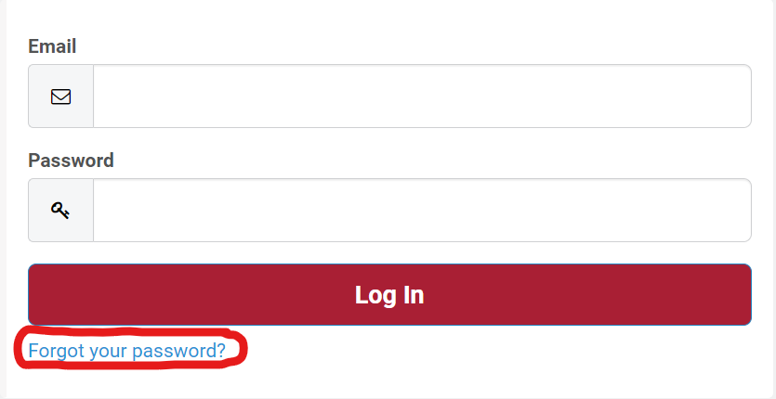
How to Log In: Returning Users
If you are an existing Professional Member or interacted with ADA prior to November 2022, we have already created your account based on information from another system. Your username is now your primary email address that was on file with ADA.
To activate your account, click "Forgot your password?" below the login screen. You will receive an email to reset your login information.
For help with login technical difficulties, please email membership@diabetes.org.
DiabetesPro Forum User Guide 4

Slide 6
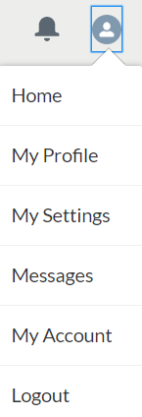
Navigating the Profile Menu
Your Profile menu can be accessed by clicking on the profile icon in the top right hand corner of the page.
The Home button returns you to the forum homepage.
On My Profile, you can change your profile image and make further changes using the Edit My Profile button.
On My Settings, you can change your personal information including username, password, language, email address and email notification preferences.
Under Messages, you can send communications to other users on the forum by clicking the New message button.
On My Account, you can edit your personal information.
Click the Logout button to exit your profile.
DiabetesPro Forum User Guide 6

Slide 7
How to Join Interest Groups and WIN ADA
All members must join at least one Interest Group and/or WIN ADA (our Women’s Interprofessional Network) on the forum in order to engage on the site. To do this:
Click the profile icon at the top right corner of the site. Then, click My Profile. You will be directed to your profile page.
On your profile page, click the Edit my Profile button beneath your profile image. You will be redirected to the Edit My Profile page.
Under the Specialty panel, find the Interest Group dropdown menu and select your preferred groups. Each person can select up to three interest groups to join, as well as choosing whether to join the WIN ADA group. Within 24 hours, you will officially receive access to the group(s) you select.
To view your group communities, click the Discussion Forums main menu bar tab. You will see your discussion groups listed under the Groups I Am a Part Of tab.
Click on the name of the group you wish to view. This will direct you to their community page. As noted in Step 3, it may take up to 24 hours for you to gain access to the groups.
DiabetesPro Forum User Guide 5

Slide 8
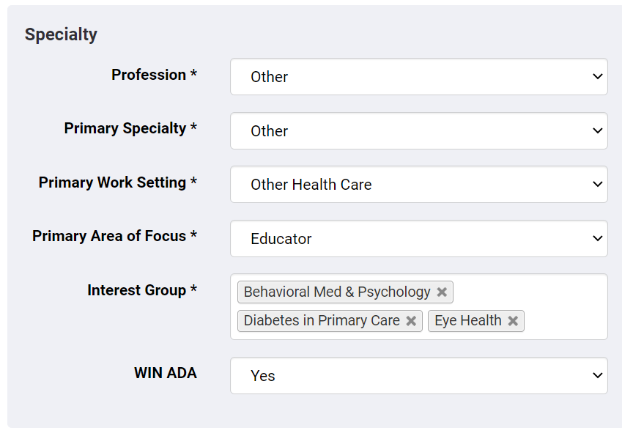
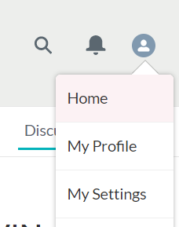
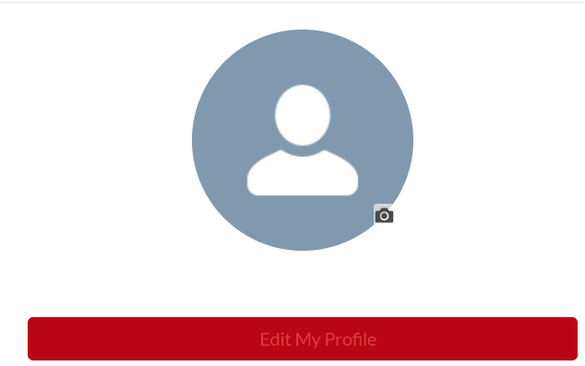
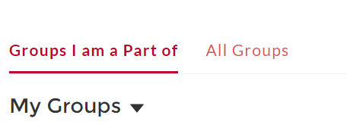
How to Join Interest Groups and WIN ADA
Click My Profile. On your profile page, click the Edit My Profile button.
3. To view your groups, click the Discussion Forums main menu bar tab. You will see your discussion groups listed under Groups I Am a Part Of.
2. Under the Specialty panel, find the Interest Group dropdown menu and select your preferred groups. Within 24 hours, you will officially receive access to the group(s) you select.
Edit My Profile
DiabetesPro Forum User Guide 6

Slide 9
How to Edit Your Profile
Click the My Account tab on the main toolbar from the homepage. You can also edit your personal information by clicking on the Profile menu in the top right corner of the page, navigating to My Account and selecting the Edit My Profile button.
Ensure your name and credentials are listed correctly. The information on your profile is the same as what is on your membership account. If this needs to be updated, please click the edit icon next to your name, and also update your information on your account at (http://professional.diabetes.org/profile).
Complete the remaining profile sections, e.g., Title and Degree, Specialty, phone number and address.
You can add a profile image by opening the menu in the top right corner of the forum homepage, navigating to My Account and selecting a picture.
DiabetesPro Forum User Guide 7

Slide 10
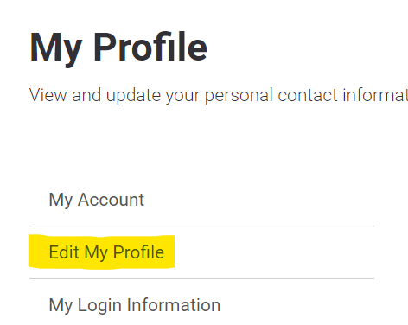
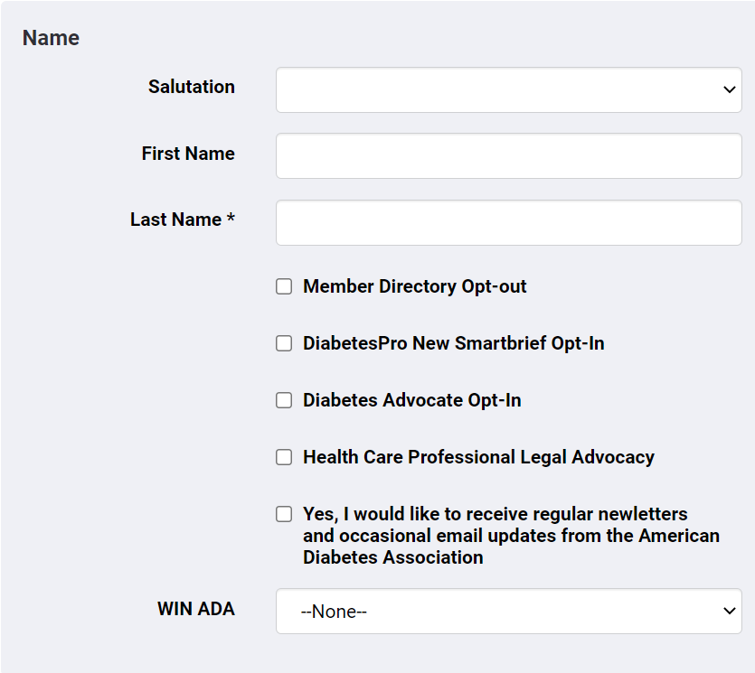
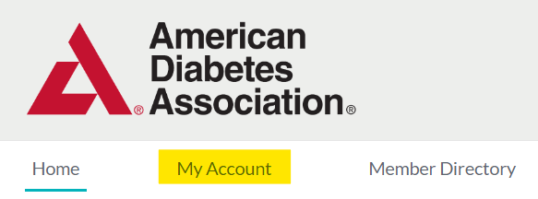
How to Edit your Profile
1. Click the My Account tab
on the main toolbar.
2. Edit your personal information by clicking on Edit My Profile on the side toolbar.
DiabetesPro Forum User Guide 7

Slide 11
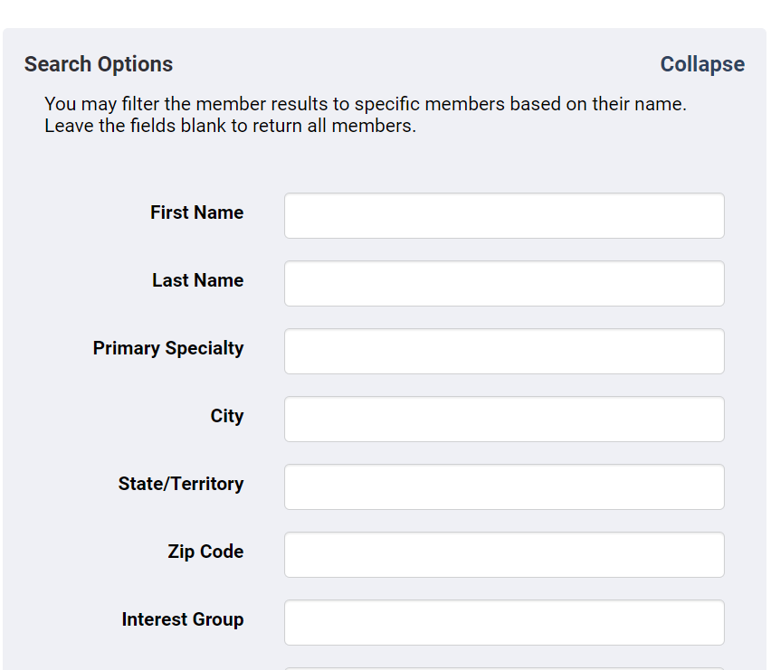
Using the Member Directory
The DiabetesPro Forum and discussion groups open an exclusive space for members to build connections with other professionals in the ADA community.
Members can connect with others in their Discussion Groups, as well as locating fellow professionals through the Member Directory tool.
To access the directory, click the Member Directory tab on the main toolbar.
Then, search for other professionals by entering their information under Search Options. You may filter the member results to specific members based on their name.
Leave the fields blank to see the information of all members.
DiabetesPro Forum User Guide 7

Slide 12
How to Update Email Notifications
All discussions that take place on the DiabetesPro forum can be sent to you via email. Members can receive different types of email notifications:
Every Post: receive an email each time a member posts to the forum, or responds to a post on the forum you are following
Daily Digest: receive one email each day with a summary of all posts shared in the past 24 hours
Weekly Digest: receive one email each week with a summary of all posts shared in the past seven days
Limited: no email notifications
Users are not automatically signed up for email notifications, so it’s important to make your selection on your Discussion Forums.
To update Discussion Forum email preferences:
Under Discussion Forums, click the interest group to update communication preferences.
Locate the Email icon in the upper right corner.
Select which type of notifications you’d like to receive from that group (Every, Daily, Weekly or Limited) and press Save.
To update regular email preferences:
Navigate to your profile by clicking your profile icon at the top right side of page.
Click on My Settings and scroll down to the Email preference settings. Check or uncheck any boxes from the menu options to decide which email notifications you’d like to receive.
DiabetesPro Forum User Guide 9

Slide 13
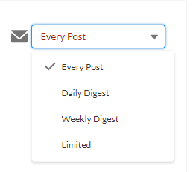
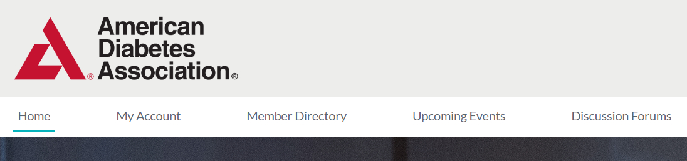
Update Discussion Forum Emails
2. Select the discussion group whose communication preferences you’d like to edit.
Navigate to your Discussion Forums by clicking the tab on the main toolbar.
3. Next to the Email icon in the top right corner, select the frequency of communications you’d like to receive from that group from the dropdown menu.
DiabetesPro Forum User Guide 10

Slide 14
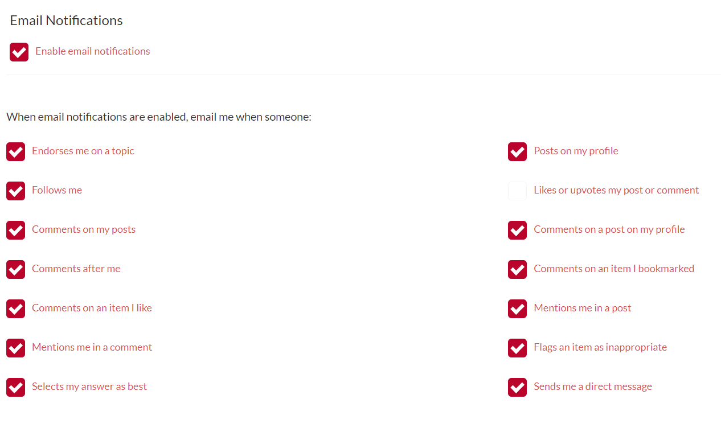
How to Update Email Notifications
2. Click on My Settings and scroll down to the Email preference settings.
Navigate to your profile by clicking your profile icon at the top right side of page.
3. Check or uncheck any boxes from the menu options. Press Save in the bottom right corner to record your preferences.
DiabetesPro Forum User Guide 10

Slide 15
How to Post to a Discussion Group
Posting to a Discussion group enables you to ask questions, share resources, and promote new scientific, educational, and clinical resources with other members in your Interest Groups.
Click on Discussion Forums in the main menu bar and select Groups I Am a Part Of from the toolbar.
Click on the name of the group you plan to share a message with.
Choose the type of message you’d like to create:
  Members can create a Post to share resources and promote new scientific, educational, and clinical resources with others. To create a Post, select Post and then press the red Share button. You’ll be able to type your post, then press Share again to send the message out into the discussion forum.
  Members can ask a Question to the discussion group. Under Question, type the query you’d like to pose to the discussion group. Add any extra details of your choice, and press Share. Other members will be able to read and respond to your question in the Feed.
When you are finished with your message, click Share. This will send your message to all members in your group and upload your post to the Discussion Group/WIN ADA community page. Members will receive your message via email immediately or as a digest according to their own email settings.
DiabetesPro Forum User Guide 15

Slide 16
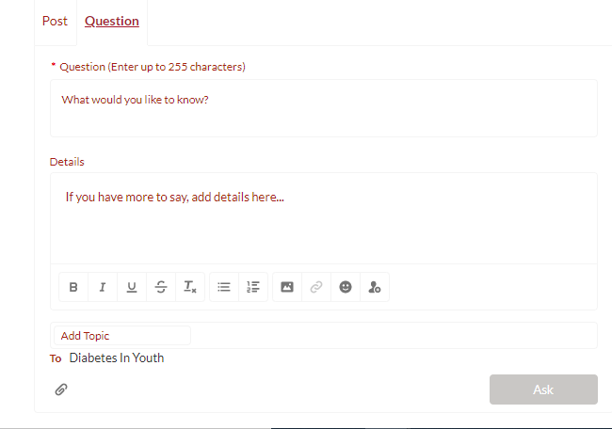
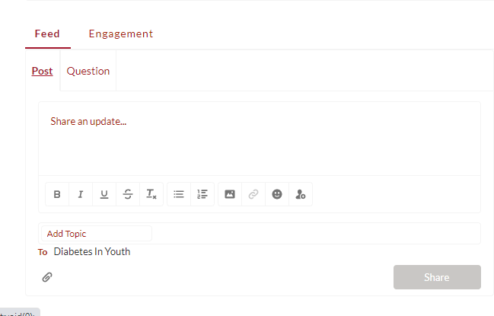
Post to a Discussion Group
3. Choose the type of message you’d like to create:
  Members can create a Post to share resources and promote new scientific, educational, and clinical resources with others. To create a Post, select Post and then press the red Share button. Type your post, then press Share again to send the message.
  Members can ask a Question to the discussion group. Under Question, type the query you’d like to pose to the discussion group. Add any extra details of your choice, and press Share. Other members will be able to read and respond to your question in the Feed.
A
B
Click on Discussion Forums in the main menu bar and select Groups I Am a Part Of from the toolbar.
Click on the name of the group you plan to share a message with.
DiabetesPro Forum User Guide 16

Slide 17
Contact Us
For additional questions or information, please email interestgroups@diabetes.org.
We look forward to seeing you on the forum!
DiabetesPro Forum User Guide 17

