Slide 1
This slide deck contains content created, reviewed, and approved by the American Diabetes Association® (ADA). You are free to use the slides in presentations without further permission as long as the slide content is not altered in any way and appropriate attribution is made to the ADA (the ADA's name and logo on the slides constitutes appropriate attribution). Permission is required from the ADA for any commercial use or for reproduction in any print materials (contact permissions@diabetes.org).

Slide 2
Standards of Care in diabetes 2024
Abridged for Primary Care Professionals
Published annually in Clinical Diabetes
Contains evidence-based recommendations most pertinent to primary care
Recommendations are substantively the same as in the complete Standards of Care
Access:
Abridged Standards of Care — diabetesjournals.org/clinical
Complete Standards of Care and all supporting references — professional.diabetes.org/standards

Slide 3
Section 1 Improving Care and Promoting Health in Populations

Slide 4
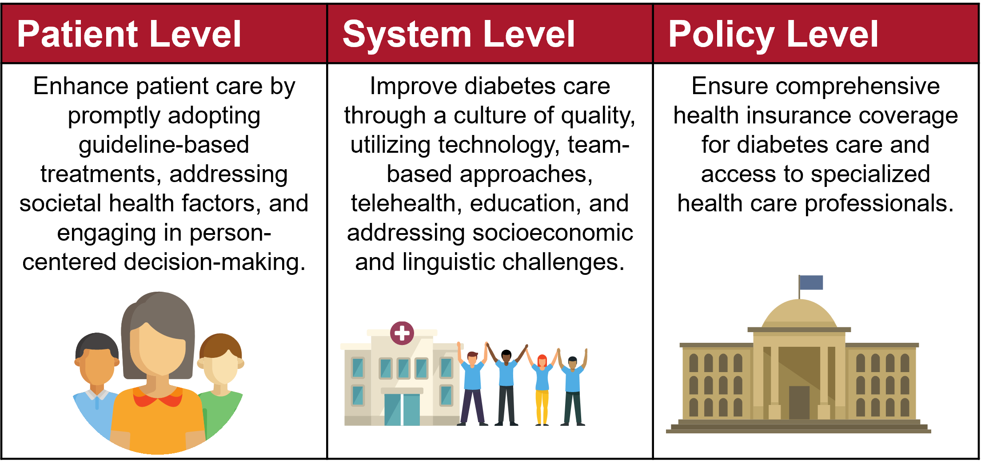
Standards of Care: Section 1
Improving Care and Promoting Health in Populations
A multifaceted approach encompassing patient-level, system-level, and policy-level interventions is crucial for enhancing population health in the context of diabetes. This approach may include the following key elements.

Slide 5
Section 2 Diagnosis and Classification of Diabetes

Slide 6
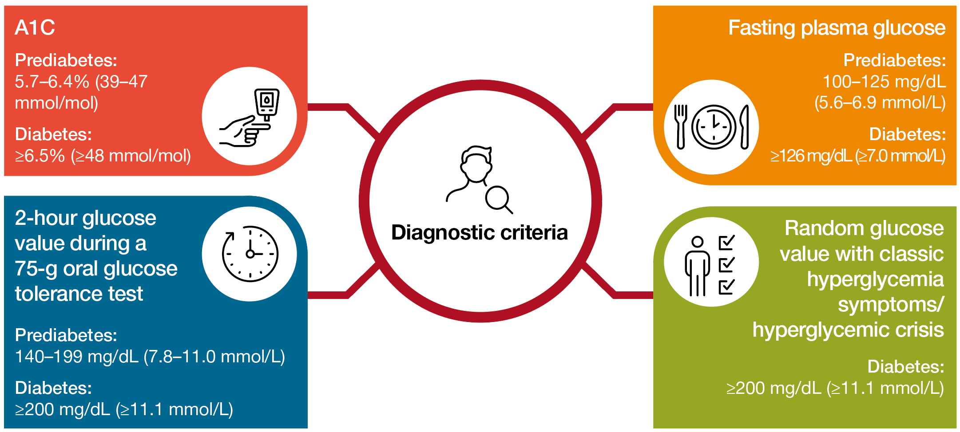
Standards of Care: Section 2
Diagnostic Tests for Diabetes
Notes:
• There is insufficient evidence to support the use of continuous glucose monitoring for screening or diagnosing prediabetes or diabetes.
• In the absence of unequivocal hyperglycemia (e.g., hyperglycemic crisis), diagnosis of type 2 diabetes requires confirmatory testing, which can be a different test on the same day or the same test on a different day.
• Marked discordance between A1C and repeated blood glucose measurements should raise the possibility of a problem or interference with either test.

Slide 7
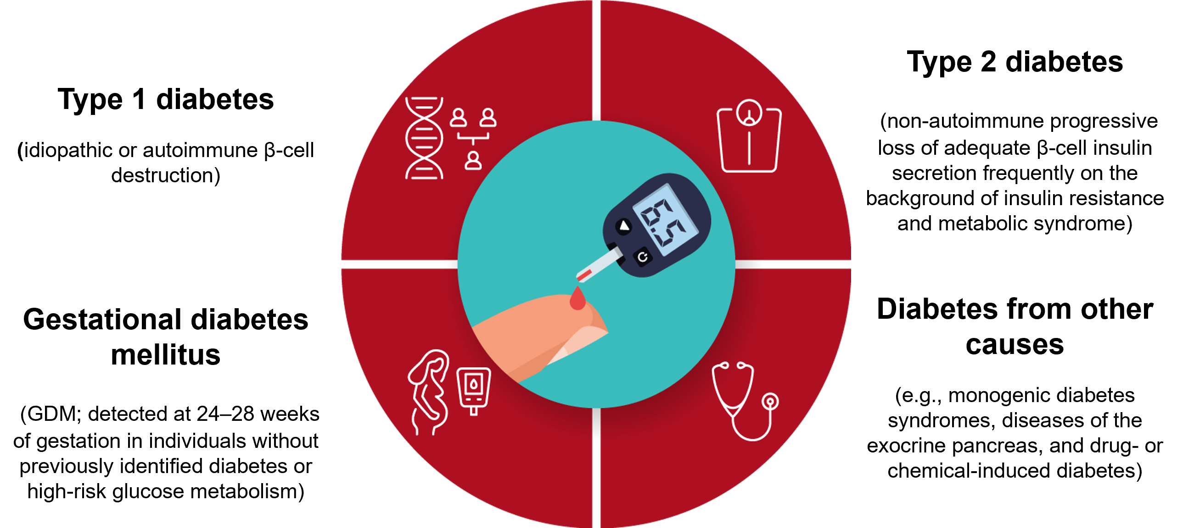
Standards of Care: Section 2
Classification
Classification of diabetes type is not always straightforward at presentation, and misdiagnosis is common.

Slide 8
Standards of Care: Section 2
Screening Criteria for Prediabetes and Type 2 Diabetes
Informal assessment of risk factors
Validated risk calculator

Slide 9
Standards of Care: Section 2
Informal Risk Factor Assessment for Prediabetes and Type 2 Diabetes

Slide 10
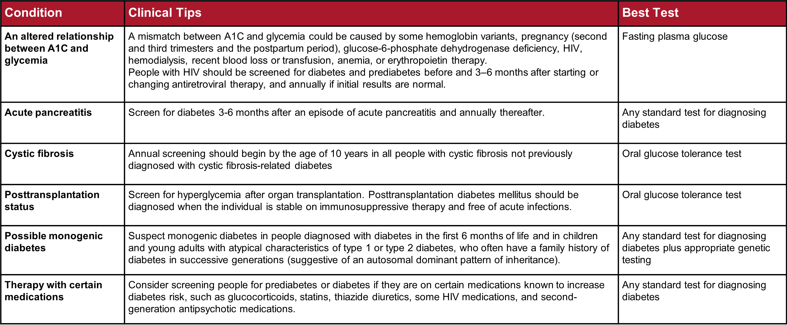
Standards of Care: Section 2
Additional Screening Guidelines

Slide 11
Section 3 Prevention or Delay of Diabetes and Associated Comorbidities

Slide 12
Standards of Care: Section 3
Diet and Physical Activity Recommendations for Adults at Risk for Type 2 Diabetes

Slide 13
Standards of Care: Section 3
Person-Centered Care Goals for Individuals at Risk of Type 2 Diabetes

Slide 14
Standards of Care: Section 3

Slide 15
Standards of Care: Section 3

Slide 16
Standards of Care: Section 3
Staging of Type 1 Diabetes
Notes:
Does statin therapy increase the risk of developing type 2 diabetes?
• Statin therapy may slightly elevate type 2 diabetes risk in high-risk individuals.
• In primary and secondary prevention of cardiovascular disease, statin benefits outweigh diabetes risk.
• Discontinuing statins based on concerns about increased diabetes risk is not advised.
Does pioglitazone have a role in secondary cardiovascular prevention in people at risk for type 2 diabetes?
Pioglitazone could reduce stroke and myocardial infarction risks in people with a history of stroke and evidence
of insulin resistance or prediabetes. However, the benefit must be weighed against potential weight gain,
edema, and increased fracture risk. Lower doses may lessen these adverse effects.

Slide 17
Section 4 Comprehensive Medical Evaluation and Assessment of Comorbidities

Slide 18
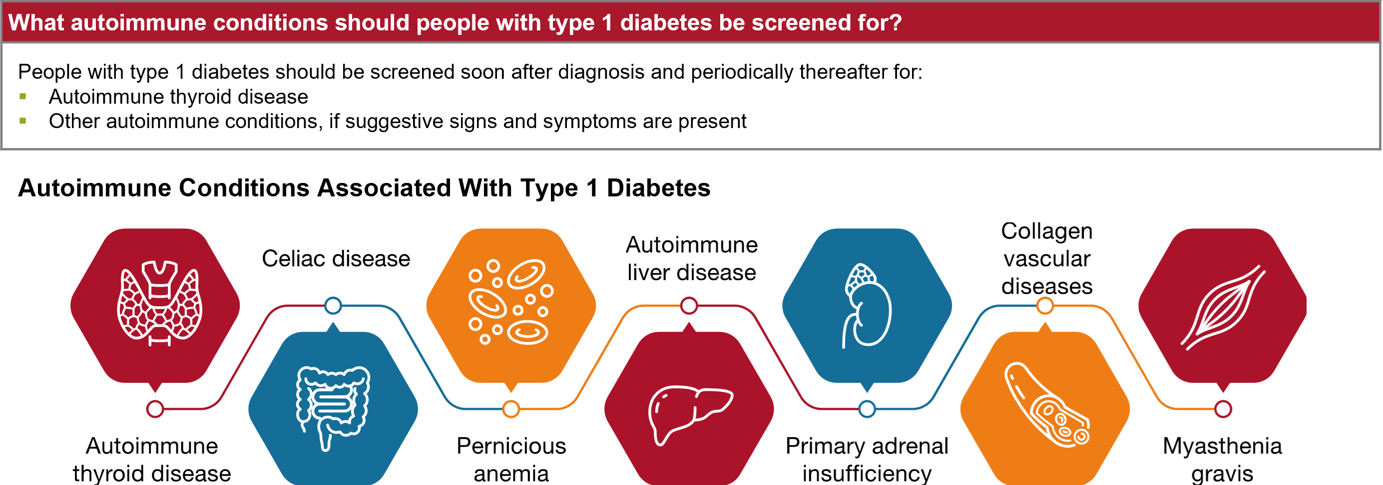
Standards of Care: Section 4
Assessment of Comorbidities
Notes:
Diabetes treatment goals aim to prevent or delay complications and optimize quality of life. These goals should be developed collaboratively with people with diabetes to honor their preferences and values. Comprehensive diabetes care should be provided by an interprofessional team which may include but is not limited to diabetes care and education specialists, primary care and subspecialty clinicians, nurses, registered dietitian nutritionists, exercise specialists, pharmacists, dentists, podiatrists, behavioral health professionals, and community partners such as community health workers and community paramedics. Ongoing treatment necessitates regular follow-up and the active engagement of people with diabetes and their care partners. Comprehensive medical evaluations (described in the table below) and the provision of all recommended vaccinations (cdc.gov/vaccines) are essential components of ongoing diabetes care.

Slide 19
Standards of Care: Section 4

Slide 20
Standards of Care: Section 4

Slide 21
Standards of Care: Section 4

Slide 22
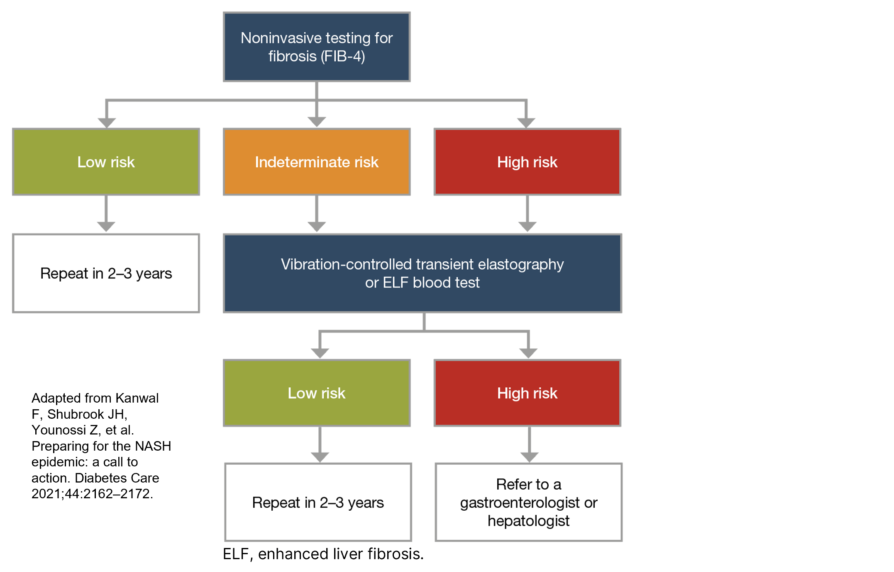
Standards of Care: Section 4
Proposed Algorithm for Risk Stratification in Individuals with NAFLD or NASH.

Slide 23
Standards of Care: Section 4

Slide 24
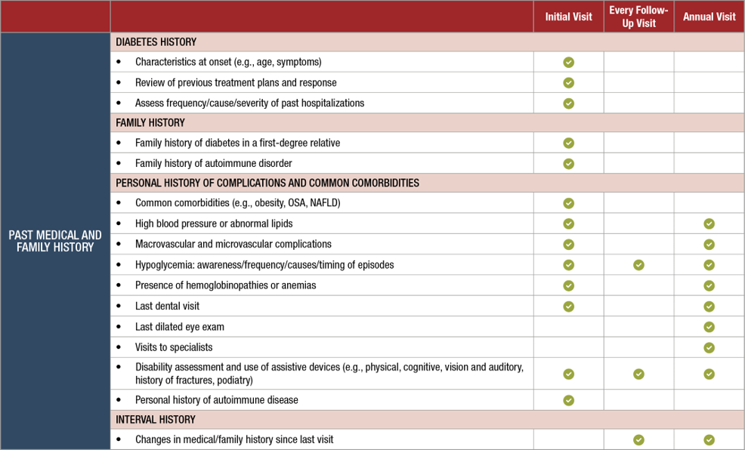
Standards of Care: Section 4
Components of the Comprehensive Diabetes Medical Evaluation at Initial, Follow-Up, and Annual Visits
Notes:
ABI, ankle-brachial pressure index; ARBs, angiotensin receptor blockers; CGM, continuous glucose monitors; MDI, multiple daily injections; NAFLD, nonalcoholic fatty liver disease; OSA, obstructive sleep apnea; PAD, peripheral arterial disease.
*At 65 years of age or older.
+May be needed more frequently in people with diabetes with known chronic kidney disease or with changes in medications that affect kidney function and serum potassium
#May also need to be checked after initiation or dose changes of medications that affect these laboratory values (i.e., diabetes medications, blood pressure medications, cholesterol medications, or thyroid medications).
^In people without dyslipidemia and not on cholesterol-lowering therapy, testing may be less frequent.
**Should be performed at every visit in people with diabetes with sensory loss, previous foot ulcers, or amputations.

Slide 25
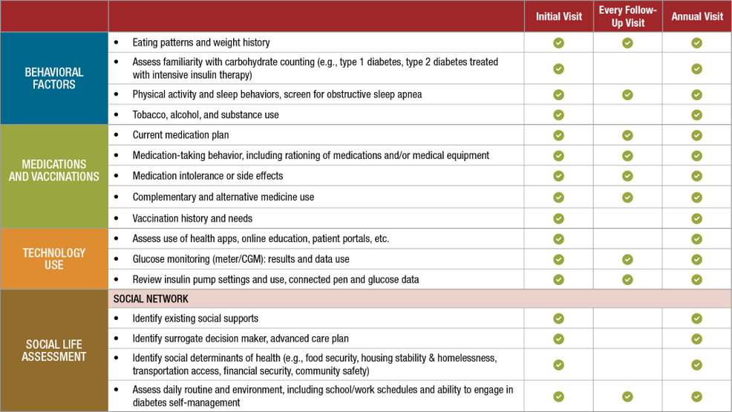
Standards of Care: Section 4
Components of the Comprehensive Diabetes Medical Evaluation at Initial, Follow-Up, and Annual Visits
Notes:
ABI, ankle-brachial pressure index; ARBs, angiotensin receptor blockers; CGM, continuous glucose monitors; MDI, multiple daily injections; NAFLD, nonalcoholic fatty liver disease; OSA, obstructive sleep apnea; PAD, peripheral arterial disease.
*At 65 years of age or older.
+May be needed more frequently in people with diabetes with known chronic kidney disease or with changes in medications that affect kidney function and serum potassium
#May also need to be checked after initiation or dose changes of medications that affect these laboratory values (i.e., diabetes medications, blood pressure medications, cholesterol medications, or thyroid medications).
^In people without dyslipidemia and not on cholesterol-lowering therapy, testing may be less frequent.
**Should be performed at every visit in people with diabetes with sensory loss, previous foot ulcers, or amputations.

Slide 26
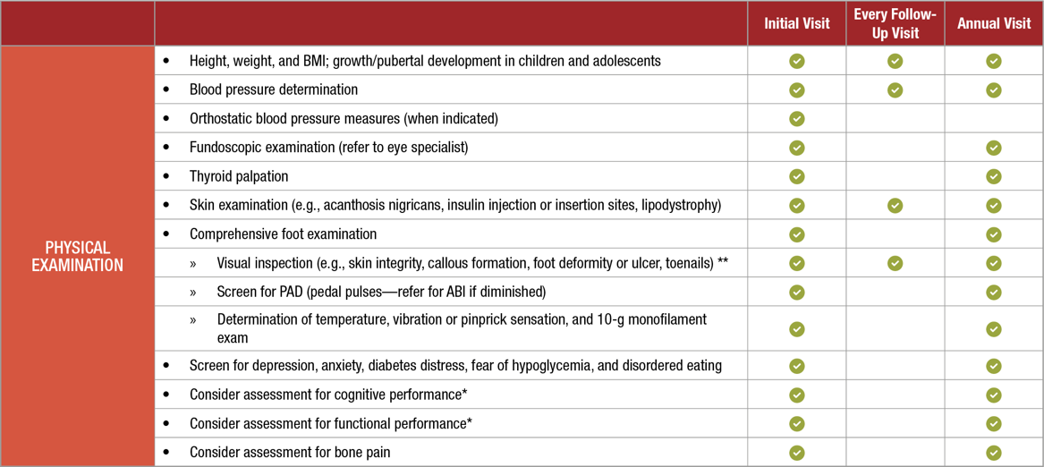
Standards of Care: Section 4
Components of the Comprehensive Diabetes Medical Evaluation at Initial, Follow-Up, and Annual Visits
Notes:
ABI, ankle-brachial pressure index; ARBs, angiotensin receptor blockers; CGM, continuous glucose monitors; MDI, multiple daily injections; NAFLD, nonalcoholic fatty liver disease; OSA, obstructive sleep apnea; PAD, peripheral arterial disease.
*At 65 years of age or older.
+May be needed more frequently in people with diabetes with known chronic kidney disease or with changes in medications that affect kidney function and serum potassium
#May also need to be checked after initiation or dose changes of medications that affect these laboratory values (i.e., diabetes medications, blood pressure medications, cholesterol medications, or thyroid medications).
^In people without dyslipidemia and not on cholesterol-lowering therapy, testing may be less frequent.
**Should be performed at every visit in people with diabetes with sensory loss, previous foot ulcers, or amputations.

Slide 27
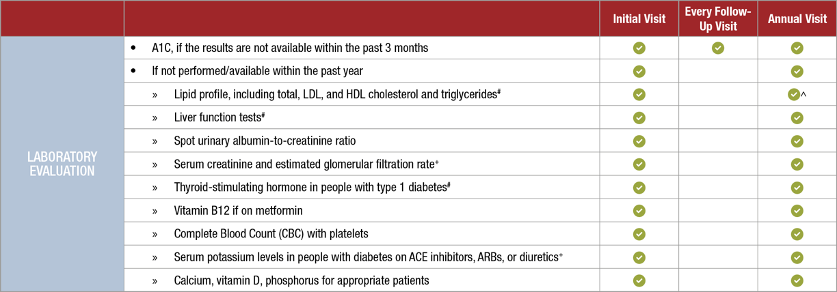
Standards of Care: Section 4
Components of the Comprehensive Diabetes Medical Evaluation at Initial, Follow-Up, and Annual Visits
Notes:
ABI, ankle-brachial pressure index; ARBs, angiotensin receptor blockers; CGM, continuous glucose monitors; MDI, multiple daily injections; NAFLD, nonalcoholic fatty liver disease; OSA, obstructive sleep apnea; PAD, peripheral arterial disease.
*At 65 years of age or older.
+May be needed more frequently in people with diabetes with known chronic kidney disease or with changes in medications that affect kidney function and serum potassium
#May also need to be checked after initiation or dose changes of medications that affect these laboratory values (i.e., diabetes medications, blood pressure medications, cholesterol medications, or thyroid medications).
^In people without dyslipidemia and not on cholesterol-lowering therapy, testing may be less frequent.
**Should be performed at every visit in people with diabetes with sensory loss, previous foot ulcers, or amputations.

Slide 28
Section 5 Facilitating Positive Health Behaviors and Well-Being to Improve Health Outcomes

Slide 29
Standards of Care: Section 5
Building positive health behaviors and maintaining psychological well-being are foundational for achieving diabetes management goals and maximizing quality of life.

Slide 30
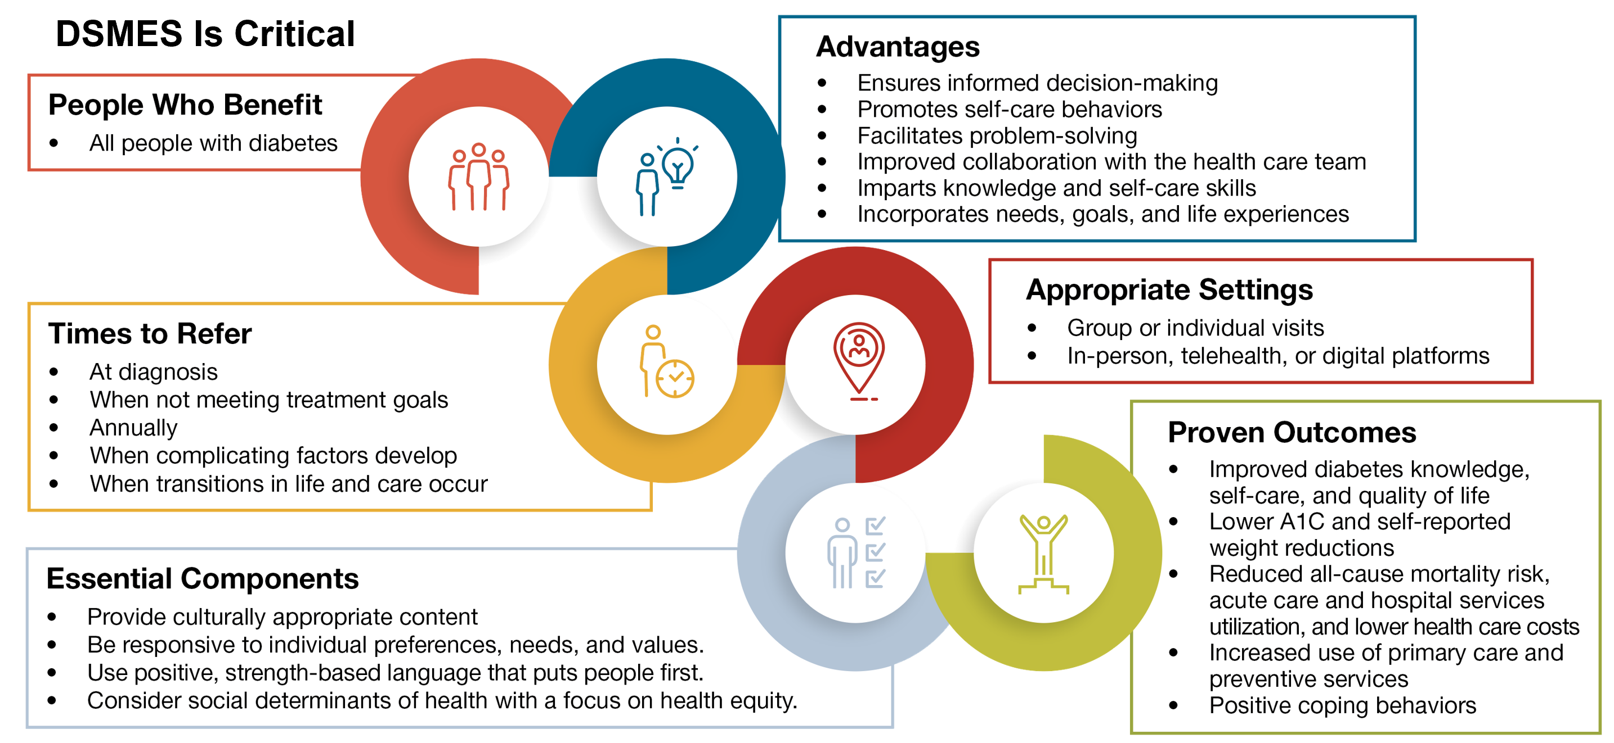
Standards of Care: Section 5

Slide 31
Standards of Care: Section 5
Psychosocial Care for All People With Diabetes: Considerations and Recommendations

Slide 32
Standards of Care: Section 5
Psychosocial Care for All People With Diabetes: Considerations and Recommendations

Slide 33
Standards of Care: Section 5

Slide 34
Standards of Care: Section 5
MNT
There is a no one-size-fits-all eating pattern. Successful MNT programs are:

Slide 35
Standards of Care: Section 5

Slide 36
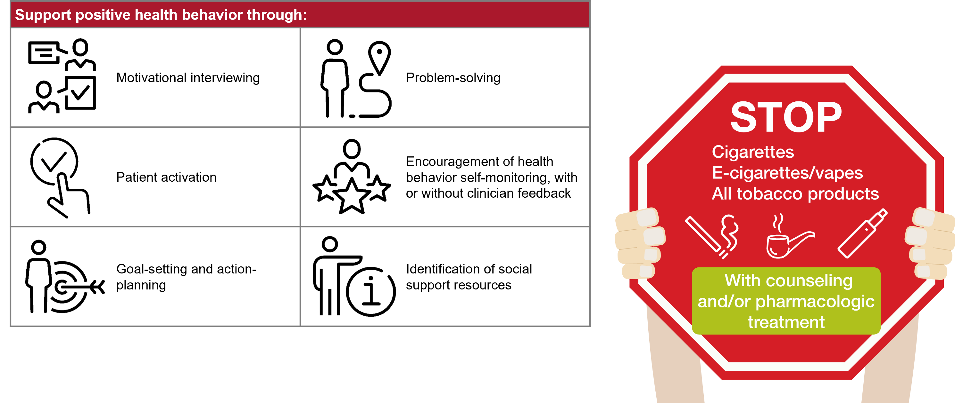
Standards of Care: Section 5

Slide 37
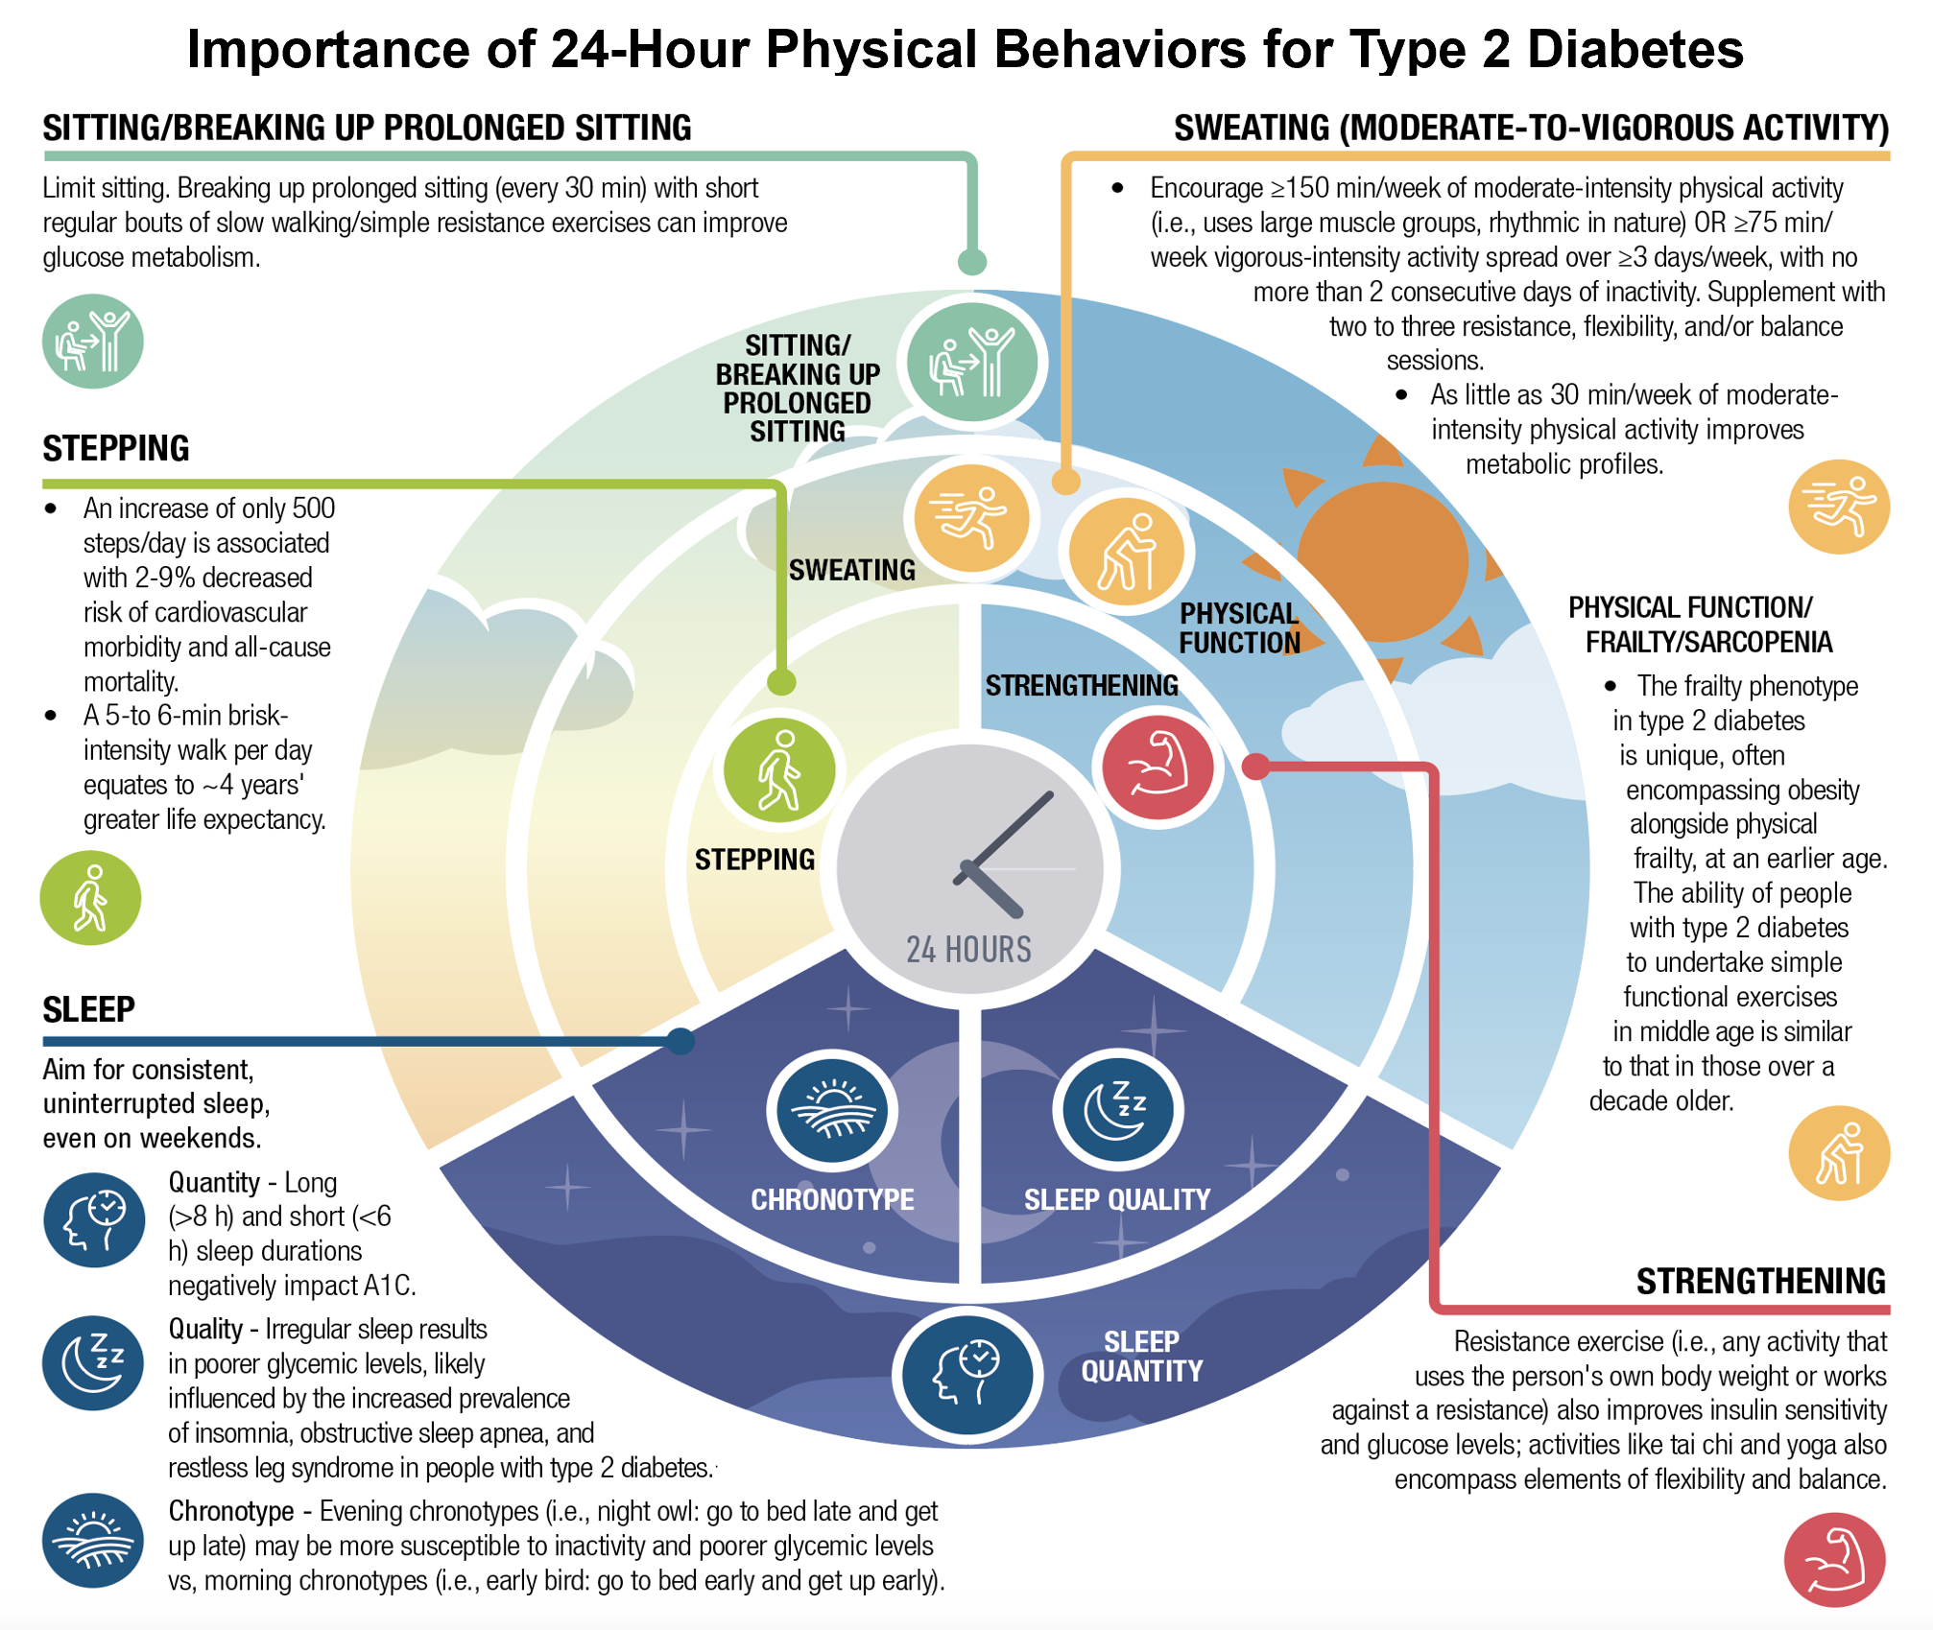
Standards of Care: Section 5

Slide 38
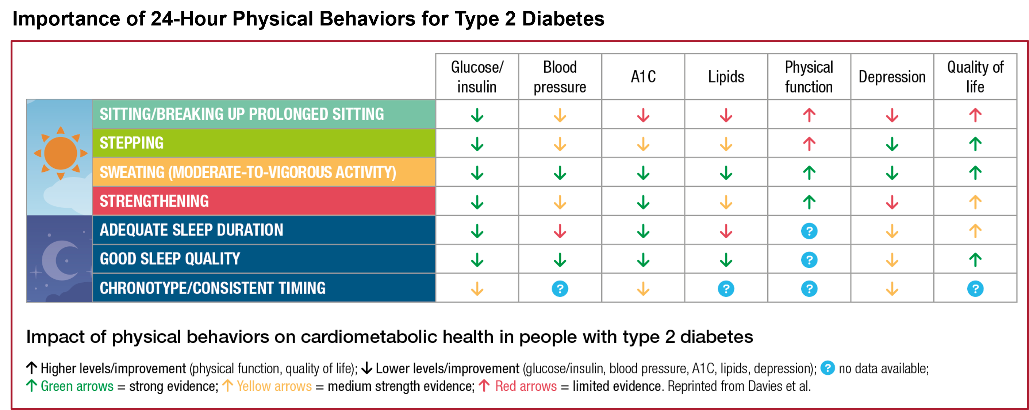
Standards of Care: Section 5

Slide 39
Section 6 Glycemic Goals and Hypoglycemia

Slide 40
Standards of Care: Section 6

Slide 41
Standards of Care: Section 6

Slide 42
Standards of Care: Section 6
Glucose Assessment via CGM: The Ambulatory Glucose Profile (AGP) Report

Slide 43
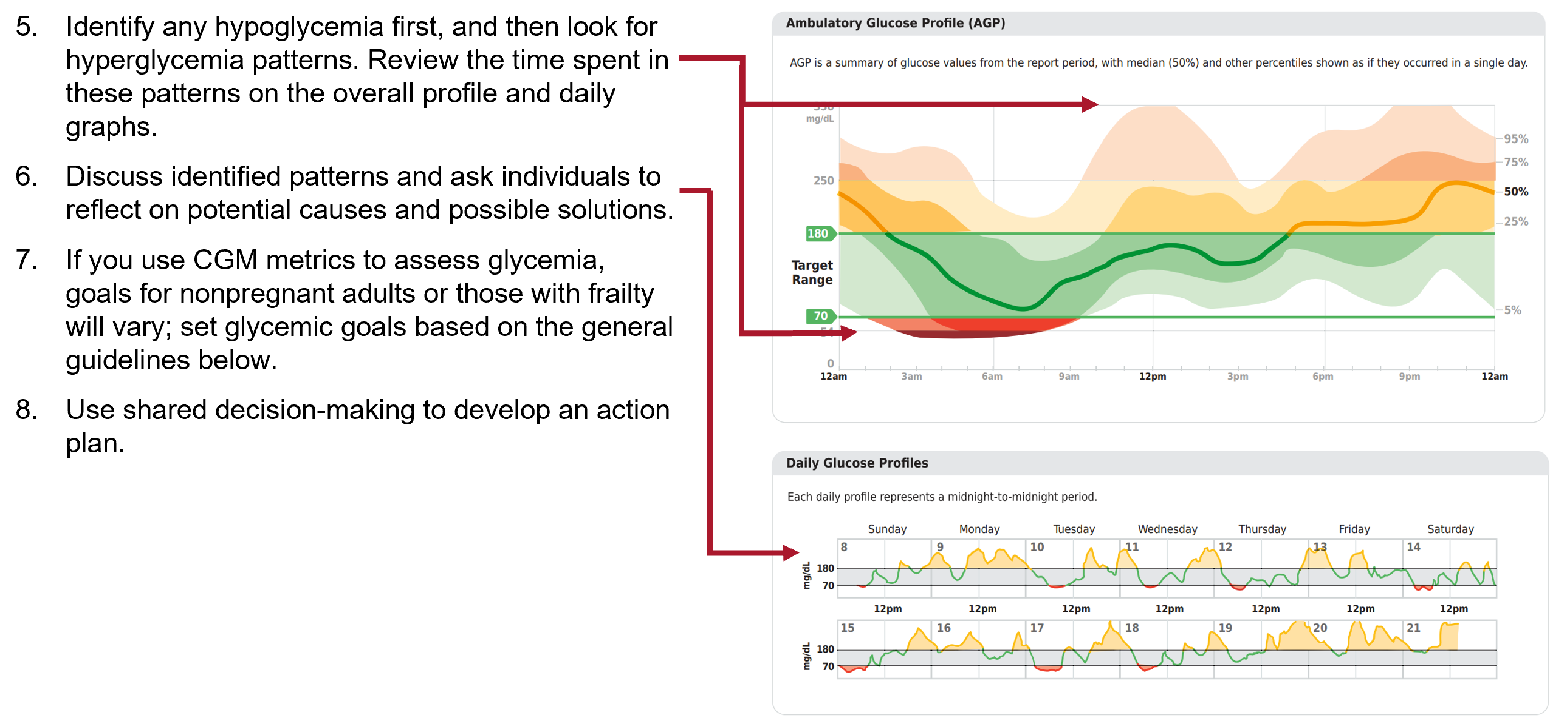
Standards of Care: Section 6
Glucose Assessment via CGM: The Ambulatory Glucose Profile (AGP) Report

Slide 44
Standards of Care: Section 6

Slide 45
Standards of Care: Section 6

Slide 46
Standards of Care: Section 6

Slide 47
Standards of Care: Section 6
Hypoglycemia Assessment, Prevention, and Treatment
Notes:
Hypoglycemia is categorized into three levels based on blood glucose concentrations and symptom severity. Level 1 is glucose <70 mg/dL (<3.9 mmol/L) but ≥54 mg/dL (≥3.0 mmol/L). Level 2 is glucose <54 mg/dL (<3.0 mmol/L). Level 3 is a severe event characterized by altered mental and/or physical status requiring assistance for treatment of hypoglycemia, irrespective of glucose level.

Slide 48
Standards of Care: Section 6
Hypoglycemia Assessment, Prevention, and Treatment
Notes:
Hypoglycemia is categorized into three levels based on blood glucose concentrations and symptom severity. Level 1 is glucose <70 mg/dL (<3.9 mmol/L) but ≥54 mg/dL (≥3.0 mmol/L). Level 2 is glucose <54 mg/dL (<3.0 mmol/L). Level 3 is a severe event characterized by altered mental and/or physical status requiring assistance for treatment of hypoglycemia, irrespective of glucose level.

Slide 49
Section 7 Diabetes Technology

Slide 50
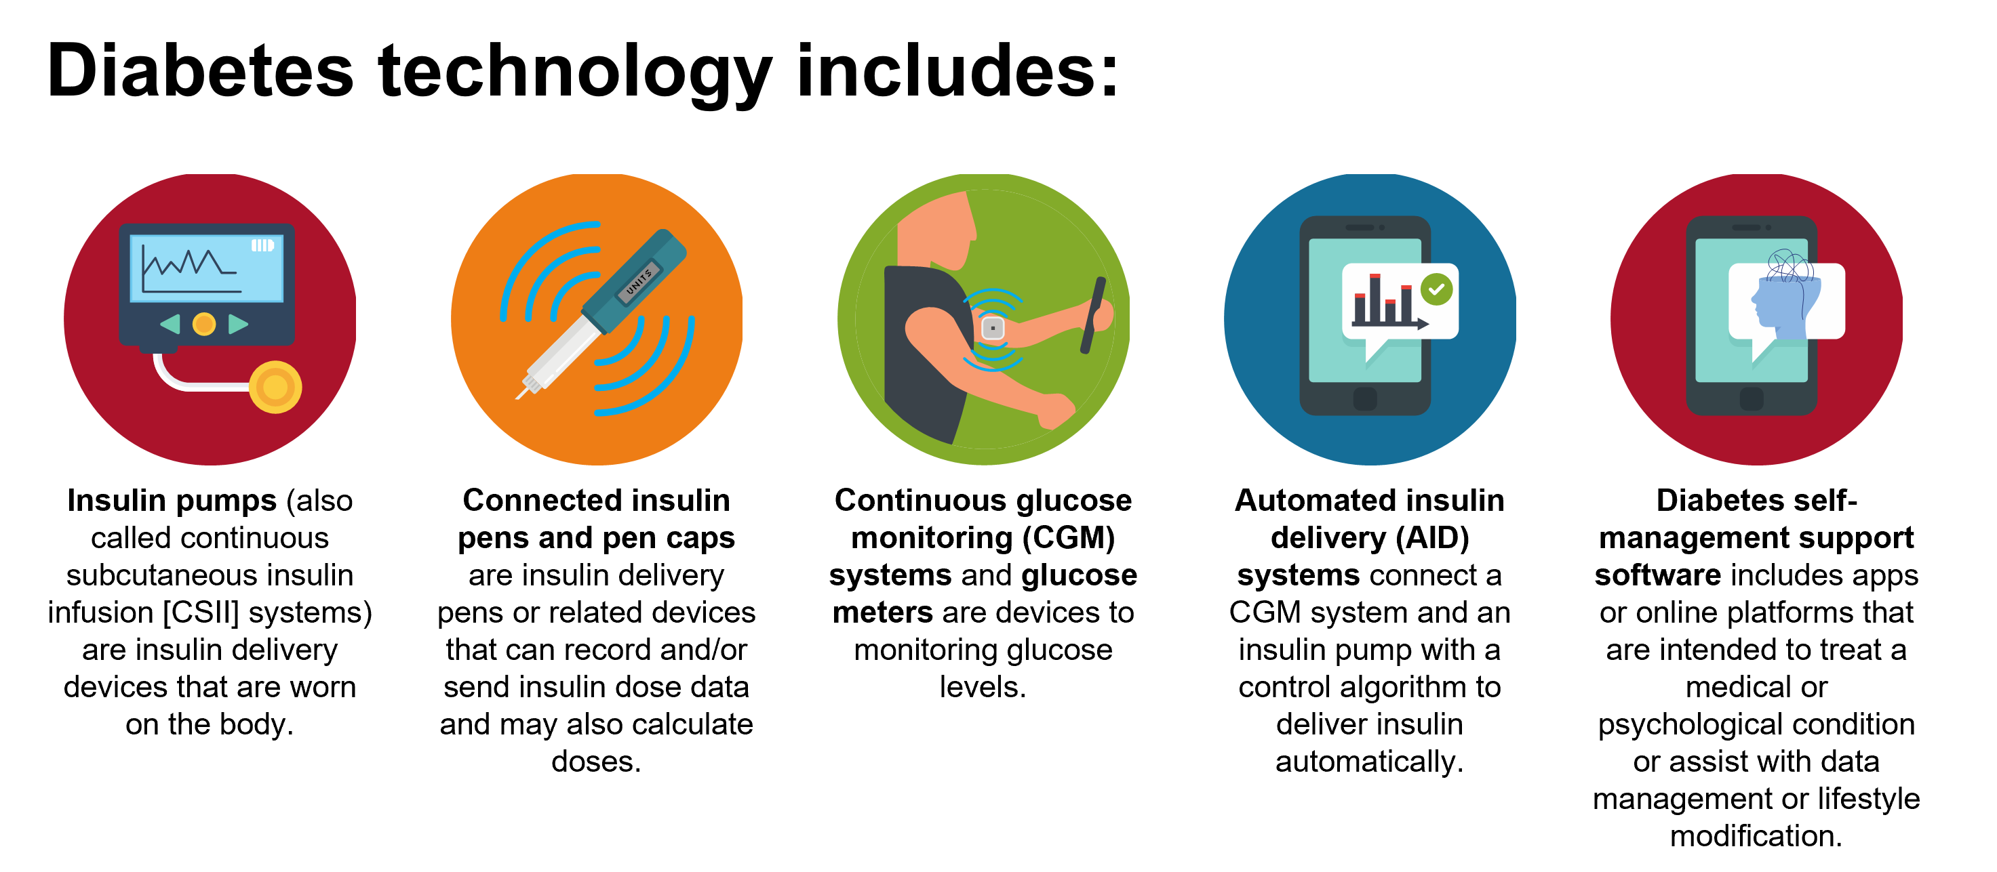
Standards of Care: Section 7

Slide 51
Standards of Care: Section 7

Slide 52
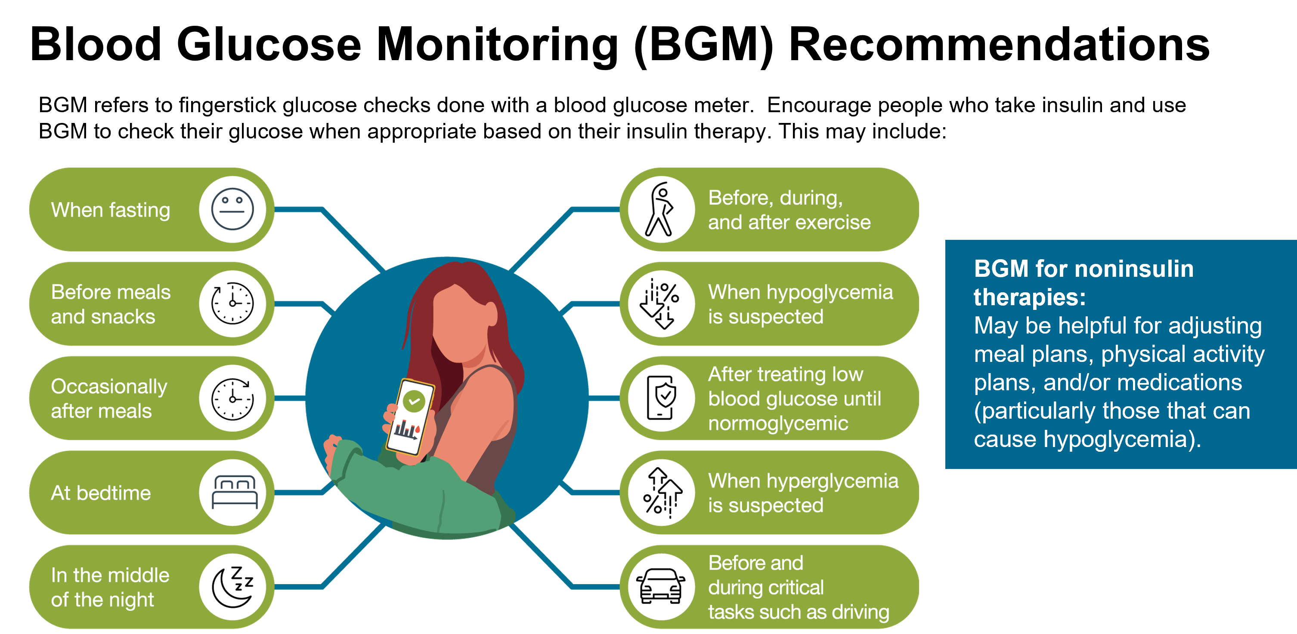
Standards of Care: Section 7

Slide 53
Standards of Care: Section 7

Slide 54
Standards of Care: Section 7

Slide 55
Standards of Care: Section 7
Notes:
Learn More
Section 7 of the complete ADA Standards of Care in Diabetes—2024 includes a wealth of additional information on blood glucose meters, evidence supporting the use of CGM, various insulin delivery systems, and digital health apps and online programs.

Slide 56
Section 8 Obesity and Weight Management for the Prevention and Treatment of Type 2 Diabetes

Slide 57
Standards of Care: Section 8

Slide 58
Standards of Care: Section 8

Slide 59
Standards of Care: Section 8

Slide 60
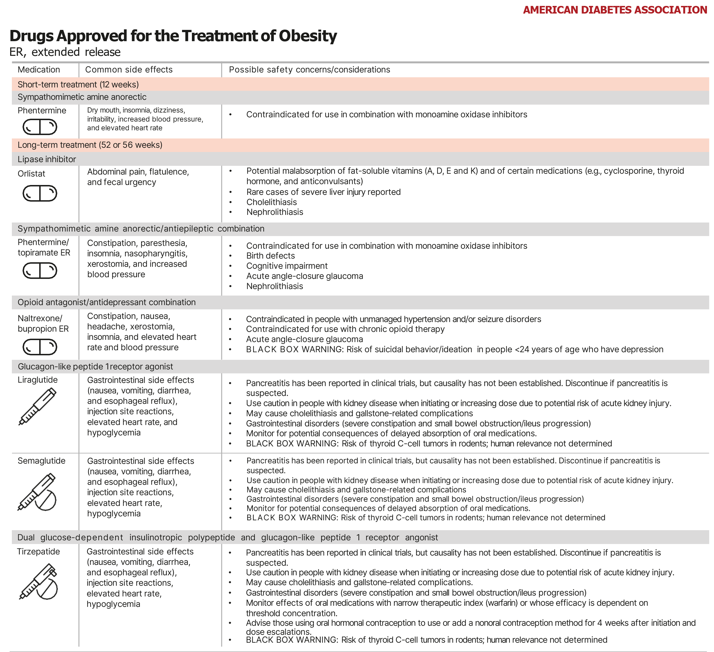
Standards of Care: Section 8

Slide 61
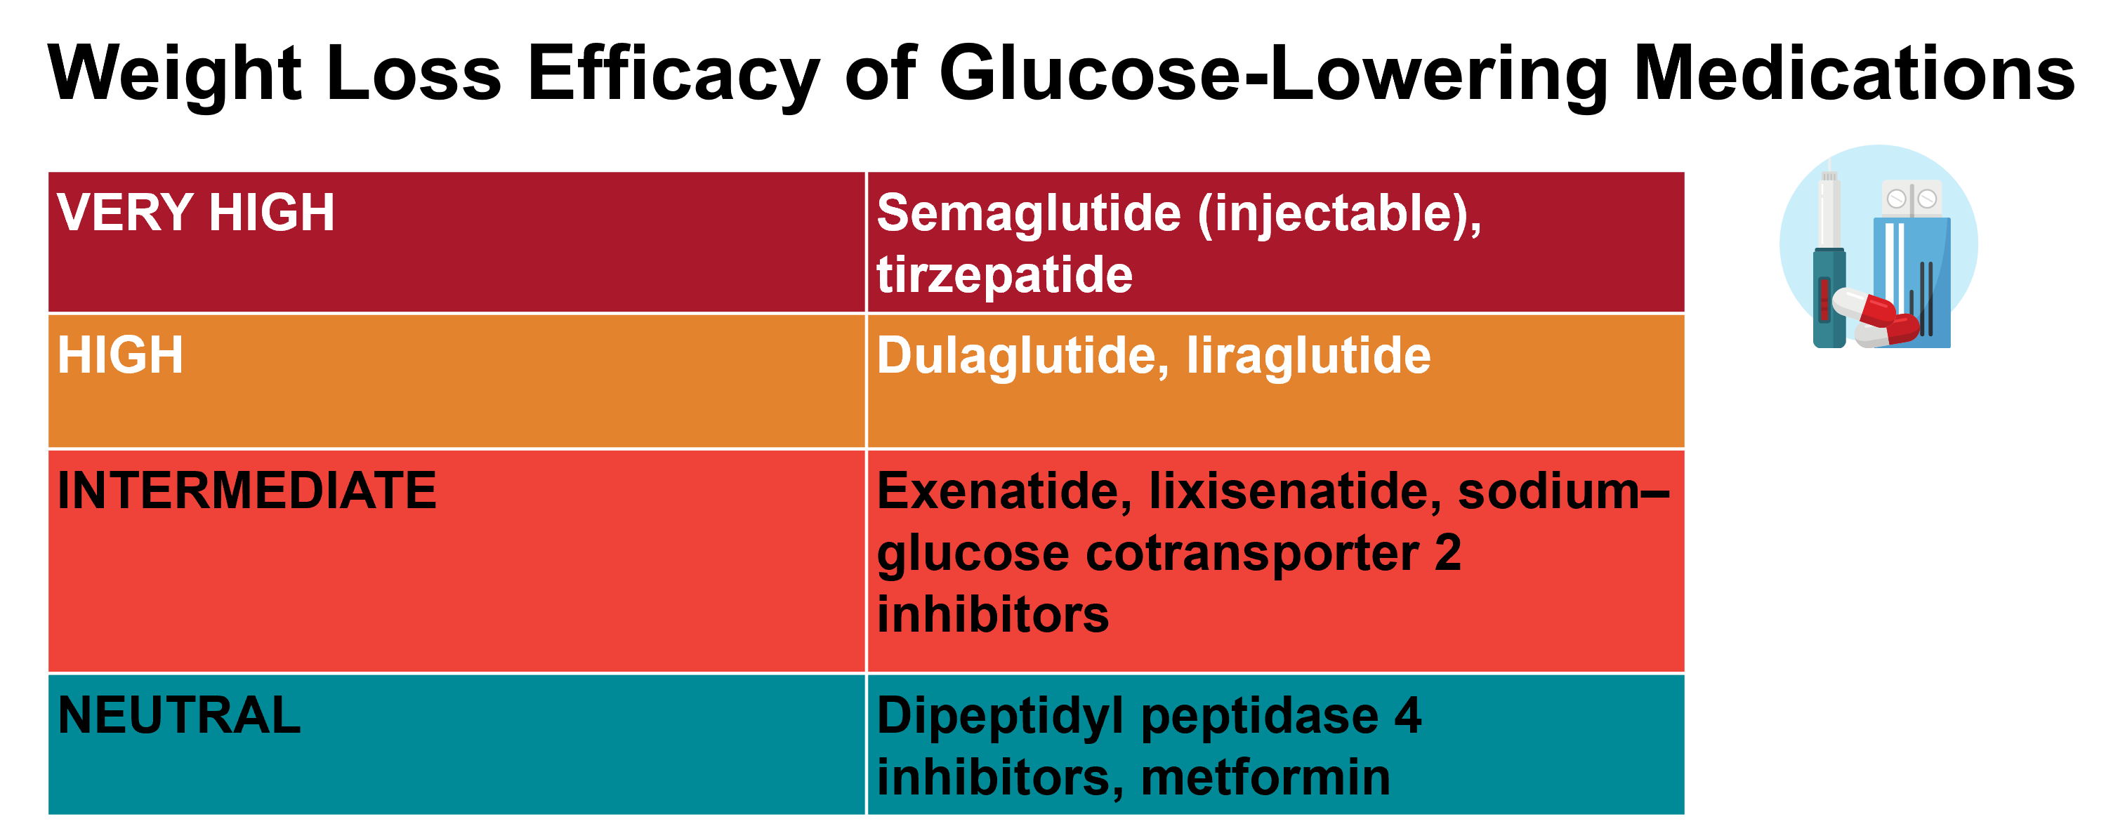
Standards of Care: Section 8

Slide 62
Standards of Care: Section 8

Slide 63
Section 9 Pharmacologic Approaches to Glycemic Treatment

Slide 64
Standards of Care: Section 9

Slide 65
Standards of Care: Section 9

Slide 66
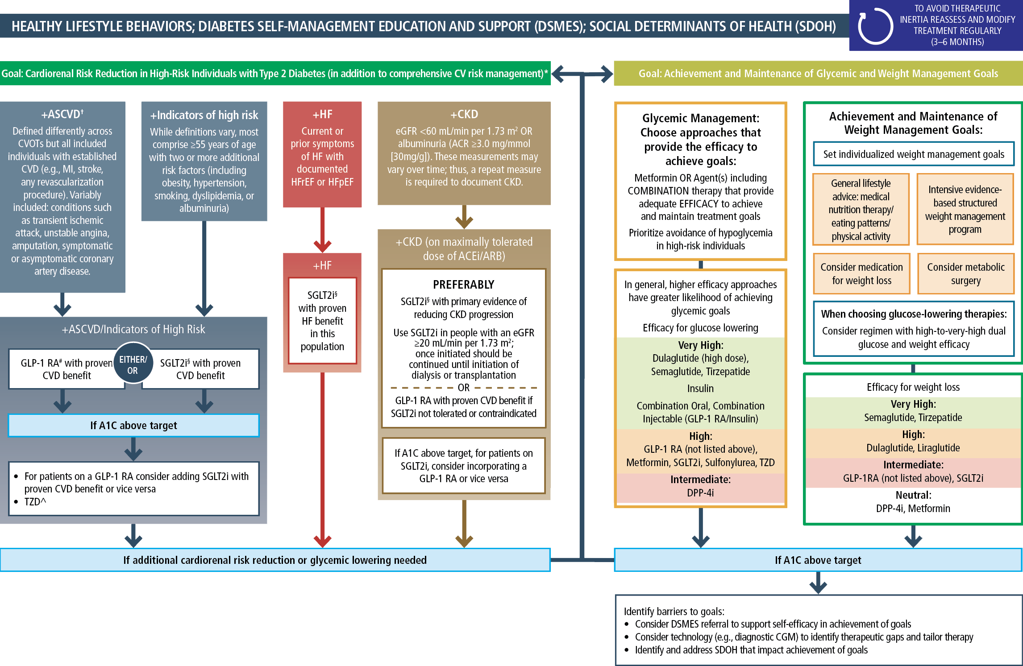
Use of Glucose-Lowering Medications in the Management of Type 2 Diabetes
Standards of Care: Section 9
Notes:
* In people with HF, CKD, established CVD, or multiple risk factors for CVD, the decision to use a GLP-1 RA or SGLT2i with proven benefit should be independent of background use of metformin;† A strong recommendation is warranted for people with CVD and a weaker recommendation for those with indicators of high CV risk. Moreover, a higher absolute risk reduction and thus lower numbers needed to treat are seen at higher levels of baseline risk and should be factored into the shared decision-making process. See text for details; ^ Low-dose TZD may be better tolerated and similarly effective; § For SGLT2i, CV/renal outcomes trials demonstrate their efficacy in reducing the risk of composite MACE, CV death, all-cause mortality, MI, HHF, and renal outcomes in individuals with T2D with established/high risk of CVD; # For GLP-1 RA, CVOTs demonstrate their efficacy in reducing composite MACE, CV death, all-cause mortality, MI, stroke, and renal endpoints in individuals with T2D with established/high risk of CVD.
ACEi, angiotensin-converting enzyme inhibitor; ACR, albumin-to-creatinine ratio; ARB, angiotensin receptor blocker; ASCVD, atherosclerotic cardiovascular disease; CGM, continuous glucose monitoring; CKD, chronic kidney disease; CV, cardiovascular; CVD, cardiovascular disease; CVOT, cardiovascular outcomes trial; DPP-4i, dipeptidyl peptidase 4 inhibitor; eGFR, estimated glomerular filtration rate; GLP-1 RA, glucagon-like peptide 1 receptor agonist; dual GIP/GLP-1 RA, dual glucose-dependent insulinotropic polypeptide and glucagon-like peptide 1 receptor agonist; HF, heart failure; HFpEF, heart failure with preserved ejection fraction; HFrEF, heart failure with reduced ejection fraction; HHF, hospitalization for heart failure; MACE, major adverse cardiovascular events; MI, myocardial infarction; SDOH, social determinants of health; SGLT2i, sodium-glucose cotransporter 2 inhibitor; T2D, type 2 diabetes; TZD, thiazolidinedione. Adapted from Davies MJ, D’Alessio DA, Fradkin J, et al. Management of hyperglycemia in type 2 diabetes, 2018: a consensus report by the American Diabetes Association (ADA) and the European Association for the Study of Diabetes (EASD). Diabetes Care 2018;41:2669–2701.

Slide 67
Standards of Care: Section 9

Slide 68
Section 10 Cardiovascular Disease and Risk Management

Slide 69
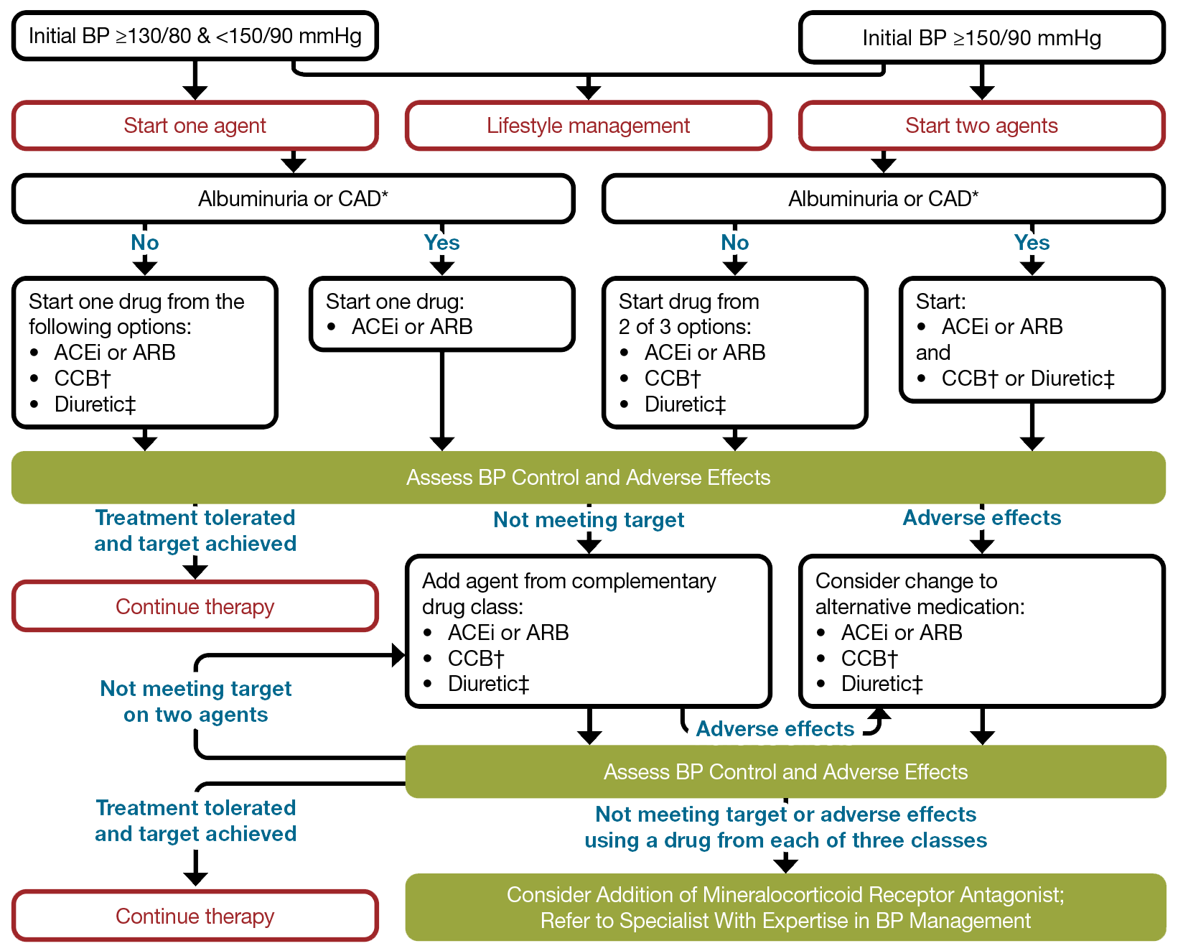
Standards of Care: Section 10
Notes:
Atherosclerotic cardiovascular disease (ASCVD), encompassing coronary heart disease, cerebrovascular disease, and peripheral artery disease (PAD) presumed to be of atherosclerotic origin, is the primary cause of morbidity and mortality in individuals with diabetes, leading to significant health care costs. Managing multiple risk factors simultaneously can prevent or slow the progression of ASCVD. Heart failure is another major cause of morbidity and mortality from cardiovascular disease.
Legend: *An ACE inhibitor (ACEi) or angiotensin receptor blocker (ARB) is suggested to treat hypertension for people with coronary artery disease (CAD) or urine albumin-to-creatinine ratio (UACR) 30–299 mg/g creatinine and strongly recommended for individuals with UACR ≥300 mg/g creatinine. †Dihydropyridine calcium channel blocker (CCB). ‡Thiazide-like diuretic; long-acting agents shown to reduce cardiovascular events, such as chlorthalidone and indapamide, are preferred. BP, blood pressure. Adapted from de Boer IH, Bangalore S, Benetos A, et al. Diabetes and hypertension: a position statement by the American Diabetes Association. Diabetes Care 2017;40:1273–1284

Slide 70
Standards of Care: Section 10

Slide 71
Standards of Care: Section 10

Slide 72
Standards of Care: Section 10

Slide 73
Standards of Care: Section 10

Slide 74
Standards of Care: Section 10

Slide 75
Section 11 Chronic Kidney Disease and Risk Management

Slide 76
Standards of Care: Section 11

Slide 77
Standards of Care: Section 11

Slide 78
Standards of Care: Section 11

Slide 79
Standards of Care: Section 11
Notes:
eGFR is presented in units of mL/min/1.73 m2. *ACEi or ARB (at maximal tolerated doses) should be first-line therapy for hypertension when albuminuria is present. Otherwise, dihydropyridine CCB or diuretic can also be considered; all three classes are often needed to attain BP targets. †Finerenone is currently the only nonsteroidal MRA with proven clinical kidney and cardiovascular benefits. ACEi, ACE inhibitor; ACR, albumin-to creatinine ratio; ARB, angiotensin receptor blocker; ASCVD, atherosclerotic cardiovascular disease; BP, blood pressure; CCB, calcium channel blocker; CVD, cardiovascular disease; GLP-1 RA, glucagon-like peptide 1 receptor agonist; HTN, hypertension; MRA, mineralocorticoid receptor antagonist; PCSK9i, proprotein convertase subtilisin/kexin type 9 inhibitor; RAS, renin- angiotensin system; SGLT2i, sodium–glucose cotransporter 2 inhibitor; T1D, type 1 diabetes; T2D, type 2 diabetes. Adapted from de Boer IH, Khunti K, Sadusky T, et al. Diabetes management in chronic kidney disease: a consensus report by the American Diabetes Association (ADA) and Kidney Disease: Improving Global Outcomes (KDIGO). Diabetes Care 2022;45:3075–3090.

Slide 80
Standards of Care: Section 11

Slide 81
Section 12 Retinopathy, Neuropathy, and Foot Care

Slide 82
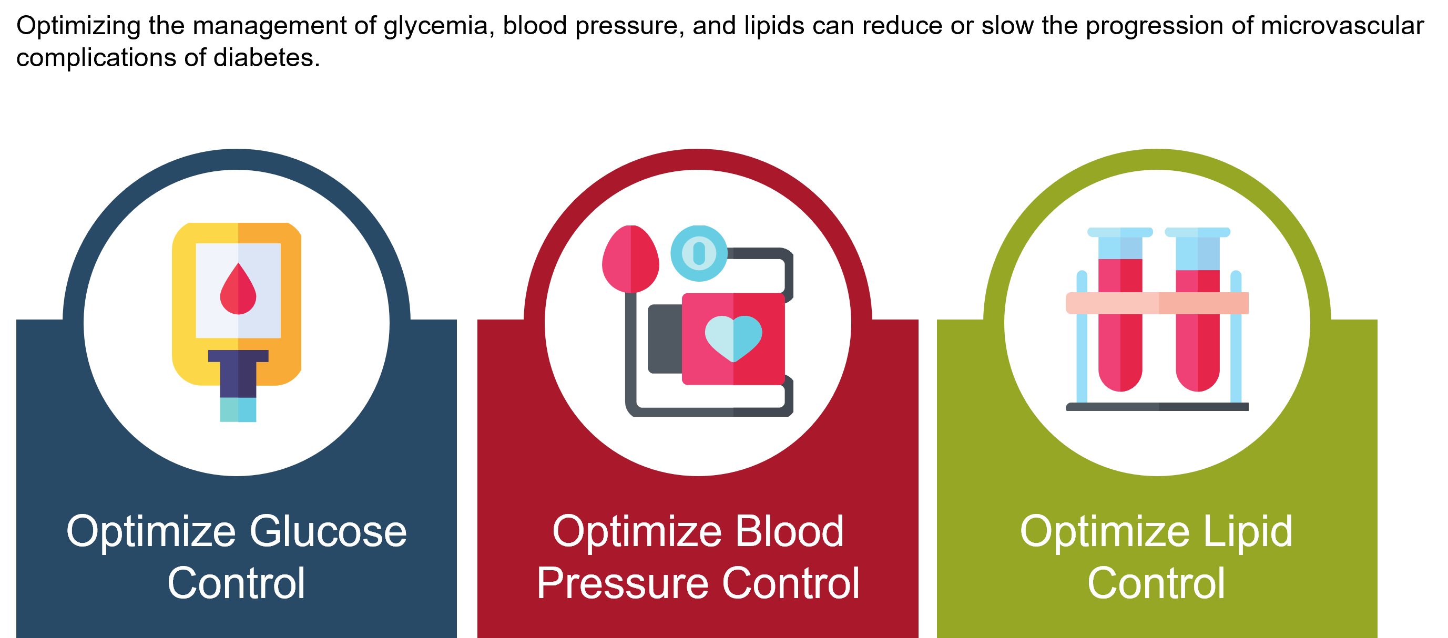
Standards of Care: Section 12

Slide 83
Standards of Care: Section 12

Slide 84
Standards of Care: Section 12

Slide 85
Standards of Care: Section 12

Slide 86
Standards of Care: Section 12
Neuropathy
Treatment
Various drugs may reduce pain from DPN, and both drug and non-drug strategies may ease symptoms of DPN and autonomic neuropathy.
The safest and most evidence-based pharmacologic options for DPN include gabapentinoids, serotonin-norepinephrine reuptake inhibitors, tricyclic antidepressants, and sodium channel blockers.
Refer to a neurologist or pain specialist when pain control is not achieved within the scope of practice of the treating clinician.

Slide 87
Standards of Care: Section 12

Slide 88
Standards of Care: Section 12

Slide 89
Section 13 Older Adults

Slide 90
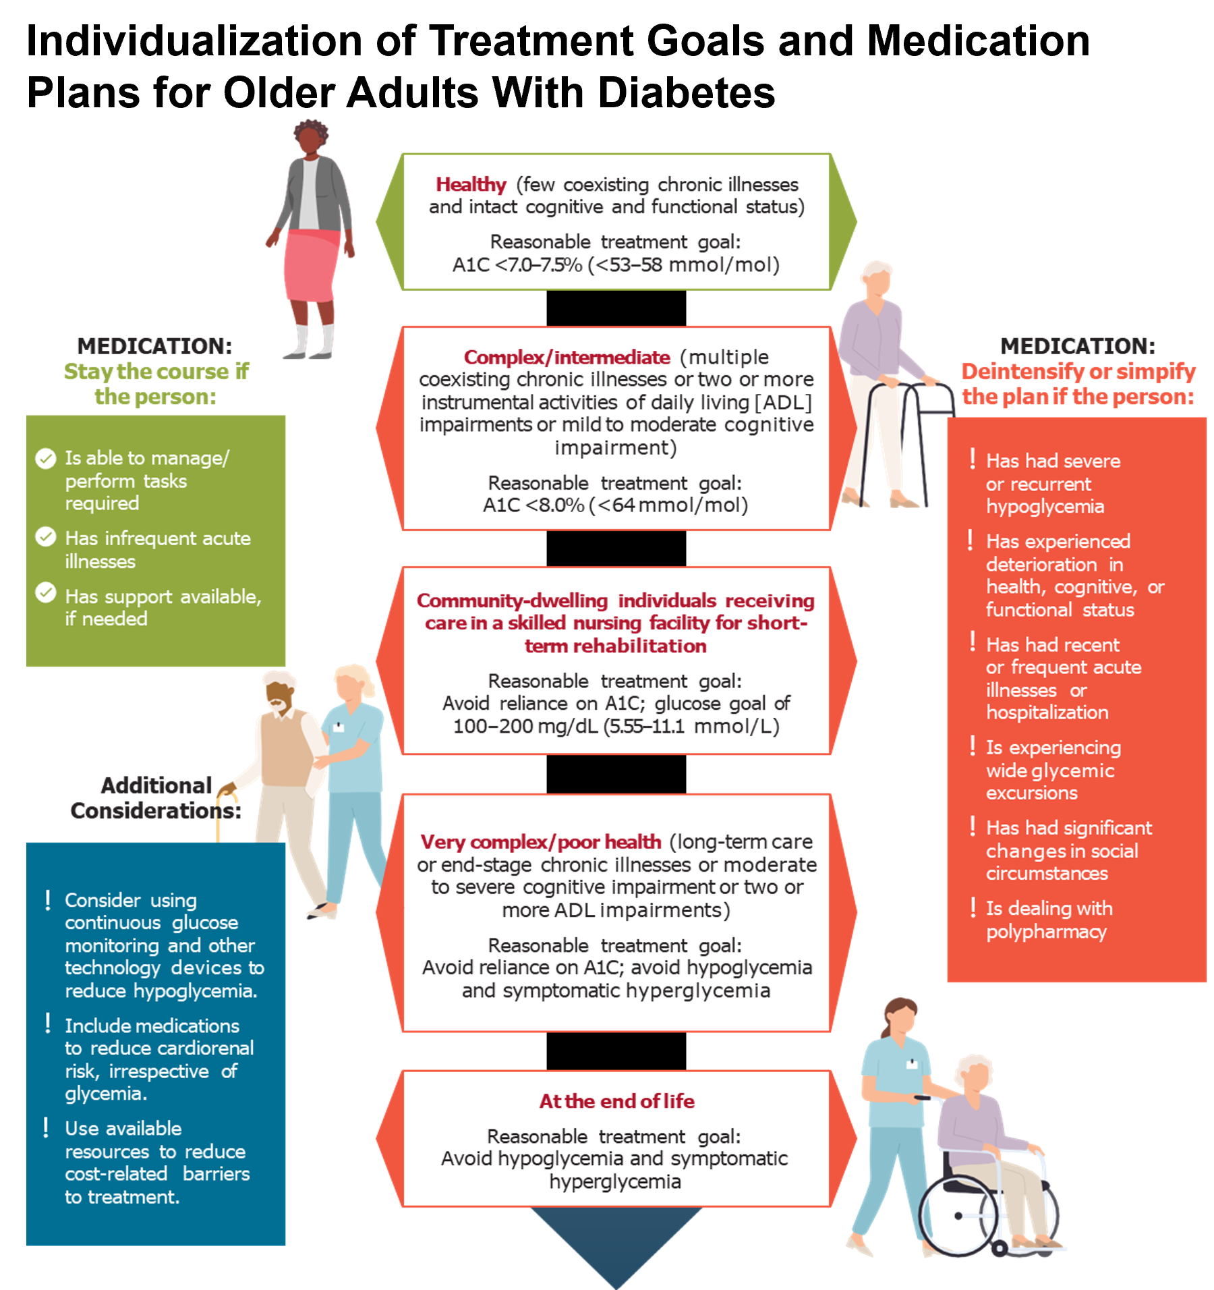
Standards of Care: Section 13

Slide 91
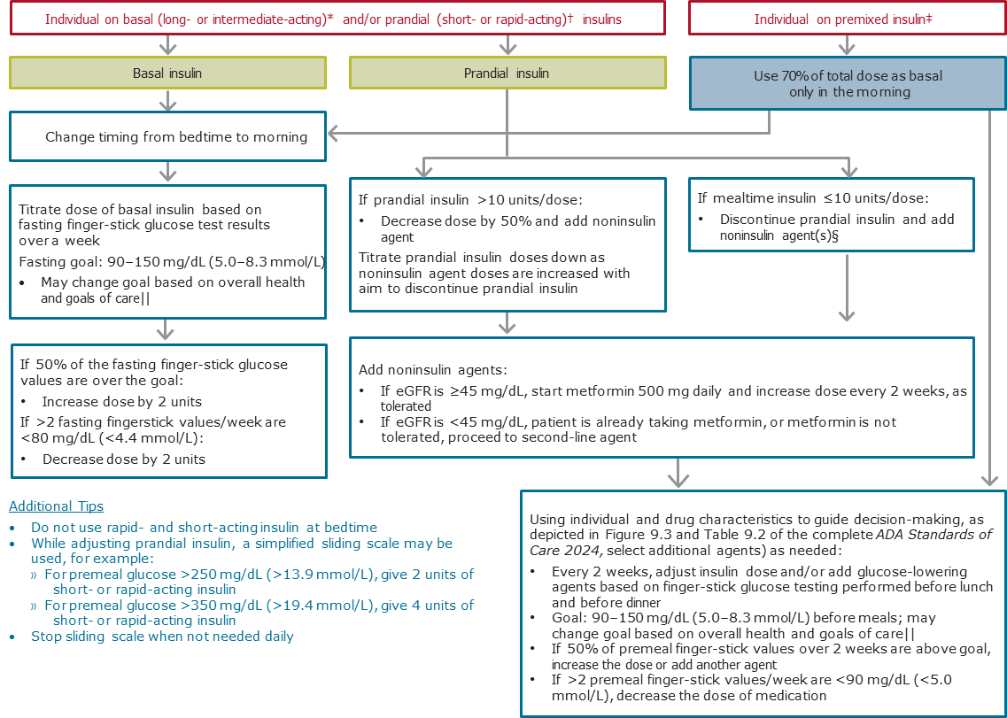
Standards of Care: Section 13
Simplification of Complex Insulin Therapy
Notes:
Algorithm to simplify insulin plans for older adults with type 2 diabetes. eGFR, estimated glomerular filtration rate. *Basal insulins: glargine U-100 and U-300, detemir, degludec, and human NPH. †Prandial insulins: short-acting (regular human insulin) or rapid-acting (lispro, aspart, and glulisine). ‡Premixed insulins: 70/30, 75/25, and 50/50 products. §Examples of noninsulin agents include metformin, sodium–glucose cotransporter 2 inhibitors, dipeptidyl peptidase 4 inhibitors, and glucagon-like peptide 1 receptor agonists. ||See previous page for more information. Adapted with permission from Munshi MN, Slyne C, Segal AR, Saul N, Lyons C, Weinger K. Simplification of insulin regimen in older adults and risk of hypoglycemia. JAMA Intern Med 2016;176:1023–1025.

Slide 92
Section 14 Children and Adolescents

Slide 93
Standards of Care: Section 14

Slide 94
Standards of Care: Section 14

Slide 95
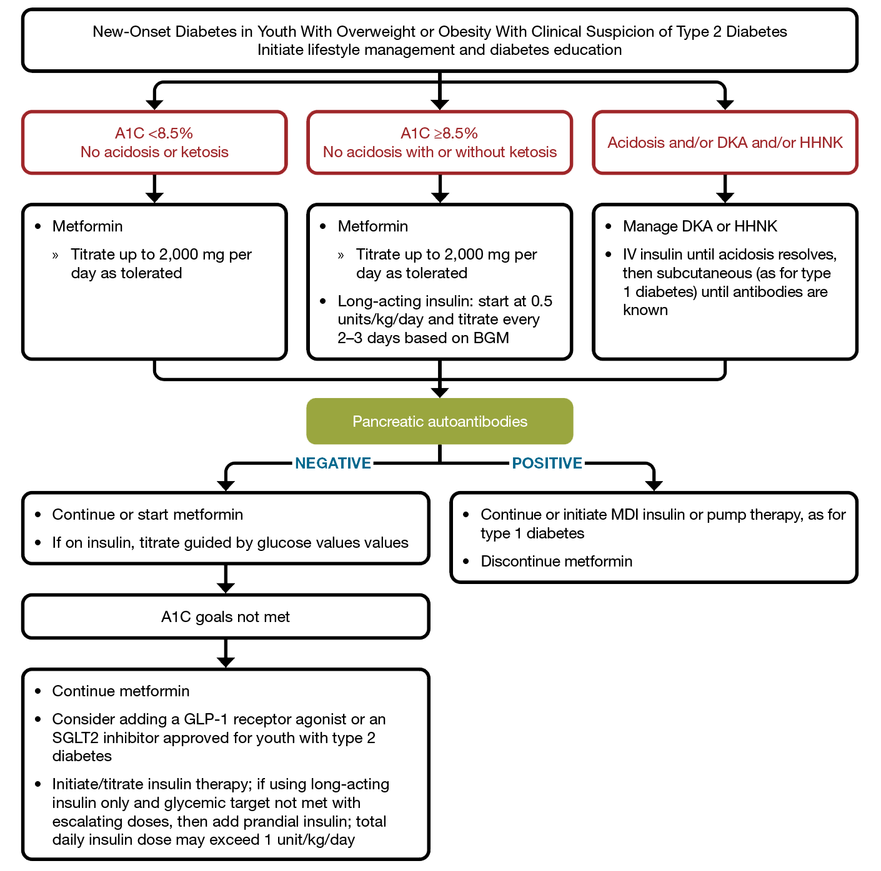
Standards of Care: Section 14
Addressing Probable New Cases of Type 2 Diabetes in Youth
Notes:
Management of new-onset diabetes in you with overweight or obesity with clinical suspicion of type 2 diabetes. A1C 8.5% = 69 mmol/mol. Adapted from Arslanian S, Bacha F, Grey M, Marcus MD, White NH, Zeitler P. Evaluation and management of youth-onset type 2 diabetes: a position statement by the American Diabetes Association. Diabetes Care 2018;41:2648–2668. BGM, blood glucose monitoring; DKA, diabetic ketoacidosis: HHNK, hyperosmolar hyperglycemic nonketotic syndrome; IV, intravenous; MDI, multiple daily injection.

Slide 96
Section 15 Management of Diabetes in Pregnancy

Slide 97
Standards of Care: Section 15
Notes:
The preconception care of people with diabetes is detailed in Table 15.1 in the complete ADA Standards of Care in Diabetes—2024.

Slide 98
Standards of Care: Section 15

Slide 99
Standards of Care: Section 15

Slide 100
Standards of Care: Section 15

Slide 101
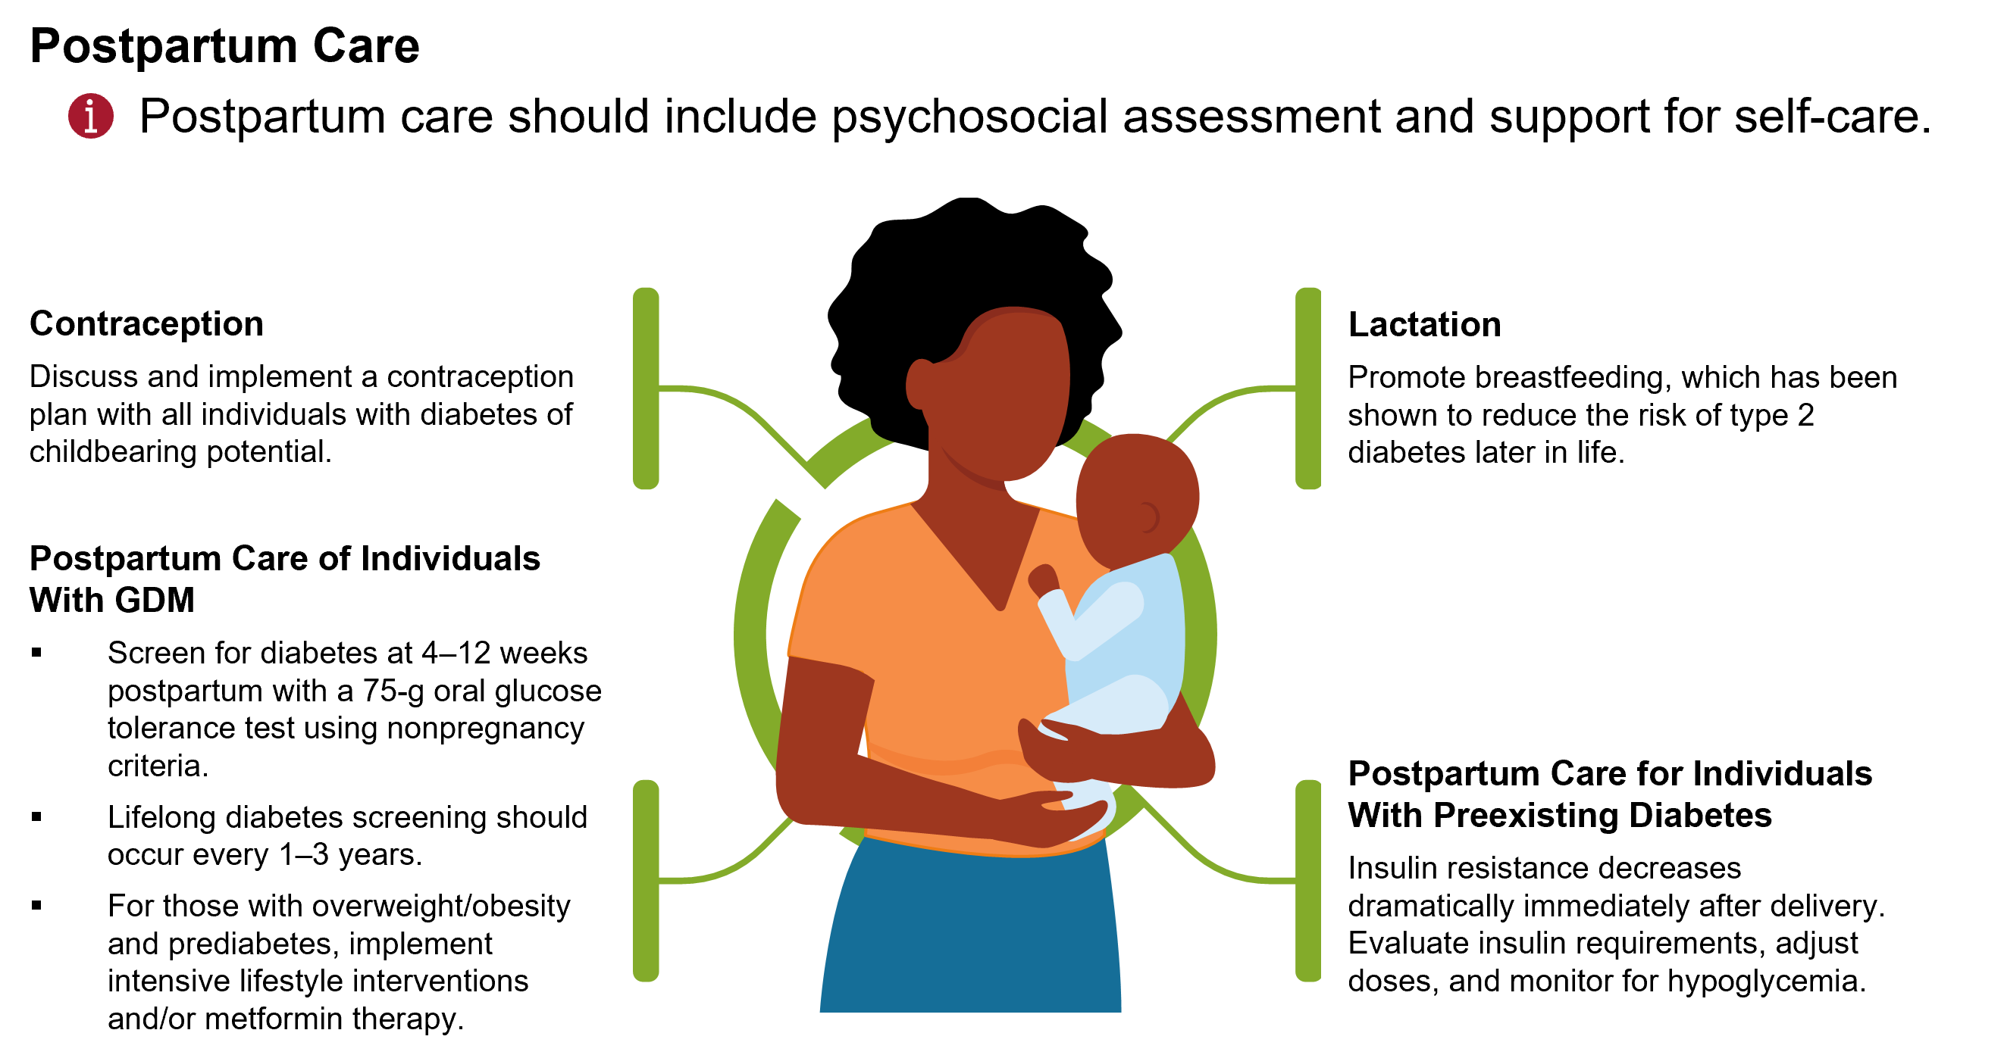
Standards of Care: Section 15

Slide 102
Section 16 Diabetes Care in the Hospital

Slide 103
Standards of Care: Section 16

Slide 104
Standards of Care: Section 16

Slide 105
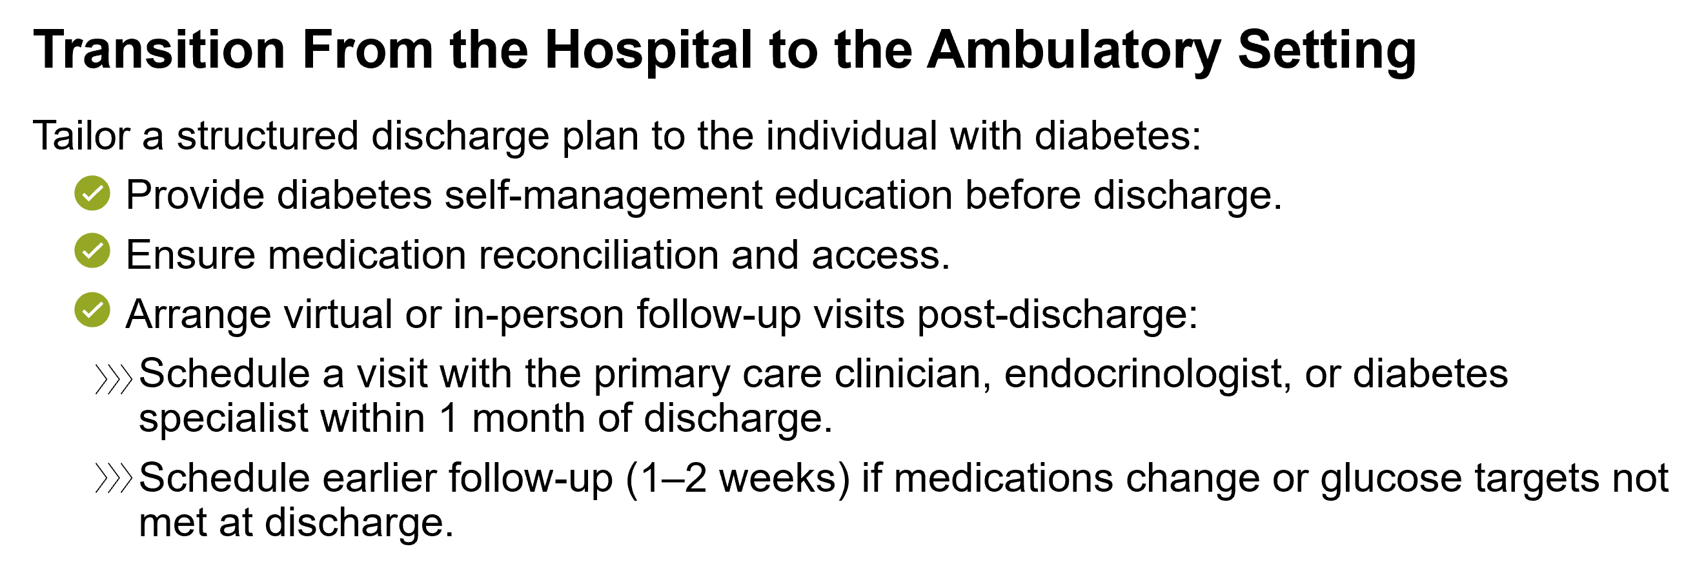
Standards of Care: Section 16

Slide 106
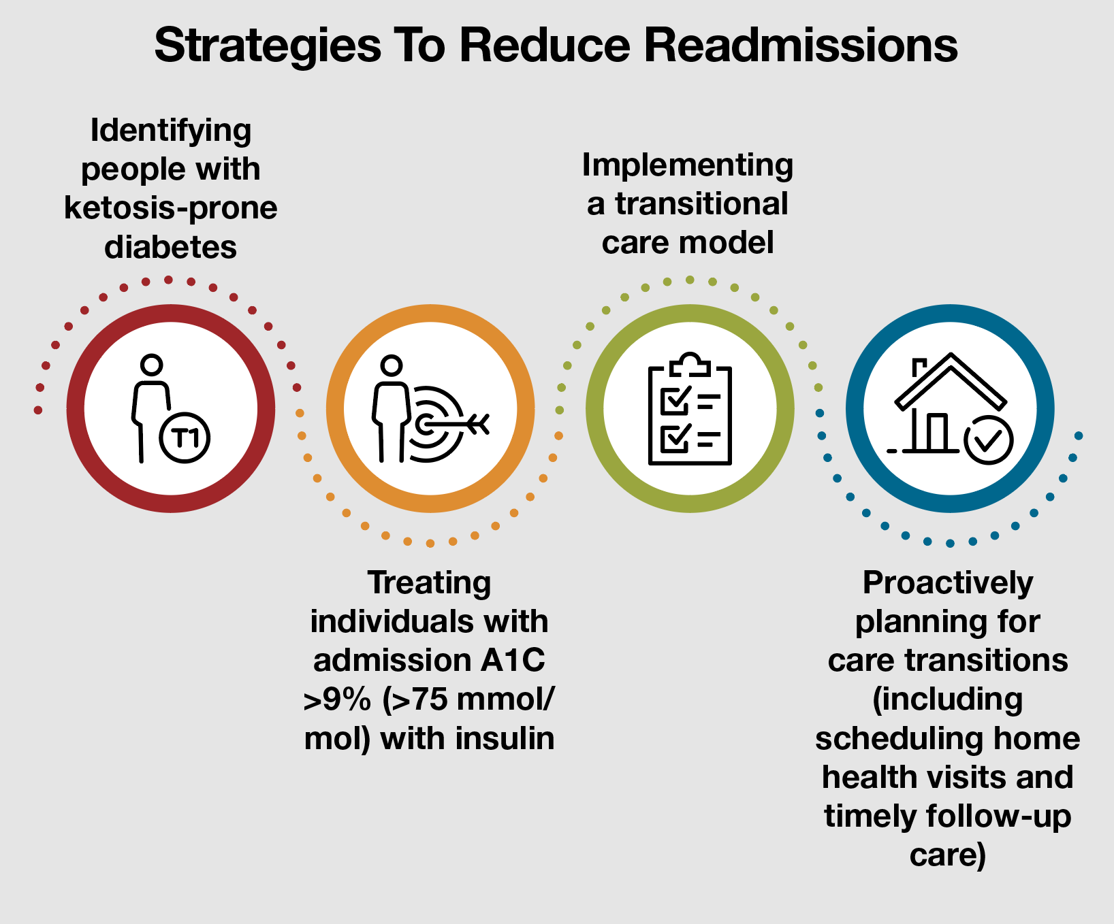
Standards of Care: Section 16

